Slide 1
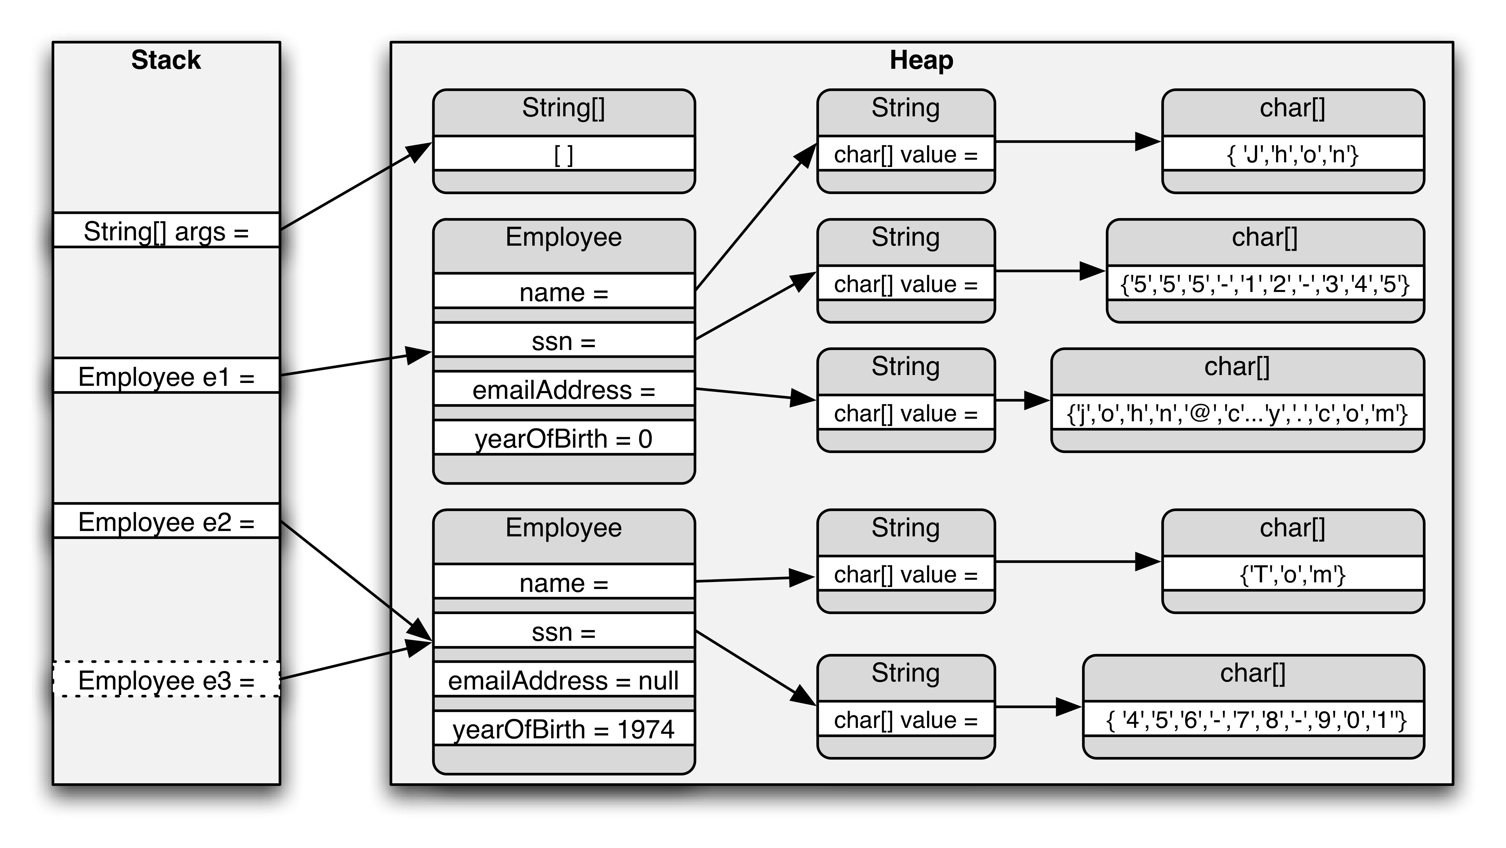
Notes:
Value types vs reference types. How they resolve in memory? Code difference.

Slide 2
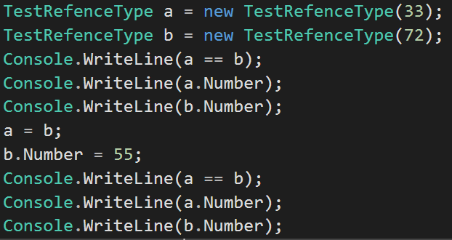
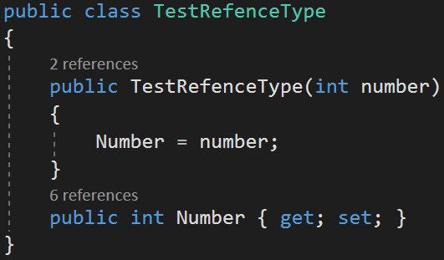
Reference types
Notes:
Debug it. Mention that is passes in reference and not an actual value on a = b;

Slide 3
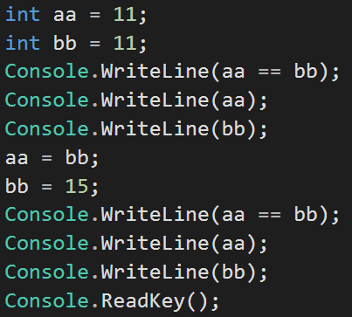
Value types
Notes:
Mentioned that value are copied on assignment, while refence types copy references that does not copy values. Do some coding after this.

Slide 4
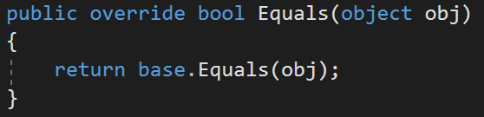
Equals vs ==

Slide 5
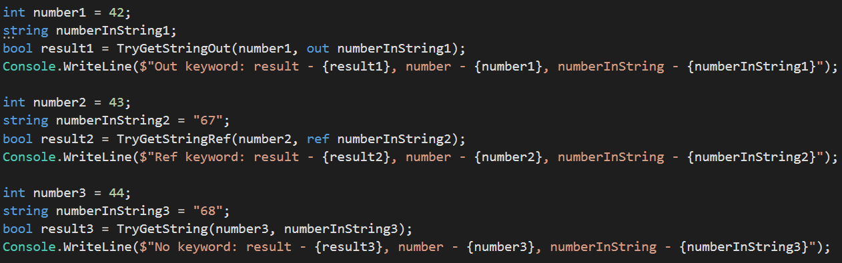
out, ref keywords
Notes:
Value types passes in the copy not address. With Ref & Out you pass in pointer to memory where variable is located.

Slide 6
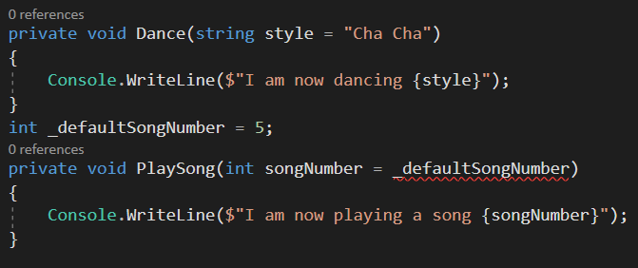
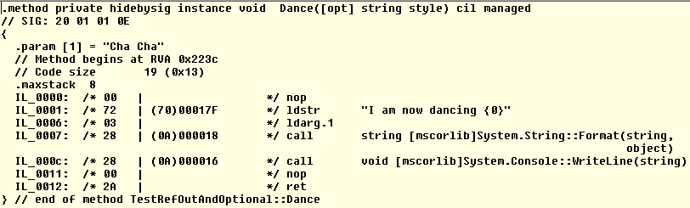
Optional parameters

Slide 7


Slide 8
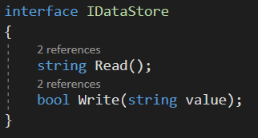
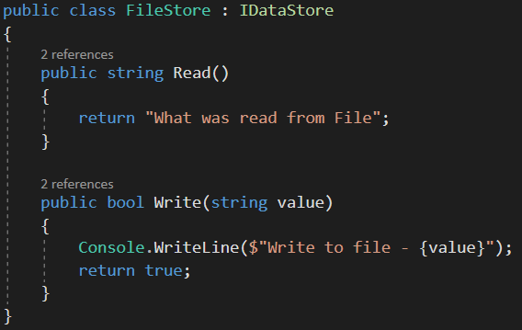
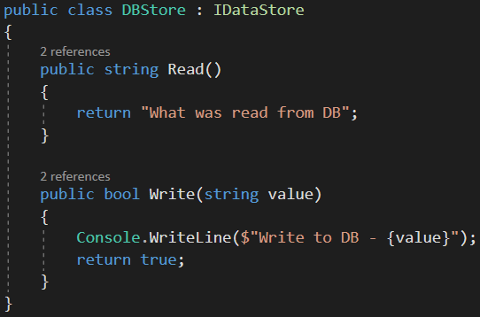
Interfaces

Slide 9
Delegates, LET’S CODE!

