Slide 1
ProofGate: Public Plans, Private Results
Prepare the right supplier negotiations.
Keep company facts and rules local.
Blind Workbench · synthetic supplier contracts
Notes:
An employee needs to decide which supplier renewals to negotiate and what to ask for. ProofGate governs actual hosted AI composition, local private calculation and separately approved internal action.
Sources: .planning/PROJECT.md; TEAM.md
Retained original proof date: 2026-10-04T01:29:53.383Z. Retained intention proof date: 2026-10-04T02:07:09.266Z. Browser capture date: 2026-10-04T07:54:36.814Z. Source revision: f1565c23ff185cb87587c6108be96dbec243b5ce. Capture scope: Current judge-story UI rendering of a consistent SQLite snapshot of the retained actual hosted run360c040e-16a1-4f81-ac76-1e1ec4ef6195. Authenticated GET-only loopback capture; model generation disabled, non-GET host routes rejected. No new inference, rebind or save. Previous public-input/control screenshots and actual composition/backup retain original dates; deployment UI banner is concurrently owned.; README-only documentary rebind to this revision; UI bytes identical to44c; no new capture/inference/rebind/save.
Disclosure: Synthetic supplier-renewal prototype. Public objective/capability descriptions and transport metadata remain disclosed. Local host/employee access is trusted. Targets are potential outcomes, never achieved savings. Current package evidence does not establish production security or formal noninterference.

Slide 2
Which suppliers should we negotiate with?
The employee asks
The company knows
Within the next 60 days,
prepare at most two renewals,
earliest renewals first.
Private supplier quotes and prices
Private price and service rules
Which renewals meet those rules
The result should tell me who to contact
and the price ceiling to negotiate.
Those facts determine the selection
and the useful brief, inside the host.
Public intent is disclosed. The demonstrated records and rule bodies stay local. All records are synthetic.
Notes:
The public request is within 60 days, at most two renewal negotiations, earliest renewals first. Private quotes, current prices and company thresholds decide which records qualify and what the negotiation brief says.
Sources: test/blind-intent-case.json; src/blind.ts; actual intention proof
Retained original proof date: 2026-10-04T01:29:53.383Z. Retained intention proof date: 2026-10-04T02:07:09.266Z. Browser capture date: 2026-10-04T07:54:36.814Z. Source revision: f1565c23ff185cb87587c6108be96dbec243b5ce. Capture scope: Current judge-story UI rendering of a consistent SQLite snapshot of the retained actual hosted run360c040e-16a1-4f81-ac76-1e1ec4ef6195. Authenticated GET-only loopback capture; model generation disabled, non-GET host routes rejected. No new inference, rebind or save. Previous public-input/control screenshots and actual composition/backup retain original dates; deployment UI banner is concurrently owned.; README-only documentary rebind to this revision; UI bytes identical to44c; no new capture/inference/rebind/save.
Disclosure: Synthetic supplier-renewal prototype. Public objective/capability descriptions and transport metadata remain disclosed. Local host/employee access is trusted. Targets are potential outcomes, never achieved savings. Current package evidence does not establish production security or formal noninterference.

Slide 3
Actual AI composes an approved method
Public request + capabilities
Admitted operations
AI chose
60-day window
Earliest renewal first
At most 2 renewals
1. Select renewals within 60 days
2. Apply private price ceiling
3. Rank by renewal date
4. Keep 2 renewals
5. Render the negotiation brief
The host checks the whole method before private access. No arbitrary code, SQL or network operations.
Notes:
The public request and independent expected selection were frozen before the model reply. Actual AI returned the 60-day / soonest / two method. It chooses approved operations and parameters; it does not invent an algorithm or run arbitrary code.
Sources: validated actual intention proof; test/blind-intent-case.json
Retained original proof date: 2026-10-04T01:29:53.383Z. Retained intention proof date: 2026-10-04T02:07:09.266Z. Browser capture date: 2026-10-04T07:54:36.814Z. Source revision: f1565c23ff185cb87587c6108be96dbec243b5ce. Capture scope: Current judge-story UI rendering of a consistent SQLite snapshot of the retained actual hosted run360c040e-16a1-4f81-ac76-1e1ec4ef6195. Authenticated GET-only loopback capture; model generation disabled, non-GET host routes rejected. No new inference, rebind or save. Previous public-input/control screenshots and actual composition/backup retain original dates; deployment UI banner is concurrently owned.; README-only documentary rebind to this revision; UI bytes identical to44c; no new capture/inference/rebind/save.
Disclosure: Synthetic supplier-renewal prototype. Public objective/capability descriptions and transport metadata remain disclosed. Local host/employee access is trusted. Targets are potential outcomes, never achieved savings. Current package evidence does not establish production security or formal noninterference.

Slide 4
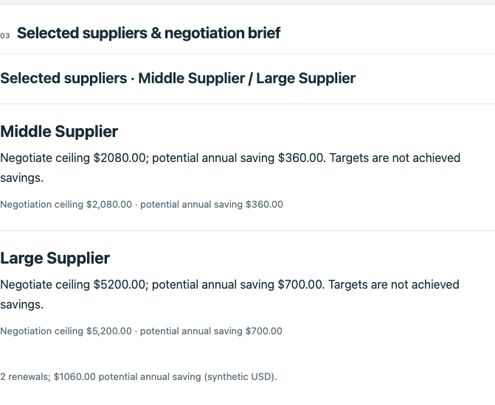
Private changes produce a different useful brief
Before the private change
Near + Middle
After quotes and the price rule change
Middle + Large
Negotiation ceilings
Middle: $2,080 · Large: $5,200
0 new provider attempts during local rebind
$130 → $1,060 potential annual opportunity · synthetic USD
Notes:
Independent expected results change from Near/Middle to Middle/Large after private quote and price-rule changes. The retained admitted method and captured application bodies stay unchanged. Rebind adds zero provider attempts. The current screenshot observes a retained result and historical save; it establishes no new inference, rebind or save.
Sources: validated actual intention rebind; genuine retained-run GET result capture
Retained original proof date: 2026-10-04T01:29:53.383Z. Retained intention proof date: 2026-10-04T02:07:09.266Z. Browser capture date: 2026-10-04T07:54:36.814Z. Source revision: f1565c23ff185cb87587c6108be96dbec243b5ce. Capture scope: Current judge-story UI rendering of a consistent SQLite snapshot of the retained actual hosted run360c040e-16a1-4f81-ac76-1e1ec4ef6195. Authenticated GET-only loopback capture; model generation disabled, non-GET host routes rejected. No new inference, rebind or save. Previous public-input/control screenshots and actual composition/backup retain original dates; deployment UI banner is concurrently owned.; README-only documentary rebind to this revision; UI bytes identical to44c; no new capture/inference/rebind/save.
Disclosure: Synthetic supplier-renewal prototype. Public objective/capability descriptions and transport metadata remain disclosed. Local host/employee access is trusted. Targets are potential outcomes, never achieved savings. Current package evidence does not establish production security or formal noninterference.

Slide 5
ProofGate controls each step
PUBLIC INPUT → HOSTED AI → ADMITTED METHOD
Public intent
and capabilities
Advisory checker
AI planner
Method checker
Deterministic AND
actual AI checks
PRIVATE FACTS → LOCAL WORK
Employee-approved
internal save
Independent read-back
Private records
and rule bodies
Local executor
Useful brief
Authenticated host · current policy · finite shared allowance · observable audit and export
Notes:
The hosted checker inspects the advisory before planner exposure and the full method before private access. Deterministic schemas/dependencies/current policy AND actual AI semantic inspection must permit the work. The local host then applies private facts. A separate typed internal-save action uses independent read-back. Authentication, actor, checker and tools share a finite allowance.
Sources: src/blind.ts; src/prompt-profiles.ts; src/model.ts; src/host.ts; fixture/blind-server.ts; fixture/blind-store.ts
Retained original proof date: 2026-10-04T01:29:53.383Z. Retained intention proof date: 2026-10-04T02:07:09.266Z. Browser capture date: 2026-10-04T07:54:36.814Z. Source revision: f1565c23ff185cb87587c6108be96dbec243b5ce. Capture scope: Current judge-story UI rendering of a consistent SQLite snapshot of the retained actual hosted run360c040e-16a1-4f81-ac76-1e1ec4ef6195. Authenticated GET-only loopback capture; model generation disabled, non-GET host routes rejected. No new inference, rebind or save. Previous public-input/control screenshots and actual composition/backup retain original dates; deployment UI banner is concurrently owned.; README-only documentary rebind to this revision; UI bytes identical to44c; no new capture/inference/rebind/save.
Disclosure: Synthetic supplier-renewal prototype. Public objective/capability descriptions and transport metadata remain disclosed. Local host/employee access is trusted. Targets are potential outcomes, never achieved savings. Current package evidence does not establish production security or formal noninterference.

Slide 6
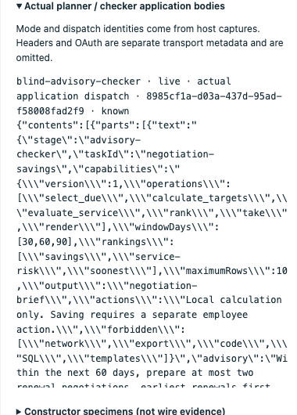
Inspect what the hosted models received
Disclosed public input
Employee intent and capabilities
Admitted public advisory
Proposed approved method
The inspected bodies exclude
private records, rule bodies
and the computed brief.
Task/capability and transport metadata remain disclosed. The local host and employee are trusted.
Notes:
Actual serialized application bodies are captured at metered SDK dispatch. They are different from constructor specimens. The public task, capabilities, admitted advisory and recipe are disclosed. Headers/OAuth are omitted and transport metadata remains disclosed. Local host and employee access are trusted. No arbitrary-secret or formal confidentiality proof is claimed.
Sources: actual SDK dispatch captures; src/prompt-profiles.ts; dated payload capture
Retained original proof date: 2026-10-04T01:29:53.383Z. Retained intention proof date: 2026-10-04T02:07:09.266Z. Browser capture date: 2026-10-04T07:54:36.814Z. Source revision: f1565c23ff185cb87587c6108be96dbec243b5ce. Capture scope: Current judge-story UI rendering of a consistent SQLite snapshot of the retained actual hosted run360c040e-16a1-4f81-ac76-1e1ec4ef6195. Authenticated GET-only loopback capture; model generation disabled, non-GET host routes rejected. No new inference, rebind or save. Previous public-input/control screenshots and actual composition/backup retain original dates; deployment UI banner is concurrently owned.; README-only documentary rebind to this revision; UI bytes identical to44c; no new capture/inference/rebind/save.
Disclosure: Synthetic supplier-renewal prototype. Public objective/capability descriptions and transport metadata remain disclosed. Local host/employee access is trusted. Targets are potential outcomes, never achieved savings. Current package evidence does not establish production security or formal noninterference.

Slide 7
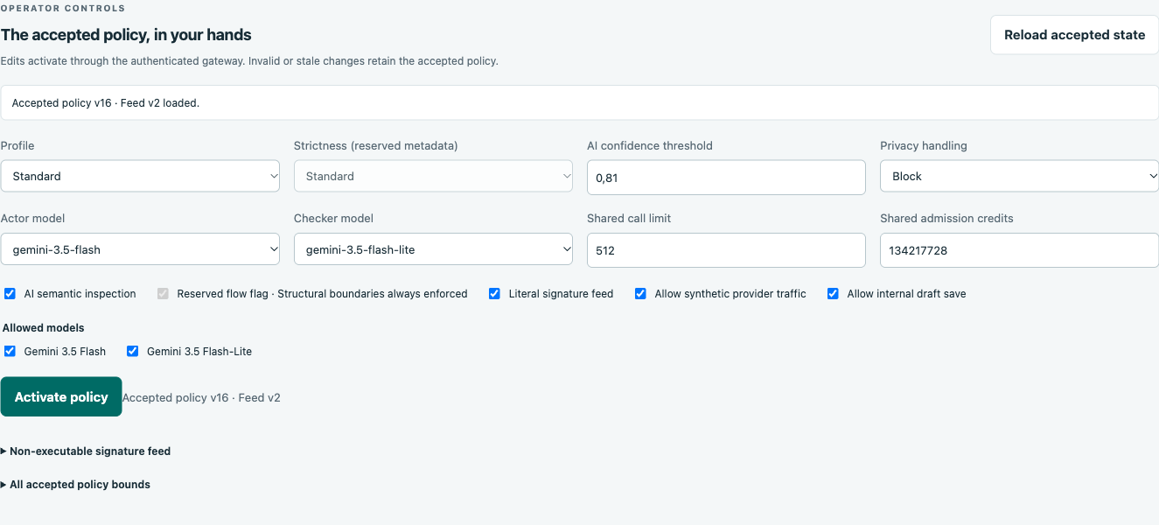
An internal save must match the actual brief
Observed permitted action
1 exact internal record
confirmed independently
Employee approves the current brief.
An independent reader checks its content
and artifact / action identities.
Policy can block new dispatch.
Hostile advisory quarantined as a whole.
Actor, checker and tools share one budget.
Stale save: no added effect
Manual external export: refused
Save evidence is retained and separately dated. A GET screenshot makes no new save.
Notes:
The permitted registered MCP save was observed previously and independently matched the exact content, artifact and parent/action identities. Current GET capture is observation only. Stale save and deliberately manual external export refusal are separate negative cases. A benign advisory was admitted and the whole hostile paraphrase quarantined before actor exposure. This does not establish downstream causal benefit.
Sources: actual intention proof; independent SQLite effects; current genuine controls capture
Retained original proof date: 2026-10-04T01:29:53.383Z. Retained intention proof date: 2026-10-04T02:07:09.266Z. Browser capture date: 2026-10-04T07:54:36.814Z. Source revision: f1565c23ff185cb87587c6108be96dbec243b5ce. Capture scope: Current judge-story UI rendering of a consistent SQLite snapshot of the retained actual hosted run360c040e-16a1-4f81-ac76-1e1ec4ef6195. Authenticated GET-only loopback capture; model generation disabled, non-GET host routes rejected. No new inference, rebind or save. Previous public-input/control screenshots and actual composition/backup retain original dates; deployment UI banner is concurrently owned.; README-only documentary rebind to this revision; UI bytes identical to44c; no new capture/inference/rebind/save.
Disclosure: Synthetic supplier-renewal prototype. Public objective/capability descriptions and transport metadata remain disclosed. Local host/employee access is trusted. Targets are potential outcomes, never achieved savings. Current package evidence does not establish production security or formal noninterference.

Slide 8
Evidence you can inspect; limits you should know
Retained actual evidence
Material limits
Hosted AI returned the admitted methods
Local rebind changed the selected suppliers
Internal effects matched independent records
Audit, captures and measured spans inspectable
Synthetic data; trusted host and employee
Hosted-only AI; no demonstrated local LLM
Peripheral ERP / email integrations mocked
Potential opportunity, not achieved savings
No universal security or confidentiality proof
339/339 offline checks in supplied evidence
Unknown dispatched work stays charged.
Historical injection on/off test:
no causal protection gain established.
Forecast overrun remains in notes and evidence.
Four automated walkthroughs; no human rehearsal
Backup: seven paced historical UI captures
Notes:
Retained evidence: four advisory cases, two prepared compositions and one previously unprepared intention; exact internal saves and zero-attempt local rebinds. Four automated walkthroughs, zero human rehearsals. Backup is 48.933333 seconds and seven paced genuine historical captures, not continuous recording or latency. Original proof24 plus earlier walkthrough12 equals36, exceeding original combined32 forecast. Separately approved intention adds8 wires (3 model,1 auth,4 MCP); fourth walkthrough adds4 MCP, giving48 wires and15 model inferences. Recorded same-epoch checkpoint328 calls/89021463 credits has10 historical charged unknowns. Observed tokens are separate from conservative admission credits; tariff remains unpriced. One intention composition observed3.66s overall, hosted3.65s and local1.61ms; separate MCP save span10.95ms. Those are single observations, not benchmarks. Historical release on/off actors both succeeded safely, so no downstream causal benefit was observed. Source scoring and PM timing conflicts remain in TASK-CONTRACT.
Sources: validated original and intention proofs; input accounting; submission/evidence.json; goldman/TASK-CONTRACT.md
Retained original proof date: 2026-10-04T01:29:53.383Z. Retained intention proof date: 2026-10-04T02:07:09.266Z. Browser capture date: 2026-10-04T07:54:36.814Z. Source revision: f1565c23ff185cb87587c6108be96dbec243b5ce. Capture scope: Current judge-story UI rendering of a consistent SQLite snapshot of the retained actual hosted run360c040e-16a1-4f81-ac76-1e1ec4ef6195. Authenticated GET-only loopback capture; model generation disabled, non-GET host routes rejected. No new inference, rebind or save. Previous public-input/control screenshots and actual composition/backup retain original dates; deployment UI banner is concurrently owned.; README-only documentary rebind to this revision; UI bytes identical to44c; no new capture/inference/rebind/save.
Disclosure: Synthetic supplier-renewal prototype. Public objective/capability descriptions and transport metadata remain disclosed. Local host/employee access is trusted. Targets are potential outcomes, never achieved savings. Current package evidence does not establish production security or formal noninterference.

Slide 9
Choose suppliers.
Prepare a useful negotiation brief.
AI composes the approved method.
Company facts and rules determine the result.
ProofGate: Public Plans, Private Results
Michał Jabłoński Karol Krawczyk
Kamil Krawczyk Viktoriia Vinnykova
Notes:
Invite the judge to inspect the public request, change a private quote or rule through the authorized local scene and inspect the selection/brief/provider delta. Fresh actions require root-approved run/admission; retained playback must be labeled. Genuine team names are owner-provided, not invented contribution claims.
Sources: TEAM.md; current validated proof and retained browser observations
Retained original proof date: 2026-10-04T01:29:53.383Z. Retained intention proof date: 2026-10-04T02:07:09.266Z. Browser capture date: 2026-10-04T07:54:36.814Z. Source revision: f1565c23ff185cb87587c6108be96dbec243b5ce. Capture scope: Current judge-story UI rendering of a consistent SQLite snapshot of the retained actual hosted run360c040e-16a1-4f81-ac76-1e1ec4ef6195. Authenticated GET-only loopback capture; model generation disabled, non-GET host routes rejected. No new inference, rebind or save. Previous public-input/control screenshots and actual composition/backup retain original dates; deployment UI banner is concurrently owned.; README-only documentary rebind to this revision; UI bytes identical to44c; no new capture/inference/rebind/save.
Disclosure: Synthetic supplier-renewal prototype. Public objective/capability descriptions and transport metadata remain disclosed. Local host/employee access is trusted. Targets are potential outcomes, never achieved savings. Current package evidence does not establish production security or formal noninterference.

