Slide 1
TBS PPT TEST

Slide 2
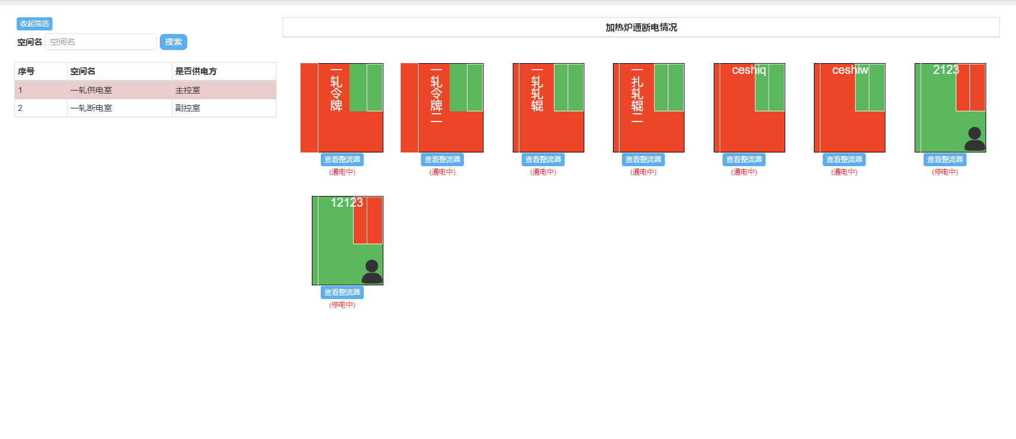
TBS PPT TEST

