Slide 1
Lesson 2
Android Architecture
For Mobile App Development

Slide 2
Android - Architecture
Android architecture is a software stack of components to support a mobile device needs.
Android operating system is a stack of software components which is roughly divided into five sections and four main layers as shown below in the architecture diagram.

Slide 3
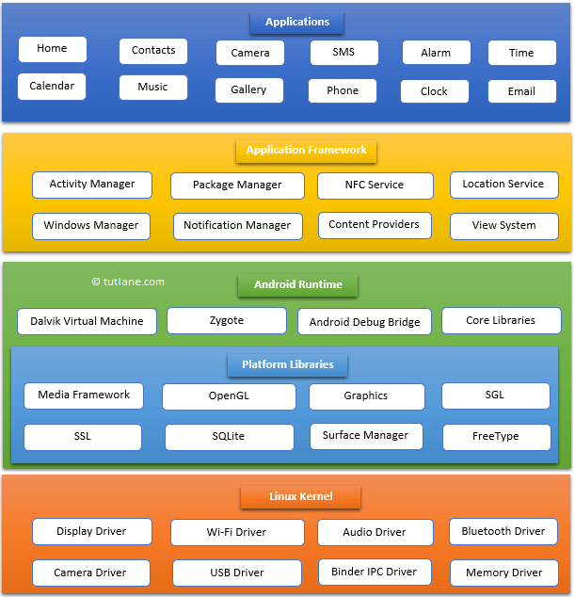
Android – Architecture(cont.)

Slide 4
Applications
The top layer of android architecture is Applications.
The native and third party applications like contacts, email, music, gallery, clock, games, etc. whatever we will built those will be installed on this layer only.
The application layer runs within the Android run time using the classes and services made available from the application framework.

Slide 5
Application Framework
The Application Framework provides the classes used to create an Android applications.
Provides a generic abstraction for hardware access and manages the user interface and application resources.
Provides the services through which we can create the particular class and make that class helpful for the Applications creation.
The application framework includes services like telephony service, location services, notification manager, NFC service, view system, etc. which we can use for application development as per our requirements.

Slide 6
Android Runtime
Android Runtime environment is an important part of Android rather than an internal part and it contains a components like core libraries and the Dalvik virtual machine. The Android run time is the engine that powers our applications along with the libraries and it forms the basis for the application framework.
Dalvik Virtual Machine (DVM) is a register-based virtual machine like Java Virtual Machine (JVM). It is specially designed and optimized for android to ensure that a device can run multiple instances efficiently. It relies on the Linux kernel for threading and low-level memory management.
The core libraries in android runtime will enable us to implement an android applications using standard JAVA programming language.

Slide 7
Platform Libraries
The Platform Libraries includes various C/C++ core libraries and Java based libraries such as SSL, libc, Graphics, SQLite, Webkit, Media, Surface Manger, OpenGL etc. to provide a support for android development.
Following are the summary details of some core android libraries available for android development.

Slide 8
Platform Libraries(cont.)
Media library for playing and recording an audio and video formats
The Surface manager library to provide a display management
SGL and OpenGL Graphics libraries for 2D and 3D graphics
SQLite is for database support and FreeType for font support
Web-Kit for web browser support and SSL for Internet security.

Slide 9
Linux kernel
Linux Kernel is a bottom layer and heart of the android architecture.
It manage all the drivers such as display drivers, camera drivers, Bluetooth drivers, audio drivers, memory drivers, etc. which are mainly required for the android device during the runtime.
The Linux Kernel will provides an abstraction layer between the device hardware and the remainder of the stack.
It is responsible for memory management, power management, device management, resource access, etc.

Slide 10
Android - Application Components
Application components are the essential building blocks of an Android application.
These components are loosely coupled by the application manifest file AndroidManifest.xml that describes each component of the application and how they interact.
There are following four main components that can be used within an Android application
S.No | Components & Description
1 | Activities They dictate the UI and handle the user interaction to the smart phone screen.
2 | Services They handle background processing associated with an application.
3 | Broadcast Receivers They handle communication between Android OS and applications.
4 | Content Providers They handle data and database management issues.

Slide 11
Activities
An activity represents a single screen with a user interface,in-short Activity performs actions on the screen.
For example, an email application might have one activity that shows a list of new emails, another activity to compose an email, and another activity for reading emails.
If an application has more than one activity, then one of them should be marked as the activity that is presented when the application is launched.
  An activity is implemented as a subclass of Activity class as follows −
  public class MainActivity extends Activity {
  }

Slide 12
Services
A service is a component that runs in the background to perform long-running operations.
For example, a service might play music in the background while the user is in a different application, or it might fetch data over the network without blocking user interaction with an activity.
A service is implemented as a subclass of Service class as follows −
public class MyService extends Service {
}

Slide 13
Broadcast Receivers
Broadcast Receivers simply respond to broadcast messages from other applications or from the system.
For example, applications can also initiate broadcasts to let other applications know that some data has been downloaded to the device and is available for them to use, so this is broadcast receiver who will intercept this communication and will initiate appropriate action.
A broadcast receiver is implemented as a subclass of Broadcast Receiver class and each message is broadcaster as an Intent object.
public class MyReceiver extends BroadcastReceiver {
public void onReceive(context,intent){}
}

Slide 14
Content Providers
A content provider component supplies data from one application to others on request. Such requests are handled by the methods of the ContentResolver class. The data may be stored in the file system, the database or somewhere else entirely.
A content provider is implemented as a subclass of ContentProvider class and must implement a standard set of APIs that enable other applications to perform transactions.
public class MyContentProvider extends ContentProvider {
public void onCreate(){}
}

Slide 15
Additional Components
There are additional components which will be used in the construction of above mentioned entities, their logic, and wiring between them.
These components are −
S.No | Components & Description
1 | Fragments: Represents a portion of user interface in an Activity.
2 | Views: UI elements that are drawn on-screen including buttons, lists forms etc.
3 | Layouts: View hierarchies that control screen format and appearance of the views.
4 | Intents: Messages wiring components together.
5 | Resources: External elements, such as strings, constants and drawable pictures.
6 | Manifest: Configuration file for the application.

Slide 16
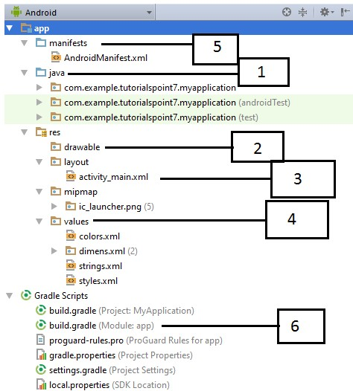
Anatomy of Android Application
Before you run your app, you should be aware of a few directories and files in the Android project −

Slide 17
Anatomy of Android Application(cont.)
Sr.No. | Folder, File & Description
1 | Java This contains the .java source files for your project. By default, it includes an MainActivity.java source file having an activity class that runs when your app is launched using the app icon.
2 | res/drawable-hdpi This is a directory for drawable objects that are designed for high-density screens.
3 | res/layout This is a directory for files that define your app's user interface.

Slide 18
Anatomy of Android Application(cont.)
Sr.No. | Folder, File & Description
1 | Java This contains the .java source files for your project. By default, it includes an MainActivity.java source file having an activity class that runs when your app is launched using the app icon.
2 | res/drawable-hdpi This is a directory for drawable objects that are designed for high-density screens.
3 | res/layout This is a directory for files that define your app's user interface.
4 | res/values This is a directory for other various XML files that contain a collection of resources, such as strings and colours definitions.
5 | AndroidManifest.xml This is the manifest file which describes the fundamental characteristics of the app and defines each of its components.
6 | Build.gradle This is an auto generated file which contains compileSdkVersion, buildToolsVersion, applicationId, minSdkVersion, targetSdkVersion, versionCode and versionName

Slide 19
The Main Activity File
The main activity code is a Java file MainActivity.java.
This is the actual application file which ultimately gets converted to a Dalvik executable and runs your application.
Following is the default code generated by the application wizard for Hello World! application −

Slide 20
The Main Activity File(cont.)
package com.example.helloworld;
import android.support.v7.app.AppCompatActivity;
import android.os.Bundle;
public class MainActivity extends AppCompatActivity {
@Override
protected void onCreate(Bundle savedInstanceState) {
super.onCreate(savedInstanceState);
setContentView(R.layout.activity_main);
}
}
Here, R.layout.activity_main refers to the activity_main.xml file located in the res/layout folder. The onCreate() method is one of many methods that are figured when an activity is loaded

Slide 21
The Manifest File
Whatever component you develop as a part of your application, you must declare all its components in a manifest.xml which resides at the root of the application project directory.
This file works as an interface between Android OS and your application, so if you do not declare your component in this file, then it will not be considered by the OS.
For example, a default manifest file will look like as following file −

Slide 22
The Strings File
The strings.xml file is located in the res/values folder and it contains all the text that your application uses. For example, the names of buttons, labels, default text, and similar types of strings go into this file. This file is responsible for their textual content. For example, a default strings file will look like as following file −
<resources>
<string name="app_name">HelloWorld</string>
<string name="hello_world">Hello world!</string>
<string name="menu_settings">Settings</string>
<string name="title_activity_main">MainActivity</string>
</resources>

Slide 23
The Layout File
The activity_main.xml is a layout file available in res/layout directory, that is referenced by your application when building its interface.
You will modify this file very frequently to change the layout of your application.
For your "Hello World!" application, this file will have following content related to default layout

Slide 24
The Layout File
<RelativeLayout xmlns:android="http://schemas.android.com/apk/res/android"
xmlns:tools="http://schemas.android.com/tools"
android:layout_width="match_parent"
android:layout_height="match_parent" >
<TextView
android:layout_width="wrap_content"
android:layout_height="wrap_content"
android:layout_centerHorizontal="true"
android:layout_centerVertical="true"
android:padding="@dimen/padding_medium"
android:text="@string/hello_world"
tools:context=".MainActivity" />
</RelativeLayout>

Slide 25
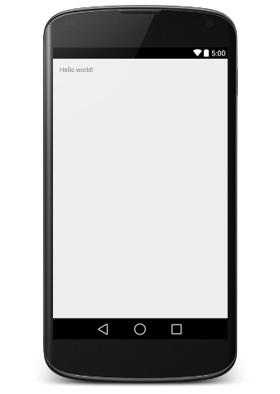
Running the Application
Let's try to run our Hello World! application we just created.
I assume you had created your AVD while doing environment set-up.
To run the app from Android studio, open one of your project's activity files and click Run icon from the tool bar.
Android studio installs the app on your AVD and starts it and if everything is fine with your set-up and application, it will display following Emulator window

Slide 26
THE END
Thank you!

