Slide 1
E-commerce

Slide 2
about
our web-site is objective is to .

Slide 3
how the web site workes
-register
-log in
-log out
-home page
-findproduct :
-

Slide 4
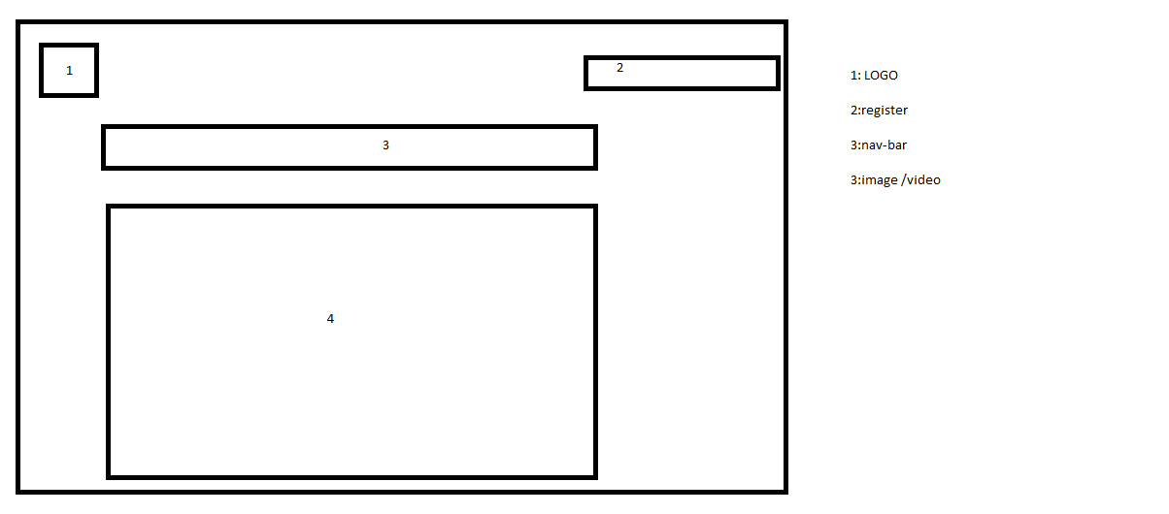

Slide 5
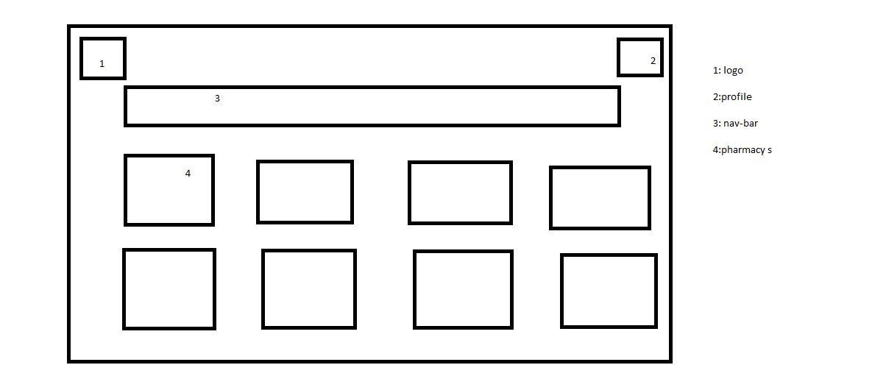

Slide 6
