Slide 1

Fantasy Draft AID
CS 465
John Byrd

Slide 2
Introduction
Fantasy Premier League is an online game where millions of participants draft real-life Premier League players into fantasy squads to score points based on weekly performances.
Draft is a game mode of premier league fantasy. A league of typically 8-12 managers compete head-to-head using unique teams to try and end up at the top of the league table once the final gameweek has finished.
In a competitive league, hours and hours of research must be done to facilitate draft success. One mistake or unlucky circumstance can derail a years' worth of work.
The goal of this project was to help managers make informed decisions while not needing to contemplate or debate the future implications a trade may have

Slide 3
Key Related Work
Implementing AI to make predictions in fantasy sports, as well as their real-life counterparts, is a well-researched problem, many of which explore using Random Forest Regressors to make predictions on player performance
Player Recommendation System for FPL
Demonstrated the use of classification and regression models to recommend FPL players based on position, form, and price [1].
Inspired the two-model architecture: short-term vs. long-term performance predictions.
Random Forest-Based Fantasy Football Team Selection
Applied Random Forest Regression to weekly team selection, validating its ability to model FPL performance [2].
Supported our choice to use Random Forest as the predictive core for both scoring models.
Using ML Models to Predict Points in FPL
Compared various ML models (Random Forest, Gradient Boosting, etc.) and analyzed feature importance [3].
Encouraged our emphasis on feature selection and interpretation for transparency in predictions.
While most of these methods have focused on classic FPL and traditional fantasy sports formats, this project adapts and extends them specifically for the under-served draft format.

Slide 4
Approach
The purpose of this project is to try and predict how well each player will perform in the near future, then extrapolating the data to give an accurate estimation of how well the player will do over the course of the season.
Short-Term Model
Predicts next game week's score.
Long-Term Model
Predicts rest of season (ROS) performance
Helps to assess the total value of players in trade negotiations.
These models are used to:
Rank free agents
Assess trade targets and fillers
Score team strength over time

Slide 5
Approach
Also wanted the model to be capable of recommending realistic, balanced trade offers between managers.
Searches for high-value players owned by other teams
Proposes a 3-1 trade package, i.e. one manager trades 3 mediocre players for 1 premium, and two lower tier players fill out the numbers.
Ensures total net gain is reasonable and realistic, within 10 projected points
Filters trades by
Position compatibility
Manager ownership
ROS projections
to provide explainable and actionable suggestions
A Deep Q-Network was originally the choice to implement this feature, but there were unfortunately some issues

Slide 6
Experiments & Training
Data Sources
FPL official API – player stats, fixture difficulty, ICT index, etc.
FPL API is also used to access information on managers and teams within the league
A dictionary is kept of managers and their rosters,
xG and xGA from Understat to add to feature calculation
Historical FPL data from publicly available on github

Slide 7

Experiments & Training
Short-Term Model
Random Forest Regressor from scikit-learn
Features:
Training Data: gameweek-by-gameweek format, each row = a player-GW
Target: next game-week’s points
Long-Term Model
Random Forest Regressor from scikit-learn
Features:
Target: projected rest of season (ROS) points.
Feature Engineering and target variable selection allow for the models to differentiate in purpose and outcome

Slide 8


Results
The Short-Term Model
The Long-Term Model
K Fold
Splits dataset into k-sized folds, randomly shuffling before partitioning
Runs k times. In each run, one fold is held out for validation while other k-1 folds are used for training using the Random Forest Regressor
Used for short term as it allows for generalization across all gameweeks
Time Series Split
Splits the folds chronologically, fold one trains on the earliest points and validates thereafter, fold two extends the training window and so on.
As we’re trying to predict future performance over a prolonged period, the Long-Term model can validate the predictions of each training slice immediately on known data to better it’s estimation.

Slide 9
Results
Metrics
CV MAE (Cross Validation Mean Absolute Error)
The average absolute error computed across all cross-validation folds, where each fold is held out in turn
For the short-term model, the estimation is within ~ 1 point
For the long-term model, the estimation seems to be outstanding, projecting within ~ 2 points,
Variance is limited with the season ending soon
MAE
The average of absolute differences between predicted and actual points
Short-Term is 1.15 points
Long-Term is ~ 2.5 points as the players current points are added in to make the forecasting projection
RMSE (Root Mean Squared Error)
The square root of the mean squared errors, penalizes large misses
Short-Term is ~2.4 points,
Long-Term is ~ 4 points.
R² (Coefficient of Determination)
Fraction of variance in the true scores that the model explores
We’re able to explain ~ 25% of the variance in the short-term model, inherent randomness of the problem limits the projection for a single gw,
Long-Term again benefits from the player’s current points being applied to the forecast, explaining ~99% of the variance.

Slide 10
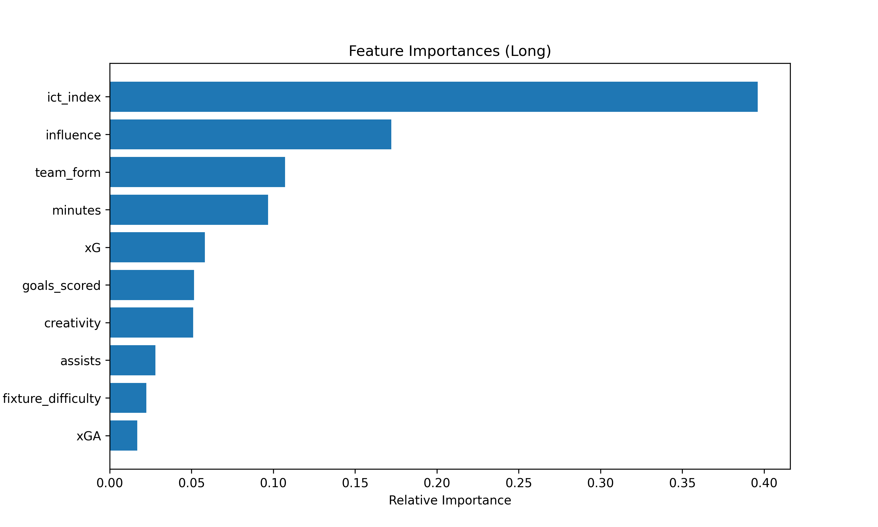
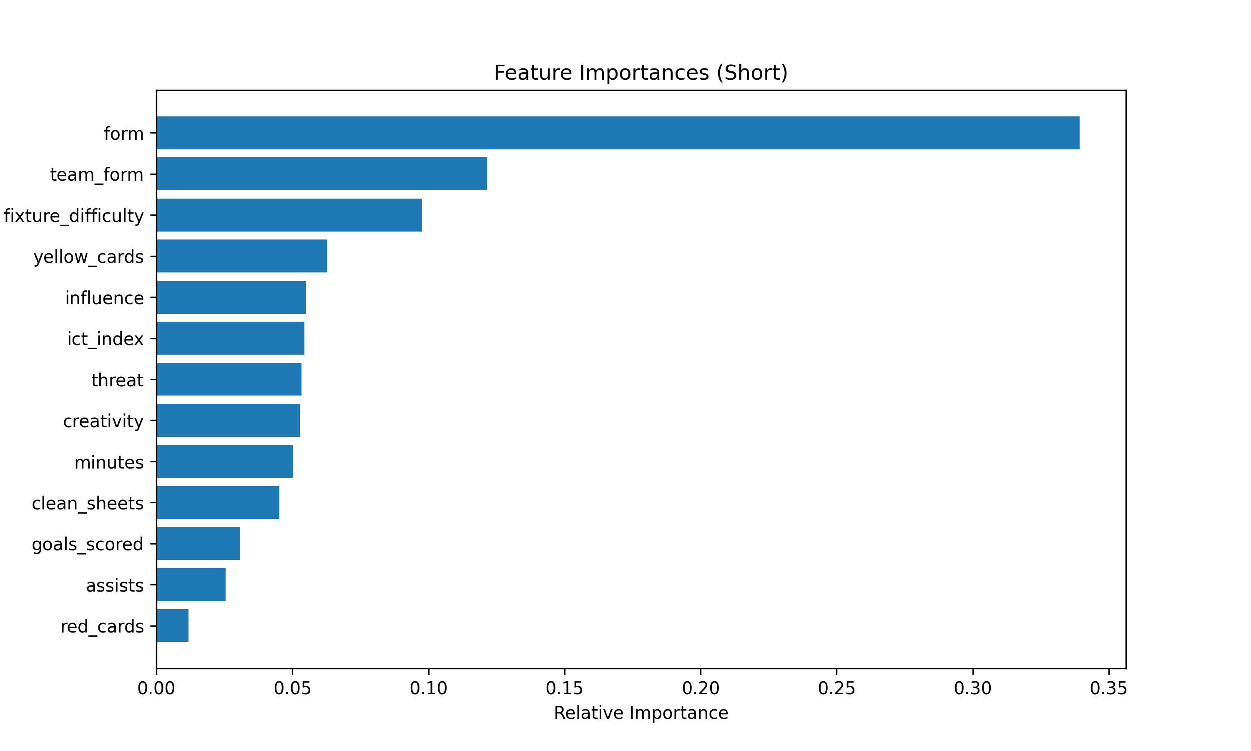
Results
Feature Importance
Displays which features each model resonated towards to best root out variance in its estimations

Slide 11
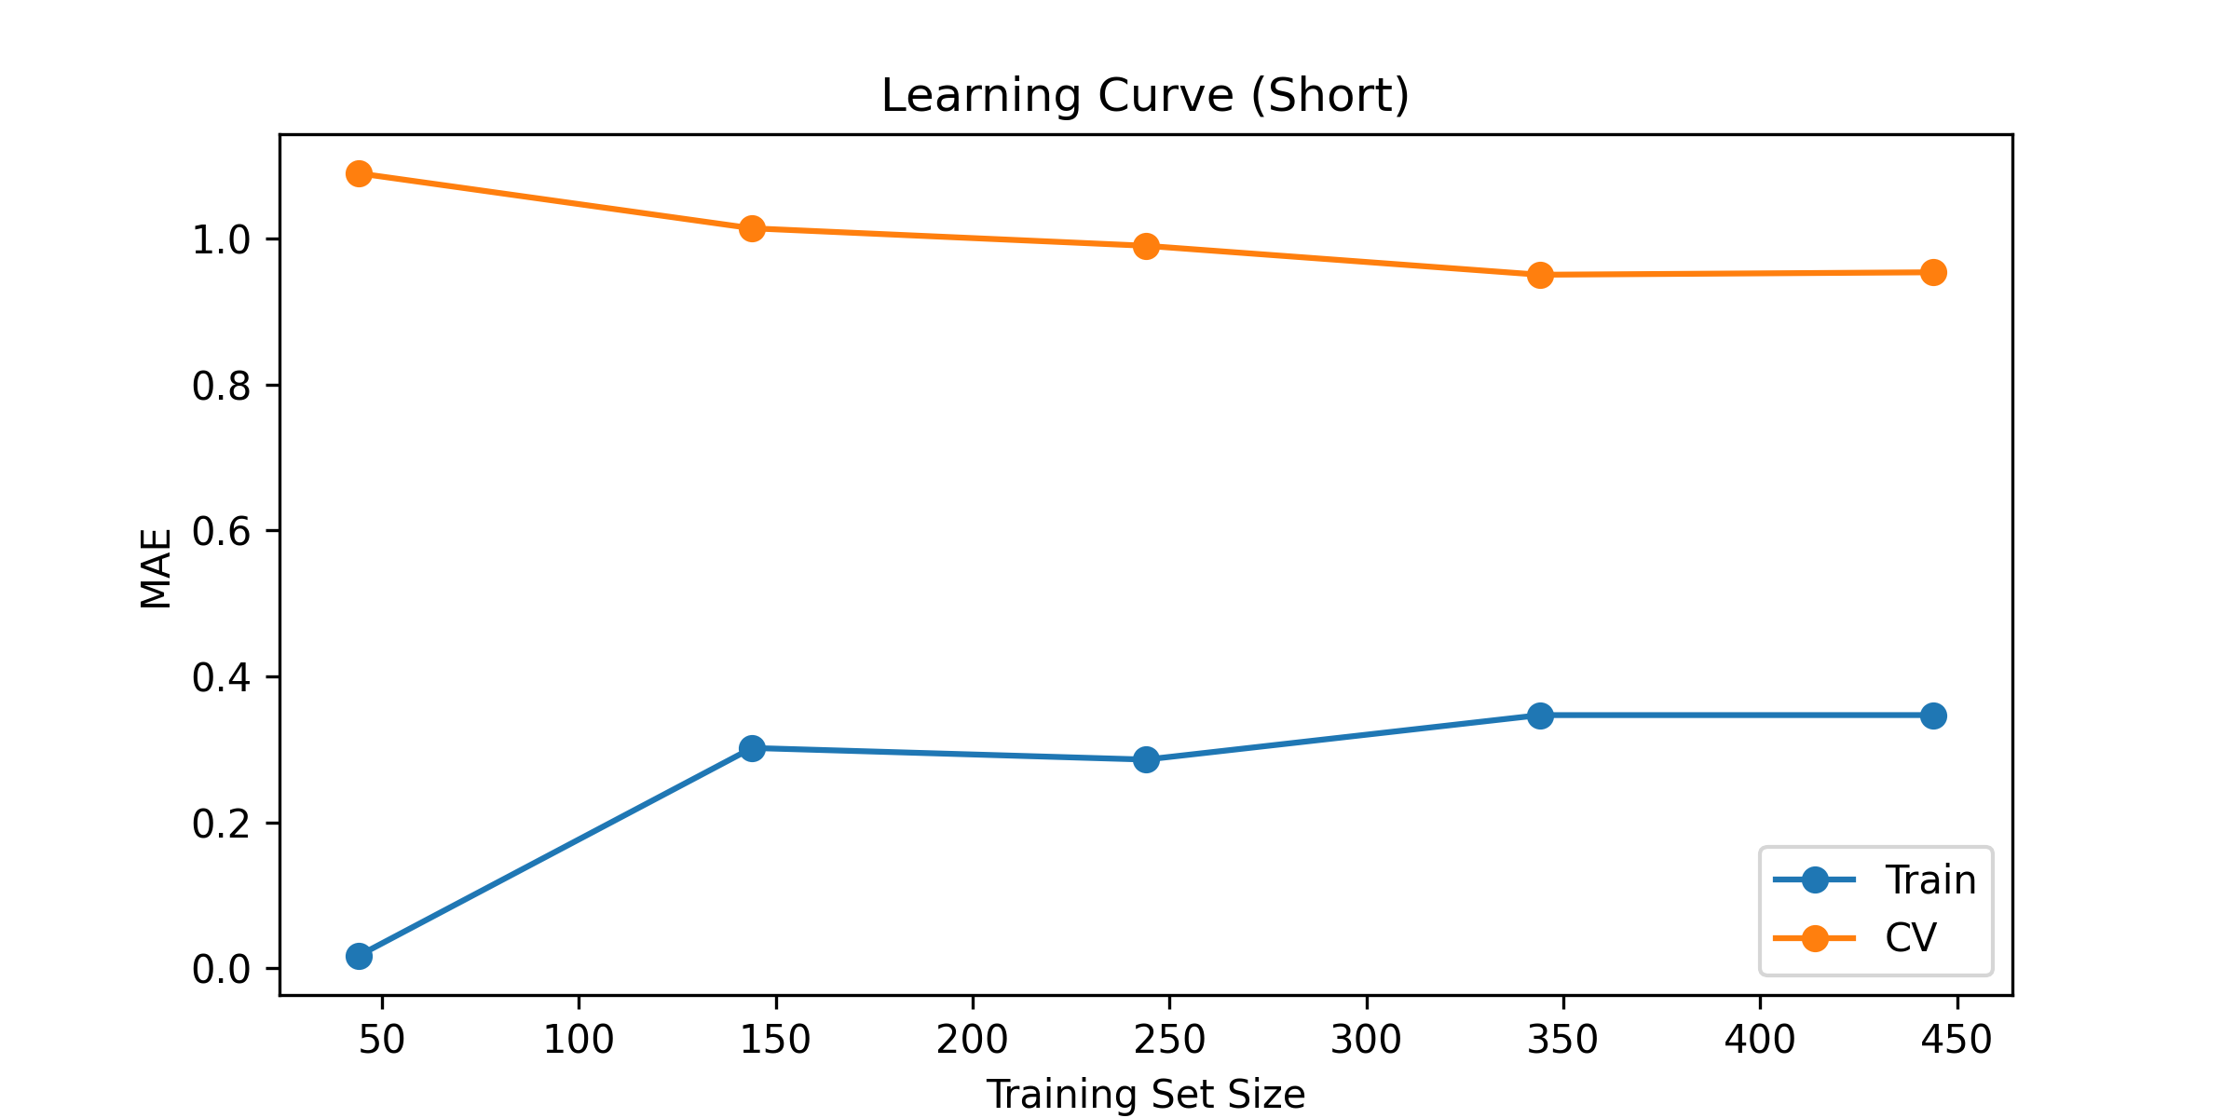
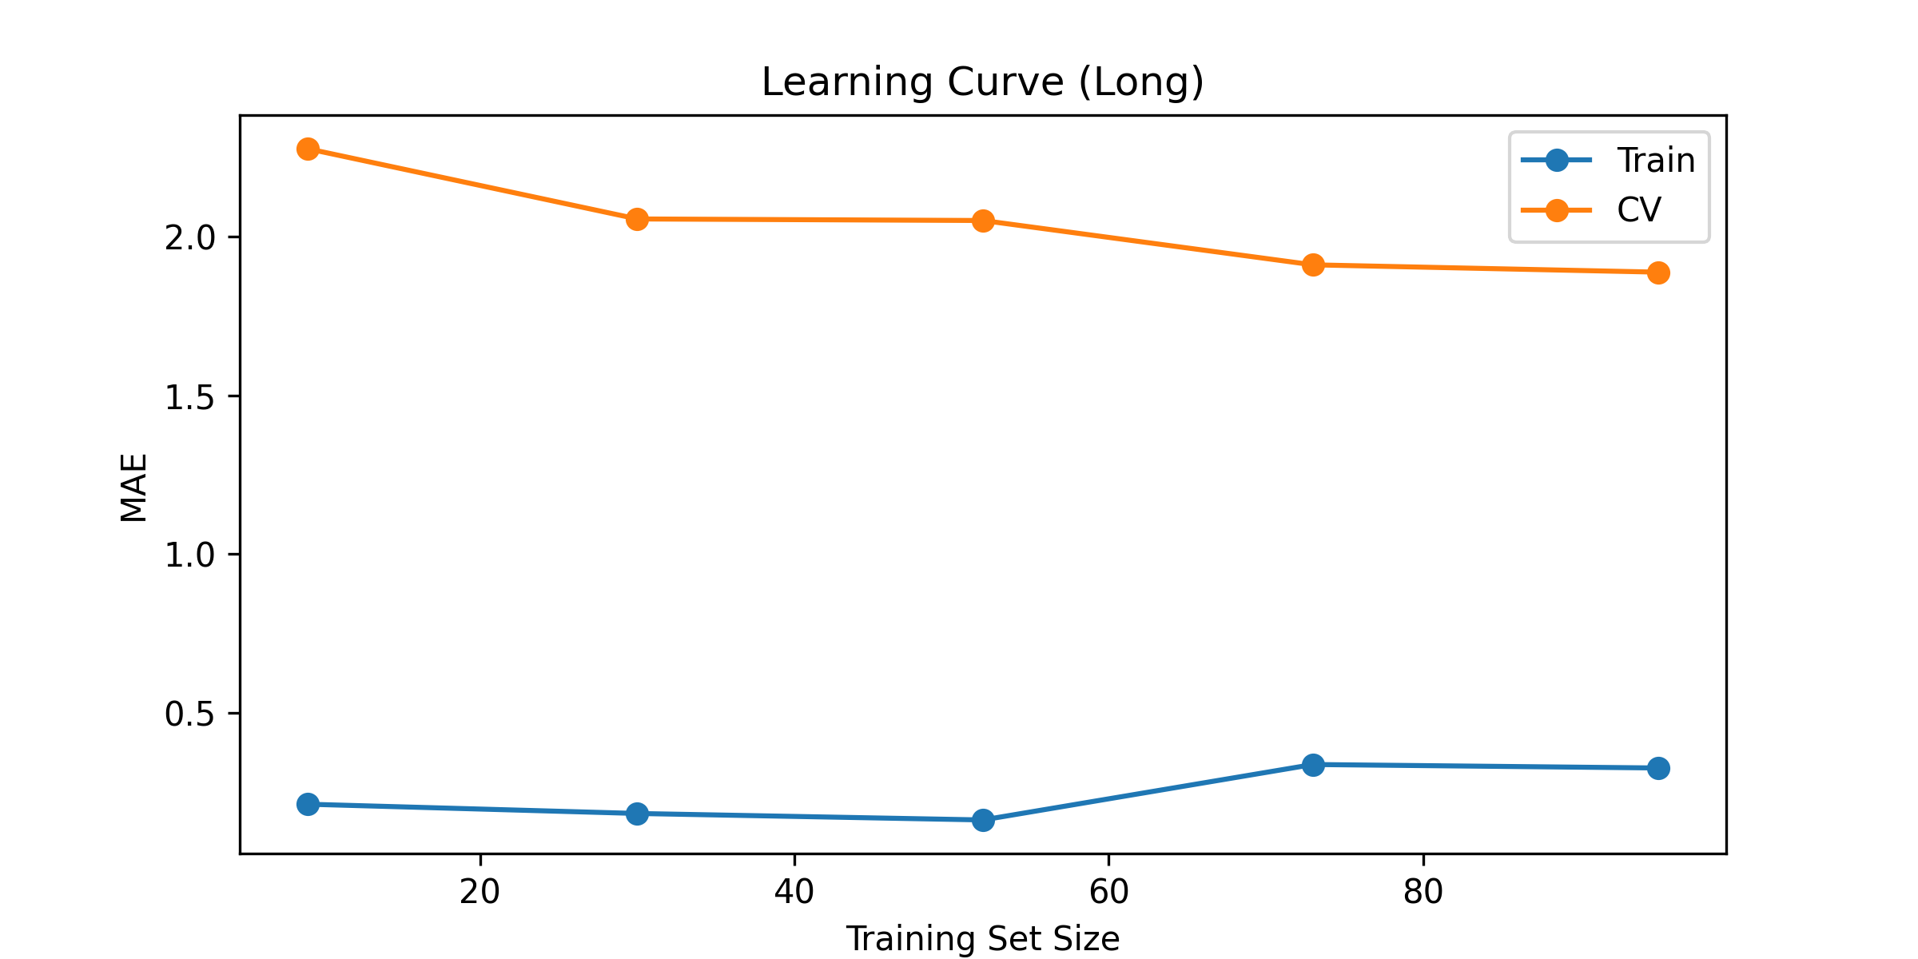
Results
Learning Curve
The MAE for each model after player-gw rows used for training
“Train” is the MAE on the training folds
CV is the MAE on the held-out, validation, folds

Slide 12
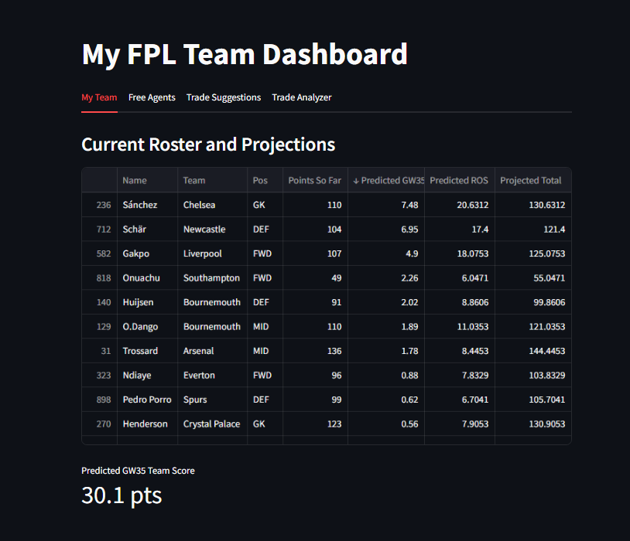
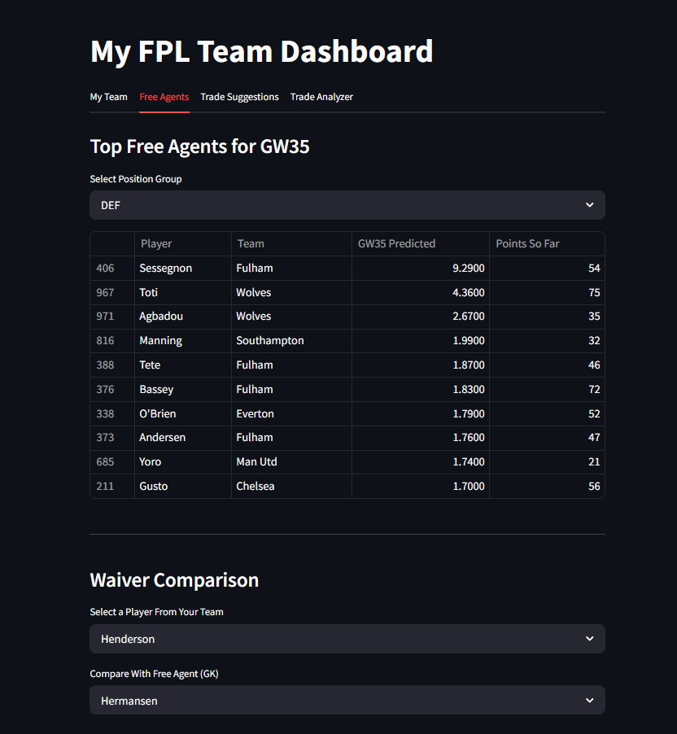
Results

Slide 13
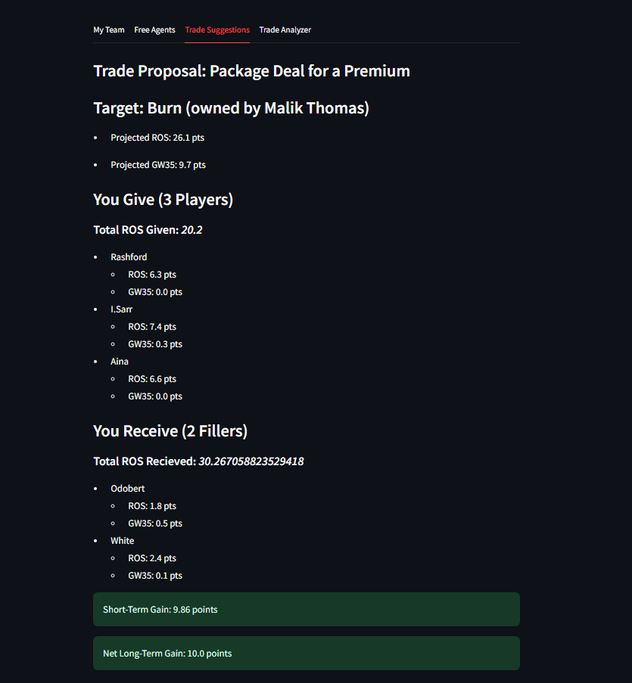
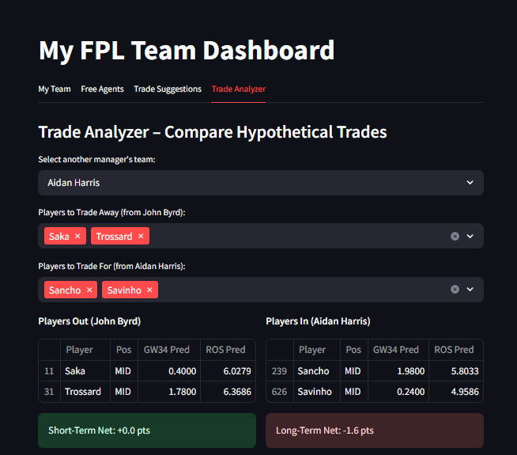
Results

Slide 14
Conclusion
Using Random Forest Regression, the system
Predicts short-term player performance
Estimates long-term value based on projected season totals
Identifies optimal waiver signings to patch positional gaps
Suggests realistic trades that benefit the manager
Evaluates trades based on projected point gains for both sides
Forecasts total team performance over time
And most importantly, the system provides a quantitative basis for decision-making

Slide 15
Conclusion
Next Steps
Fully integrate the Deep Q-Network to improve on player trade suggestions, improving on the current rule-based logic
Including better, more comprehensive state encoding for the agent
Automate roster updates
Improve the UI
Work through some of the complications with the FPL Draft API

Slide 16
References
[1] V. Rajesh, P. Arjun, K. R. Jagtap, S. C. M and J. Prakash, "Player Recommendation System for Fantasy Premier League using Machine Learning," 2022
[2] A. Peddii and R. Jain, "Random Forest-Based Fantasy Football Team Selection," 2023
[3] M. Bangdiwala, R. Choudhari, A. Hegde and A. Salunke, "Using ML Models to Predict Points in Fantasy Premier League," 2022

