Slide 1
Jeopardy!!
Jack Pham
Walter Gula
Hunter Ochabauer
Ibrahima Bah

Slide 2
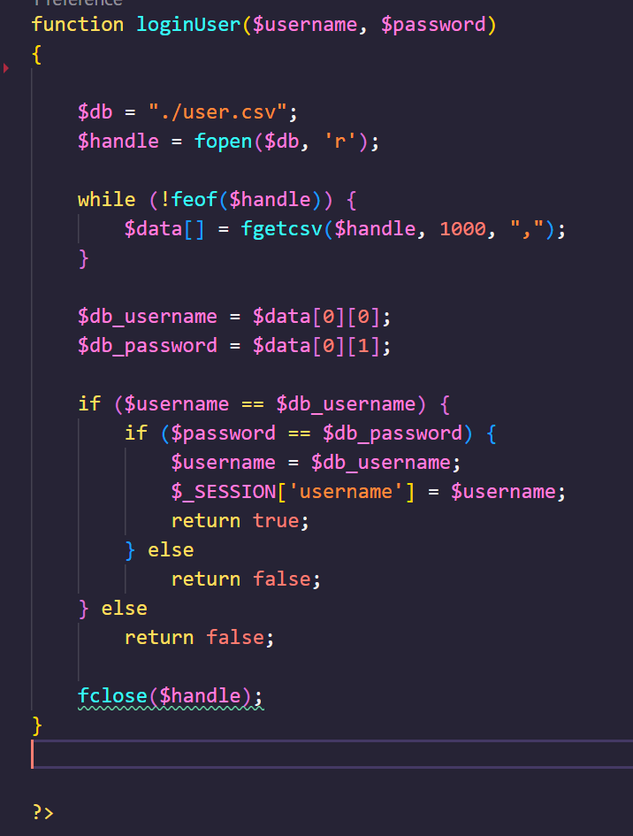
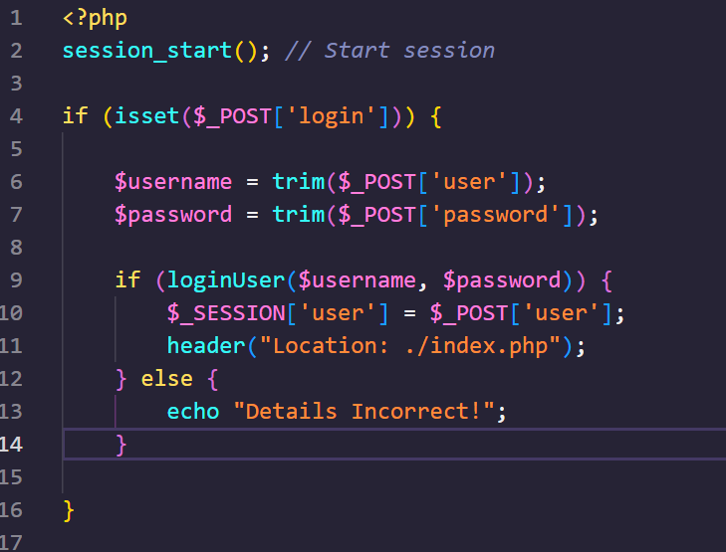
Login / Signup
To login, we need to find the username and password in a csv file. Once doing so, we transfer to the game page
For signup, we create a new username and password array and write it into the csv file. It then leads back to the login page if successful.

Slide 3
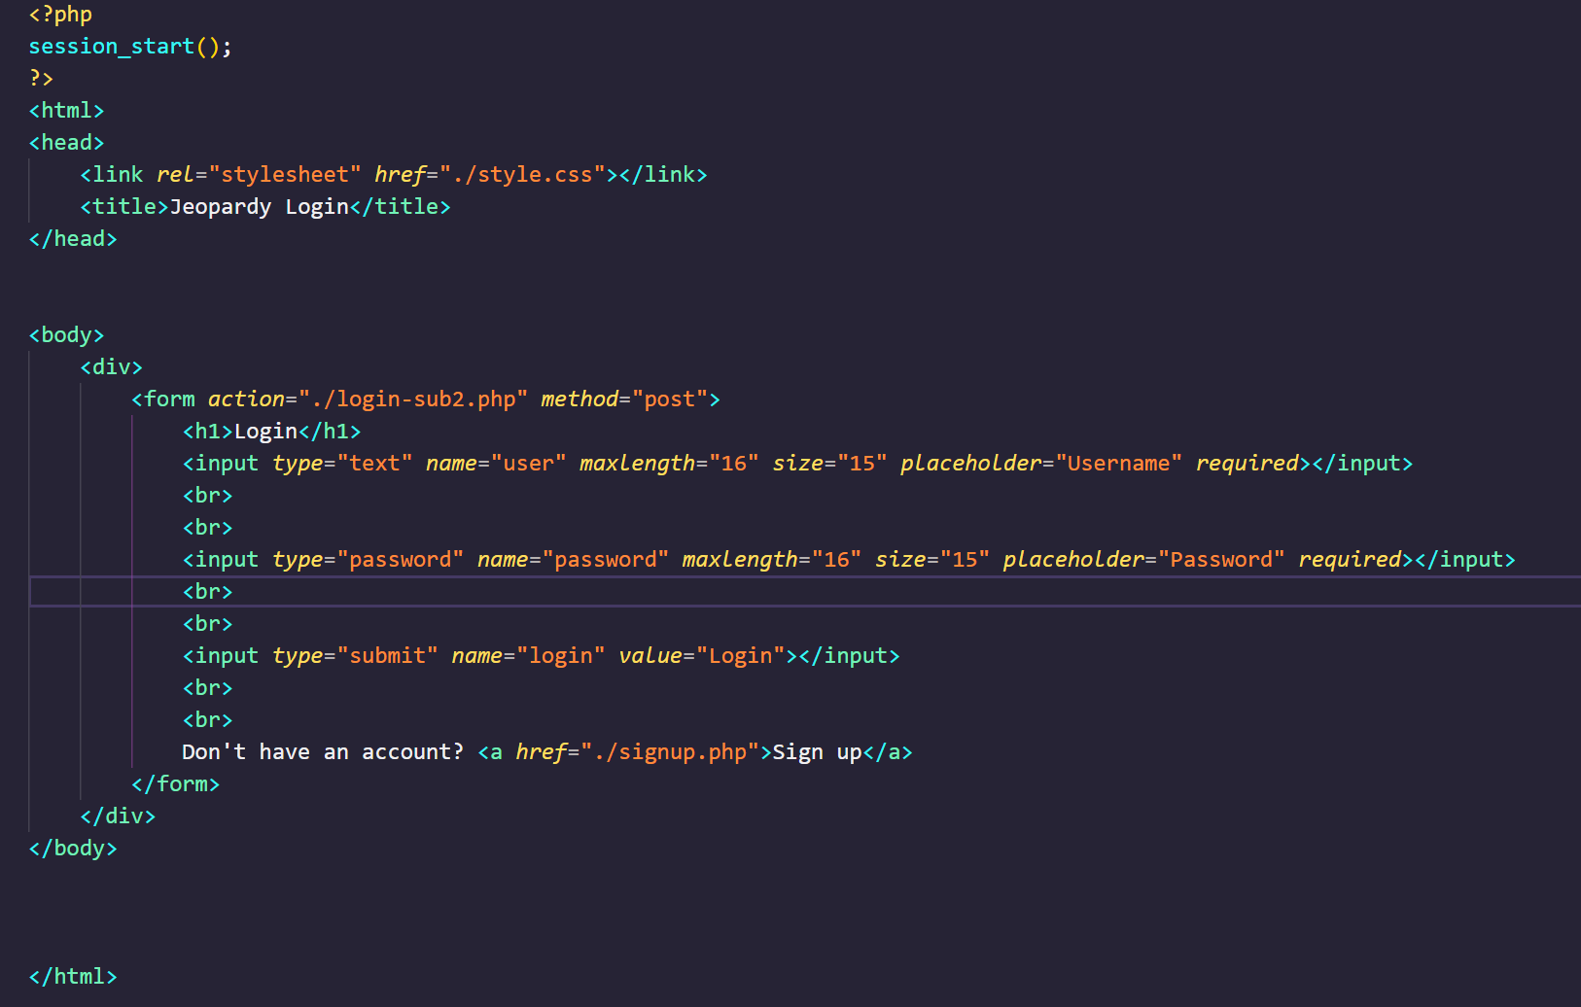
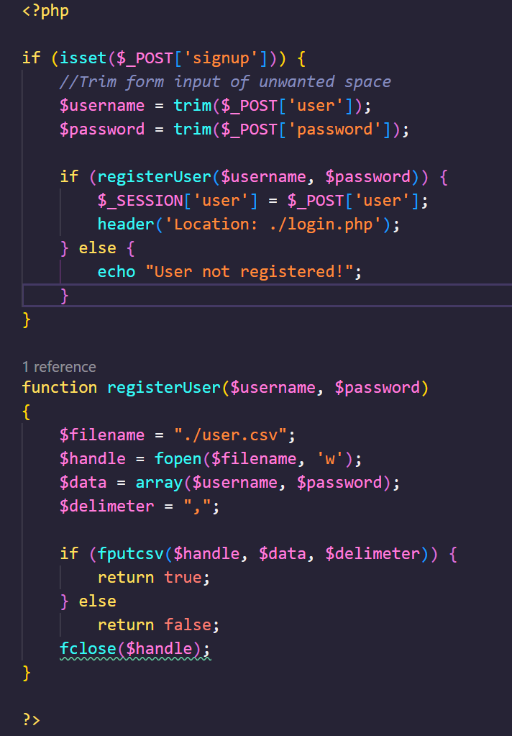

Slide 4
Jeopardy Table

Slide 5
Sessions

