Slide 1
Jeopardy!!
Jack Pham
Walter Gula
Hunter Ochabauer
Ibrahima Bah

Slide 2
Demo

Slide 3
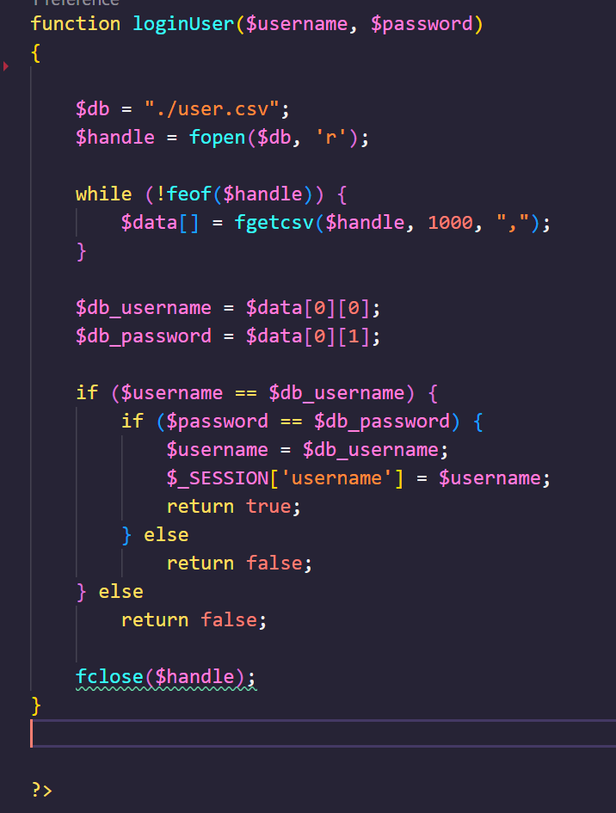
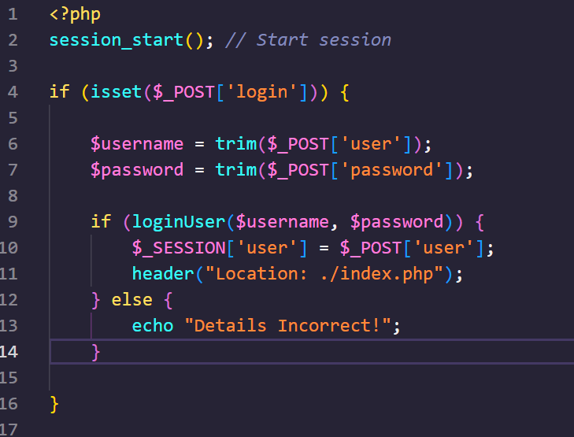
Login / Signup
To login, we need to find the username and password in a csv file. Once doing so, we transfer to the game page
For signup, we create a new username and password array and write it into the csv file. It then leads back to the login page if successful.

Slide 4
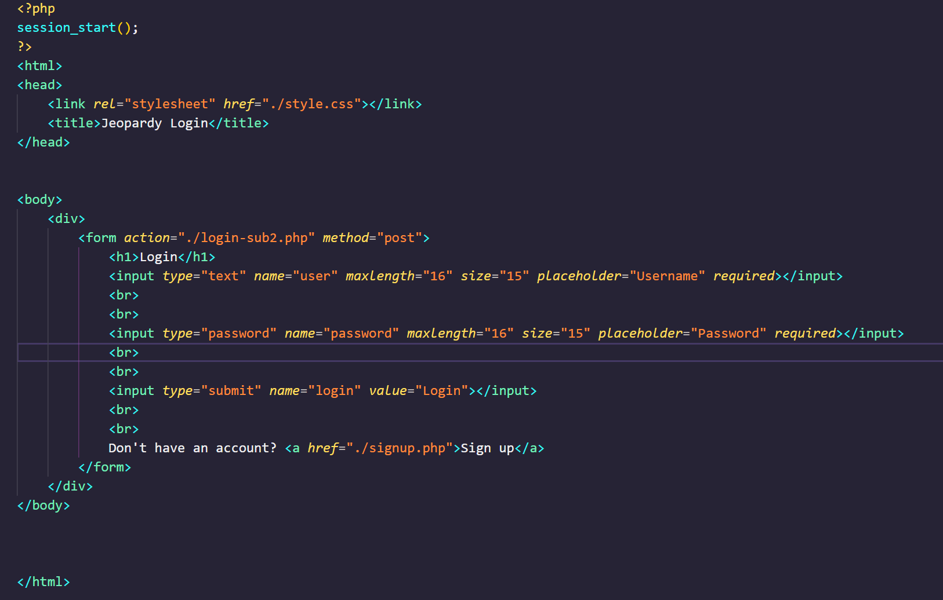
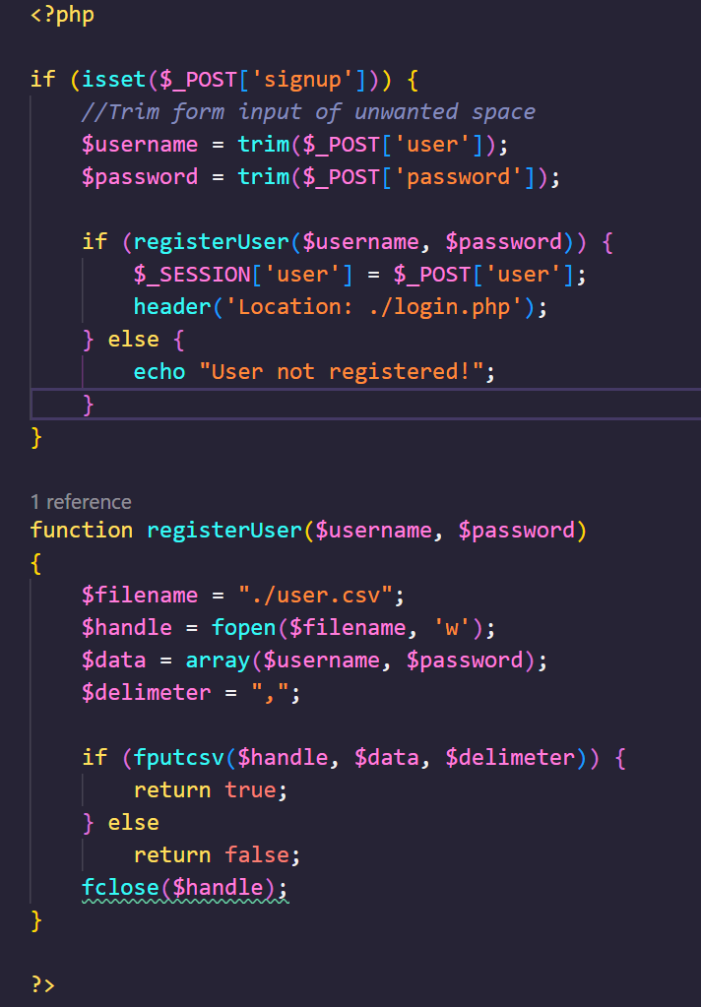

Slide 5
Jeopardy Table

Slide 6
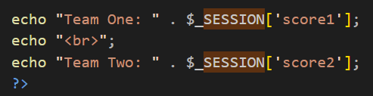
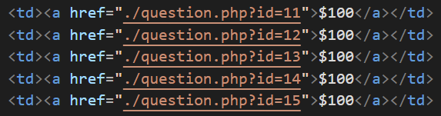

Sessions
We used certain session variables to keep track of things like
Team 1 points
Team 2 points
The user
We also passed information to the question page by adding a variable to the href link, and using $_GET['id’] to read that value

Slide 7
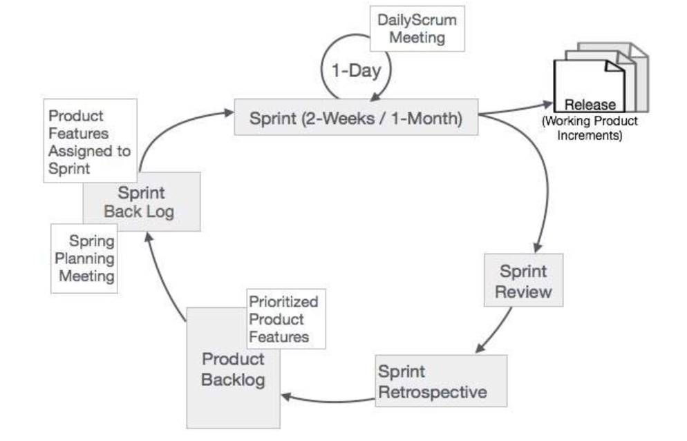
Scrum
The Scrum framework helped our team keep track of the progress of our project due to the constant check ups. This was useful to know how much work is left, and how to break up that work.

Slide 8
Testing

