Slide 1
LINK TIME OPTIMIZATION

Slide 2
LTO in GCC
Link Time Optimization (LTO) gives GCC the capability of dumping its internal representation (GIMPLE) to disk, so that all the different compilation units that make up a single executable can be optimized as a single module. This expands the scope of inter-procedural optimizations to cover the whole program
Inter-procedural optimization
Seeks reduce or eliminate
Duplicate calculations.
Inefficient use of memory,
Simplify iterative sequences such as loops.
If there is a call to another routine that occurs within a loop, IPO analysis may determine that it is best to inline that.
IPO may re-order the routines for better memory layout and locality.

Slide 3
Advantages of LTO:
LTO grants the compiler the opportunity to see more than a single .o file at a time. This grants extra freedom for the optimization that yields:
Reduced code size:
Increased execution speed.
Disadvantages:
Compilation time increase
Build time increases (incremental build is not feasible).
Build machine requires more memory.
May affect debugging of the source code.
May introduce new bugs which are difficult to trace.

Slide 4
Enable LTO in Gcc:
We should pass configure option “—enable-lto” to support LTO in Gcc and Binutils.
Example with LTO :
$cat test.c
int main()
{
printf(“Hello”);
return 0;
}

Slide 5
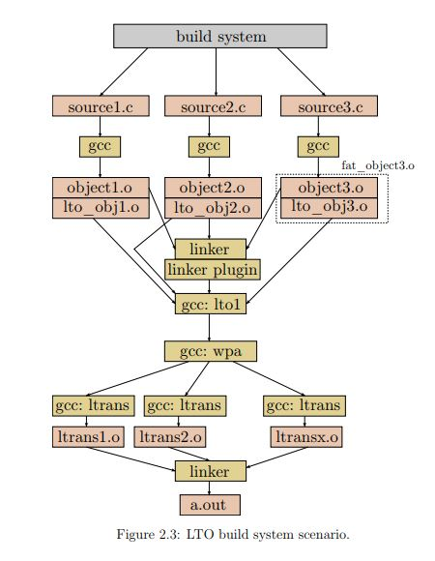

Slide 6
VERBOSE(-V) WITH LTO
Default collect2:
/data/home/toolchain/prefix/libexec/gcc/x86_64-windriver-linux/4.8.1/collect2 --build-id \
--eh-frame-hdr --hash-style=sysv -m elf_x86_64 -dynamic-linker /lib64/ld-linux-x86-64.so.2
Collect2 with LTO:
/data/home/toolchain/prefix/libexec/gcc/x86_64-windriver-linux/4.8.1/collect2 -plugin \
/data/home/toolchain/prefix/libexec/gcc/x86_64-windriver-linux/4.8.1/liblto_plugin.so \
-plugin-opt=/data/home/toolchain/prefix/libexec/gcc/x86_64-windriver-linux/4.8.1/lto-wrapper
For more reference of collect2
https://gcc.gnu.org/onlinedocs/gccint/Collect2.html
Purpose of liblto_plugin.so and ltowrapper:
LD can't really recognize the exported GIMPLES.
‫‫For this purpose ld use the lto plugin(liblto_plugin.so.0.0.0) which call make or the lto-wrapper directly which call the lto1 where each lto1 lauch is responsible for producing a 'partition' (see the -flto-partition option and the lto-partitions parameter in gcc's documentation).

Slide 7
LTO1 1st time:
/data/home/toolchain/prefix/libexec/gcc/x86_64-windriver-linux/4.8.1/lto1 \
-quiet -dumpbase test.o -mtune=generic -march=x86-64 -mtune=generic -march=x86-64 \
-auxbase test -version -fltrans-output-list=/tmp/ccG72ir8.ltrans.out -fwpa \
-fresolution=test.res @/tmp/ccKB1Id8
$cat test.res
1
test.o 1
165 95e82b8825f9f424 PREVAILING_DEF main
$cat /tmp/ccG72ir8.ltrans.out
/tmp/ccG72ir8.ltrans0.o
$cat /tmp/ccKB1Id8
test.o

Slide 8
LTO1 2nd time:
/data/home/toolchain/prefix/libexec/gcc/x86_64-windriver-linux/4.8.1/lto1 \
-quiet -dumpbase ccG72ir8.ltrans0.o -mtune=generic -march=x86-64 \
-mtune=generic -march=x86-64 -auxbase-strip /tmp/ccG72ir8.ltrans0.ltrans.o -version \
-fltrans-output-list=/tmp/ccG72ir8.ltrans.out -fltrans @/tmp/ccBtWKqc -o ccG72ir8.ltrans0.s
$ readelf -S /tmp/ccG72ir8.ltrans0.o
There are 8 section headers, starting at offset 0x40:
Section Headers:
[Nr] Name Type Address Offset
Size EntSize Flags Link Info Align
[ 0] NULL 0000000000000000 00000000
0000000000000000 0000000000000000 0 0 0
[ 1] .gnu.lto_main.11f PROGBITS 0000000000000000 00000240
00000000000001e1 0000000000000000 0 0 8
[ 2] .gnu.lto_.cgrapho PROGBITS 0000000000000000 00000428
0000000000000021 0000000000000000 0 0 8
[ 3] .gnu.lto_.symbol_ PROGBITS 0000000000000000 00000450
000000000000001e 0000000000000000 0 0 8
[ 4] .gnu.lto_.refs.11 PROGBITS 0000000000000000 00000470
000000000000000d 0000000000000000 0 0 8
[ 5] .gnu.lto_.decls.1 PROGBITS 0000000000000000 00000480
0000000000000185 0000000000000000 0 0 8
[ 6] .gnu.lto_.opts PROGBITS 0000000000000000 00000608
000000000000008a 0000000000000000 0 0 8
[ 7] .shstrtab STRTAB 0000000000000000 00000692
00000000000000c7 0000000000000000 0 0 1

Slide 9
$cat ccG72ir8.ltrans0.s
.file "<artificial>"
.section .rodata
.LC0:
.string "Hello"
.text
.globl main
.type main, @function
main:
.LFB0:
.cfi_startproc
pushq %rbp
.cfi_def_cfa_offset 16
.cfi_offset 6, -16
$cat /tmp/ccBtWKqc
/tmp/ccG72ir8.ltrans0.o
movq %rsp, %rbp
.cfi_def_cfa_register 6
movl $.LC0, %edi
movl $0, %eax
call printf
movl $0, %eax
popq %rbp
.cfi_def_cfa 7, 8
ret
.cfi_endproc
.LFE0:
.size main, .-main
.ident "GCC: (Ubuntu 5.4.0-6ubuntu1~16.04.10) 5.4.0 20160609"
.section .note.GNU-stack,"",@progbits

Slide 10
LTO usage with example:
$cat main.c
#include<stdio.h>
int main()
{
fun1();
}
$cat fun.c
static int i;
void fun1()
{
fun2();
printf("fun1\n");
}
void fun2()
{
i=0;
if(i>0)
fun3();
printf("fun2\n");
}
void fun3()
{
printf("fun3\n");
}
void fun4()
{
printf("fun4\n");
}
Commands:
gcc -flto -c -o main_lto.o
gcc -flto -c -o fun_lto.o
gcc -flto main_lto.o fun_lto.o -o output_lto

Slide 11
Main.o
Fun.o:
Section Headers:
……..
……..
[ 4] .gnu.lto_.inline. PROGBITS 0000000000000000 00000040
0000000000000040 0000000000000000 E 0 0 1
[ 5] .gnu.lto_fun3.711 PROGBITS 0000000000000000 00000080
00000000000000ff 0000000000000000 E 0 0 1
[ 6] .gnu.lto_fun2.711 PROGBITS 0000000000000000 0000017f
0000000000000200 0000000000000000 E 0 0 1
[ 7] .gnu.lto_fun1.711 PROGBITS 0000000000000000 0000037f
0000000000000138 0000000000000000 E 0 0 1
[ 8] .gnu.lto_fun4.711 PROGBITS 0000000000000000 000004b7
0000000000000100 0000000000000000 E 0 0 1
[ 9] .gnu.lto_.symbol_ PROGBITS 0000000000000000 000005b7
000000000000005f 0000000000000000 E 0 0 1
[10] .gnu.lto_.refs.71 PROGBITS 0000000000000000 00000616
0000000000000019 0000000000000000 E 0 0 1
[11] .gnu.lto_.decls.7 PROGBITS 0000000000000000 0000062f
000000000000038c 0000000000000000 E 0 0 1
[12] .gnu.lto_.symtab. PROGBITS 0000000000000000 000009bb
0000000000000050 0000000000000000 E 0 0 1
[13] .gnu.lto_.opts PROGBITS 0000000000000000 00000a0b
00000000000000b7 0000000000000000 E 0 0 1
Section Headers:
……..
……..
[ 4] .gnu.lto_.inline. PROGBITS 0000000000000000 00000040
0000000000000023 0000000000000000 E 0 0 1
[ 5] .gnu.lto_main.927 PROGBITS 0000000000000000 00000063
000000000000014a 0000000000000000 E 0 0 1
[ 6] .gnu.lto_.symbol_ PROGBITS 0000000000000000 000001ad
0000000000000033 0000000000000000 E 0 0 1
[ 7] .gnu.lto_.refs.92 PROGBITS 0000000000000000 000001e0
000000000000000e 0000000000000000 E 0 0 1
[ 8] .gnu.lto_.decls.9 PROGBITS 0000000000000000 000001ee
00000000000001d7 0000000000000000 E 0 0 1
[ 9] .gnu.lto_.symtab. PROGBITS 0000000000000000 000003c5
0000000000000028 0000000000000000 E 0 0 1
[10] .gnu.lto_.opts PROGBITS 0000000000000000 000003ed
00000000000000b7 0000000000000000 E 0 0 1
[11] .comment PROGBITS 0000000000000000 000004a4

Slide 12
LTO file sections
1.Command line options (.gnu.lto_.opts)
This section contains the command line options used to generate the object files.
2.Symbol table (.gnu.lto_.symtab)
This table replaces the ELF symbol table for functions and variables represented in the LTO IL. Symbols used and exported by the optimized assembly code of “fat” objects might not match the ones used and exported by the intermediate code. This table is necessary because the intermediate code is less optimized and thus requires a separate symbol table.
3.Global declarations and types (.gnu.lto_.decls)
This section contains an intermediate language dump of all declarations and types required to represent the callgraph, static variables and top-level debug info.
4.The callgraph (.gnu.lto_.cgraph)
This section contains the basic data structure used by the GCC inter-procedural optimization infrastructure. This section stores an annotated multi-graph which represents the functions and call sites as well as the variables, aliases and top-level asm statements.

Slide 13
5.IPA references (.gnu.lto_.refs)
This section contains references between function and static variables
6.Function bodies (.gnu.lto_.function_body.<name>)
This section contains function bodies in the intermediate language representation. Every function body is in a separate section to allow copying of the section independently to different object files or reading the function on demand.
7.Static variable initializers (.gnu.lto_.vars)
This section contains all the symbols in the global variable pool.

Slide 14
LTO modes of operation
1. WHOPR or partitioned mode:
WHOPR stands for WHOle Program optimizeR.
It partitions the aggregated callgraph from many different .o files and distributes the compilation of the sub-graphs to different CPUs.
It is designed to utilize multiple CPUs and/or a distributed compilation environment to quickly link large applications.
2. LTO mode or non-partitioned mode:
In this mode, the whole program is read into the compiler at link-time and optimized in a similar way as if it were a single source-level compilation unit.

Slide 15
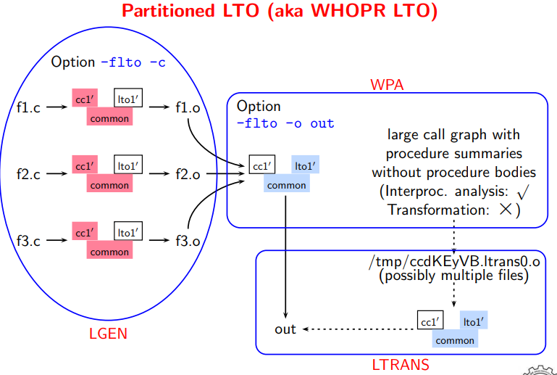
Partitioned LTO (aka WHOPR Mode of LTO)
• Three steps
◮ LGEN: Potentially Parallel
− generation of summary information
− generation of translation unit information
◮ WPA: Whole Program Analysis Sequential
− Reads the call graph and not function bodies
− Summary information for each function
◮ LTRANS: Local Transformations Potentially Parallel
-fwpa
This option runs the serial part of the link-time optimizer performing the inter-procedural propagation (WPA mode). The compiler reads in summary information from all inputs and performs an analysis based on summary information only. It generates object files for subsequent runs of the link-time optimizer where individual object files are optimized using both summary information from the WPA mode and the actual function bodies. It then drives the LTRANS phase.
-fltrans
This option runs the link-time optimizer in the local-transformation (LTRANS) mode, which reads in output from a previous run of the LTO in WPA mode. In the LTRANS mode, LTO optimizes an object and produces the final assembly.

Slide 16
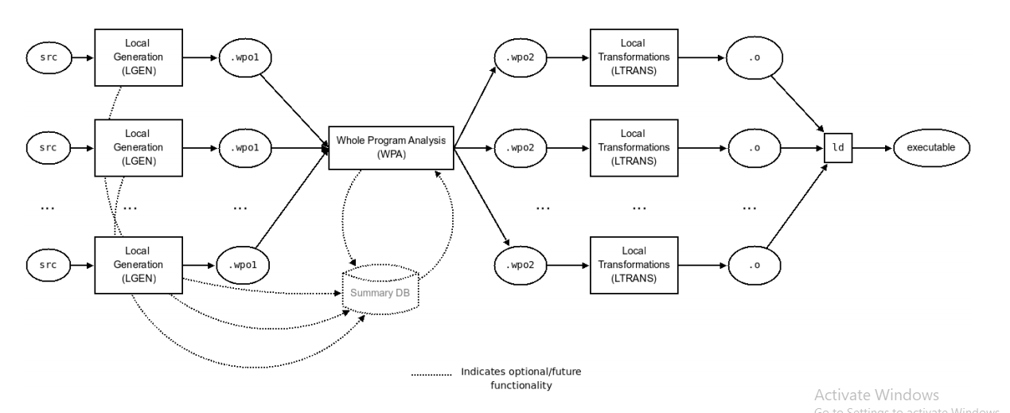

Slide 17
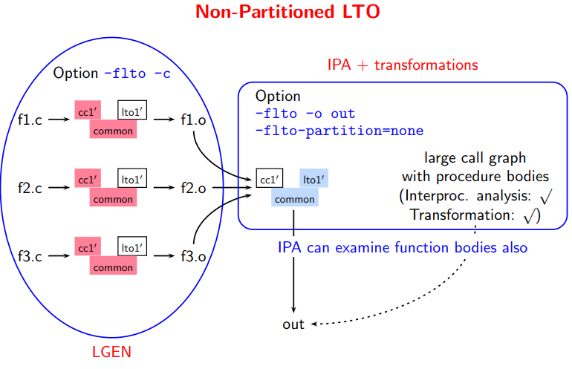
Non-Partitioned LTO
• Two steps
◮ LGEN:
− generation of translation unit information
− no summary
◮ IPA: Inter-Procedural Analysis
− Reads the call graph and function bodies
− Performs analysis and transformation
IPA is a whole program analysis
(processes the entire program together)

Slide 18
QUERIES……?

Slide 19
THANK YOU

