Slide 1
Caller and Callee Saved Registers
BlacKfig technologies pvt ltd
JAYDEEP CHAUHAN Software engineer

Slide 2
Saving Registers during calls
A procedure often needs many registers for local variables, copies of parameters, and temporary calculations.
In a load/store architecture, the procedure needs registers in order to access values stored on the stack.
A newly invoked procedure therefore must immediately have some registers made available to it.
Therefore any register that is part of the environment of the calling program cannot be used by a newly called procedure unless its value can first be preserved and then be restored upon return to the calling program.

Slide 3
Registers are typically partitioned into:
Caller saved registers
whose value the calling method must save and restore (if it depends on them after the call).
Caller saving has the advantage that you only save the registers in use at a particular call rather than all registers ever used in the procedure (although you may end up saving registers that aren't altered by the called procedure).
Caller-save are volatile.
Callee saved registers
whose values the called method must save and restore (if it uses them).
Callee saving has the advantage of keeping the total size of your code small (each method only contains one set of instructions to save registers).
Callee-save are non-volatile.

Slide 4
Registers are typically partitioned into:
Caller saved registers (volatile)
it is the caller’s responsibility to save any important data in these registers before calling another procedure (i.e. the callee can freely change data in these registers)
Caller saves values in its stack frame before calling Callee, then restores values after the call Callee saved registers
Callee saved registers (
It is the callee’s responsibility to save any data in these registers before using the registers (i.e. the caller assumes the data will be the same across the callee procedure call)
Callee saves values in its stack frame before using, then restores them before returning to caller

Slide 5
Why all register all register are not taking as same type like all caller saved or callee saved ?
It’s beneficial for a calling convention to designate both caller-save registers and callee-save registers.
If the convention designated all registers as callee-save, then subroutines would not be able to use any registers at all without saving them onto the stack first — which would be a waste, since some of the saved registers would be transient values that the calling subroutine did not care about long-term.
And if the convention designated all registers as caller-save, then programmers would be forced to save many registers before every call to a subroutine and to restore them afterwards, lengthening the amount of time to call a subroutine.
In general, neither caller‐save nor callee‐save is “best”:
If caller isn’t using a register, caller‐save is better
If callee doesn’t need a register, callee‐save is better
If “do need to save”, callee‐save generally makes smaller programs

Slide 6
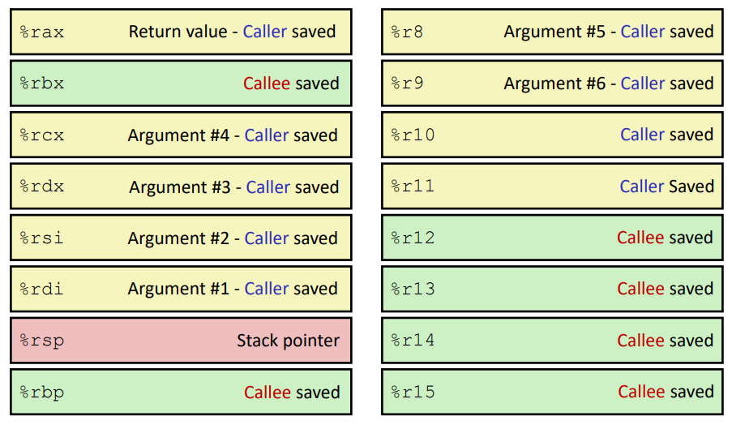
x86‐64 64‐bit Registers: Usage Conventions

Slide 7
Example1:-
int fn(int a,int b,int c,int d,int e,int f,int g,int h,int i,int j,int k)
{
return a+b+c+d+e+f+g+h+i+j+k;
}
int main()
{
int a=10,b=20,c=30,d=40,e=50,f=60,g=70,h=80,i=90,j=a,k=b;
printf("%d %d %d %d\n",a,b,j,k);
int r=fn(a,b,c,d,e,f,g,h,i,j,k);
printf("%d %d %d %d\n",a,b,j,k);
}

Slide 8
Example2:-
extern foo(int,int,int,int,int,int,int,int,int,int,int);
//extern fun(int,int,int,int,int,int,int,int,int,int,int);
int fn(int a,int b,int c,int d,int e,int f,int g,int h,int i,int j,int k)
{
int r=a+b+c+d+e+f+g+h+i+j+k;
foo(a,b,c,d,e,f,g,h,i,j,k);
fun(g,h,i,j,k,a,b,c,d,e,f);
return r;
}

Slide 9
Example3:-
extern foo(int,int,int,int,int,int,int,int,int,int,int);
extern fun(int,int,int,int,int,int,int,int,int,int,int);
void fn(int a,int b,int c,int d,int e,int f,int g,int h,int i,int j,int k,int l,int m,int n)
{
int a1, b1, c1, d1, e1, f1, g1, h1, i1, j1, k1, l1,m1, n1;
foo(a,b,c,d,e,f,g,h,i,j,k);
fun(a1=a,b1=b,c1=c,d1=d,e1=e,f1=f,g1=g,h1=h,i1=i,j1=j,k1=k);
}

Slide 10
Reference
http://pages.cs.wisc.edu/~goadl/cs354/handouts/ch9.pdf
http://www.cs.williams.edu/~tom/courses/434/outlines/lect18_2.html
https://courses.cs.washington.edu/courses/cse410/17wi/lectures/CSE410-L13-procedures-II_17wi.pdf

