Slide 1
Introduction to Linux
Shell Commands
Dr. Changjiang Zhang
Summer 2020

Slide 2
Linux Shell
A shell is a computer program that interprets the commands you type and sends them to the operating system. Secondly, it provides a programming environment consisting of environment variables.
Several shells.
The Bourne shell (sh): was a new Unix shell by Stephen Bourne at Bell Labs.
Almquist shell (ash): written as a BSD-licensed replacement for the Bourne Shell
Debian Almquist shell (dash): a modern replacement for ash in Debian and Ubuntu
Bourne-Again shell (bash): written as part of the GNU Project to provide a superset of Bourne Shell functionality. This shell can be found installed and is the default interactive shell for users on most Linux systems.
Korn shell (ksh): written by David Korn based on the Bourne shell sources while working at Bell Labs.
C shell (csh): (was modeled on the C programming language, including the control structures and the expression grammar. It was written by Bill Joy as a graduate student at University of California, Berkeley, and was widely distributed with BSD Unix)
Z shell (zsh): a relatively modern shell that is backward compatible with bash. It's the default shell in macOS since 10.15 Catalina.
tcsh: a Unix shell based on and compatible with the C shell (csh). It is essentially the C shell with programmable command-line completion, command-line editing, and a few other features.

Slide 3
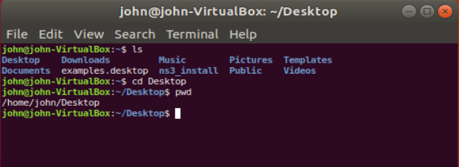
Open up a terminal:
The “prompt”
The current directory (“path”)
The host

Slide 4
What exactly is a “shell”?
After logging in, Linux/Unix starts another program called the shell
The shell interprets commands the user types and manages their execution
The shell communicates with the internal part of the operating system called the kernel
The most popular shells are: tcsh, csh, ksh, and bash
The differences are most times subtle
For this tutorial, we are using bash
Shell commands are CASE SENSITIVE!

Slide 5
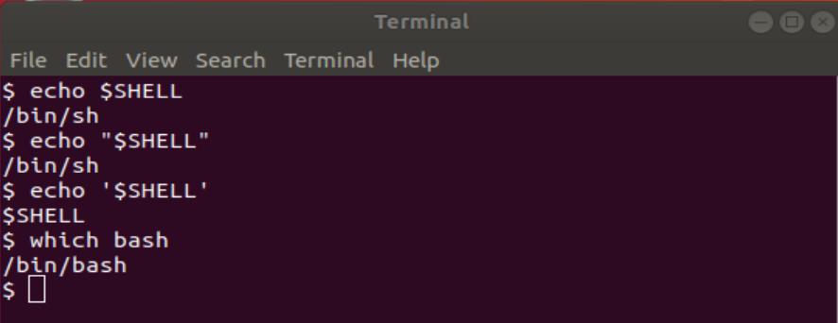
Linux Shell
The most popular and powerful Linux shell today is BASH.
To determine your shell type:
echo $SHELL (shell prints contents of env)
echo “$SHELL” (shell still processes env. variable)
echo ‘$SHELL’ (shell treats env. variable as simple literal)
To determine the path to the shell program, type:
which bash

Slide 6
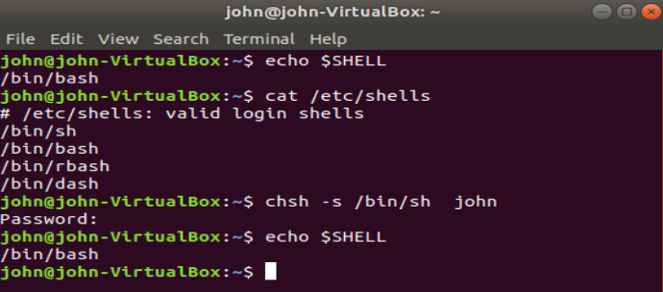
Linux Shell
Valid login shells info are saved in /etc/shells
cat /etc/shells
Change the default login shell with “chsh” utility
chsh -s /path/to/shell user
For example: chsh -s /bin/bash john

Slide 7
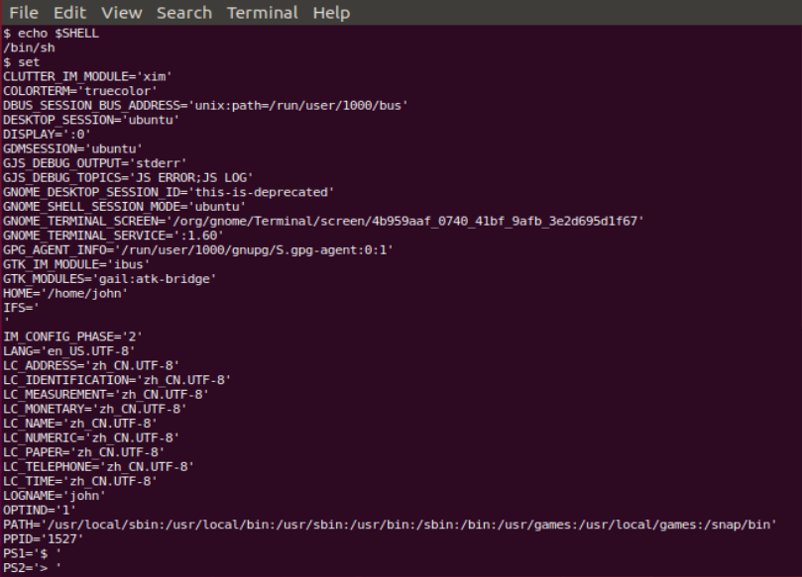
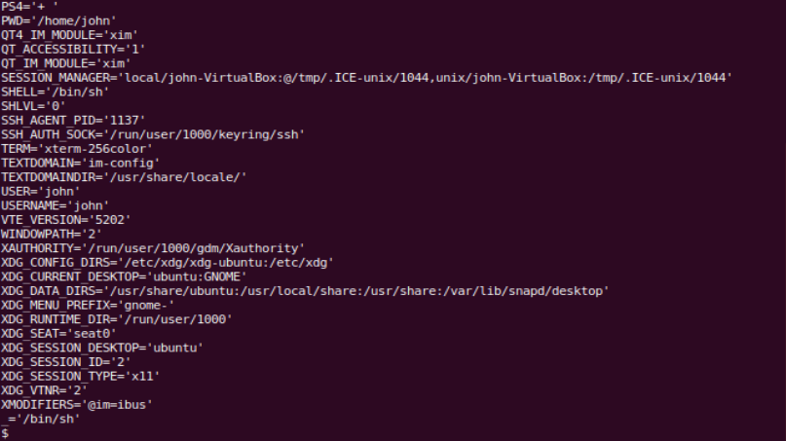
Linux Shell
The complete environment can be printed with set command.

Slide 8
Linux Commands
Commands have three parts:
command options and parameters.
Example: cal –j 3 1999.
“cal” is the command,
“-j” is an option (or switch),
“3” and “1999” are parameters.
Options have long and short forms.
Example:
date –u
date --universal

Slide 9
Command History and Simple Command Line Editing
Try the history command
Choose from the command history by using the up ↑ and down ↓ arrows
What do the left ← and right → arrow do on the command line? (edit the command)
Try the <Del> and <Backspace> keys
history | Output a list of previously entered command lines
!! | Re-execute the most recent command line (csh, tcsh, and bash)
!## | Re-execute the command number ### (csh, tcsh, and bash)
!xxx | Re-execute the last command that begins with xxx (csh, tcsh, and bash)
r | Re-execute the most recent command line (ksh)
r ## | Re-execute the command number ###(ksh)
r xxx | Re-execute the last command that begins with xxx (ksh)

Slide 10

Help with Commands
Type
hostname --help
man hostname
info hostname (gives the same or most information, but must be paged)
And “Yes,” you can always Google it

Slide 11
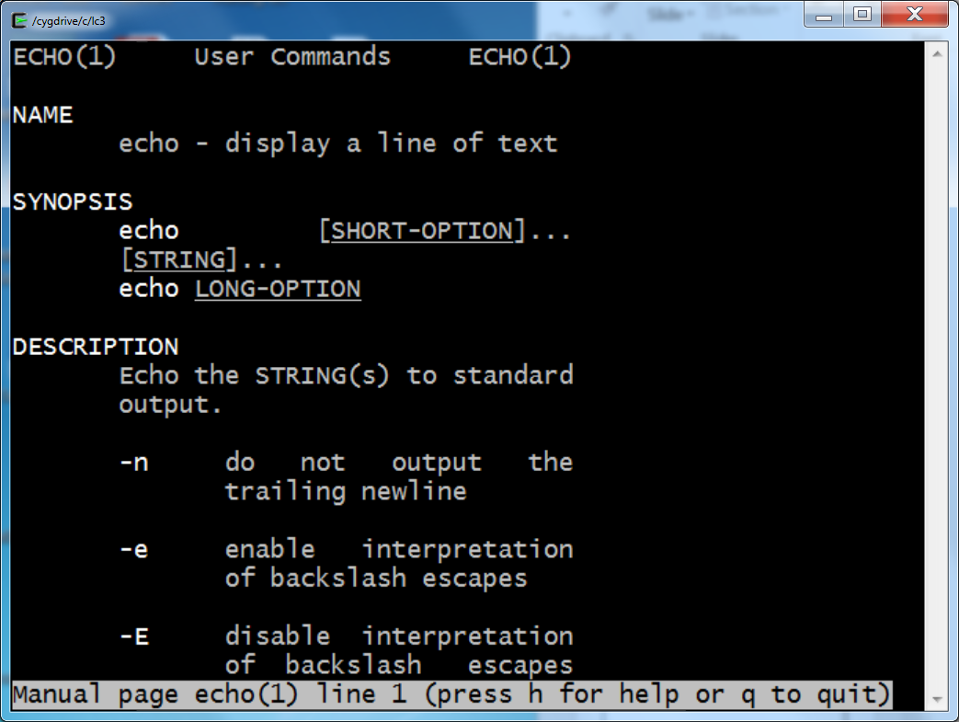
Help!
Whenever you need help with a command type “man” and the command name
man echo

Slide 12
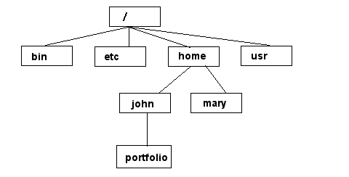
Unix/Linux File System
NOTE: Unix file names
are CASE SENSITIVE!
/home/mary/
/home/john/portfolio/
The Path

Slide 13
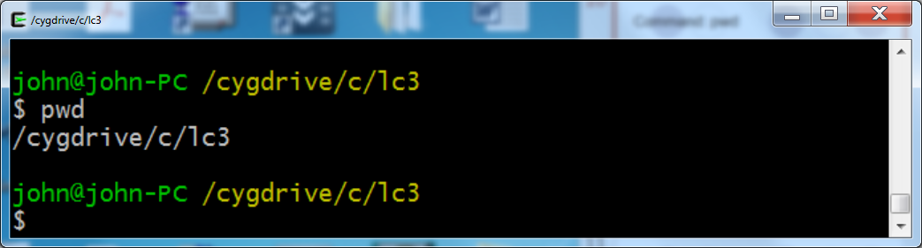
Command: pwd
To find your current path use “pwd” command

Slide 14
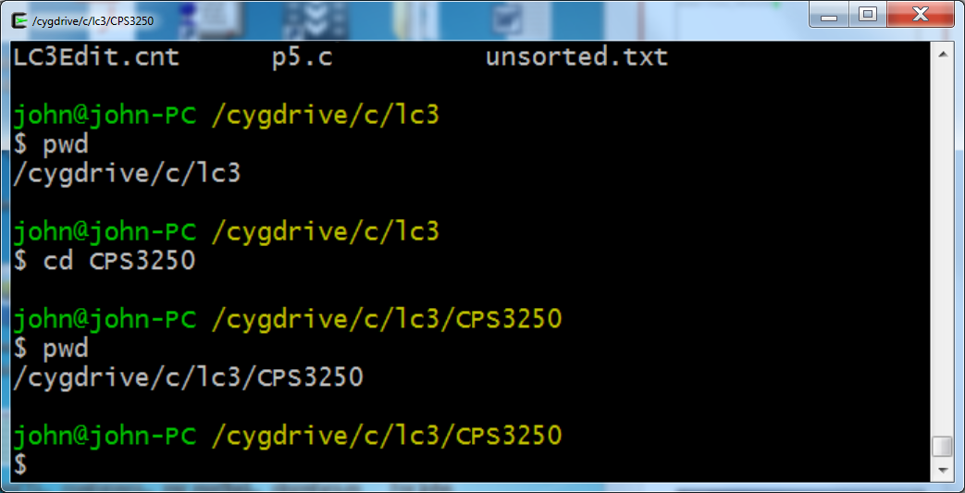
Command: cd
To change to a specific directory use “cd”

Slide 15
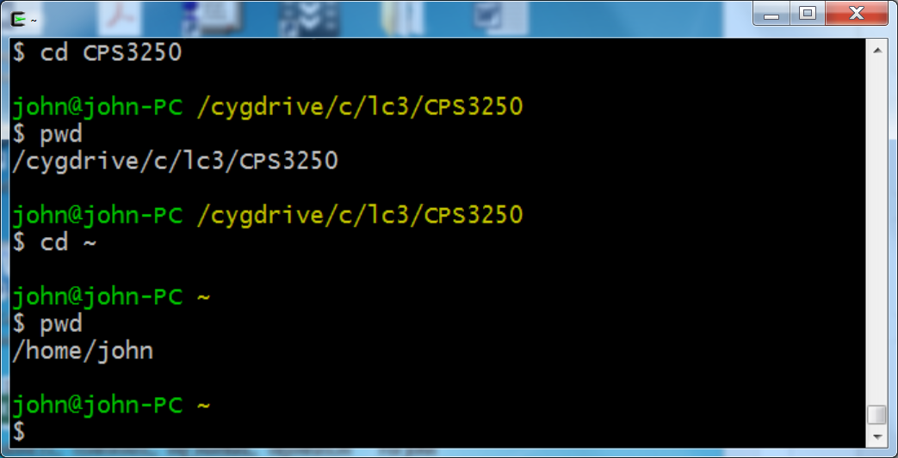
Command: cd
“~” is the location of your home directory

Slide 16
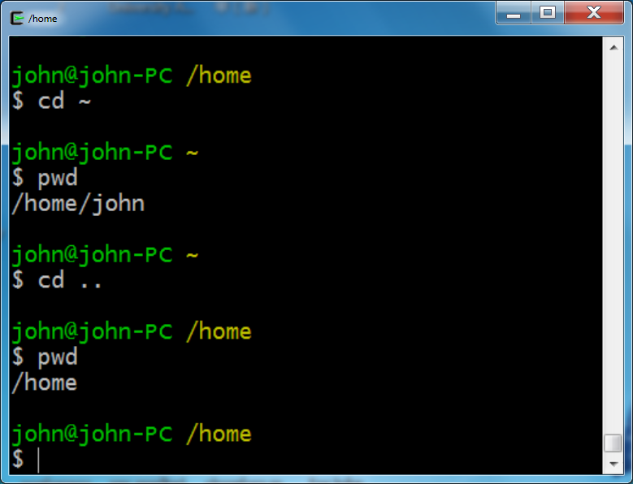
Command: cd
“..” is the location of parent directory

Slide 17
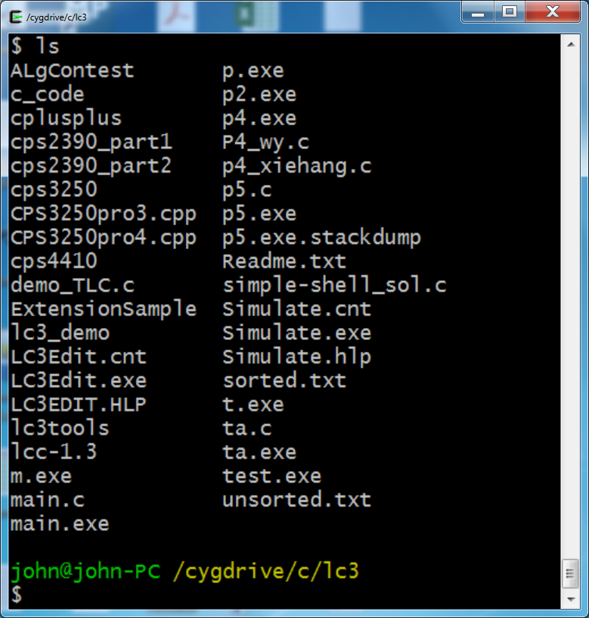
Command: ls
To list the files in the current directory use “ls”

Slide 18
Command: ls
ls has many options
-l lists files and folders with associated permissions
-t sort by modification time, newest first
-S sort by size
-h list file sizes in human readable format
-r reverse the order
-a list all files including the dots and hidden files
-i print the index number (inode) of each file
-F List files and directories, with a forward slash (/) at the end of each directory
“man ls” for more options
Options can be combined: “ls -ltr”

Slide 19
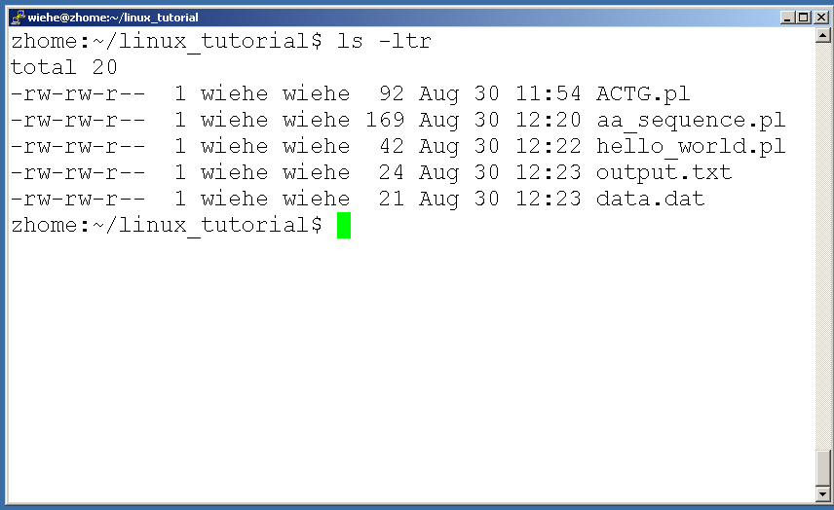
Command: ls -ltr
List files by time in reverse order with long listing

Slide 20
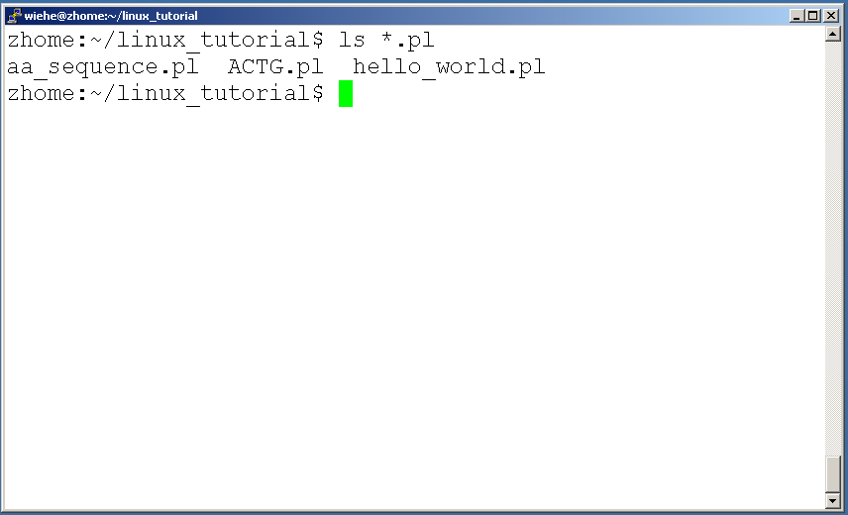
General Syntax: *
“*” can be used as a wildcard in unix/linux

Slide 21
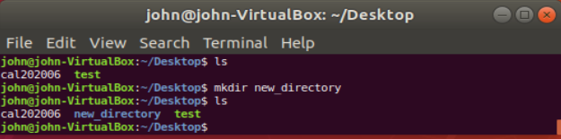
Command: mkdir
To create a new directory use “mkdir”
$mkdir new_directory

Slide 22
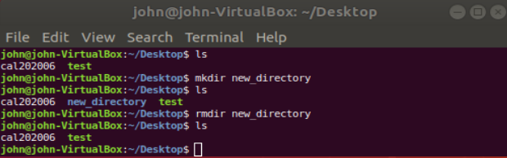
Command: rmdir
To remove and empty directory use “rmdir”
$rmdir new_directory

Slide 23
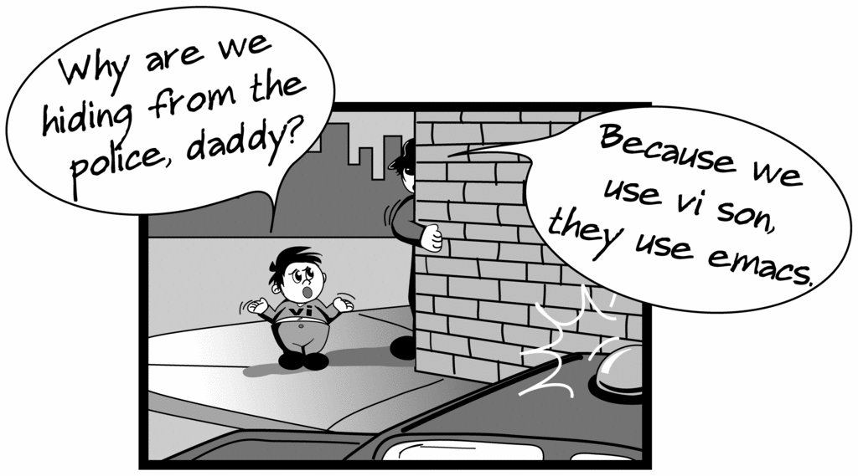
Creating files in Unix/Linux
Requires the use of an Editor
Various Editors:
nano / pico
vi
emacs

Slide 24
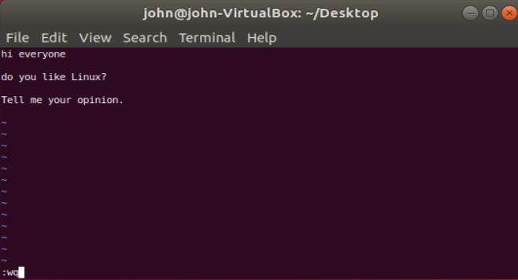
Creating/Editing a file using vi
vi demo
Insert text: type i first to enter insert mode
To save file type :wq

Slide 25
Displaying a file
Various ways to display a file in Unix
cat : shows the contents of a file, all at once
more : shows the contents of a file, screen by screen
less : also shows the contents of a file, screen by screen
head : used to show so many lines form the top of a file
tail : used to show so many lines form the bottom of a file
more filename
cat file1
head filename
tail filename
less filename

Slide 26
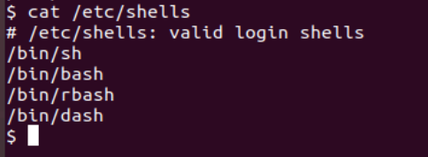
Command: cat
Dumps an entire file to standard output
Good for displaying short, simple files

Slide 27
Command: more
“more” displays a large file contents on the screen
more filename | Display file’s contents on the screen
SAPCEBAR | Advance one screen
ENTER | Advance one line
b | Go back toward the top of the file one screen
/xxx | Go forward to the first target (xxx) and display the page
n | Go to the next target (xxx)
q | Quit more

Slide 28
Command: less
“less” displays a file, allowing forward/backward movement within it
return scrolls forward one line, space one page
y scrolls back one line, b one page
use “/” to search for a string
Press q to quit

Slide 29
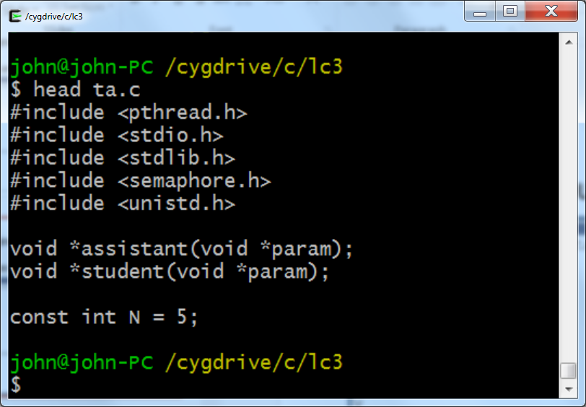
Command: head
“head” displays the top part of a file
By default it shows the first 10 lines
-n option allows you to change that
“head -n50 file.txt” displays the first 50 lines of file.txt
head filename | Display the first 10 lines of filename

Slide 30
File Commands
Copying a file: cp
Move or rename a file: mv
Remove a file: rm
Change file timestamp or create an empty new file: touch
Sort the contents of the file filename: sort
Remove duplicate adjacent lines from filename: uniq
Determine file type: file
sort filename
uniq filename
touch file1
file filename

Slide 31
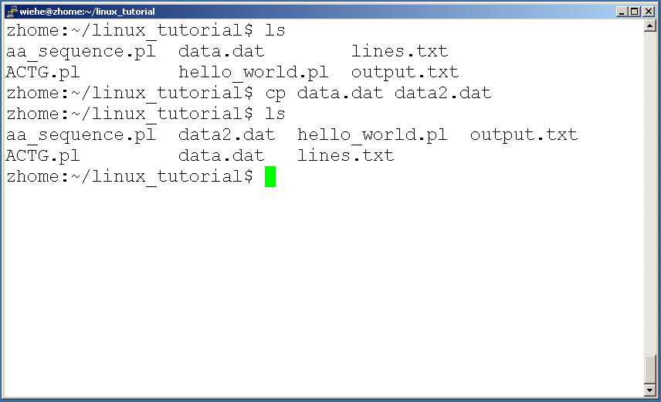
Command: cp
To copy a file use “cp”

Slide 32
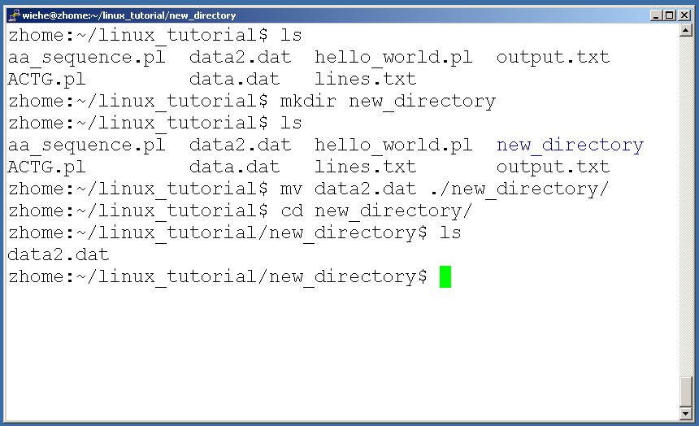
Command: mv
To move a file to a different location use “mv”

Slide 33
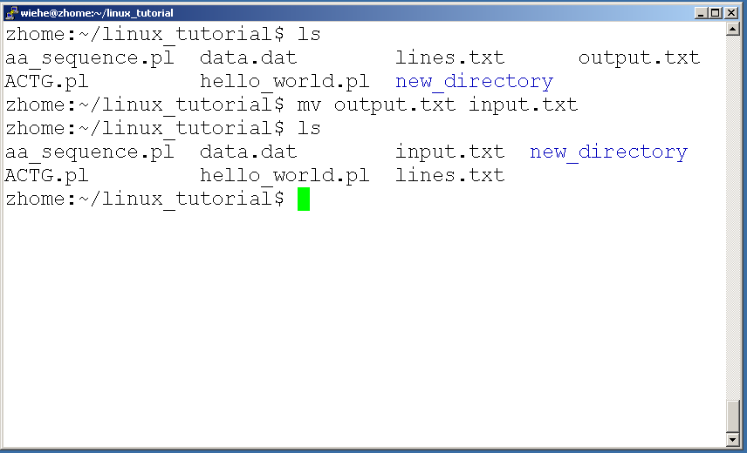
Command: mv
mv can also be used to rename a file

Slide 34
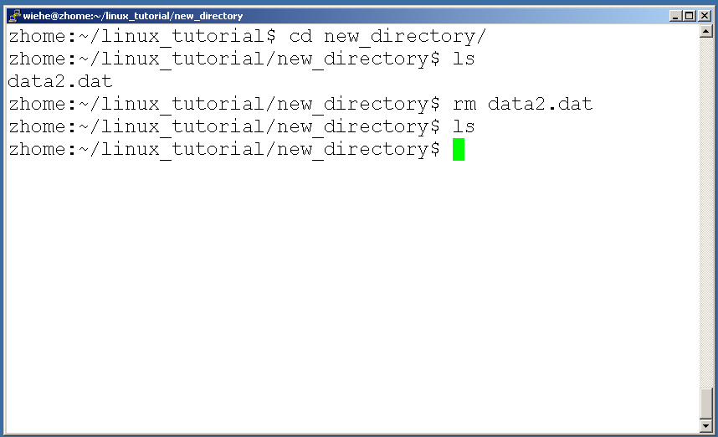
Command: rm
To remove a file use “rm”

Slide 35
Command: rm
To remove a file “recursively”: rm –r
Used to remove all files and directories
Be very careful, deletions are permanent in Unix/Linux

Slide 36
File permissions
Each file in Unix/Linux has an associated permission level
This allows the user to prevent others from reading/writing/executing their files or directories
Use “ls -l filename” to find the permission level of that file

Slide 37
Permission levels
“r” means “read only” permission
“w” means “write” permission
“x” means “execute” permission
In case of directory, “x” grants permission to list directory contents

Slide 38
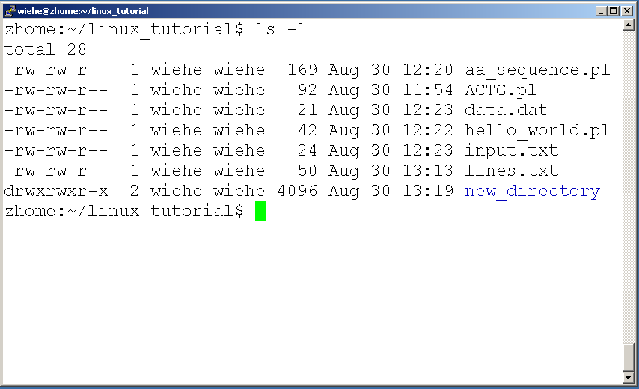
File Permissions
User (you)

Slide 39
File Permissions
Group

Slide 40
File Permissions
“The World”

Slide 41
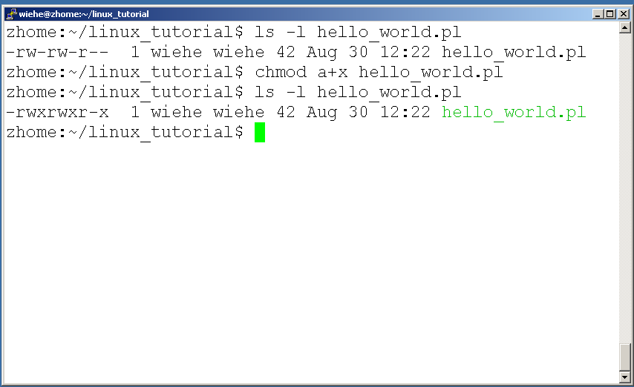
Command: chmod
If you own the file, you can change it’s permissions with “chmod”
Syntax: chmod [user/group/others/all]+[permission] [file(s)]
Below we grant execute permission to all:

Slide 42
Running a program (a.k.a. a job)
Make sure the program has executable permissions
Use “./” to run the program

Slide 43
Running a program (a.k.a. a job)
Make sure the program has executable permissions
Use “./” to run the program

Slide 44
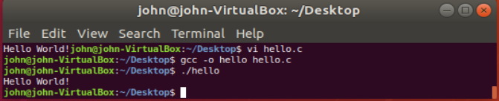
Running a program: an example
Create a sample c file of hello world first using vi
$vi hello.c
Compile it to create an executable code
$gcc –o hello hello.c
Run the file
./hello

Slide 45
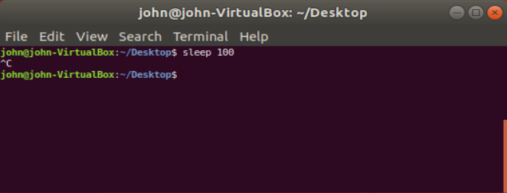
Ending a program
To end a program use “ctrl-c”. To try it:

Slide 46
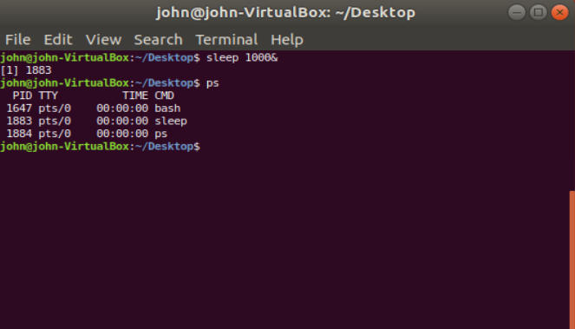
Command: ps
To view the processes that you’re running:
ps | Lists processes that you own
ps –l | Generates a long listing of your processes
ps –f | Outputs a full listing of processes that you own
ps –u login | Lists processes that are owned by the user whose login ID is login
ps –t nn | Lists processes that are associated with the workstation tty
ps –ef | Prints information about all processes
ps –aux | Prints information about all processes

Slide 47
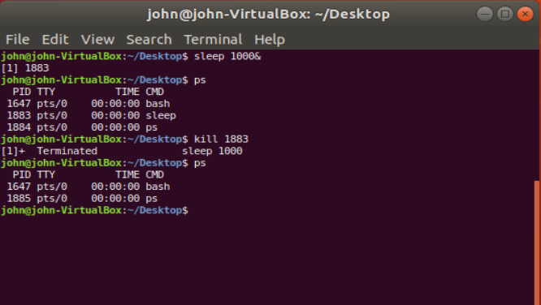
Command: kill
To terminate a process use “kill”
$kill pid
kill PID | Terminates a process by sending a software terminate signal
kill -1 PID | Hangs up communication links to a process
kill -2 PID | Ends a process by sending a process interrupt signal
kill -3 PID | Brings a process to a conclusion by issuing a process quit signal
kill -6 PID | Instructs a process to end by issuing the Abort Process signal
kill -15 PID | Instructs a process to end by issuing the software termination signal
kill -9 PID | Kills a process.

Slide 48
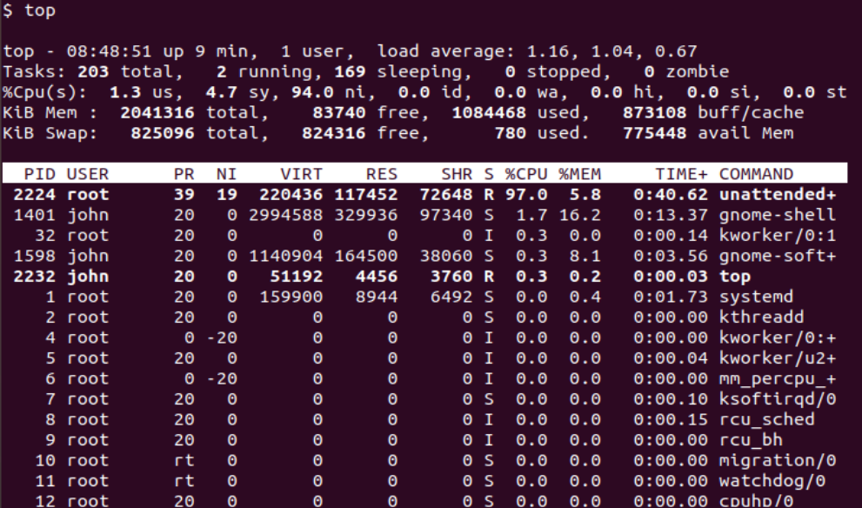
Command: top
To view the CPU usage of all processes:

Slide 49
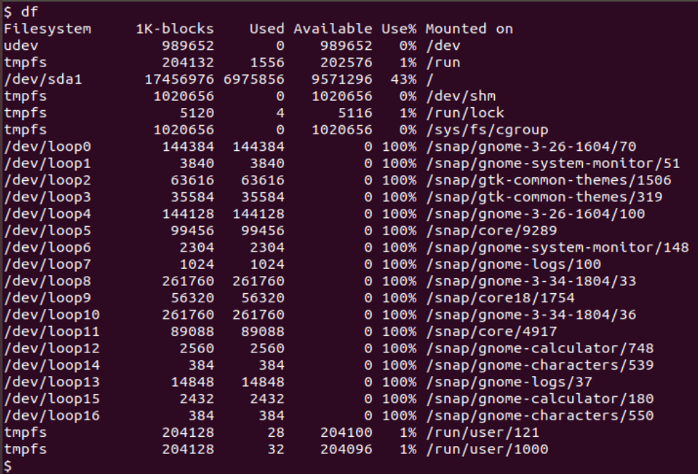
Command: df
To check the disk usage info use “df”

Slide 50
Input/Output Redirection(“piping”)
Programs can output to other programs
Called “piping”
“program_a | program_b”
program_a’s output becomes program_b’s input
“program_a > file.txt”
program_a’s output is written to a file called “file.txt”
“program_a < input.txt”
program_a gets its input from a file called “input.txt”
utility > filename | Send the output of the utility to the filename
utility >> filename | Append the output of the utility to the filename
utility1 | utility2 | Make the output of utility1 the input of utility2

Slide 51
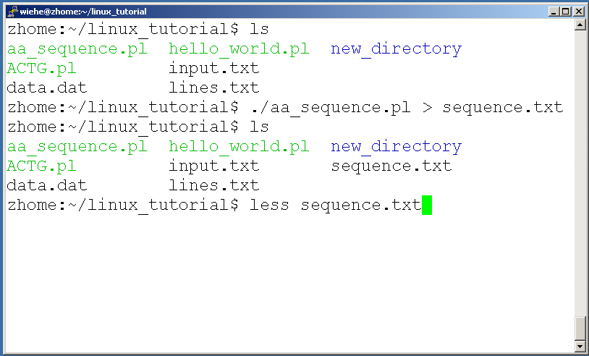
A few examples of piping

Slide 52
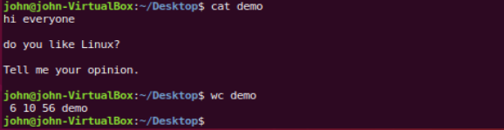
Command: wc
To count the characters, words, and lines in a file use “wc”
The first column in the output is lines, the second is words, and the last is characters
wc filename | Count the lines, words, characters in filename
wc –l filename | Count the lines in filename, including empty lines
wc –c filename | Count the characters in filename
wc –w filename | Count the words in filename

Slide 53
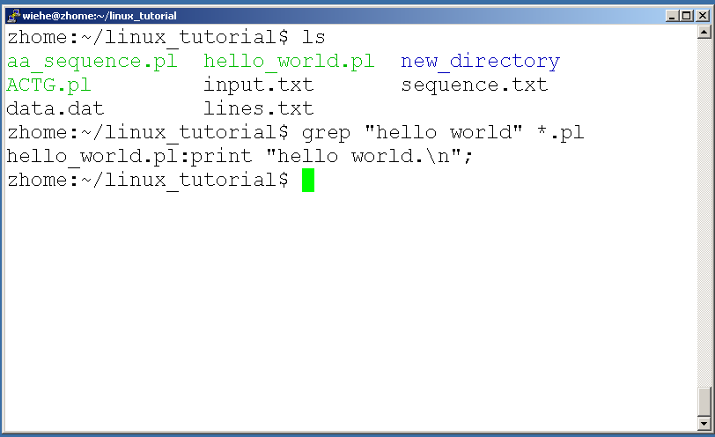
Command: grep
To search files in a directory for a specific string use “grep”
grep word filename | Search for lines containing a particular word (or pattern) in filename

Slide 54
Command: diff
To compare to files for differences use “diff”
Try: diff /dev/null hello.txt
/dev/null is a special address -- it is always empty, and anything moved there is deleted
diff file1 file2 | Show lines that are different in each file and how to modify the first file to match the second file.

Slide 55
Command: comm
To compare two files use “comm”
comm file1 file2 | Compare file1 and file2 and show the lines common and unique in each of two files

Slide 56
ssh, scp
ssh is used to securely log in to remote systems, successor to telnet
ssh [username]@[hostname]
Try:
ssh yourusername@localhost
Type “exit” to log out of session
scp is used to copy files to/from remote systems, syntax is similar to cp:
scp [local path] [usernme]@[hostname]:[remote file path]
Try:
scp hello.txt yourusername@localhost:scp-test.txt

Slide 57
Unix Web Resources
http://www.ee.surrey.ac.uk/Teaching/Unix/
http://www.ugu.com/sui/ugu/show?help.beginners
http://en.wikipedia.org/wiki/Unix

