Slide 1
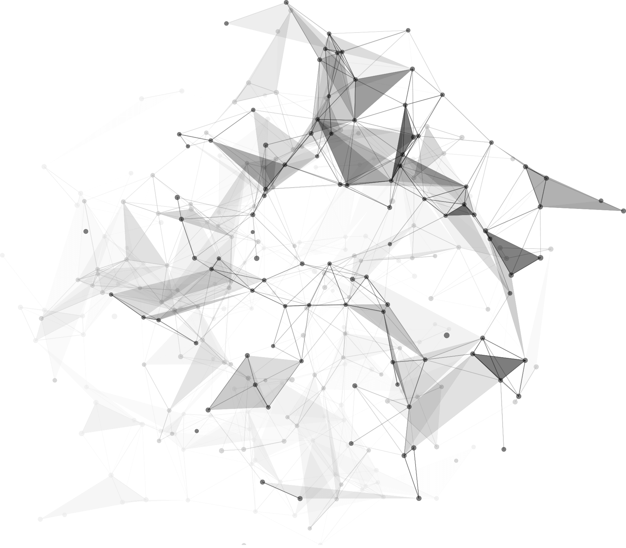
Applying blockchain technology in the lottery field
Reporter :
1930026026 Franklin
1930026155 Marco
1930026143 Jackaa

Slide 2
https://www.ypppt.com/
1
Part 01
Theoretical Foundation

Slide 3
01
Rules
Administrator included
Waiting
Fixed lottery ticket price
Bet multiple times
Bet within the specified time

Slide 4
01
Rules
Refund
Waiting
Game Round Increasement
Randomly Generated Result
Proportionally separate prize

Slide 5
01
Blockchain basics
Decentralization
ensure data integrity without relying on a central authority
Data
Blockchain technology stores data in the form of block.
Chain-like Structure
Adding new blocks
each block is connected to the previous block
After insertion of new block, they are not allowed to be modified

Slide 6
02
Ethereum basics
Computing Resources Requried
Ethereum Virtual Machine
understand and execute software written in a specific programming language on Ethereum
Smart Contract
allow trusted transactions without third parties, which are traceable and irreversible

Slide 7
02
Ethereum basics
Solidity IDE
a powerful open source tool that helps us write Solidity contracts straight from the browser
Gas
Ethereum relies heavily on the hashing efficiency of miners, which means that more miners, more hashing efficiency

Slide 8
https://www.ypppt.com/
2
Part 02
Description of the business application

Slide 9
01
Application area / short comings
Cannot avoid collusion
Sealed data
Lack of transparency
No way to resist a denial
server be hacked

Slide 10
02
How can BC technology be used to solve such problems?
encryption technology
Smart contracts & decentralized
Transparent & open-sourced

Slide 11
03
Why can blockchain technology be used to solve the problem? What are its benefits?
Improves fairness
More difficult to tamper
Reduce expense

Slide 12
3
Part 3
Methodology

Slide 13
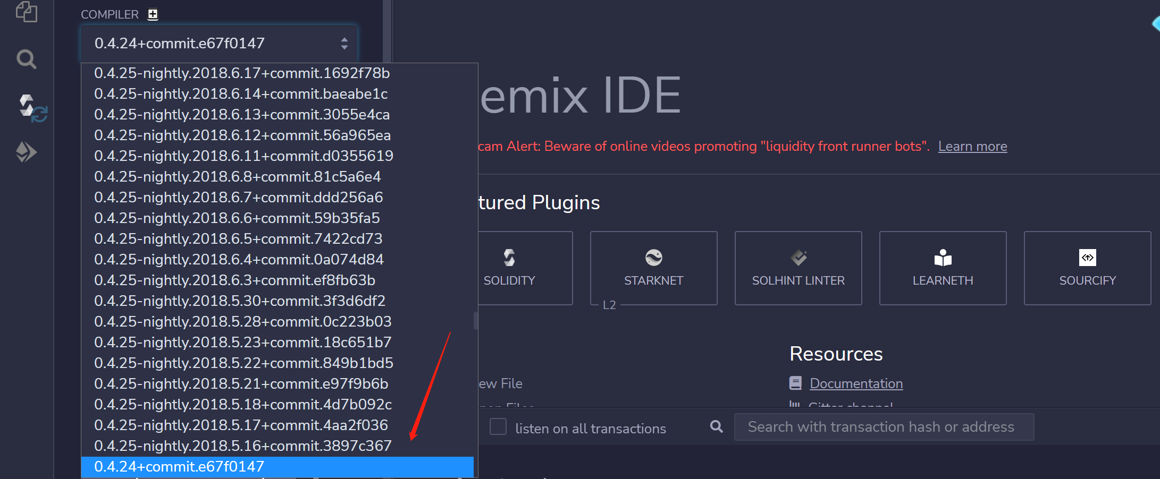
03
Based Setting
Environment： Solidity ^0.4.24

Slide 14
03
Function and Modifier
Modifier
Draw (Only Manager)
The two methods of withdrawal and lottery can only be used by the manager.
Draw the lottery and get the winner address of the lottery who will obtain 90% of the pooling.
Play
People participate the lottery and only bet 1 Ethereum at a time.
Refund (Only Manager)
Return back the charge to the players and empty the players pool.

Slide 15
4
Part 04
Implement and Result

Slide 16
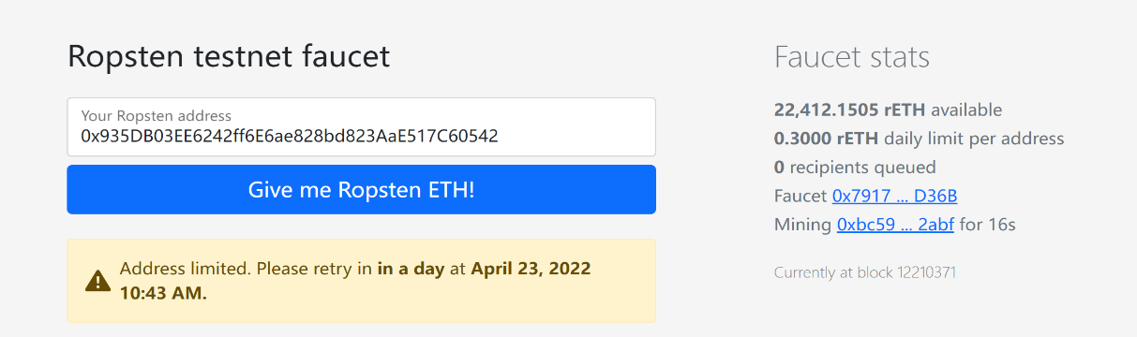
03
Implement
Get the coin from faucets
$https://faucet.egorfine.com$
2. $https://faucet.metamask/io$

Slide 17
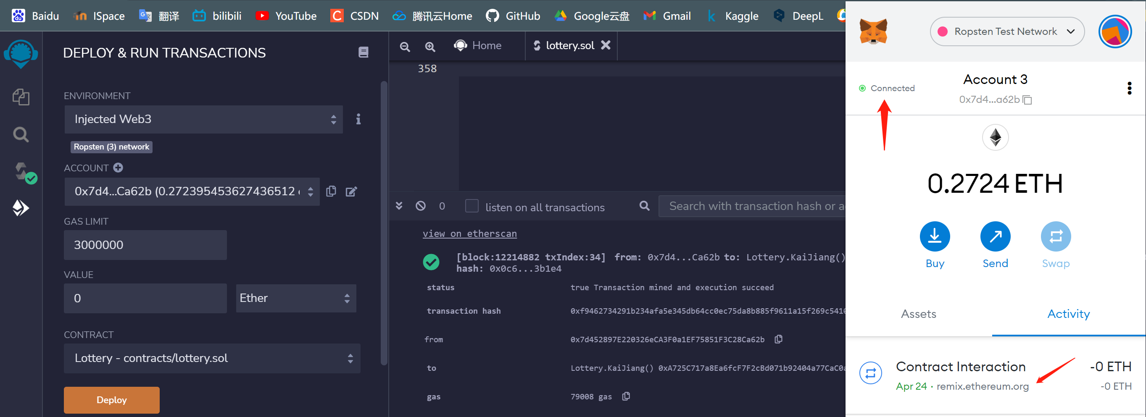
03
Implement
Connect the $Ropsten$ $testnet$ and $remix$

Slide 18
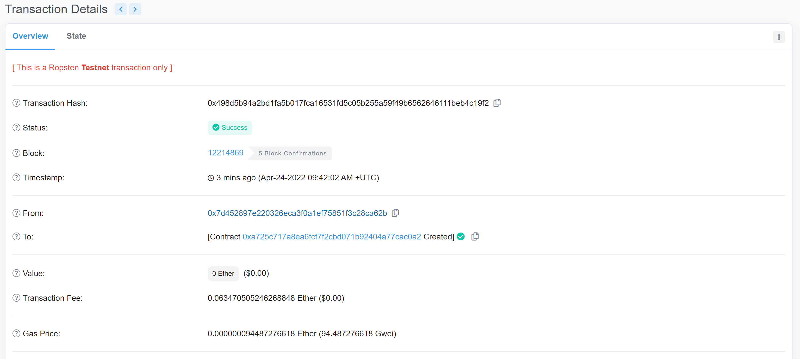
03
Implement
Compile and deploy the contract
Deployer address
Contract address

Slide 19
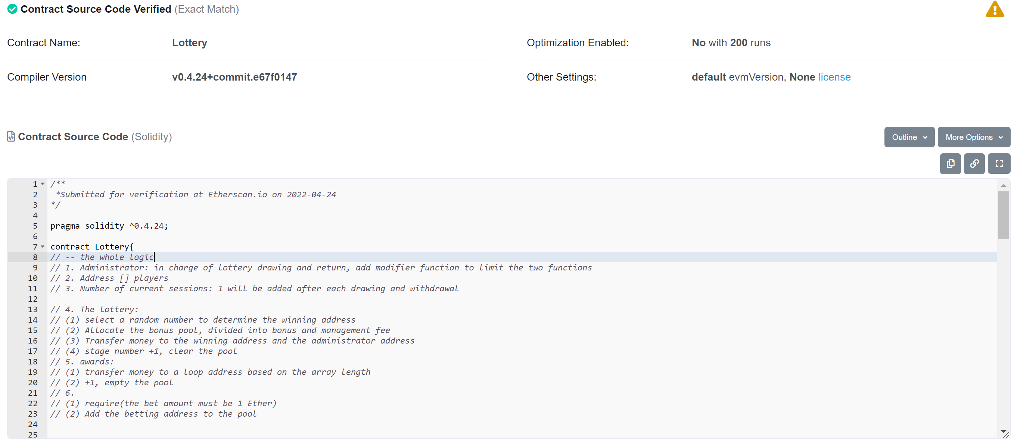
03
Implement
Verify the contract
Deployer address
Contract address

Slide 20
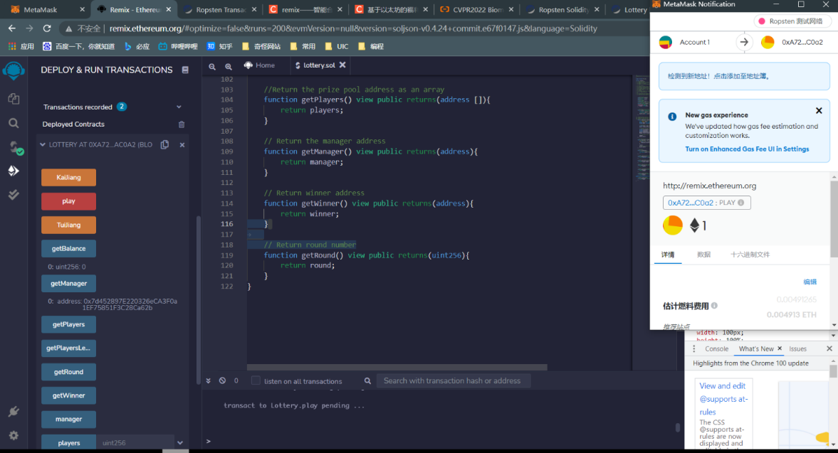
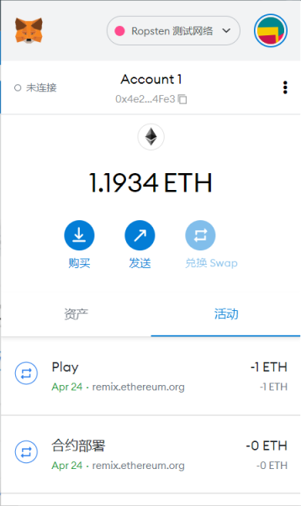
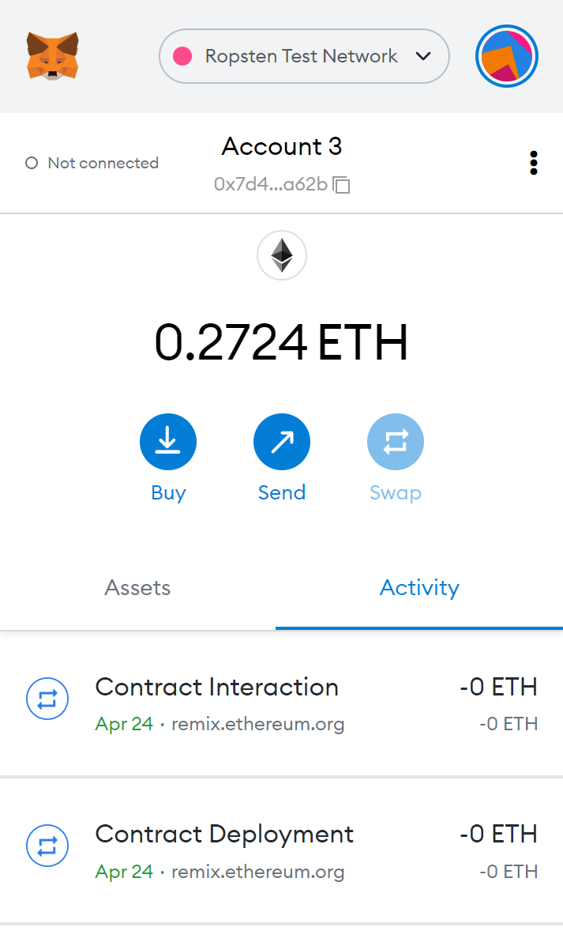
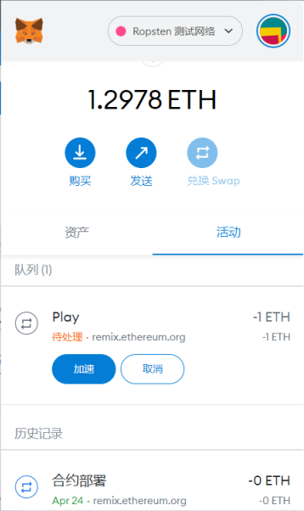
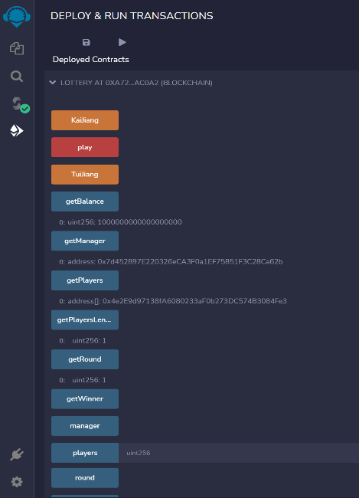
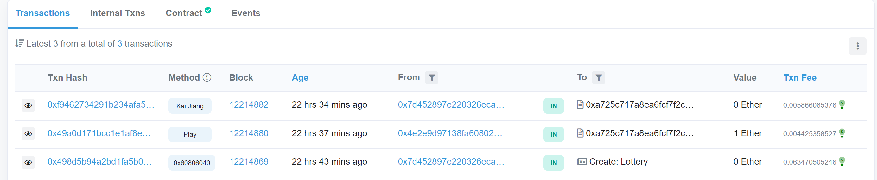
03
Implement
Implement
Transfer and show the change
Balance change of player and manager
Check the transaction information
Call the deployed contract and use function
https://ropsten.etherscan.io/address/0xa725c717a8ea6fcf7f2cbd071b92404a77cac0a2

