Slide 1
AlgoSchool

Slide 2
A GOOD NEWS

Slide 3
A GOOD NEWS
&
A BAD NEWS

Slide 4
The “GOOD NEWS”

Slide 5
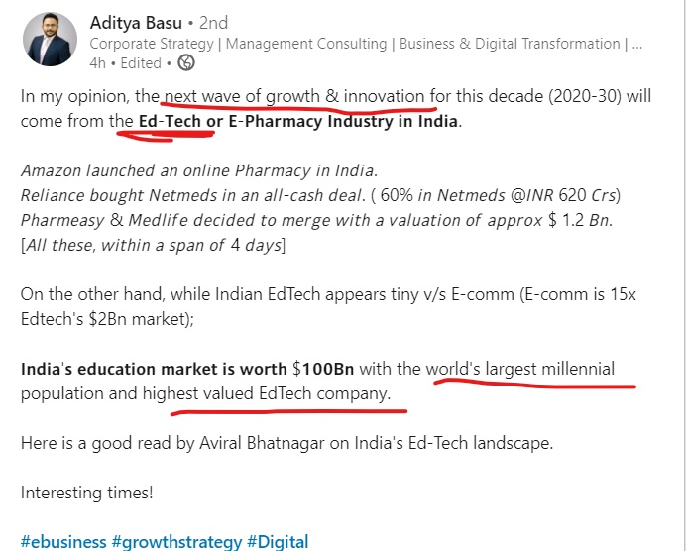
The “GOOD NEWS”

Slide 6
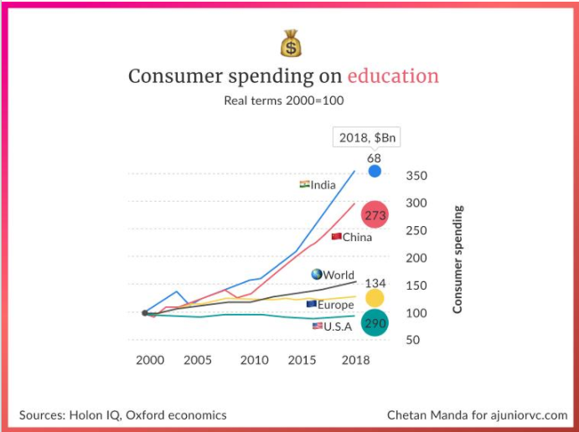
The “GOOD NEWS”

Slide 7

The “GOOD NEWS”

Slide 8
bad news

Slide 9
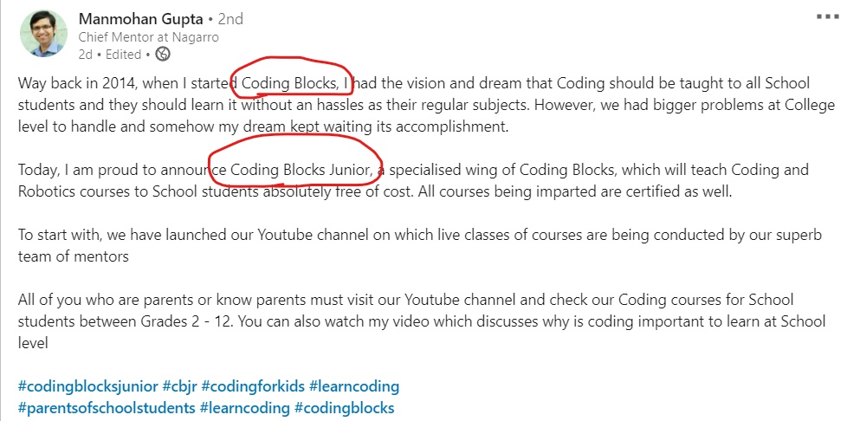
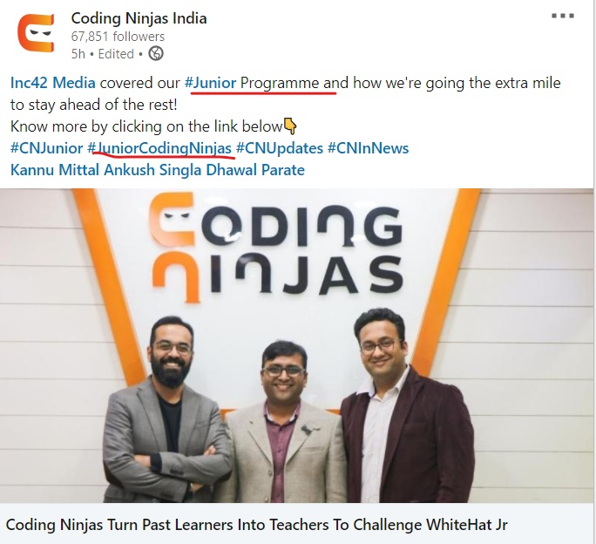
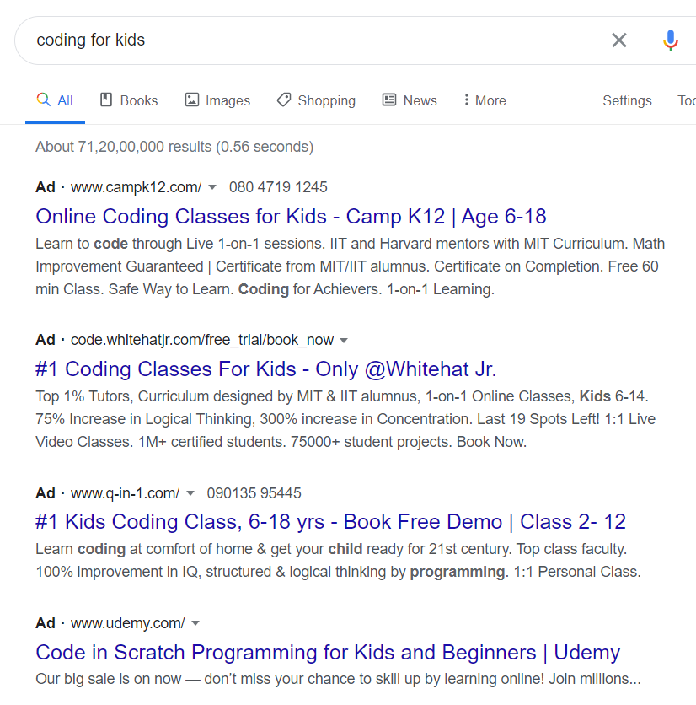
bad news

Slide 10
Competitions from the Big Fishes

Slide 11
Inexperience
Resources

Slide 12
Competitive market
Inexperience
Lack of Resources

Slide 13
SOLUTIONS

Slide 14
Competitive Market

Slide 15
Competitive Market
SOLUTION:
“We cannot lose, if we don’t take part in the competition” (well at least in the beginning)

Slide 16
Differentiating Factors:

Slide 17
Differentiating Factors:
Tutorial at low prices
Special emphasis on DSA and developing problem skills of students
Offering Special Math course

Slide 18
Differentiating Factors:
Tutorial at low prices
Special emphasis on DSA and developing problem skills of students
Offering Special Math course
To provide coding facility to underpriviliged sections of the society:
Coding culture in villages of India
Making coding classes accesible to poorer sections of society
Empowering Girl Child through the means of programming

Slide 19
Differentiating Factors:
Tutorial at low prices
Special emphasis on DSA and developing problem skills of students
Offering Special Math course
To provide coding facility to underpriviliged sections of the society:
Coding culture in villages of India
Making coding classes accesible to poorer sections of society
Empowering Girl Child through the means of programming
Northeast – The latent market

Slide 20
Differentiating Factors:
Students are our consumers
Students are our products
We have to serve the students as our own siblings
Student-Teacher Interaction (very very crucial)
Student’s opinions

Slide 21
MOTTO
Students are our consumers
Students are our products
We have to serve the students as our own siblings

Slide 22
CONCRETE OBJECTIVES / GOALS :
Certification
Preparing students for olympiads, eg. IOI, ZCO, etc.
Making students aware of the global problems and oppurtunities (instilling problem solver quality in them)
Making students aware of the new technologies

Slide 23
Inexperience

Slide 24
Inexperience
SOLUTION:
Naivity is helpful (because we are not worried)
Intuition (Logically connecting the dots)
The First Principles (Ethics, Morals)

Slide 25
Resources

Slide 26
Resources
Capital – isn’t a big factor right now
Manpower – Hiring has to be done actively (eg. CPers from NITS)
Need for Developer lead

Slide 27
Competitive market : Diff Factors
Inexperience : No issue
Lack of Resources : Will manage with time

Slide 28
SUMMARY
Competitive market : Diff Factors
Inexperience : No issue
Lack of Resources : Will manage with time

Slide 29
Technicalities / Implementation

