Slide 1

Attitudes to Cohabitation and Marriage

Slide 2
Divorce Statistics
The average total cost of divorce in the United States is $15,000.
Families with children that were not poor before the divorce see their income drop as much as 50 percent.
One researcher determined that a single divorce costs state and federal governments about $30,000, based on such things as the higher use of food stamps and public housing as well as increased bankruptcies and juvenile delinquency.
A new study entitled “Divorce and Death” shows that broken marriages can kill at the same rate as smoking cigarettes. Indications that the risk of dying is a full 23 percent higher among divorcées than married people.
If a close friend gets divorced, you are 147% more likely to become divorced and 33% more likely if a friend of a friend is divorced.
- Wilkinson & Finkbeiner Family Law Attorneys

Slide 3
Goals of the model
Find out what factors are likely to indicate an individual being married or divorced
Ideally, we find out which attitudes towards marriage, cohabitation, family, are predictive of divorce – and that these are attitudes that can be changed

Slide 4
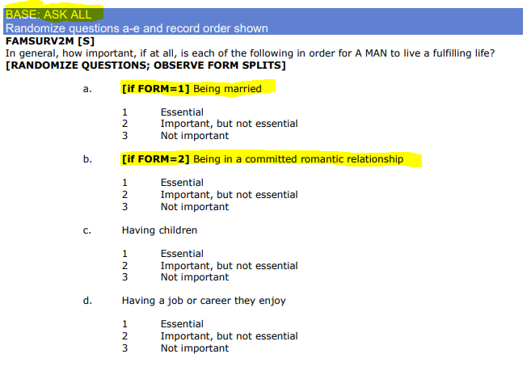
The Data
9834 Observations of 169 Questions
Questions range from attitudes on fulfillment, current life satisfaction, child rearing, ideal marriage / family structure, etc.
Part of / Entire Questions have dependencies on past questions, (ex: asking married participants how long they have been married but not asking if divorce or separated)

Slide 5
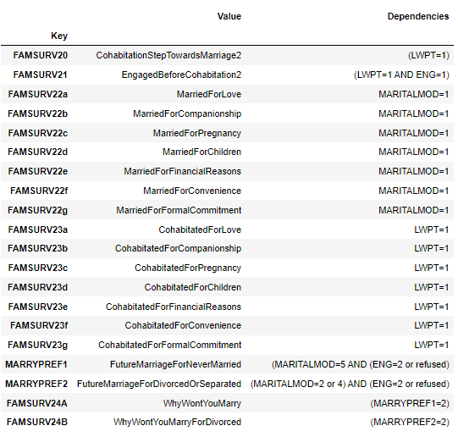
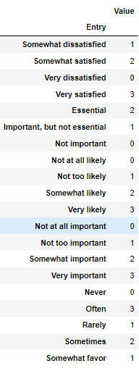
The Data
Split into Forms 1 and 2 - Marriage and Cohabitation
Raw features had in descriptive names that are converted to descriptive ones by a csv file.
Responses to questions are either turned into numeric or turned into shorter strings via a reference file.
Some questions are practically the same but just reworded for a different dependency.
These sorts of questions were merged into one column so they could be used in comparisons and modeling.

Slide 6
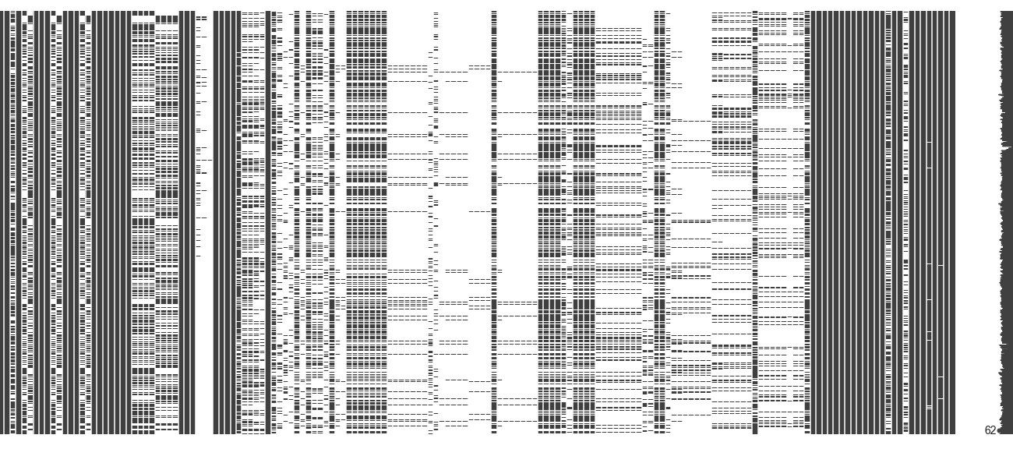
Missing values

Slide 7
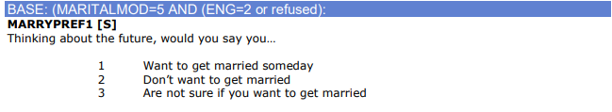
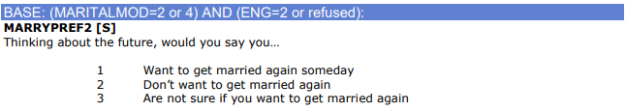
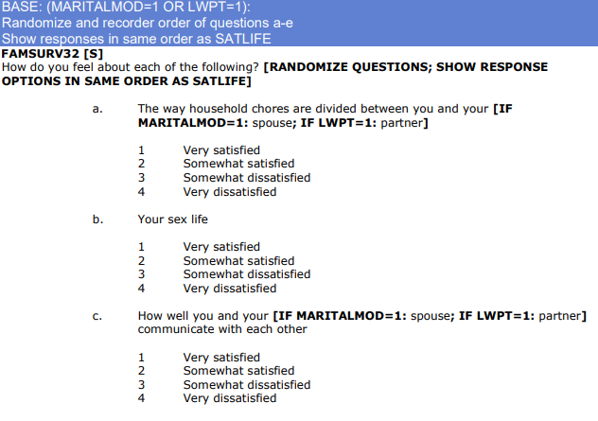
Missed Opportunities & Obvious Answers
Married and cohabitating couples are asked about their motivations on deciding to marry or move in together
Participants were also asked how much they trusted their partners and relationship specific satisfaction levels
Divorced, separated, and widowed participants are not asked about their experience with their former spouse(s)
All data was recorded AFTER a participant was divorced with no data from their married life and some features (namely income and satisfaction scores) will may be the way they are BECAUSE of the divorce

Slide 8
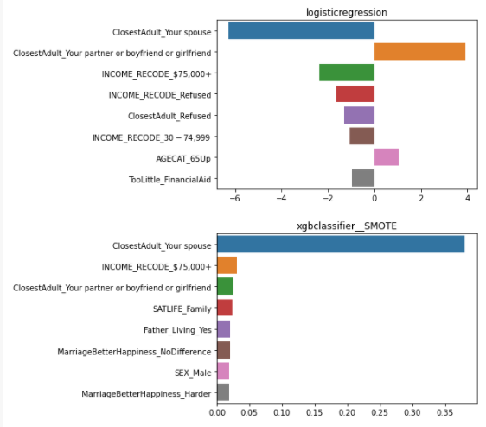
Missed Opportunities & Obvious Answers
Married and cohabitating couples are asked about their motivations on deciding to marry or move in together
Participants were also asked how much they trusted their partners and relationship specific satisfaction levels
Divorced, separated, and widowed participants are not asked about their experience with their former spouse(s)
All data was recorded AFTER a participant was divorced with no data from their married life and some features (namely income and satisfaction scores) will may be the way they are BECAUSE of the divorce

Slide 9
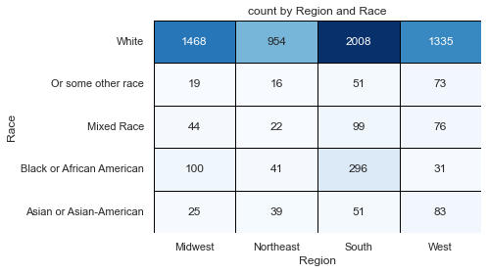

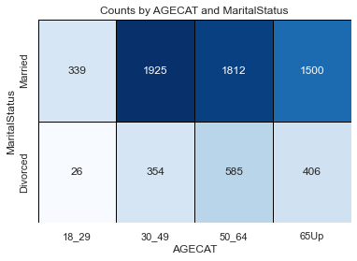
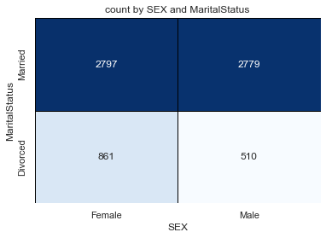
Simple Analysis
Divorces make up around 20% on the samples.
Not as many marriages and divorces for participants under 30
More female participants than males
Most of the participants where white, with a spread across the US

Slide 10
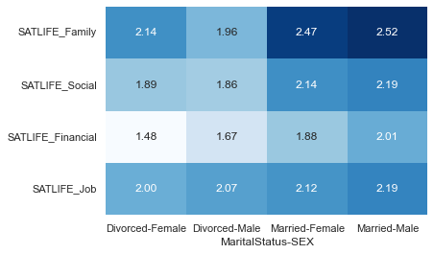
Life Satisfaction
Overall married couple are more satisfied with their lives in the surveyed categories
Marital Status doesn’t affect Job Satisfaction as much as other categories
Women have higher scores in their Family life satisfaction in the divorced group compared to men but have much lower financial satisfaction.

Slide 11
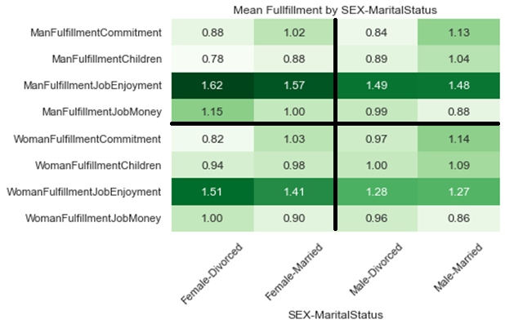
Fulfillment
Women tend to think of men as more fulfilled with career and money over companionship and children compared to how men rate their needs, and vise versa.
There appears to be at least some traditional thinking around genders effecting the thinking of both sexes.
Married participants in both genders valued commitment and children more than divorcees.
Divorcees value money more but divorced men’s attitude towards the importance of job enjoyment isn’t as large as it is in women.

Slide 12
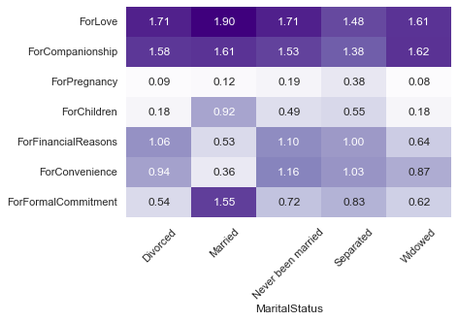
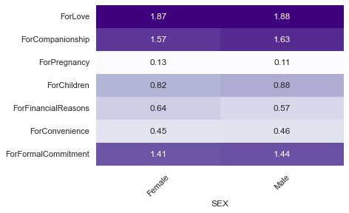
Motivations for Marriage vs Cohabitation
Cohabitation is more a matter of convenience and financial reasons then their married counterparts
Divorcees’ reasons for cohabitating are not significantly different from those with no marriage experience.
Reasons behind marriage are stronger in love, children, and making a formal commitment
Reasons for marrying and cohabitating for love and companionship are about the same across age groups
Marrying and cohabitating for financial and convenience are mainly reasons for participants under 30

Slide 13
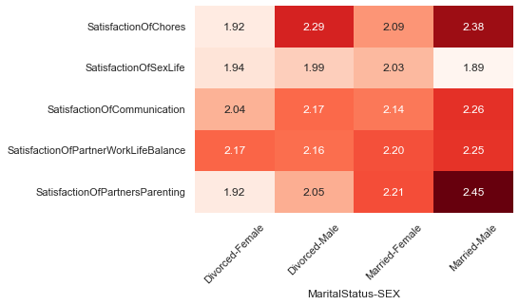
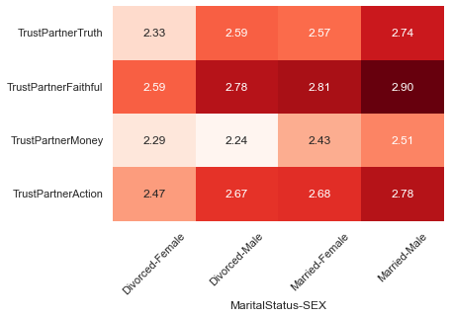
Satisfaction and Trust
Overall, married participants trust their partners more and are more satisfied
Work-Life Balance is consistent across the board, consistent with overall job satisfaction
Married men have the lowest Sex life satisfaction but the highest satisfaction with how their partners parent their children
Divorced males trust their partners the least with money
Trust scores are overall lower in divorced women, and highest in married men

Slide 14
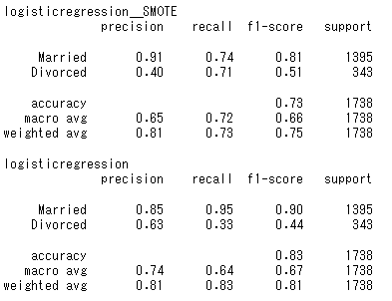
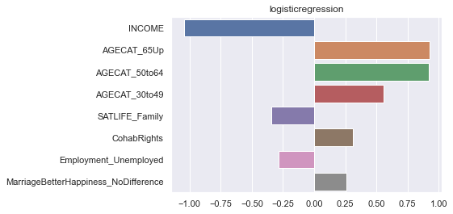
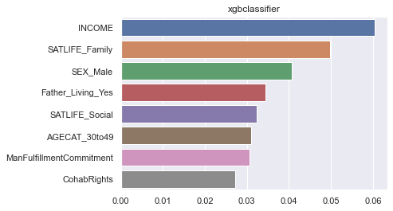
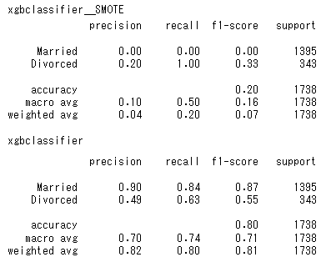
Modeling Overview
XGBOOST and Logistic Regression with 5-fold Cross validation using BayesSearchCV
Mathews correlation coefficient was chosen as the target parameter for detecting the minority class (Divorced)
SMOTE was tried on both models but caused a XGBOOST to simply guess everyone was Divorced.
Income and age were strong predictors in both models.
XGBOOST had better performance and produced more actionable results.

Slide 15

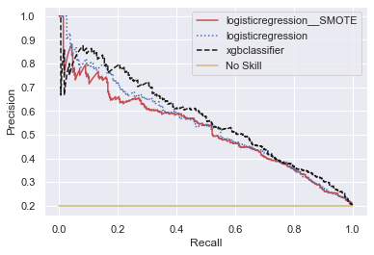
Modeling Overview
XGBOOST and Logistic Regression with 5-fold Cross validation using BayesSearchCV
Mathews correlation coefficient was chosen as the target parameter for detecting the minority class (Divorced)
SMOTE was tried on both models but caused a XGBOOST to simply guess everyone was Divorced.
Income and age were strong predictors in both models.
XGBOOST had better performance and produced more actionable results.

Slide 16
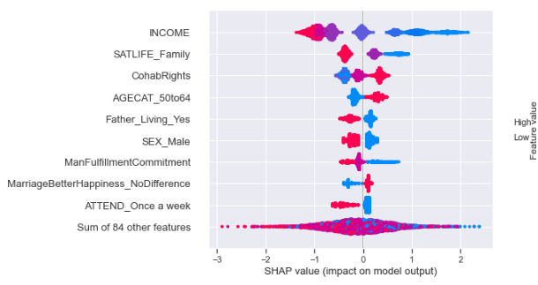
Modeling Overview
Lower income was predictive of divorce
Satisfaction in one’s family life was predictive of being married
Divorcees unsurprisingly did not think that Marriage made people happier
Divorcees supported the same legal rights as married couples

Slide 17
Conclusion & Improvements
XGBOOST performed the best overall and with the most actionable features explained
Some features are more actionable than others
Ultimately would be better with more Data
Missing information on the opinions of divorcees pre-divorce.
Questions that coupled have been asked to divorcees (that were asked to married only):
Motivations for getting married previously
Did you cohabitate prior to your previous marriage
Did you feel pressured to get married
Satisfaction/Trust in your previous marriage
It takes two to tango
Observations in the data set are of individuals, not couples
Relationship dynamics would likely be more predictive than opinions about companionship
The ground truth of the target feature can change
Married individuals can get divorced down the line
Divorced individuals can remarry

Slide 18
Possible applications
Engaged couples can fill out surveys with the most predictive features to assess their risk of divorce
Recommending counseling or therapy for couples or individuals

