Slide 1
Sprint 5 Presentation
Justin Moos, Jim Kino, Jacob Madison

Slide 2
Sprint Objectives
Objectives
  Get the website working to 90% of functionality
Key Goals
  Start hosting the website
  Implement File storage/databases
  Implement Data visualization
Connection to Overall Vision
  These objectives will allow us to finish creating the website so our client can start giving feedback

Slide 3
Feature Implementation and Demonstration
Website Hosting
  Start hosting the website so our client can access it
  Jacob set up the website using Cloudflare Pages as the host
Implement File storage/databases
  Allows uploaded files and annotations to be stored on the website
  Jim and Jacob worked together to implement file storage and databases
Implement Data visualization
  Ability to visualize analysis of data
  Justin worked on creating a word cloud and other options for the data visualization

Slide 4
Deployment of System and Feedback
Deployment:
  Live website: https://cpts-421-project-eng-data.pages.dev/dashboard
  Papers and annotations saved in a cloud database
  Redactor app for Windows and Mac
Platform and Process
  Cloudflare Pages + D1 SQLite database (free, cloud)
  Push to GitHub → auto build → live in about 1 minute
  GitHub Actions builds the redactor installers
User Testing
  Full workflow tested on the live site

Slide 5
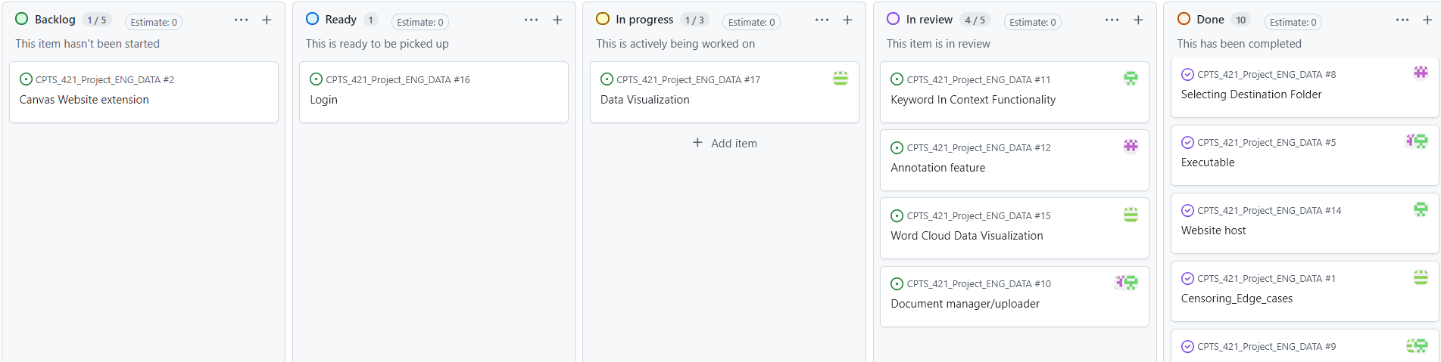
Kanban Board and Team Contributions
Justin: Data Visualization and Word Cloud Visualization
Jacob: Website Hosting and Document Manager
Jim: Document Manager

Slide 6
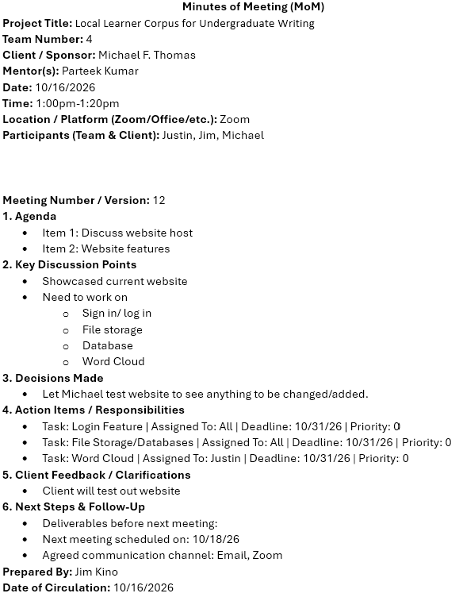
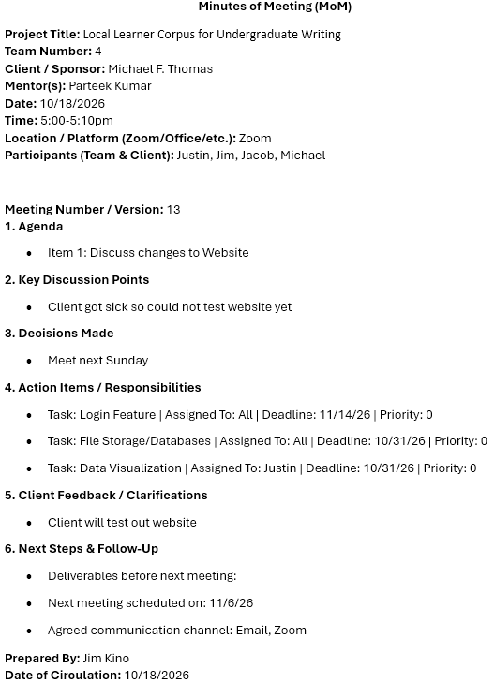
Meeting of Minutes

Slide 7
Documentation of Report
Updated Report to new Final Report layout
  Rearranging the contents to new layout
  Updating old information to new information
  Revising certain sections such as the Introduction, Design, etc.
  Adding more figures of the more complete UI and features

Slide 8
Responsible Use of AI
AI Usage & Impact
  GenAI tools such as Claude Code, ChatGPT, and Gemini were used during this sprint. These tools helped with:
    Coding
    Debugging
    Documentation
    Increasing our productivity and output
There may have been minor errors that the AI made but that could have been due to the way we prompted, so the fixes were easy to implement

Slide 9
Sprint Achievements and Challenges
Sprint Goals Reached
Website hosting: Website is currently hosted on Cloudflare.
File Upload: files are currently able to be stored and deleted on the site
Data visualization: Can now have multiple search queries and updated the visuals to the word cloud.
Incomplete goals
Login Feature: Currently there is no login feature implemented for use.
Challenges
File storage: Had to find a different method of storage besides Cloudflare and OneDrive and it took some time to find something that would work. Instead of finding a storage option we upload directly to the database.
Meetings: We ended up running into availability issues as our client had gotten sick.
Data Visualization: When updating the visualization, we ran into the issue of how things should appear for users and plan on talking with our client more on what we can improve upon.

Slide 10
Next Steps and Sprint Retrospective
Upcoming tasks:
  Login page
  Improve ease of use of the website (organization and UI)
  Data visualization improvements
Sprint retrospective:
  Website is up and running
  Database is linked to the website and functioning
  Website is almost fully complete

Slide 11
Thank You

