Slide 1
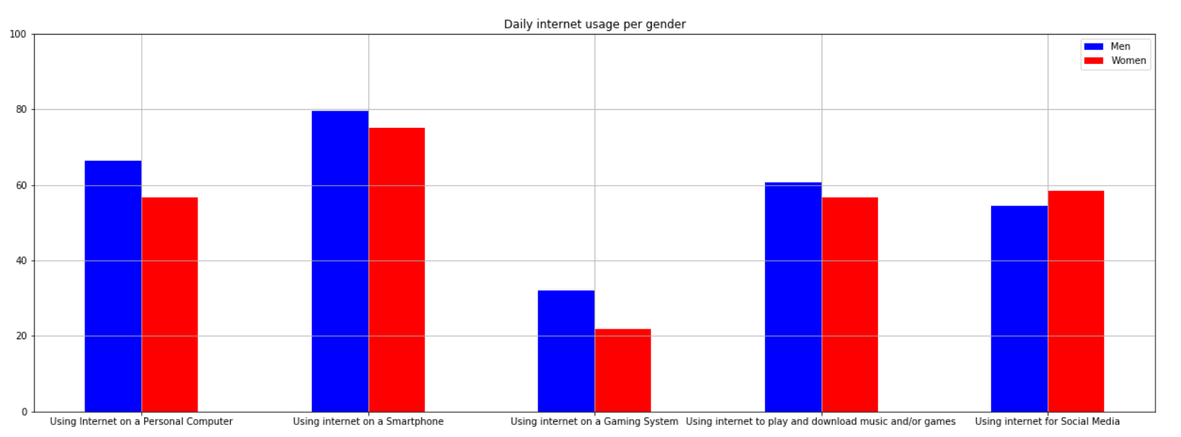
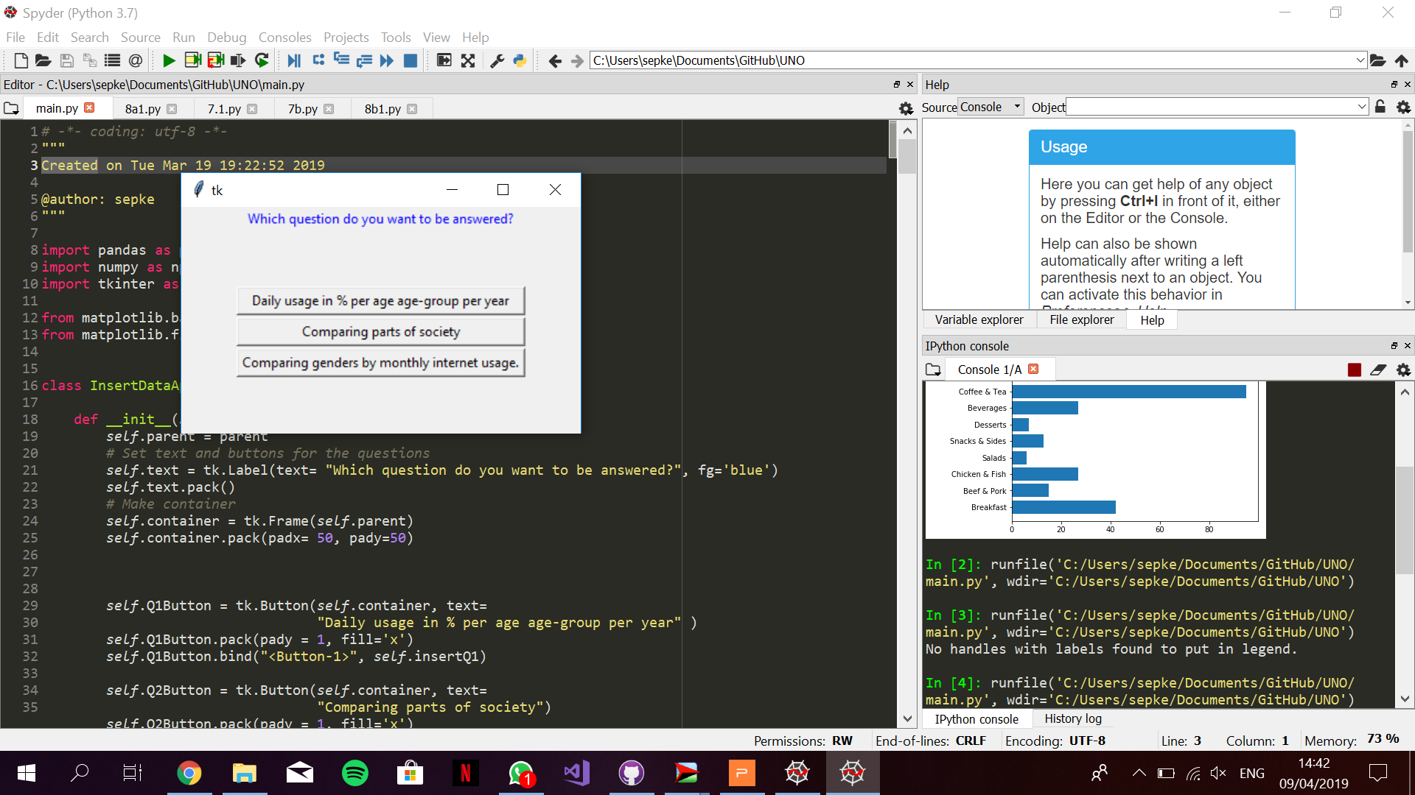
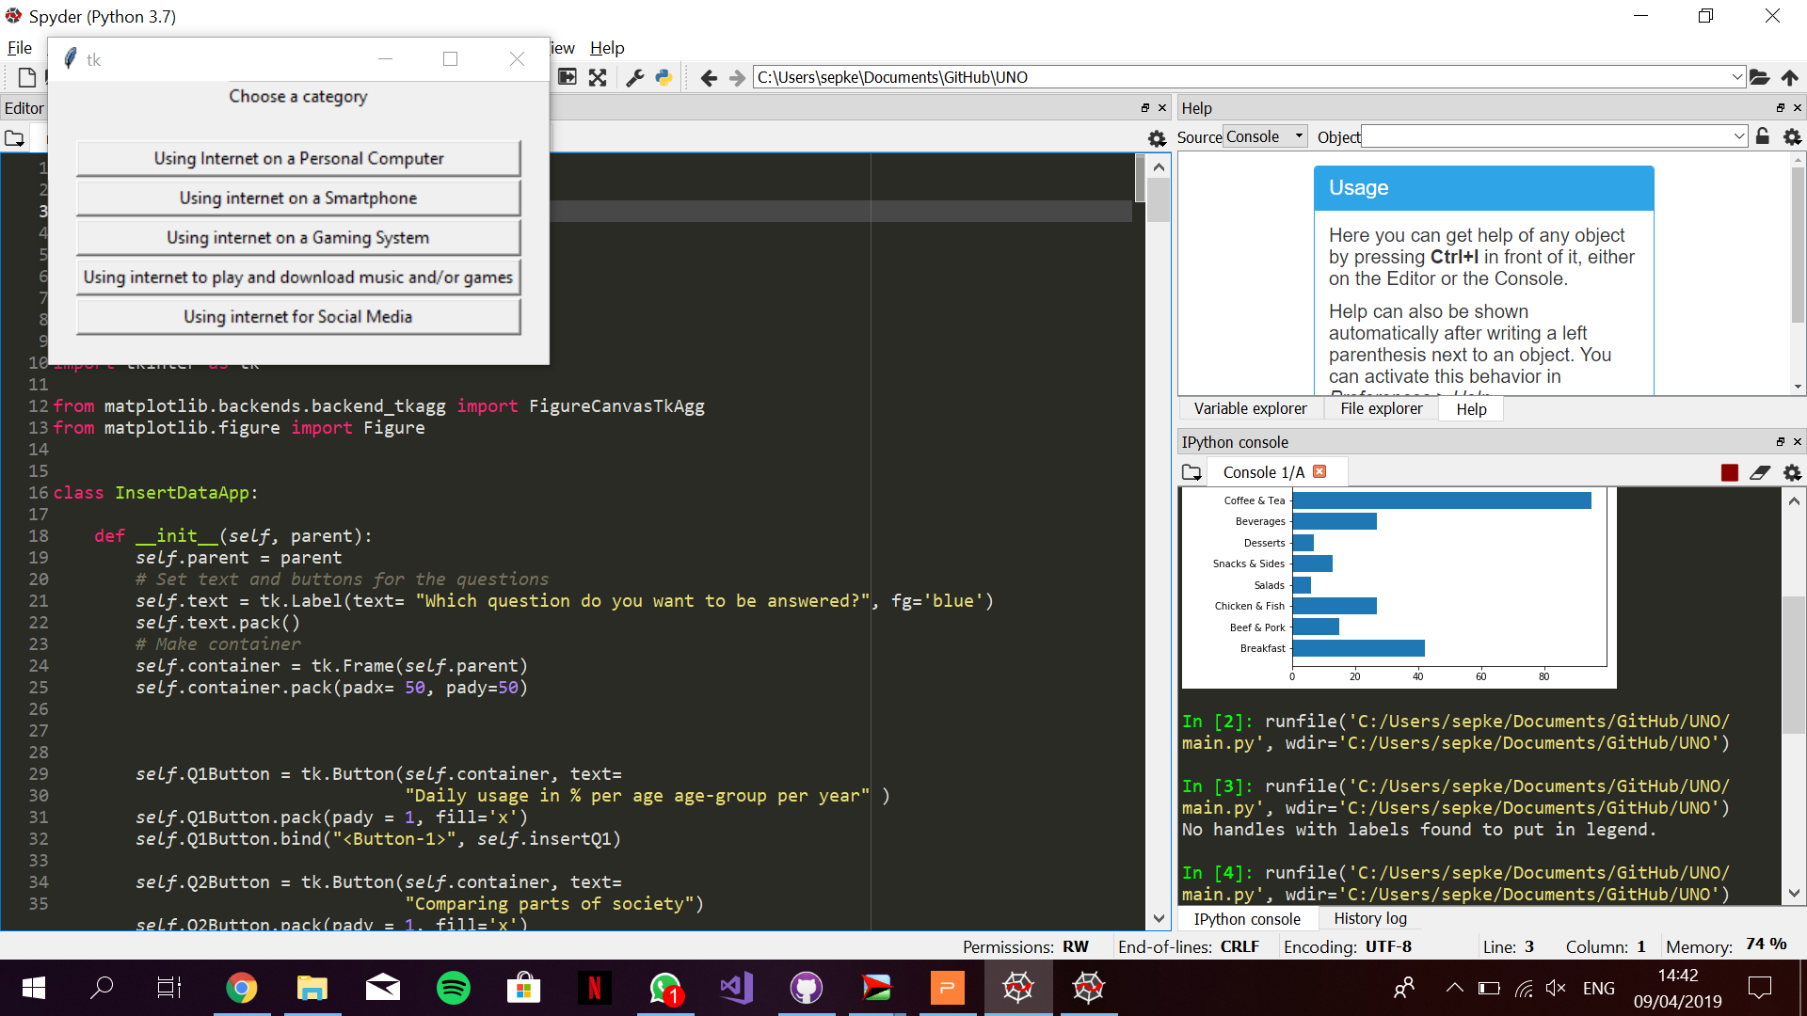
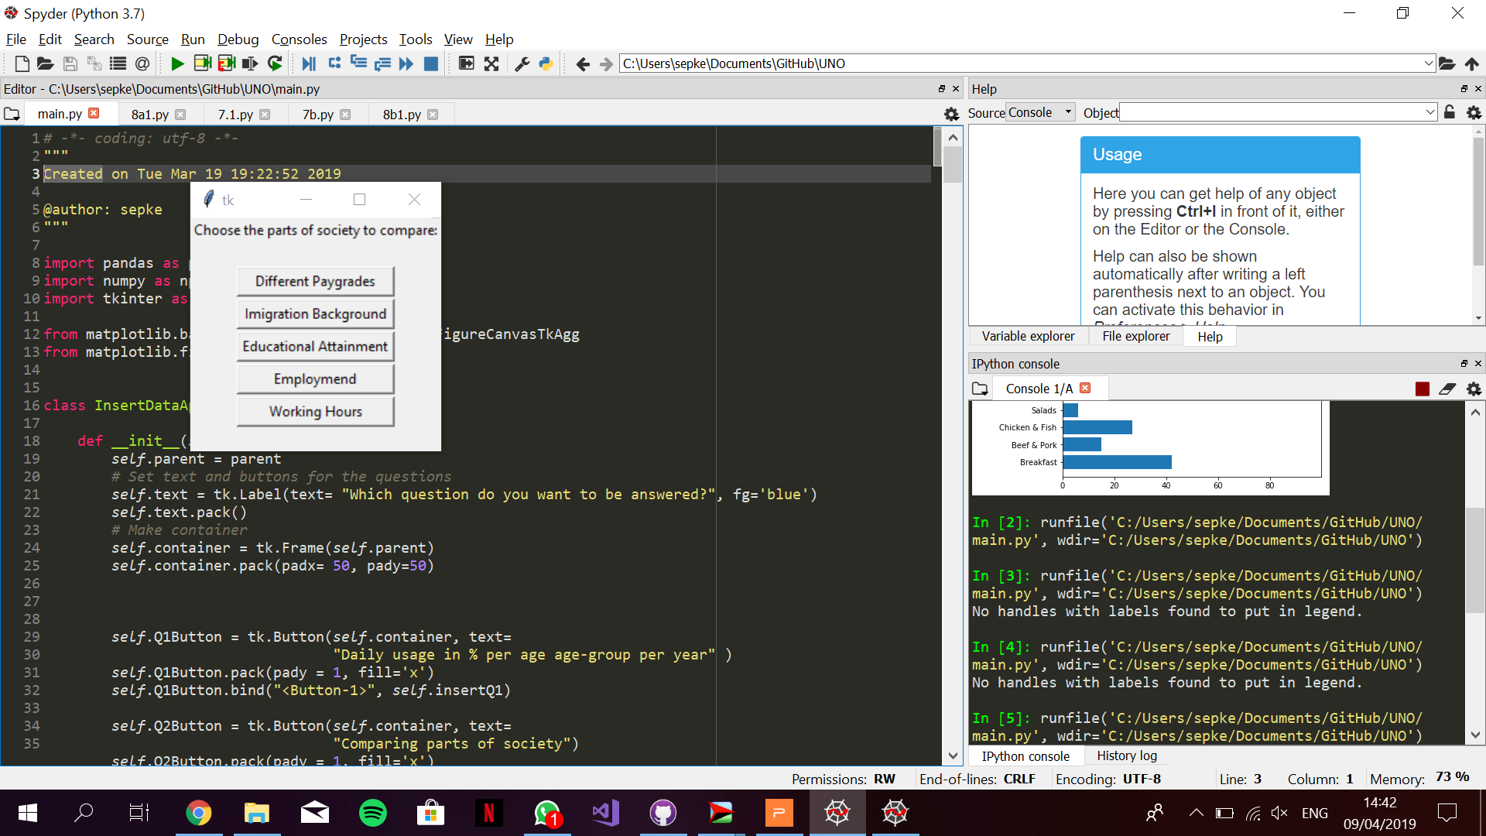
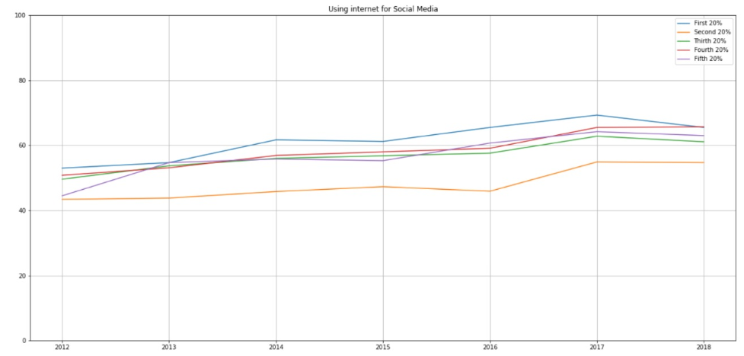
Faculty of Science
Department of Information and Computing Sciences
https://www.uu.nl/en/organisation/faculty-of-science
Study of variance in Internet Usage in The Netherlands
Jacco van Wijk, Sep Keuchenius & Rob Pennekamp
6599435, 6594190, 6523374
Introduction
Different parts of society and cultures within the Netherlands use internet for diverse purposes with varying frequency. Working on a way to visualize these deviations, we built a Python powered program to plot data in a visually explicit way with relevance to the study.
Research Questions
We are researching the following interesting points;
What is the difference in the amount of daily internet usage between age groups and how is this changing over the years?
Are there interesting significant differences in internet usage between demographic groups in Dutch society?
What are some of the differences in internet usage between men and women?
Data
We are analyzing the dataset Internet; toegang, gebruik en faciliteiten made public by the Centraal Bureau van Statistiek (CBS) in 2018. This dataset consists of internet usage and internet activities, broken down into different personal characteristics such as age, sex and income. The dataset is updated yearly and currently has data ranging from 2012 to 2018.
Figure 1:
Comparing genders in certain categories of usage. The numbers used are the mean percentages, per gender, per category of all 6 years in the dataset.
Implementation
The program consists of a main file, the BarApp and LineApp classes, and the QuestionApp, CategoryChoiceApp, CategoryCheckApp and SocietyChoiceApp classes.
The main file loads in the data, processes it and calls the right classes for opening windows for user interfaces and/or graphs. It uses the following libraries: Tkinter, Pandas, Sys, Numpy, and Matplotlib.
The BarApp and LineApp classes ask for data and plot a barplot and lineplot respectively.The QuestionApp, CategoryChoiceApp, CategoryCheckApp, and SocietyChoiceApp classes open up windows with buttons which enable the user to choose whatever selection they want to make.
Figure 2:
Screenshots of three of the interfaces used in the program. From left to right: choosing a subject, choosing a category within the subject and choosing a part of the Dutch society.
Figure 3:
Graph that shows the percentage of people within paygrades that use social media on a daily basis. Note the high usage of the lowest income group.
Follow-up questions
The thing that caught our attention when looking at the results was the usage of social media throughout different demographics in Dutch society. We think it could be very interesting to follow these trends, especially concerning education’s and employment’s impact on the usage of social media.
A common misconception about internet usage is that younger generations use the internet more frequently. This is not true for many categories, as clearly visible in the graphs. It could be interesting to try to formally disprove these misconceptions using the data we used.
Furthermore, changes in data throughout the coming years could be monitored using our program, as long as the data keeps using the same structure.
Results
As clearly visible in the program, different parts of the Dutch society claim different habits when it comes to usage of the internet. There are some noticable results in the program.
One of the other graphs shows that people with a higher level of education use the internet more frequently on a smartphone. However, internet usage within amusement categories seems more popular with people who have followed medium level education.
As we expected, internet usage for entertainments sake is less frequent with people working full-time. When talking about entertainment, one can think of activities such as playing games or downloading and streaming movies, music or tv-shows.
UNO
Unified Negotiation Organization
Referenties
Dataset: Internet; toegang, gebruik en faciliteiten (CBS)

