Slide 1
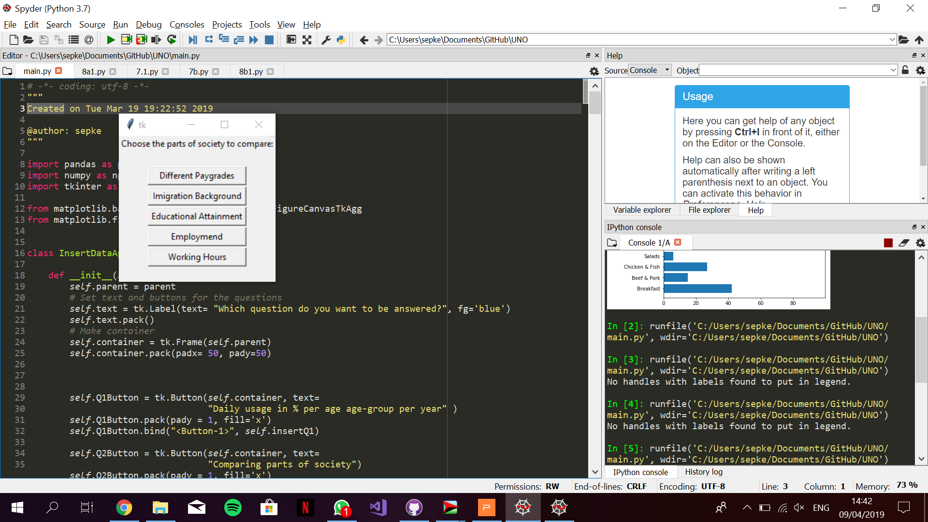
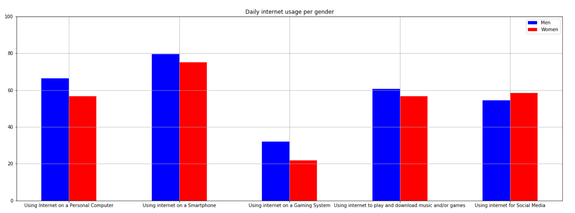
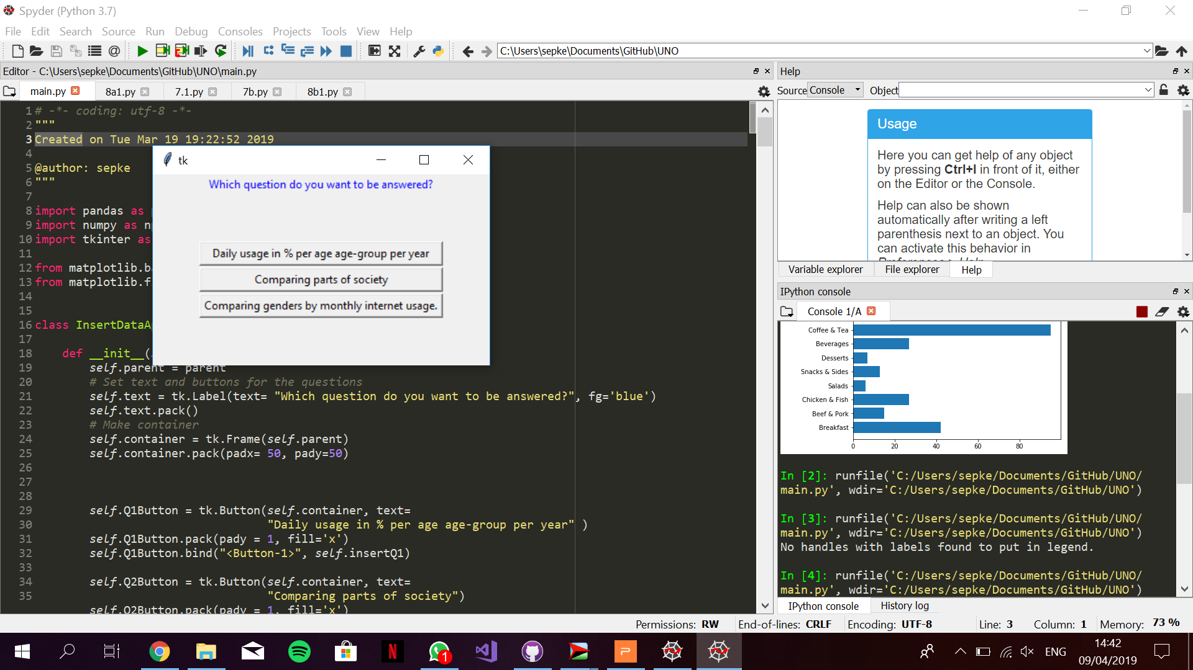
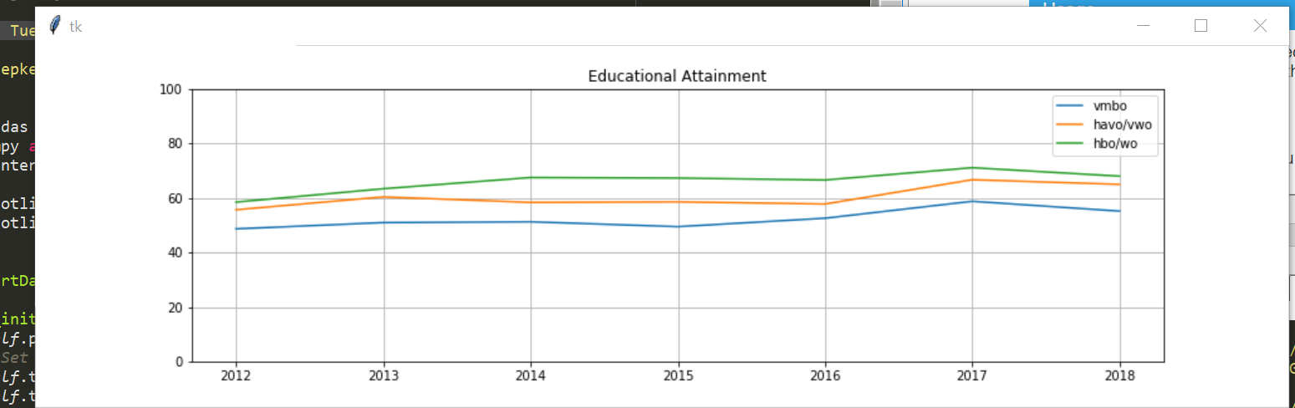
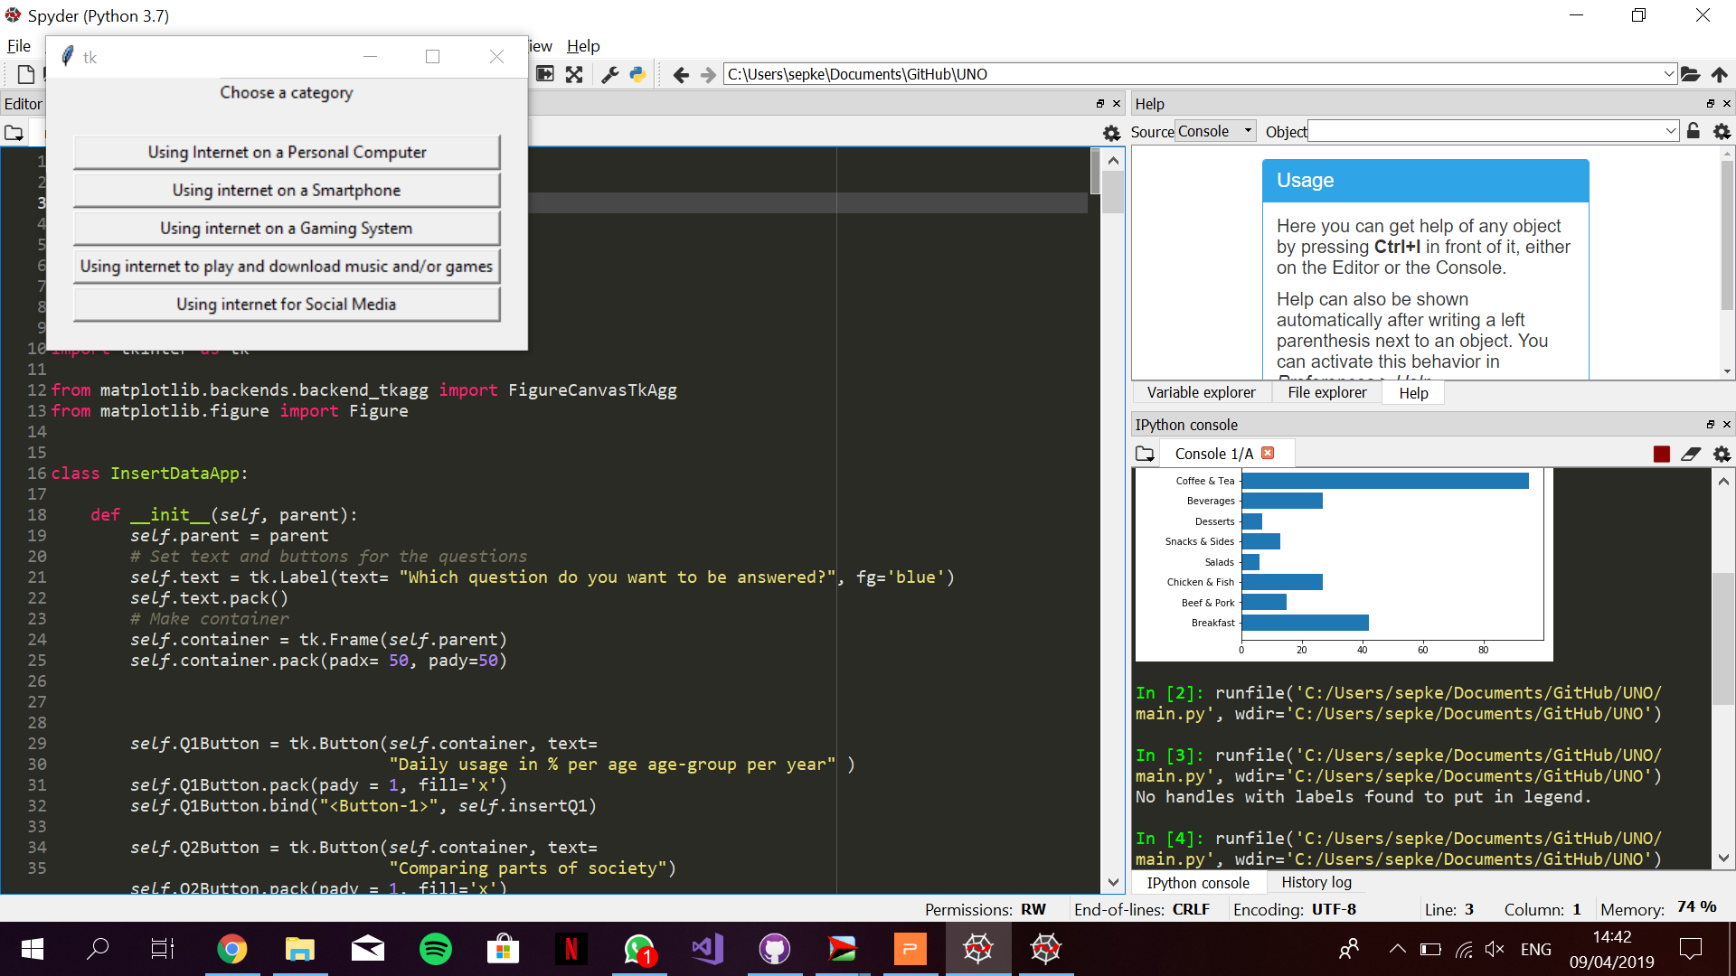
Faculty of Science
Department of Information and Computing Sciences
https://www.uu.nl/en/organisation/faculty-of-science
Study of variance in Internet Usage in The Netherlands
Jacco van Wijk, Sep Keuchenius & Rob Pennekamp
6599435, 6594190, 6523374
Introduction
Different parts of society and cultures within the Netherlands use internet for diverse purposes with varying frequency. Working on a way to visualize these deviations, we built a Python powered program to plot data in a visually explicit way with relevance to the study.
Research Questions
We are researching the following interesting points;
What is the difference in the amount of daily internet usage between age groups and how is this changing over the years?
Are there interesting significant differences in internet usage between demographic groups in Dutch society?
What are some of the differences in internet usage between men and women?
Data
We are analyzing the dataset Internet; toegang, gebruik en faciliteiten made public by the Centraal Bureau van Statistiek (CBS) in 2018. This dataset consists of internet usage and internet activities, broken down into different personal characteristics such as age, sex and income. The dataset is updated yearly and currently has data ranging from 2012 to 2018.
Barplot 1:
Comparing genders in certain categories of usage. The numbers used are the mean percentages, per gender, per category of all 6 years in the dataset.
Ruimte voor extra logo’s
Referenties
Naam auteur
Naam auteur

