Slide 1
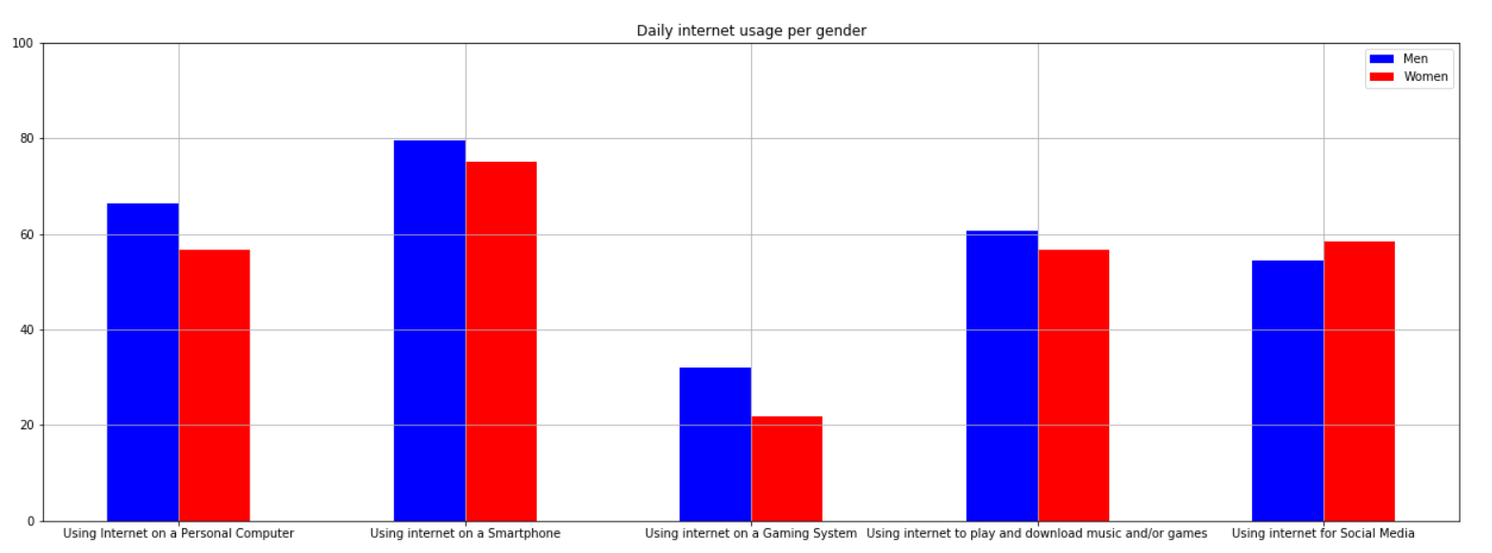
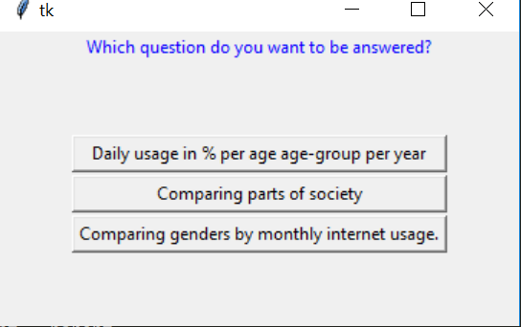
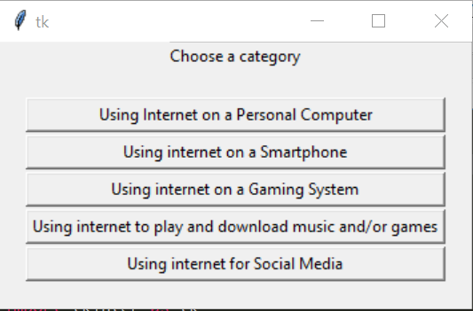
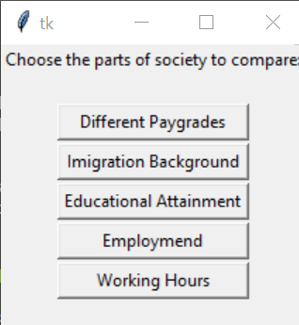
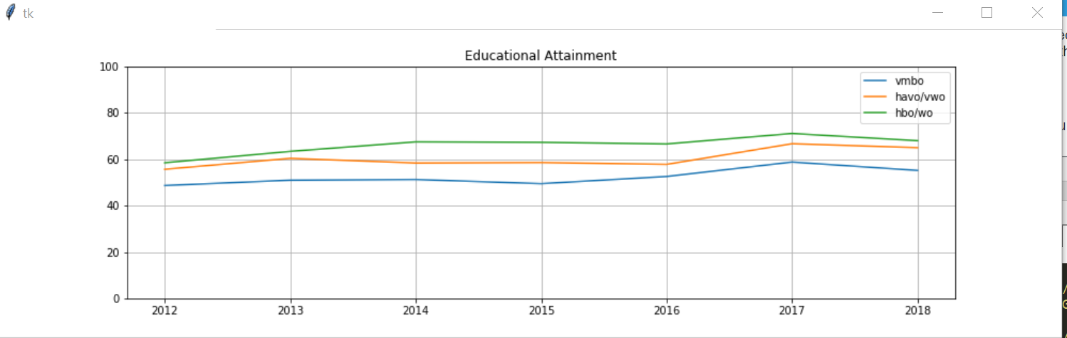
Faculty of Science
Department of Information and Computing Sciences
https://www.uu.nl/en/organisation/faculty-of-science
Study of variance in Internet Usage in The Netherlands
Jacco van Wijk, Sep Keuchenius & Rob Pennekamp
6599435, 6594190, 6523374
Introduction
Different parts of society and cultures within the Netherlands use internet for diverse purposes with varying frequency. Working on a way to visualize these deviations, we built a Python powered program to plot data in a visually explicit way with relevance to the study.
Research Questions
We are researching the following interesting points;
What is the difference in the amount of daily internet usage between age groups and how is this changing over the years?
Are there interesting significant differences in internet usage between demographic groups in Dutch society?
What are some of the differences in internet usage between men and women?
Data
We are analyzing the dataset Internet; toegang, gebruik en faciliteiten made public by the Centraal Bureau van Statistiek (CBS) in 2018. This dataset consists of internet usage and internet activities, broken down into different personal characteristics such as age, sex and income. The dataset is updated yearly and currently has data ranging from 2012 to 2018.
Barplot 1:
Comparing genders in certain categories of usage. The numbers used are the mean percentages, per gender, per category of all 6 years in the dataset.
Results
As clearly visible in the program, different parts of the Dutch society claim different habits when it comes to usage of the internet. There are some noticable results in the program.
Differences between men and women are often small, but existent nonetheless. Remarkably, men use internet more frequently than women in all but one category: social media.
One of the other graphs shows that people with a higher level of education use the internet more frequently on a smartphone. However, internet usage within amusement categories seems more popular with people who have followed medium level education.
As we expected, internet usage for entertainments sake is less frequent with people working full-time. When talking about entertainment, one can think of activities such as playing games or downloading and streaming movies, music or tv-shows.
As can be seen in the graph to the right, PC internet usage is plummeting, while smartphones take the stage.
Lessons learned
We have learned that it is very important to understand and use classes correctly, and not to put all code in one file. There is an art to keeping your code clear not only to yourself, but also to the people who will read it later.
Follow-up questions.
UNO
Unified Negotiation Organization
Referenties
Dataset: Internet; toegang, gebruik en faciliteiten (CBS)

