Slide 1
From Linear Regression to GPT
Roadmap
From simple prediction to GPT
Slides 3-22
Slides 23-29
Slides 30-37
Slides 38-42
Slides 43-58
01
02
03
04
05
Foundations
Language
Attention
Transformer
GPT
MSE, partials,
gradients
tokens and
embeddings
query, key,
value
blocks and
masking
next-token
prediction
Goal: understand GPT's core principles and architecture
to assess engineering possibilities
01
Notes:
[Sources]
This slide now functions as the table of contents: foundations, language representation, attention, Transformer, and GPT.

Slide 2
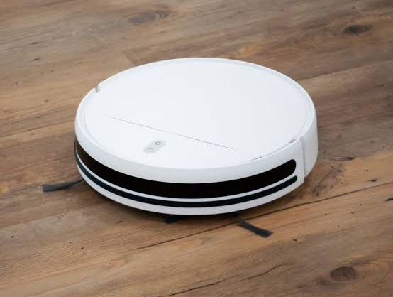
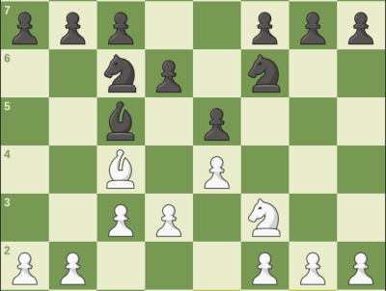
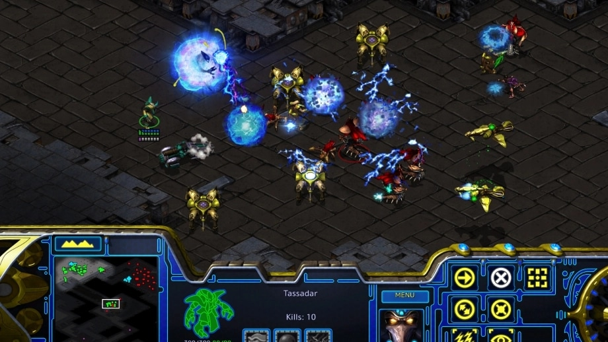
AI landscape
AI learns patterns to act in new situations
From fixed rules to prediction, decision-making, and creation
Rule-based automation
Prediction & decision
Complex strategy
Generative AI
robot vacuum
follows set rules
chess AI
chooses a move
game AI
acts in changing worlds
ChatGPT
creates language
AI = learning patterns from data to predict, decide, or create
02
Notes:
[Sources]
User-supplied image sources:
1. https://encrypted-tbn2.gstatic.com/images?q=tbn:ANd9GcTb54J7lU3TwgQ_NiIzqn22R85C3gln6w2vp8XhqfOC-notSarD
2. https://encrypted-tbn0.gstatic.com/images?q=tbn:ANd9GcR4dEnPxvotPgpwHovjkZjCA84CbNgn3y91CnPf70ilYZFwjDBmSDNJBGsv&s=10
3. https://blz-contentstack-images.akamaized.net/v3/assets/blt9c12f249ac15c7ec/blt16634e8fff6b277a/6964206ad1e07d6757e7b13d/overview_thumbnail.webp
4. https://www.internetmatters.org/wp-content/uploads/2025/06/Chat-GPT-logo.webp
Educational synthesis: AI enables computers to learn patterns from data and apply them to prediction, decision-making, or generation.

Slide 3
AI foundations
AI observes an environment and chooses actions
An intelligent-agent model
An AI agent observes an environment and selects actions through a policy
to achieve an objective.
Objective
Environment
Observation
Policy
Action
action changes the environment
Environment
the world the AI interacts with
Policy
the rule or model that selects an action
Observation
information it receives: sensors, images, text
Action
the output: movement, classification, response
Objective
the criterion for a good result
Notes:
[Sources]
Educational synthesis based on the conventional intelligent-agent formulation: environment, observation, objective, policy, and action.

Slide 4
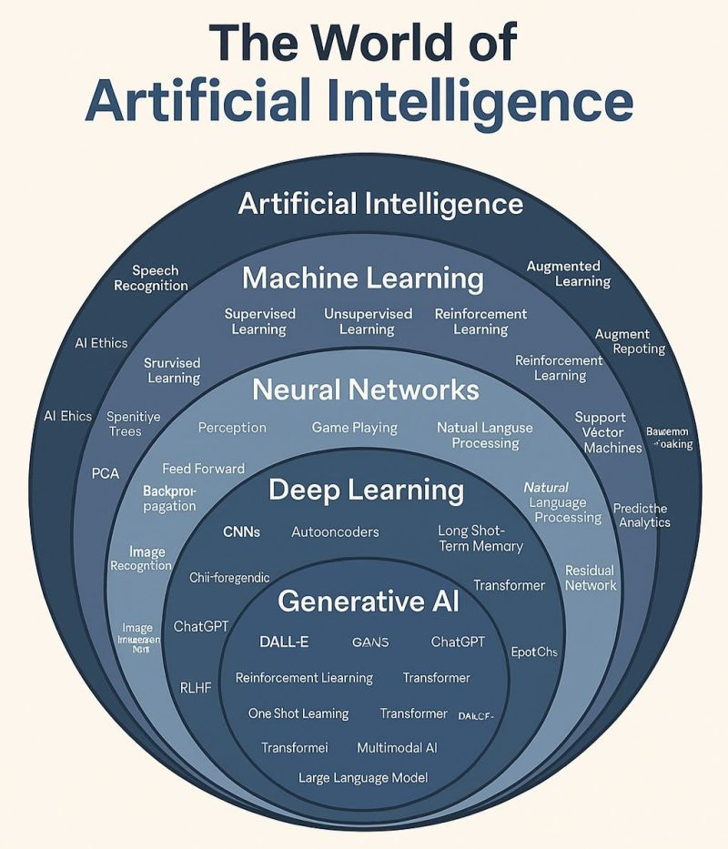
Orientation
This deck follows one path through the AI landscape
Starting point
linear regression
→ machine learning
→ neural networks
Destination
deep learning
→ Transformers
→ GPT
04
Notes:
[Sources]
AI landscape image supplied by the user: https://media.licdn.com/dms/image/v2/D4D22AQEwD7fMcLTAdQ/feedshare-shrink_800/B4DZd9bUoRG8Ag-/0/1750156005031?e=2147483647&v=beta&t=dCR6tdHvBihBUouwX60e8hqjI_j5cD386Zc8Bszzw_M
The image is presented as an orientation graphic; labels are reproduced from the supplied source.

Slide 5
Linear regression
Start with a bad line
data
MSE ≈ 4.75
large errors
model line
05
Notes:
[Sources]
Educational synthesis based on standard machine learning concepts.

Slide 6
Linear regression
Change w and b to lower MSE
data
MSE ≈ 0.19
closer line
model line
06
Notes:
[Sources]
Educational synthesis based on standard machine learning concepts.

Slide 7
Linear regression
The fitted line makes MSE small
data
MSE ≈ 0.01
model line
small errors
07
Notes:
[Sources]
Educational synthesis based on standard machine learning concepts.

Slide 8
Linear regression
Example: attendance predicts grades
more attendance,
higher predicted grade
x = attendance
y = grade
grade
line = prediction
attendance (%)
08
Notes:
[Sources]
Educational synthesis based on standard machine learning concepts.

Slide 9
Regression
Nonlinear regression allows curves
same task, more flexible shape
linear
grade
nonlinear
y_hat = f(x)
attendance (%)
09
Notes:
[Sources]
Educational synthesis based on standard machine learning concepts.

Slide 10
Regression
Too much flexibility can overfit
low training error, weak generalization
fits noise
grade
better trend
attendance (%)
10
Notes:
[Sources]
Educational synthesis based on standard machine learning concepts.

Slide 11
Regression
Data is split to separate learning from judging
train
validation
test
learn the model
choose the setup
estimate final score
uses
examples + labels
uses
held-out examples
uses
unseen examples
affects
weights directly
affects
choices indirectly
affects
nothing
timing
every update
timing
during development
timing
after all choices
validation is a development check; test is the final check
11
Notes:
[Sources]
Educational synthesis based on standard train/validation/test model evaluation practice.
Train data is used to fit parameters. Validation data is used for model selection and hyperparameter tuning, so it can influence the development process. Test data is held out until the end to estimate final generalization.

Slide 12
Regression
Train, validation, and test reveal fit quality
train
validation
test
fit weights
choose model
final check
underfitting
best fit
overfitting
error
validation error
both errors high
validation lowest
train error
gap opens
model complexity
12
Notes:
[Sources]
Educational synthesis based on standard machine learning train/validation/test evaluation concepts.

Slide 13
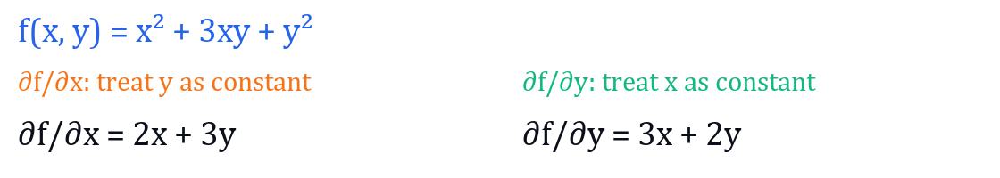
Partial derivatives
Partial derivatives: one variable at a time
1
Choose the variable
3
Differentiate normally
2
Treat the other variable as a constant
Partial derivative = slope with respect to one variable.
13
Notes:
[Sources]
Educational synthesis based on standard machine learning concepts.

Slide 14
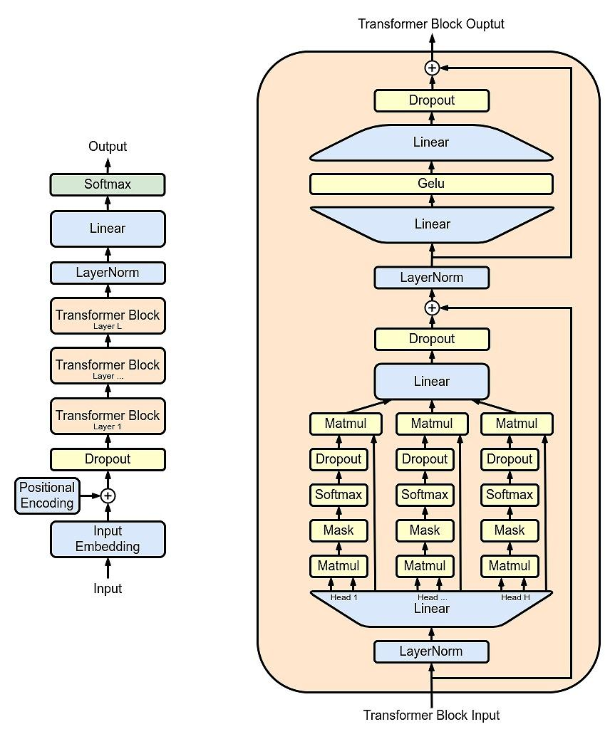
Gradient descent
Gradient descent changes w and b
MSE
tangent line
lower MSE
parameter
14
Notes:
[Sources]
Educational synthesis based on standard machine learning concepts.

Slide 15

Learning rate
Learning rate controls the step
α is the learning rate
small α
MSE
good α
too large
parameter
15
Notes:
[Sources]
Educational synthesis based on standard machine learning concepts.

Slide 16
Line search
Backtracking line search shrinks bad steps
MSE
α → α/2
reject
accept
parameter
16
Notes:
[Sources]
Educational synthesis based on standard machine learning concepts.
Backtracking line search shrinks bad steps는 다음 의미입니다.
경사하강법은 우선 비교적 큰 학습률 \(\alpha\)로 이동을 시도합니다.
\[ \theta_{\text{new}}=\theta-\alpha\nabla L(\theta) \]
이동한 뒤 손실 \(L\)이 충분히 감소했는지 확인합니다.
손실이 충분히 감소하면 해당 이동을 accept
감소하지 않거나 오히려 증가하면 reject
거부되면 학습률을 줄여 다시 시도
\[ \alpha \leftarrow \rho\alpha,\qquad 0<\rho<1 \]
일반적으로 \(\rho=0.5\)라면 다음처럼 진행됩니다.
\[ \alpha,\quad \frac{\alpha}{2},\quad \frac{\alpha}{4},\quad \frac{\alpha}{8},\dots \]
예를 들면:
\(\alpha=1.0\)으로 이동 → 손실 증가 → reject
\(\alpha=0.5\)로 다시 이동 → 감소량 부족 → reject
\(\alpha=0.25\)로 이동 → 손실 충분히 감소 → accept
즉, 제목은 “너무 큰 보폭으로 잘못 이동하려 하면, 보폭을 계속 줄여 안전하게 내려간다”는 뜻입니다. 15번 그림에는 현재 위치 → 큰 α 이동은 reject → α/2 이동은 accept가 표시되어야 의미가 더 분명해집니다.

Slide 17
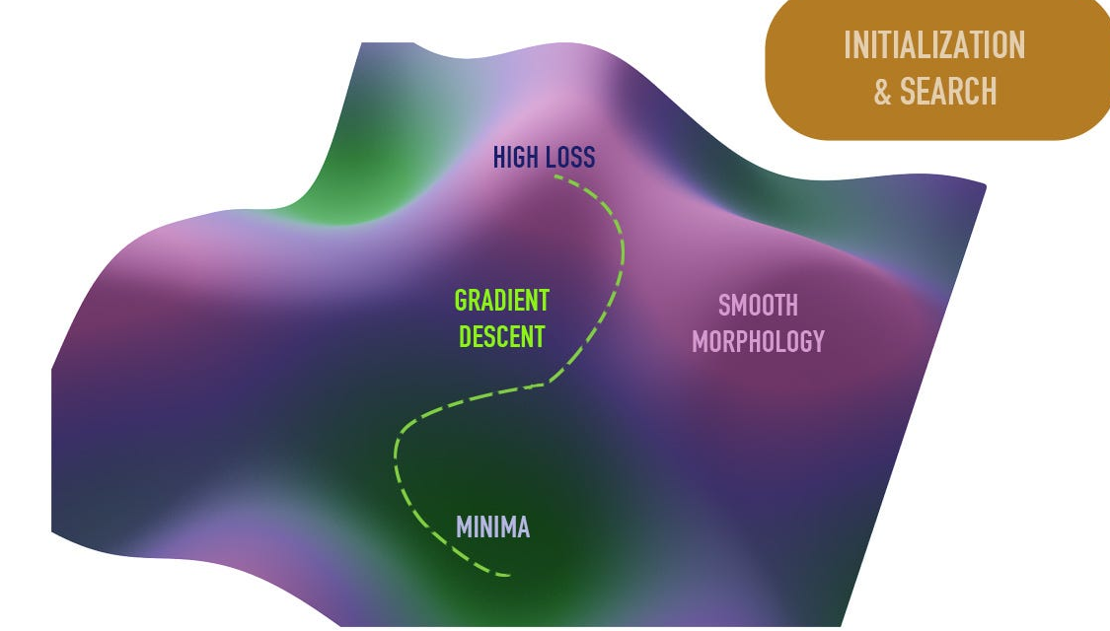
Optimization
Annealing reduces randomness over time
loss landscape
annealing
temperature / learning rate
high
low
explore
time
settle
early search is wide; later updates become stable
17
Notes:
[Sources]
3D loss landscape image provided by user: https://miro.medium.com/v2/resize:fit:1400/1*_SYK3prTMdNrTW98Uic4Pg.jpeg
Educational synthesis based on simulated annealing and learning-rate scheduling concepts.
어닐링 그래프는 “처음에는 크게 탐색하고, 시간이 갈수록 조심스럽게 수렴한다”는 뜻입니다.
가로축 time: 학습이 진행되는 시간 또는 step
세로축 temperature / learning rate: 움직임의 크기 또는 랜덤성
처음, 주황색 explore 구간에서는 값이 높습니다. 그래서 모델이 크게 움직이거나 더 랜덤하게 탐색합니다. 이때는 좋은 방향을 넓게 찾는 단계입니다.
시간이 지나면 파란 곡선이 내려갑니다. 즉 learning rate나 temperature를 줄입니다. 그러면 업데이트 폭이 작아지고, 모델이 더 안정적으로 움직입니다.
마지막, 초록색 settle 구간에서는 값이 낮습니다. 이미 찾은 좋은 해 근처에서 미세 조정하는 단계입니다.
요약하면:
high randomness / large step -> wide search
low randomness / small step -> stable convergence
그래서 슬라이드 문장인 “early search is wide; later updates become stable”은 어닐링의 핵심을 말하는 겁니다.

Slide 18
Neural networks
Neural network: basic structure
input
hidden
hidden
output
18
Notes:
[Sources]
Educational synthesis based on standard machine learning concepts.

Slide 19
Neural networks
A tiny network: width 1, depth 2
width = 1 · hidden layers = 2
x
h1
h2
ŷ
w₁
w₂
w₃
+ b₁
+ b₂
+ b₃
input x
hidden 1
hidden 2
output ŷ
h₁ = σ(w₁x + b₁) h₂ = σ(w₂h₁ + b₂) ŷ = w₃h₂ + b₃
σ = activation function
Notes:
[Sources]
Educational synthesis based on standard neural-network concepts.

Slide 20
Activation functions
Activation functions make depth useful
Linear layers only
Activation between layers
z₁ = w₁x + b₁
z₂ = w₂z₁ + b₂
ŷ = w₃z₂ + b₃
h₁ = σ(w₁x + b₁)
h₂ = σ(w₂h₁ + b₂)
ŷ = w₃h₂ + b₃
ŷ = w₃(w₂(w₁x + b₁) + b₂) + b₃
= ax + c (one linear mapping)
σ keeps the first two hidden layers nonlinear
σ = activation function
Without σ, extra depth remains only a longer linear function.
20
Notes:
[Sources]
Educational synthesis based on standard neural-network activation-function concepts.

Slide 21
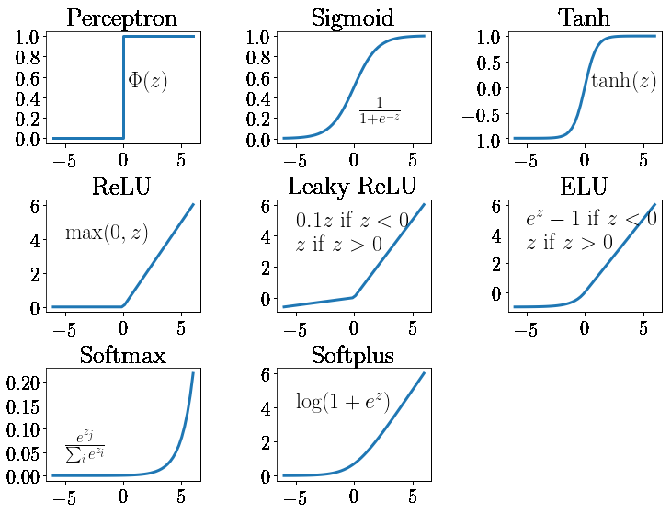
Activation functions
Common activation functions
Notes:
[Sources]
Activation-function figure supplied by the user: https://www.researchgate.net/profile/Aaron-Stebner-2/publication/341310767/figure/fig7/AS:890211844255749@1589254451431/Common-activation-functions-in-artificial-neural-networks-NNs-that-introduce.ppm

Slide 22
Calculus
The chain rule multiplies local changes
For composed functions, follow the dependency path and multiply each local derivative.
x
u = g(x)
y = f(u)
total effect = downstream change × local change
22
Notes:
[Sources]
Educational synthesis based on the standard chain rule in calculus.

Slide 23
Example
u splits the calculation into two steps
1 Define
2 Evaluate at x = 2
3 Differentiate
23
Notes:
[Sources]
Educational synthesis based on the standard chain rule in calculus.

Slide 24
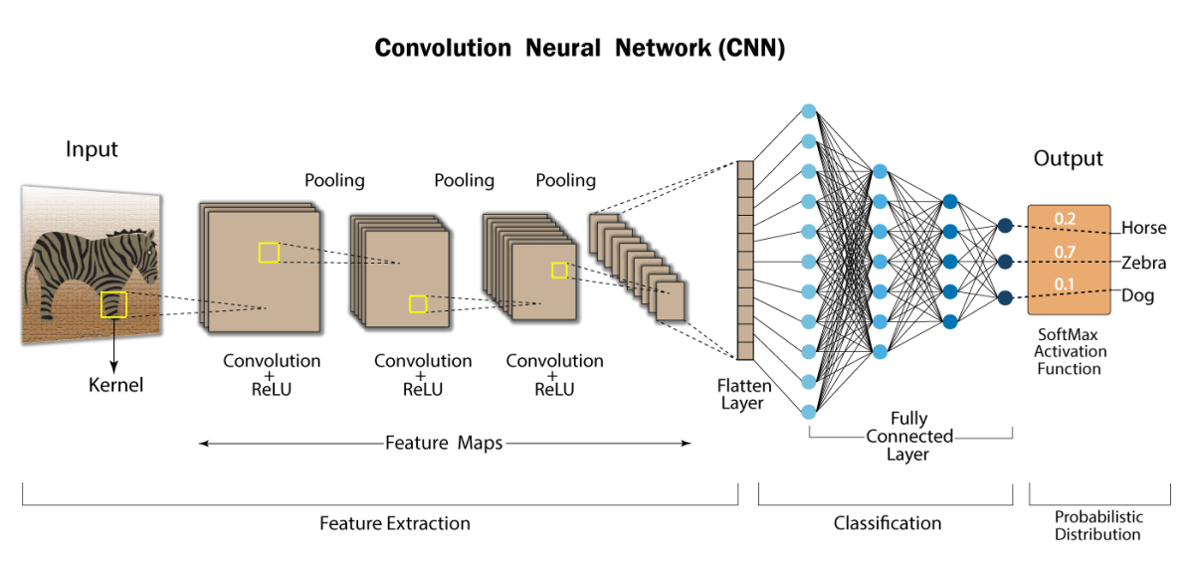
Learning
Backpropagation uses the chain rule
The forward pass computes values; the backward pass computes how the loss changes each weight.
forward: compute activations and loss
w
z = wx + b
a = σ(z)
L(a)
backward: propagate gradients toward earlier parameters
24
Notes:
[Sources]
Educational synthesis based on standard backpropagation and gradient descent.

Slide 25
Neural networks
Neural network: basic structure
input
output
x₁
0.82
0.1
−0.35
0.47
x₂
0.91
-0.1
A receiving neuron computes
zⱼ = Σᵢ wᵢⱼxᵢ + bⱼ → aⱼ = σ(zⱼ)
weighted inputs + bias, then an activation function
25
Notes:
[Sources]
Educational synthesis based on standard machine learning concepts.

Slide 26
Neural networks
Two equations become one matrix equation
x₁
0.82
0.1
Two scalar equations
y₁ = 0.82x₁ + 0.47x₂ + 0.1
−0.35
0.47
y₂ = −0.35x₁ + 0.91x₂ − 0.1
y = Wx + b
x₂
0.91
-0.1
The same computation in matrix form
[
y₁
]
[
0.82
0.47
]
[
x₁
]
[
0.1
]
=
+
y₂
−0.35
0.91
x₂
−0.1
W stores the weights by output row; b stores one bias for each output.
Notes:
[Sources]
Educational synthesis based on the numeric first-layer weights and biases shown on slides 23 and 24.

Slide 27
Vision
CNNs reuse filters to find local patterns
27
Notes:
[Sources]
CNN overview and claims about local connectivity, feature maps, pooling, and parameter sharing: https://developersbreach.com/convolution-neural-network-deep-learning/
CNN architecture image supplied by the user: https://i0.wp.com/developersbreach.com/wp-content/uploads/2020/08/cnn_banner.png?fit=1200%2C564&ssl=1

Slide 28
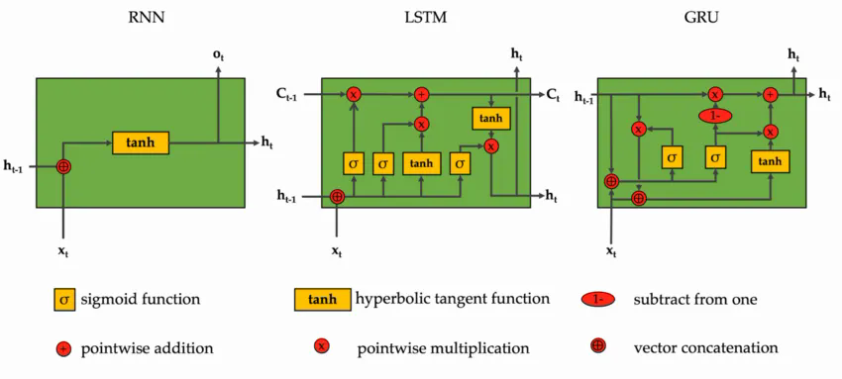
Sequences
RNNs carry state through time
LSTM and GRU add gates that decide what information to keep or forget.
RNN: hidden state • LSTM: memory cell + gates • GRU: compact gated unit
28
Notes:
[Sources]
Image supplied by the user: https://miro.medium.com/v2/resize:fit:1100/format:webp/1*AeKfV2uAPeMg9j8HhQZk2w.png
Educational synthesis based on standard recurrent neural-network concepts.

Slide 29
Sequences
RNN, LSTM, and GRU: what each adds
All pass information through time; gates improve what can be remembered.
RNN
LSTM
GRU
Carries one hidden state
from token to token.
Adds a memory cell plus
input / forget / output gates.
Uses update and reset gates
with a simpler state.
Limit: long-range context
can fade or vanish.
Trade-off: stronger memory,
more parameters and compute.
Trade-off: lighter than LSTM,
but still sequential.
Shared limitation: each step depends on the previous step, so training and inference are hard to parallelize.
29
Notes:
[Sources]
Educational synthesis based on standard RNN, LSTM, and GRU architectures.

Slide 30
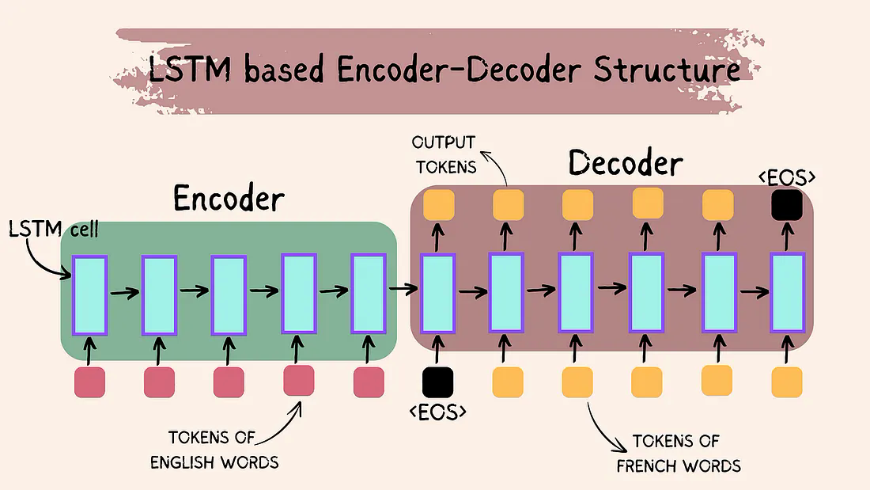
Sequences
Encoder–decoder maps one sequence to another
30
Notes:
[Sources]
Image supplied by the user: https://miro.medium.com/v2/resize:fit:1100/format:webp/1*H_heJCepouMYEqd8IwF0mQ.png
Educational synthesis based on standard encoder-decoder sequence-to-sequence concepts.

Slide 31
Attention
Attention removes the fixed-vector bottleneck
Instead of compressing every source token into one vector, each output step can consult the most relevant encoder states.
Without attention
With attention
output word
The
cat
sat
there
The
cat
sat
there
it
→
one fixed context vector
focus more on relevant tokens
This is the bridge from seq2seq to the attention mechanism (Q, K, V).
31
Notes:
[Sources]
Educational synthesis based on standard sequence-to-sequence attention concepts.

Slide 32
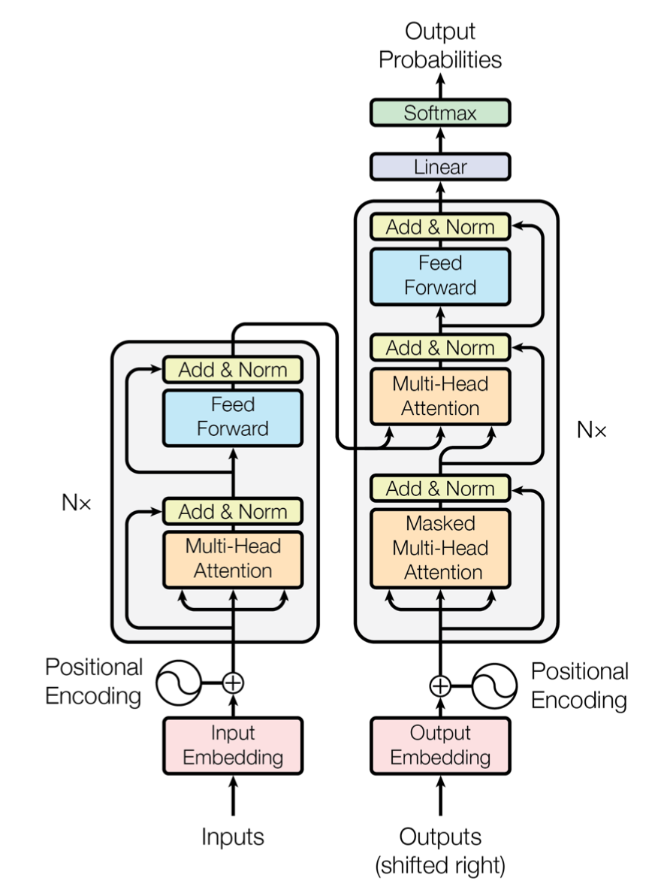
Architecture
The Transformer connects encoder and decoder stacks
Encoder
self-attention
feed-forward
Decoder
masked self-attention
cross-attention
feed-forward
32
Notes:
[Sources]
Transformer architecture image supplied by the user: https://qiita-user-contents.imgix.net/https%3A%2F%2Fqiita-image-store.s3.ap-northeast-1.amazonaws.com%2F0%2F146659%2F90f26267-2445-f2dc-b0c6-80f384054ae0.png?ixlib=rb-4.0.0&auto=format&gif-q=60&q=75&s=17811178f02900b58011bbcc4220f974

Slide 33
Transformer roadmap · Input
Tokenizer
Split text into tokens and map each token to an integer ID.
Text → tokens → token IDs
Step 1 of 9
Tokenizer
Embedding
Positional encoding
Self-attention
Attention head
Multi-head attention
Encoder block
Decoder block
Language-model head
Input component
33
Notes:
[Sources]
Educational synthesis based on the standard Transformer architecture.

Slide 34
Transformer roadmap · Input
Embedding
Turn each token ID into a learned dense vector.
token ID → embedding vector
Step 2 of 9
Tokenizer
Embedding
Positional encoding
Self-attention
Attention head
Multi-head attention
Encoder block
Decoder block
Language-model head
Input component
34
Notes:
[Sources]
Educational synthesis based on the standard Transformer architecture.

Slide 35
Transformer roadmap · Input
Positional encoding
Add position information so the model can distinguish word order.
token embedding + position signal
Step 3 of 9
Tokenizer
Embedding
Positional encoding
Self-attention
Attention head
Multi-head attention
Encoder block
Decoder block
Language-model head
Input component
35
Notes:
[Sources]
Educational synthesis based on the standard Transformer architecture.

Slide 36
Transformer roadmap · Encoder
Self-attention
Let every input token weigh the other input tokens for context.
each token ↔ all input tokens
Step 4 of 9
Tokenizer
Embedding
Positional encoding
Self-attention
Attention head
Multi-head attention
Encoder block
Decoder block
Language-model head
Encoder component
36
Notes:
[Sources]
Educational synthesis based on the standard Transformer architecture.

Slide 37
Transformer roadmap · Encoder
Attention head
One attention head learns one kind of token-to-token relationship.
one learned perspective
Step 5 of 9
Tokenizer
Embedding
Positional encoding
Self-attention
Attention head
Multi-head attention
Encoder block
Decoder block
Language-model head
Encoder component
37
Notes:
[Sources]
Educational synthesis based on the standard Transformer architecture.

Slide 38
Transformer roadmap · Encoder
Multi-head attention
Several heads learn complementary relationships in parallel.
many perspectives → combined context
Step 6 of 9
Tokenizer
Embedding
Positional encoding
Self-attention
Attention head
Multi-head attention
Encoder block
Decoder block
Language-model head
Encoder component
38
Notes:
[Sources]
Educational synthesis based on the standard Transformer architecture.

Slide 39
Transformer roadmap · Encoder
Encoder block
Repeat self-attention and a feed-forward network to refine representations.
self-attention + feed-forward
Step 7 of 9
Tokenizer
Embedding
Positional encoding
Self-attention
Attention head
Multi-head attention
Encoder block
Decoder block
Language-model head
Encoder component
39
Notes:
[Sources]
Educational synthesis based on the standard Transformer architecture.

Slide 40
Transformer roadmap · Decoder
Decoder block
Use masked self-attention, cross-attention, and feed-forward layers to generate.
past outputs + encoder context
Step 8 of 9
Tokenizer
Embedding
Positional encoding
Self-attention
Attention head
Multi-head attention
Encoder block
Decoder block
Language-model head
Decoder component
40
Notes:
[Sources]
Educational synthesis based on the standard Transformer architecture.

Slide 41
Transformer roadmap · Output
Language-model head
Convert the final decoder state into probabilities for the next token.
linear layer → softmax → next token
Step 9 of 9
Tokenizer
Embedding
Positional encoding
Self-attention
Attention head
Multi-head attention
Encoder block
Decoder block
Language-model head
Output component
41
Notes:
[Sources]
Educational synthesis based on the standard Transformer architecture.

Slide 42
Embeddings
Words become vectors
The
cat
sat
[0.75, 0.25, ...]
42
Notes:
[Sources]
Educational synthesis based on standard machine learning concepts.

Slide 43
Embeddings
Meaning becomes geometry
queen
king
dog
cat
woman
man
car
43
Notes:
[Sources]
Educational synthesis based on standard machine learning concepts.

Slide 44
Sequences
Order changes the meaning
dog
chased
cat
cat
chased
dog
44
Notes:
[Sources]
Educational synthesis based on standard machine learning concepts.

Slide 45
Mechanism
Query, key, value
K
Q
match
V
context
carry
45
Notes:
[Sources]
Vaswani et al., 2017, 'Attention Is All You Need', arXiv:1706.03762, https://arxiv.org/abs/1706.03762

Slide 46
Mechanism
Dot product turns Q and K into scores
score = QKᵀ
Q
K
·
=
one score per key
Dot product: multiply matching dimensions, then add them.
<BOS> query · each encoder key → one score for each source token
46
Notes:
[Sources]
Vaswani et al., 2017, 'Attention Is All You Need', arXiv:1706.03762, https://arxiv.org/abs/1706.03762

Slide 47
Mechanism
Scale scores, then Softmax makes weights
Attention(Q, K, V) = Softmax(QKᵀ / √dₖ)V
scale + softmax
QKᵀ / √dₖ
attention weights (sum = 1)
Dividing by √dₖ keeps large vectors from making the scores too extreme.
47
Notes:
[Sources]
Vaswani et al., 2017, 'Attention Is All You Need', arXiv:1706.03762, https://arxiv.org/abs/1706.03762

Slide 48
Mechanism
Values are mixed into context
context vector
V1
V2
V3
V4
sum
0.15
0.55
0.1
0.2
48
Notes:
[Sources]
Vaswani et al., 2017, 'Attention Is All You Need', arXiv:1706.03762, https://arxiv.org/abs/1706.03762

Slide 49
Self-attention
Self-attention updates every token
1
2
3
4
5
6
1'
2'
3'
4'
5'
6'
49
Notes:
[Sources]
Vaswani et al., 2017, 'Attention Is All You Need', arXiv:1706.03762, https://arxiv.org/abs/1706.03762

Slide 50
Multi-head
Many heads learn different links
syntax
reference
topic
position
50
Notes:
[Sources]
Vaswani et al., 2017, 'Attention Is All You Need', arXiv:1706.03762, https://arxiv.org/abs/1706.03762

Slide 51
Order
Position is added to meaning
token vector
position vector
ordered meaning
+
=
51
Notes:
[Sources]
Vaswani et al., 2017, 'Attention Is All You Need', arXiv:1706.03762, https://arxiv.org/abs/1706.03762

Slide 52
Block
A Transformer block mixes and computes
output
feed-forward
self-attention
input
residual + norm around each step
52
Notes:
[Sources]
Vaswani et al., 2017, 'Attention Is All You Need', arXiv:1706.03762, https://arxiv.org/abs/1706.03762

Slide 53
Encoder
The encoder reads the whole input
contextual representations
encoder 3
encoder 2
encoder 1
I
love
machine
learning
53
Notes:
[Sources]
Vaswani et al., 2017, 'Attention Is All You Need', arXiv:1706.03762, https://arxiv.org/abs/1706.03762

Slide 54
Decoder
The decoder hides the future
visible
masked
54
Notes:
[Sources]
Vaswani et al., 2017, 'Attention Is All You Need', arXiv:1706.03762, https://arxiv.org/abs/1706.03762

Slide 55
2017
Attention replaced recurrence
RNN
step by step
Transformer
direct comparison
->
55
Notes:
[Sources]
Vaswani et al., 2017, 'Attention Is All You Need', arXiv:1706.03762, https://arxiv.org/abs/1706.03762

Slide 56
GPT architecture
GPT repeats a decoder-only Transformer block
Decoder-only stack
masked self-attention
feed-forward network
residual + LayerNorm
Next-token output
Linear + Softmax turns the final state into a token distribution.
56
Notes:
[Sources]
GPT architecture image supplied by the user: https://img.sbbit.jp/article/image/114721/l_bit202308301441497020.jpg

Slide 57
GPT
GPT keeps the decoder idea
decoder block 1
next token
decoder block 2
decoder block 3
prompt tokens
decoder block 4
57
Notes:
[Sources]
Radford et al., 2018, 'Improving Language Understanding by Generative Pre-Training', OpenAI.
Radford et al., 2019, 'Language Models are Unsupervised Multitask Learners', OpenAI.
Brown et al., 2020, 'Language Models are Few-Shot Learners', arXiv:2005.14165, https://arxiv.org/abs/2005.14165

Slide 58
Objective
Training target: the next token
The
capital
of
France
is
Paris
predict this
58
Notes:
[Sources]
Radford et al., 2018, 'Improving Language Understanding by Generative Pre-Training', OpenAI.
Radford et al., 2019, 'Language Models are Unsupervised Multitask Learners', OpenAI.
Brown et al., 2020, 'Language Models are Few-Shot Learners', arXiv:2005.14165, https://arxiv.org/abs/2005.14165

Slide 59
Scale
Pretraining compresses patterns into weights
Transformer
weights
text
batches
tokens
train
59
Notes:
[Sources]
Radford et al., 2018, 'Improving Language Understanding by Generative Pre-Training', OpenAI.
Radford et al., 2019, 'Language Models are Unsupervised Multitask Learners', OpenAI.
Brown et al., 2020, 'Language Models are Few-Shot Learners', arXiv:2005.14165, https://arxiv.org/abs/2005.14165

Slide 60
Loading
An LLM needs three matching parts
model
CONFIG
CHECKPOINT
TEXT ↔ IDS
Architecture
+
Trained weights
+
Tokenizer
layers · hidden size
attention heads
learned parameters
that store patterns
vocabulary · split rules
special tokens
The tokenizer must match the checkpoint — otherwise token IDs mean something else.
60
Notes:
[Sources]
Hugging Face Transformers, Loading models: https://huggingface.co/docs/transformers/en/models
Hugging Face Transformers, Auto Classes: https://huggingface.co/docs/transformers/model_doc/auto

Slide 61
Generation
Inference repeats the same move
model
prompt
new token
append and repeat
61
Notes:
[Sources]
Radford et al., 2018, 'Improving Language Understanding by Generative Pre-Training', OpenAI.
Radford et al., 2019, 'Language Models are Unsupervised Multitask Learners', OpenAI.
Brown et al., 2020, 'Language Models are Few-Shot Learners', arXiv:2005.14165, https://arxiv.org/abs/2005.14165

Slide 62
Decoding
Sampling changes the voice
low temperature
high temperature
62
Notes:
[Sources]
Radford et al., 2018, 'Improving Language Understanding by Generative Pre-Training', OpenAI.
Radford et al., 2019, 'Language Models are Unsupervised Multitask Learners', OpenAI.
Brown et al., 2020, 'Language Models are Few-Shot Learners', arXiv:2005.14165, https://arxiv.org/abs/2005.14165

Slide 63
Decoding
Generation has adjustable controls
temperature
top-p
keep the smallest set whose probability mass reaches p
A
A
A
B
C
D
E
F
low = focused
high = varied
sample only inside nucleus
max tokens
penalties
stop
how long to continue
reduce repetition
where to end
63
Notes:
[Sources]
OpenAI API Reference, Responses create parameters: https://platform.openai.com/docs/api-reference/responses/create
OpenAI API Reference, Chat create parameters: https://platform.openai.com/docs/api-reference/chat/create
Temperature changes distribution sharpness. Top-p nucleus sampling limits sampling to a cumulative probability mass.

Slide 64
Recap
The whole path is one learning story
learn from error -> compare tokens -> predict the next token
1
2
3
4
5
6
line
network
backprop
attention
Transformer
GPT
64
Notes:
[Sources]
Vaswani et al., 2017, 'Attention Is All You Need', arXiv:1706.03762, https://arxiv.org/abs/1706.03762
Radford et al., 2018, 'Improving Language Understanding by Generative Pre-Training', OpenAI.
Radford et al., 2019, 'Language Models are Unsupervised Multitask Learners', OpenAI.
Brown et al., 2020, 'Language Models are Few-Shot Learners', arXiv:2005.14165, https://arxiv.org/abs/2005.14165

Slide 65
GPT
Special tokens can change behavior
The
answer
<end>
<tool_call>
<image>
normal text tokens
control tokens
Some tokens are instructions to the system, not words for the user.
65
Notes:
[Sources]
Conceptual explanation of special tokens in language-model systems.
OpenAI API documentation describes tool calling and finish reasons at https://platform.openai.com/docs

Slide 66
GPT
A special token can trigger an external tool
The model may emit a control token instead of ordinary text.
model
prompt
<tool_call>
tool
<end>
stop generation
66
Notes:
[Sources]
Conceptual explanation of tool-call and end-of-generation control behavior.
OpenAI API documentation describes tool calling and finish reasons at https://platform.openai.com/docs

Slide 67
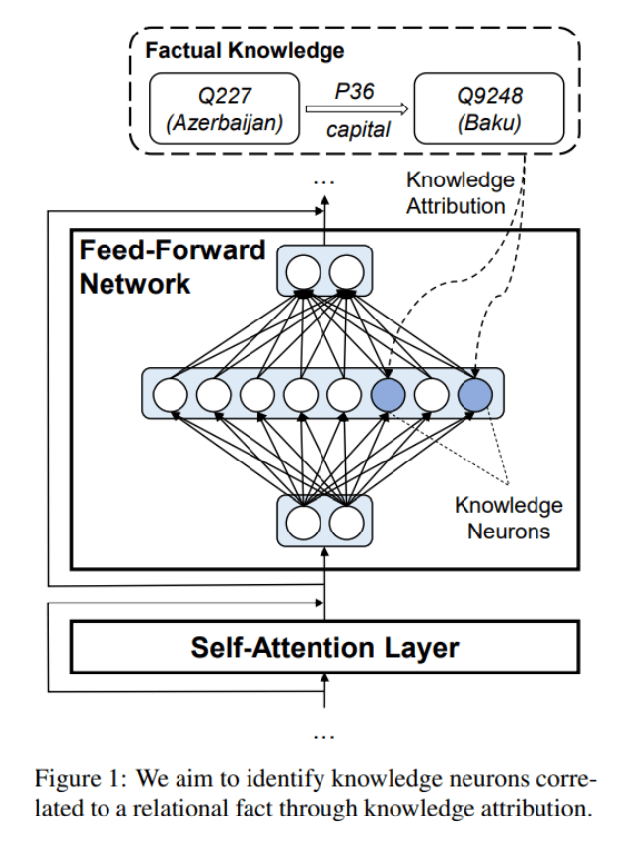
Transformer
Why FFNs help is still not fully settled
Attention mixes tokens; the FFN transforms each token nonlinearly.
Known: FFNs detect and combine learned features.
Evidence: FFN weights can act like key–value parameter memory.
Ablations: reducing FFN capacity shifts work elsewhere and can cost more compute.
Conclusion: the mechanism is clearer than the single cause of the performance gain.
67
Notes:
[Sources]
User-supplied FFN / knowledge-neuron figure: https://i0.wp.com/syncedreview.com/wp-content/uploads/2021/04/image-114.png?resize=652%2C863&ssl=1
Dai et al., 2022, 'Knowledge Neurons in Pretrained Transformers': https://aclanthology.org/2022.acl-long.581/
Smithline and Mascioli, 2026, 'Sparsity Moves Computation: How FFN Architecture Reshapes Attention in Small Transformers': https://arxiv.org/abs/2605.09403

Slide 68
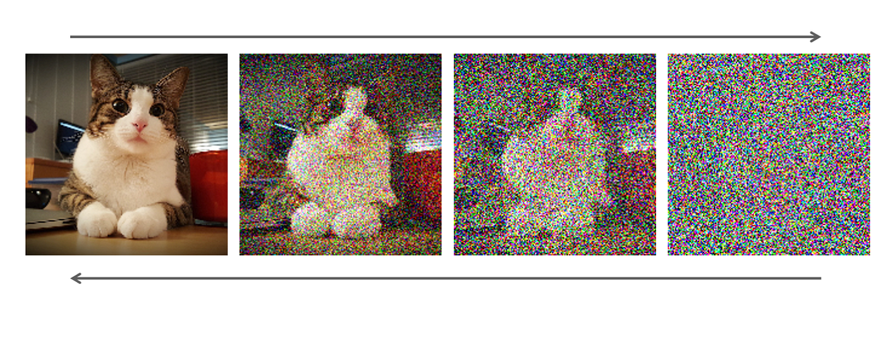
Diffusion
Diffusion learns to reverse noise
Forward: gradually add noise →
← Generation: predict and remove noise step by step
68
Notes:
[Sources]
User-supplied diffusion image: https://miro.medium.com/v2/resize:fit:1400/1*yvClU5LgylulNWLPNpOCfA.png
Ho et al., 2020, 'Denoising Diffusion Probabilistic Models': https://arxiv.org/abs/2006.11239

Slide 69
Alternative generation
dLLMs refine many token positions in parallel
not always left-to-right
noise
[MASK]
[MASK]
[MASK]
[MASK]
[MASK]
[MASK]
MERCURY 2
Transformer dLLM
step 1
The
[MASK]
learns
[MASK]
[MASK]
.
noisy sequence
→ parallel predictions
repeat refinement
→ final text
step 2
The
model
learns
from
[MASK]
.
text
The
model
learns
from
data
.
69
Notes:
[Sources]
Inception, Introducing Mercury 2: https://www.inceptionlabs.ai/blog/introducing-mercury-2
Khanna et al., 2025, 'Mercury: Ultra-Fast Language Models Based on Diffusion': https://arxiv.org/abs/2506.17298

Slide 70
Faster inference
Speculative decoding uses a draft-and-verify loop
1 small draft model
3 large target model
The
cat
sat
on
cheap guesses
2 propose token block
verify block in one pass
4a accept prefix
4b reject + resample
The
cat
sat
on
mat
draft → verify → accept / resample → repeat
same target distribution, fewer serial waits
70
Notes:
[Sources]
Leviathan, Kalman, and Matias, 2023, 'Fast Inference from Transformers via Speculative Decoding': https://arxiv.org/abs/2211.17192

Slide 71
Scaling trend
Frontier models scale total compute
not just parameter count
more useful computation
pretraining
MoE
post-training
test-time
bigger models
more data
many params
few active
SFT + RL
feedback loops
think longer
before answer
train-time compute
sparse compute
alignment compute
inference compute
Trend: scale the whole compute budget
71
Notes:
[Sources]
Scaling Laws for Neural Language Models: https://arxiv.org/abs/2001.08361
Training Compute-Optimal Large Language Models: https://arxiv.org/abs/2203.15556
Mixtral of Experts: https://arxiv.org/abs/2401.04088
DeepSeek-V3 Technical Report: https://arxiv.org/abs/2412.19437
OpenAI, Learning to reason with LLMs: https://openai.com/index/learning-to-reason-with-llms/
DeepSeek-R1: https://arxiv.org/abs/2501.12948

Slide 72
Compression
Teacher-student distillation transfers behavior
deployment
soft targets
probabilities carry extra signal
teacher
cat .62
dog .21
fox .09
...
large, expensive
student
smaller, faster
learn the teacher's output distribution
72
Notes:
[Sources]
Distilling the Knowledge in a Neural Network: https://arxiv.org/abs/1503.02531
DistilBERT, a distilled version of BERT: https://arxiv.org/abs/1910.01108

