Slide 1
OT/IIoT cybersecurity and
Zero Trust for smart factories:
The mediating role of secure access and microsegmentation and
the moderating role of legacy system complexity and standards alignment
Javohir To'rayev 220044
Supervisor: Mohammed Tareq

Slide 2
Introduction
Research background
- Smart factories depend on connected OT/IIoT systems, remote access, gateways, and data sharing, which expand cyber exposure.
- Traditional perimeter security is insufficient because industrial environments require continuous verification across users, devices, and flows.
Research problem
- Zero Trust is widely recommended for industrial environments, but implementation in real factories is difficult because of legacy assets, vendor access, production priorities, and governance constraints.
Research gap
- Previous studies often address Zero Trust, OT/IIoT threats, legacy modernization, or standards separately rather than in one integrated smart-factory model.
Objective and significance
- Develop a conceptual, survey-ready model linking Zero Trust maturity to OT cyber resilience through secure access and microsegmentation, with legacy complexity and standards alignment as path-specific conditions.
- Offer a practical framework and roadmap for factories that need stronger security without disrupting safety and production.

Slide 3
Research model
Standards alignment
(Moderator, +)
Zero Trust maturity
(IV)
Secure access and
microsegmentation
(Mediator)
OT cyber
resilience
(DV)
Legacy system complexity
(Moderator, -)
Control variables
Organization size
Industry sector
Smart-factory maturity
Formal OT cybersecurity program

Slide 4
Literature review: theoretical foundation
1. Socio-technical systems perspective
Factories combine people, processes, governance, and technology, so cybersecurity change cannot be treated as a purely technical project (Abu Bakar et al., 2021, 2022).
2. Defense-in-depth and least privilege
OT security relies on segmentation, zones, conduits, and controlled access; Zero Trust extends this logic by making enforcement more identity-aware and context-aware (Rose et al., 2020; Stouffer et al., 2023; ISA/IEC 62443).
3. Cyber resilience perspective
The outcome is not only technical protection, but the ability to prevent, detect, respond to, and recover from cyber incidents while preserving safety and production continuity (NIST, 2024).

Slide 5
Literature review: key constructs
Zero Trust maturity
OT cyber resilience
Extent to which a factory applies continuous verification, least privilege, identity-centered access, segmentation, asset knowledge, and monitoring across OT/IIoT environments (Rose et al., 2020; CISA, 2023a).
Ability to maintain or restore safe and reliable production under cyber stress, including detection, response, recovery, and continuity (NIST, 2024; Stouffer et al., 2023).
Secure access and microsegmentation
Supporting capabilities and conditions
This thesis treats secure access and microsegmentation as the main mediating mechanism because Zero Trust becomes operational through controlled access, segmentation, and constrained communication flows (Paul & Rao, 2023; ISA/IEC 62443).
Legacy system complexity weakens implementation of secure access, while standards alignment helps those controls translate into resilience more effectively (Abu Bakar et al., 2021; CISA, 2023a; ISA/IEC 62443).
These constructs are conceptually grounded in prior industrial cybersecurity literature. The contribution of this thesis is not inventing new variables, but integrating them into one smart-factory Zero Trust framework.

Slide 6
Hypothesis 1 development
Theoretical logic
Zero Trust replaces implicit trust with continuous verification, least privilege, segmentation, and monitored access. In smart factories, these practices should reduce attack surface, improve anomaly detection, and strengthen the factory's ability to maintain safe and reliable operations after cyber events.
Key supporting studies
Based on Rose et al. (2020), Paul and Rao (2023), and Abdullahi and Lazarova-Molnar (2025).
H1: Zero Trust implementation maturity is positively related to OT cyber resilience in smart factories.

Slide 7
Hypothesis 2 development
Theoretical logic
A mature Zero Trust approach should produce stronger access-control practices, tighter approval logic, and more disciplined segmentation in OT environments. When Zero Trust maturity rises, factories are expected to implement secure remote access, constrained privilege, and approved communication boundaries more consistently.
Key supporting studies
Based on Rose et al. (2020), Paul and Rao (2023), CISA (2023a), and Stouffer et al. (2023).
H2: Zero Trust maturity is positively related to the level of secure access and microsegmentation in smart factories.

Slide 8
Hypothesis 3 development
Theoretical logic
Zero Trust becomes operational when access is enforced at practical control points such as gateways, remote access sessions, and segmented network boundaries. Stronger secure access and microsegmentation should limit lateral movement and unauthorized changes, thereby improving OT cyber resilience in smart factories.
Key supporting studies
Based on Paul and Rao (2023), Wolfart et al. (2021), Fonseca et al. (2024), and ISA/IEC 62443.
H3: The level of secure access and microsegmentation is positively related to OT cyber resilience in smart factories.

Slide 9
Hypothesis 4 development
Theoretical logic
If Zero Trust maturity leads to stronger secure access and microsegmentation, and those controls improve OT cyber resilience, then part of the effect of Zero Trust should operate through this enforcement mechanism. The mediating role is therefore the path that connects strategic maturity to practical, resilience-relevant control execution.
Key supporting studies
Based on Rose et al. (2020), Paul and Rao (2023), Wolfart et al. (2021), and Fonseca et al. (2024).
H4: Secure access and microsegmentation mediates the relationship between Zero Trust maturity and OT cyber resilience in smart factories.

Slide 10
Hypothesis 5 development
Theoretical logic
Legacy-intensive factories often rely on systems that lack modern logging, encryption, patchability, or clear documentation. These constraints make it harder to convert Zero Trust intentions into secure access architecture and effective segmentation, so the first-stage implementation effect should be weaker when legacy system complexity is higher.
Key supporting studies
Based on Abu Bakar et al. (2021, 2022), Wolfart et al. (2021), Favero et al. (2025), and Fonseca et al. (2024).
H5: Legacy system complexity negatively moderates the relationship between Zero Trust maturity and the level of secure access and microsegmentation in smart factories.

Slide 11
Hypothesis 6 development
Theoretical logic
Standards give factories a shared control language, clearer governance expectations, and more consistent implementation patterns across IT and OT teams. When secure access and microsegmentation are implemented in a standards-aligned environment, those controls should be applied more consistently, audited more effectively, and integrated better into response and recovery practices, making their positive effect on OT cyber resilience stronger.
Key supporting studies
Based on Abdullahi and Lazarova-Molnar (2025), CISA (2023a, 2023b), ISA/IEC 62443, and NIST OT guidance.
H6: Standards alignment positively moderates the relationship between the level of secure access and microsegmentation and OT cyber resilience in smart factories.

Slide 12
All hypotheses
H1 Zero Trust implementation maturity is positively related to OT cyber resilience in smart factories.
H2 Zero Trust maturity is positively related to the level of secure access and microsegmentation in smart factories.
H3 The level of secure access and microsegmentation is positively related to OT cyber resilience in smart factories.
H4 Secure access and microsegmentation mediates the relationship between Zero Trust maturity and OT cyber resilience in smart factories.
H5 Legacy system complexity negatively moderates the relationship between Zero Trust maturity and the level of secure access and microsegmentation in smart factories.
H6 Standards alignment positively moderates the relationship between the level of secure access and microsegmentation and OT cyber resilience in smart factories.

Slide 13
Research methods
- Research design: conceptual and survey-ready thesis based on literature synthesis and secondary evidence.
- Evidence base: academic studies, NIST and CISA guidance, ISA/IEC 62443, MITRE ATT&CK for ICS, and structured literature coding.
- Target respondents for future testing: OT cybersecurity, automation, plant IT, IIoT, and production professionals.
- Suggested sample for empirical testing: about 150-200 valid responses.
- Analysis plan for future testing: regression or PLS-SEM with mediation, first-path moderation by legacy complexity, and second-path moderation by standards alignment; interviews may extend the study in a mixed-methods design.

Slide 14
Measures
Questionnaire structure: screening questions, Section A profile questions, Sections B-G five-point Likert constructs with N/A option, and Section H optional open-ended questions.
Construct | Items | Source basis
Zero Trust maturity | 7 | NIST SP 800-207; CISA ZTMM; Rose et al.
Secure access and microseg. | 6 | Paul & Rao; ISA/IEC 62443
Legacy system complexity | 5 | Abu Bakar et al.; Wolfart et al.; Favero et al.
Standards alignment | 5 | NIST; CISA; ISA/IEC 62443
IT/OT governance | 5 | Medina et al.; NIST SP 800-82
OT cyber resilience | 7 | NIST CSF 2.0; OT resilience literature

Slide 15
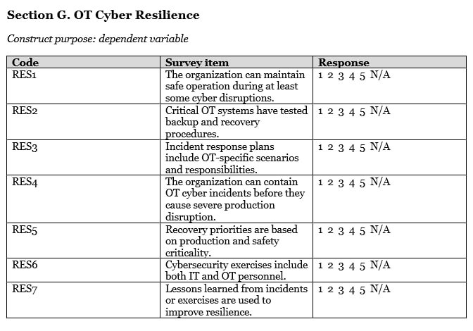

Slide 16
