Slide 1
Introduction to Computational Text Analysis
Introduction to Computational Text Analysis & Corpus Linguistics
Jacek Bąkowski & Michał Woźniak Institute of Polish Language of the Polish Academy of Sciences

Slide 2
What is Computational Text Analysis?

Slide 3
Computational Text analysis
combines:
Linguistics,
Computer Science,
Statistics,
Data Analysis
but also:
Digital Humanities
Literary Studies,
Cognitive Science
and also others, depending on the research question

Slide 4
Purposes of Computational Text Analysis
Generate insights from large collection of documents and of single texts as well:
Extract information from texts,
Find patterns in texts,
Authorship attribution
Analyze meaning
Analyze topics of texts

Slide 5
Purposes of Computational Text Analysis
Switch from subjective analysis to OBJECTIVE, REPEATABLE and MEASURABLE results.

Slide 6
Purposes of Computational Text Analysis
Switch from subjective analysis to OBJECTIVE, REPEATABLE and MEASURABLE results.
We want QUANTIFIABLE results

Slide 7
Real-world example
Can I use the word oftentimes in a scientific paper?

Slide 8
Real-world example
Can I use the word oftentimes in a scientific paper?
We can rely on our intuition, but instead of that we can try to
measure the popularity of these words:
https://books.google.com/ngrams/

Slide 9
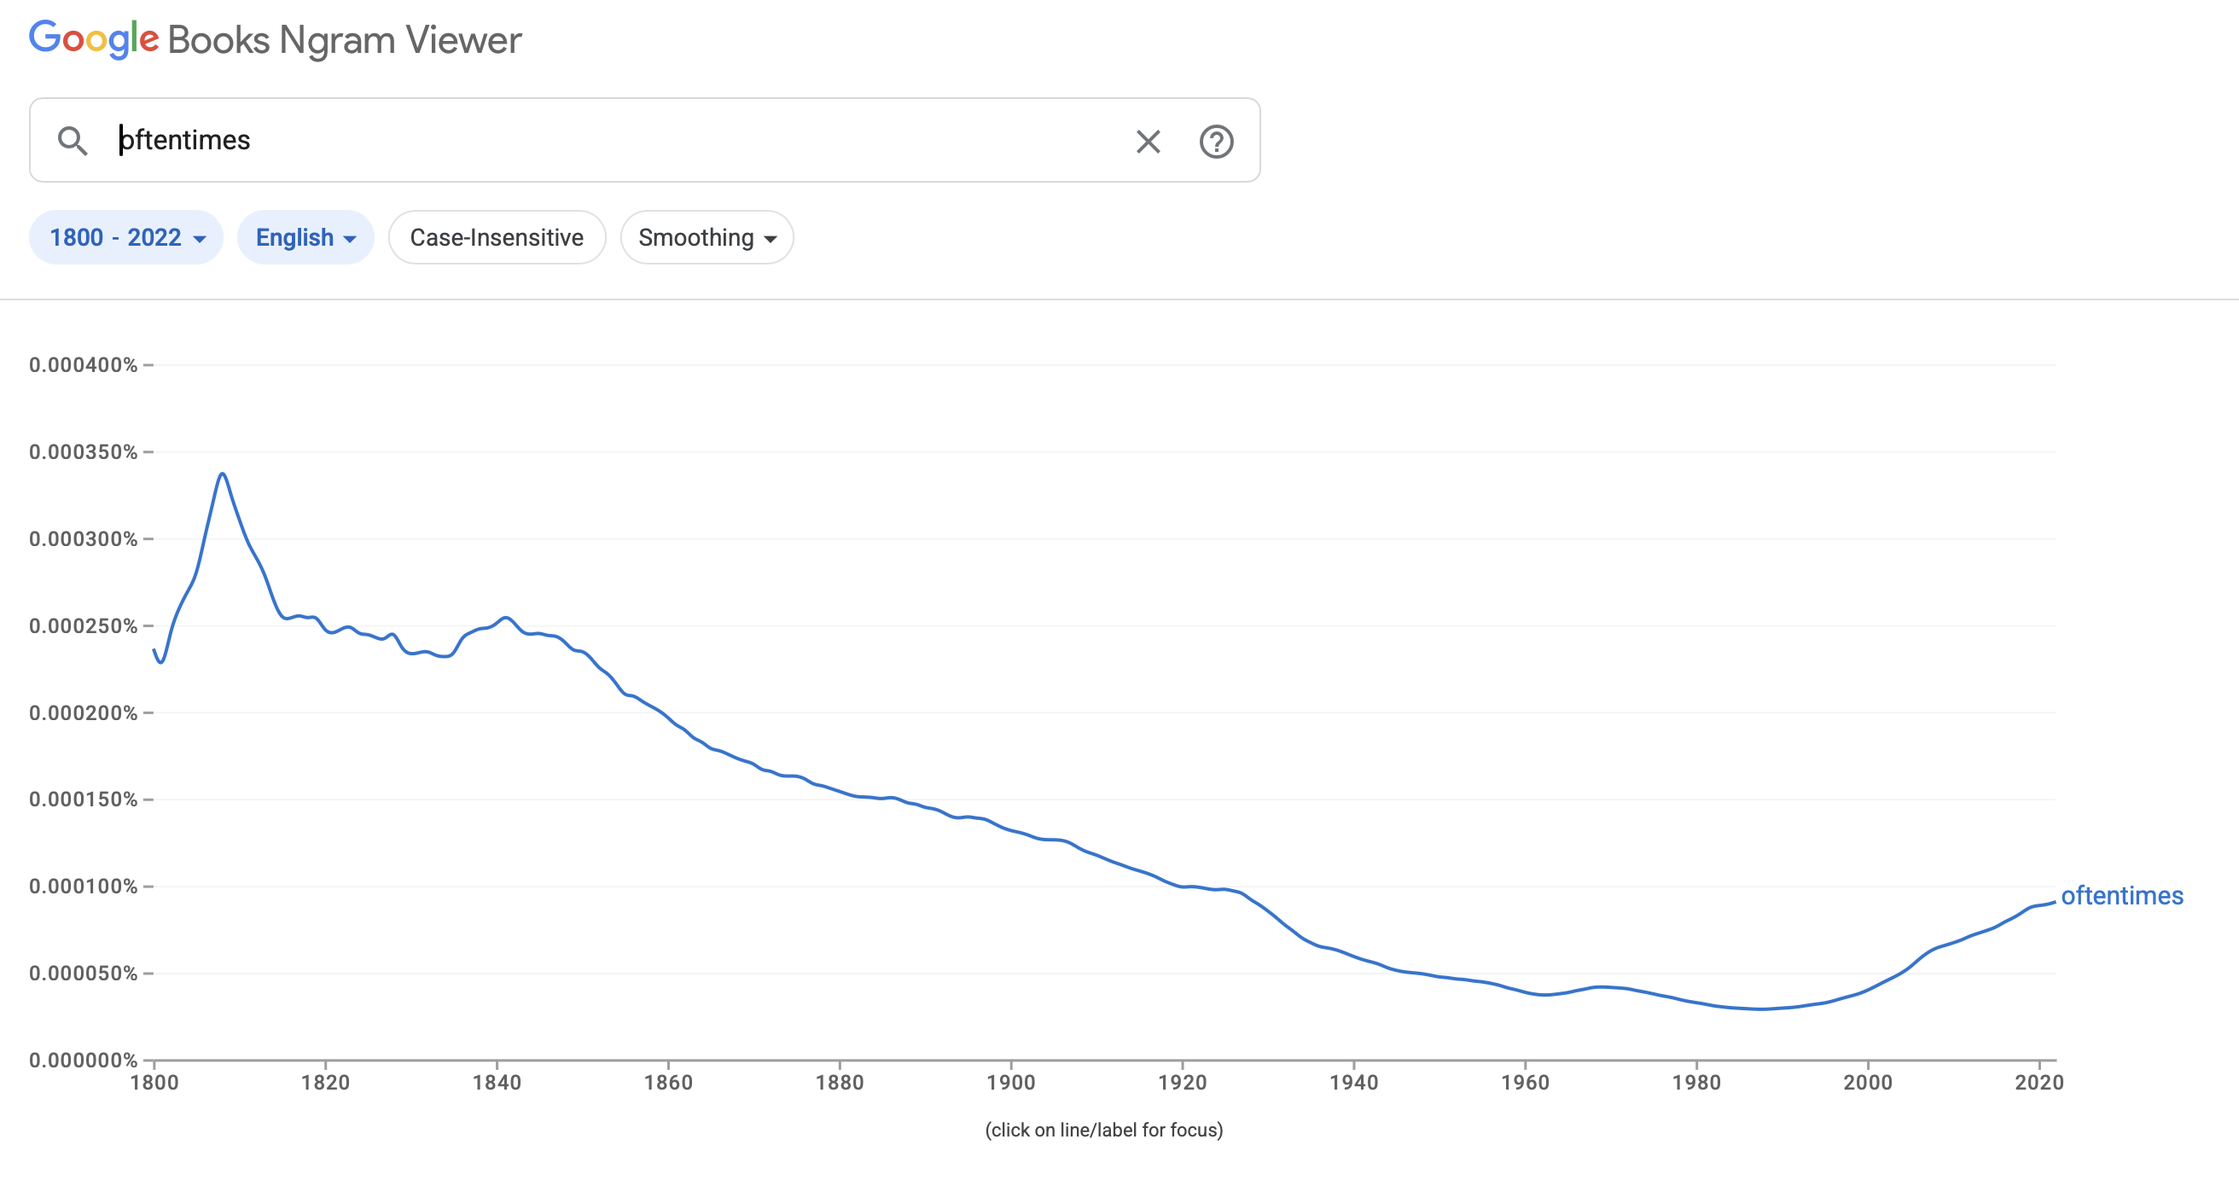

Slide 10
We no longer rely on our intuition
or convictions, but on DATA.
Thus, we need tools to MEASURE
what may seem unmeasurable.

Slide 11
This means, that Computational Text Analysis is not an end in itself.
It is a tool to extract information, check hypothesis and find new insights from any textual information.

Slide 12
Computational text analysis is inherently interdisciplinary and can should support research in any field involving textual material.
It is a SUPPORTING DISCIPLINE for any field that works with text.

Slide 13
This does not replace expert knowledge.
HUMAN EXPERTISE remains essential.

Slide 14
These methods complement than replace domain expertise (we still need to think).
A big part of data science is
in interpreting our results.
Domain knowledge must be incorporated to get the best
of Digital Humanities.

Slide 15

Research in the vein of Digital Humanities can give different answers from those we are used to or from those we know from „classical research”.
However, it is necessary to return from graphs, charts, plots, and AI to the texts and to analyse and interpret them in the face of these data.

Slide 16
Corpus Linguistics

Slide 17
What’s a corpus?
A corpus is a large collection of naturally occurring examples of language stored electronically.

Slide 18
What’s a corpus?
This large collection of texts must be systematically selected and organized rather than gathered randomly.

Slide 19
What’s corpus linguistics?
The Corpus Approach is EMPIRICAL, analyzing the actual patterns of language use in natural texts

Slide 20
What’s corpus linguistics?
The Corpus Approach uses both quantitative and qualitative analytical techniques.

Slide 21
To summarize:
Corpus Linguistics is the study of the language as that language is expressed in a corpus, a body of „real-world” texts
It brings digital tools and methods to the study of the humanities in a multidisciplinary way.

Slide 22
Advantages of the Corpus Driven Approach
The empirical approach in science is primarily associated with the sciences, which base their research on the observation of phenomena, and verify hypotheses through experiments.
Thanks to Corpus Linguistics, this empirical approach is now also possible in Linguistics and other fields that require text analysis.

Slide 23
Advantages of the Corpus-Driven Approach
It allows researchers to obtain objective, repeatable, and measurable results.
These results are derived from large amounts of data that would otherwise be impossible to process manually.
It eliminates the need to rely on people intuitions, which may vary considerably and can be affected by subjective bias.

Slide 24
But also…
Since a linguistic corpus is a large collection of texts and/or spoken utterances, it can be assumed to represent — to some extent — the language and its patterns of use;
but also as part of the collective knowledge and stereotypes embedded in it, which is fascinating.

Slide 25
And all that leads us to….
Quantitative Linguistics

Slide 26
How to prepare a corpus?

Slide 27
Further Readings:
Franco Moretti: Distant Reading

Slide 28
Further Readings:
Monika Zaśko-Zielińska:
Small Corpora – Big Challenges
https://www.researchgate.net/publication/396309936_Maly_korpus_-_wielkie_wyzwania_Small_corpora_-_big_challenges

