Slide 1
Where to rent small start-up office within Toronto?

Slide 2
Introduction
Small companies/start-ups are interested in setting up office in Toronto.
Background & Criteria:
In order to be attractive for prospective employees in addition to be close to public transport (subway) there should be enough attractive amenities around the office.
Office needs to be walking distance from any Toronto Subway station (0-400m)
There have to be enough breakfast, coffee and lunch places around.
Cost of the office space needs to be taken into account.
There should be leisure/recreational venues in vicinity (gym etc).

Slide 3
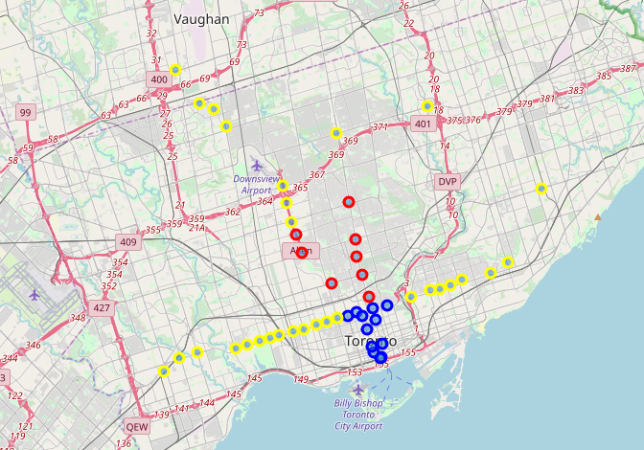
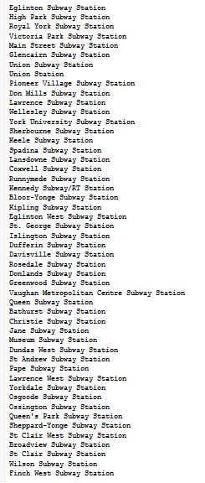
Toronto Metro Network
50 Toronto Metro stations together with locations were pulled form Foursquare.
Each of them was categorised to sit in:
Downtown (blue)
Midtown (red)
Suburb (yellow)
The classification is used as clustering attribute as well as to classify the cost of renting the office.

Slide 4
Method
15 most popular relevant venues were pulled from Foursquare for each metro station vicinity.
Stations were clustered in groups is similar neighbourhoods using various clustering algorithms.
All of them returned very close results.

Slide 5
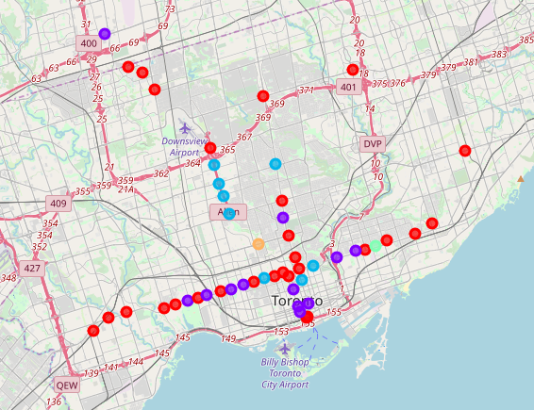
K means

Slide 6
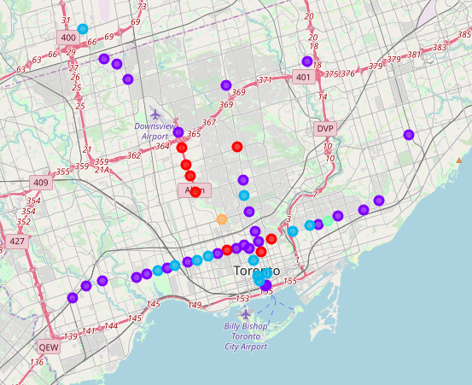
Agglomerative Clustering

Slide 7
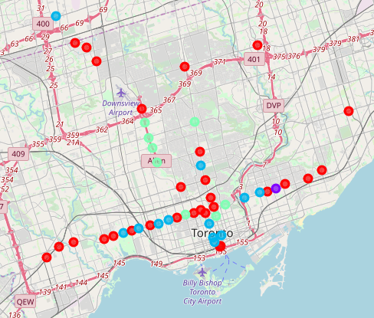
Affinity Propagation

Slide 8
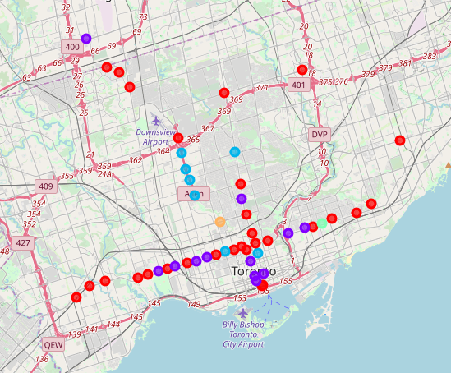
Mean Shift

Slide 9
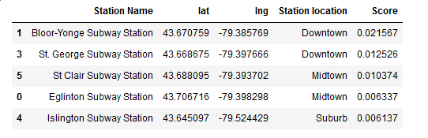
Results
For further analysis only locations from larger (more than 5 elements) clusters were used.
Also, only locations with had all required types of venues were selected from each clustering method output:
- coffee place
- breakfast/lunch/fast food place
- restaurant/bar/pub
fitness venue/gym
Also distance from city centre and office rental cost were used in scoring all stations’ neighbourhoods.
Finally 5 locations were selected with highest scores

Slide 10
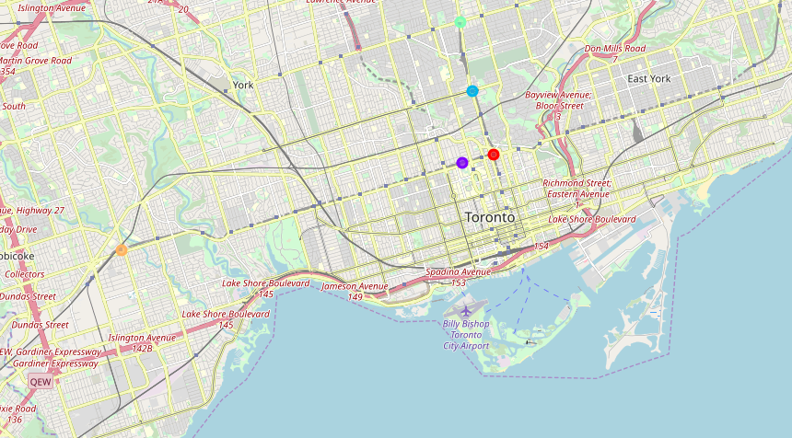
Shortlisted locations.

