Slide 1


Webservice/API Testing
www.theTestingworld.com

Slide 2
Types of WebService
SOAP SERVICES
REST SERVICES ( REST API)

Slide 3
SOAP SERVICES
SOAP Stands for SIMPLE OBJECT ACCESS PROTOCOL
It is use to exchange message between APPLICATIONS/ SYSTEMS
Internally it use HTTP protocol to transfer XML Messages, SOAP protocol is a wrapper over HTTP protocol
Support XML for data exchange (Request and Response)
Heavy Weight / Slow
Use WSDL (Web service definition language)

Slide 4
WSDL
Stands for WEB SERVICE DEFINITION LANGUAGE
It is written in XML Format
It is a base file, which is use to describe web service and how to access them
It also describe different functionalities, how to access them, format, request content etc

Slide 5
RESTful Services(API)
Representation State Transfer
REST is set of guidelines which described how a client should interact with server
RESTful services use HTTP protocol for data exchange between 2 application / machines
Here we can use standard operations like GET, POST, PUT, DELETE
Light Weight, Fast
Data or functionality that a client can access from server is called resource.
We can use WADL or URI to access resource
IT support different types for request and response like XML, JSON, HTML, TXT, PDF

Slide 6
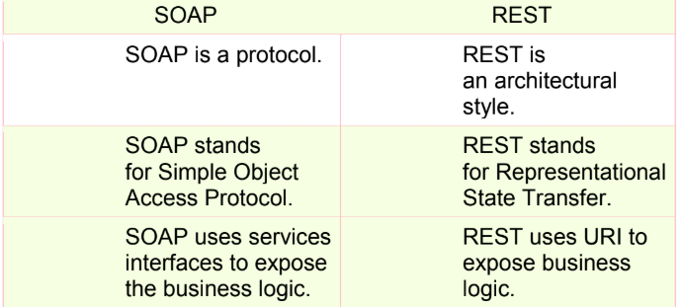
Difference between SOAP & REST

Slide 7
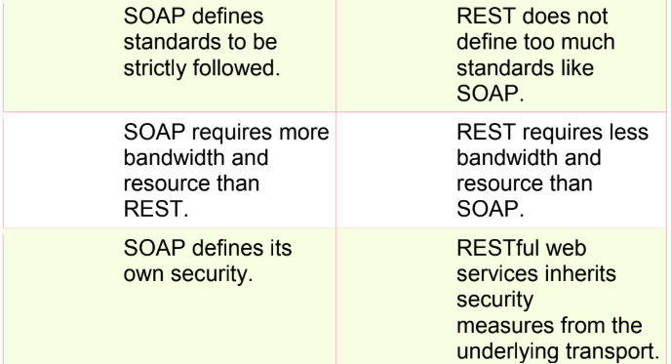
Difference between SOAP & REST

Slide 8
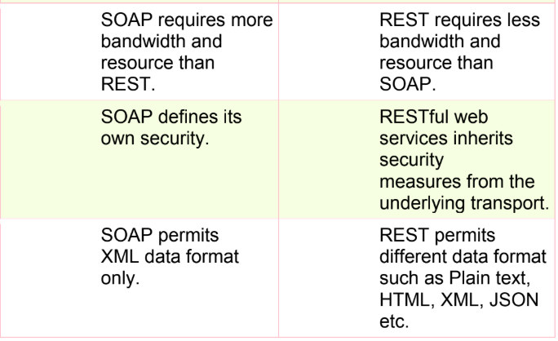
Difference between SOAP & REST

Slide 9
Advantage of REST over SOAP
REST support multiple format to exchange data between 2 application or machine
REST services are faster than SOAP
Less data transfer between machines
SOAP is a protocol but REST is set of guidelines which described how a client should interact with server
SOAP can be access through WSDL only but REST can be access through WADL or URI
<< SOAP Can apply extra security features using SOAP Protocol

Slide 10
Advantage of REST over SOAP
REST support multiple format to exchange data between 2 application or machine
REST services are faster than SOAP
Less data transfer between machines

Slide 11
Advantage of REST over SOAP
REST support multiple format to exchange data between 2 application or machine
REST services are faster than SOAP
Less data transfer between machines

Slide 12
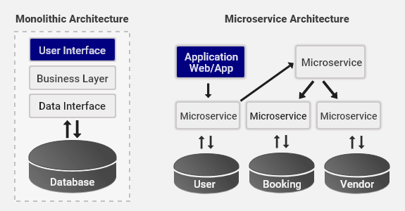
Microservice Architecture

