Slide 1


API Testing REST API REQUEST METHODS

Slide 2
REST API REQUEST METHODS
These methods define what kind of request we are sending to SERVER/APPLICATION
GET : Fetch data from Application
POST : Add new data/ resource to the Application
PUT : Update data into application
DELETE : Delete data in application
PATCH : Similar to PUT method but will require only updated data to send

Slide 3
OTHER METHODS
HEAD : Fetch only header data from the application
OPTIONS : To find out which request methods a server supports (Allow: OPTIONS, GET, HEAD, POST)
TRACE : This method performs a message loop-back means it will return message content as Response, providing a useful debugging mechanism.

Slide 4
API Testing UDDI
www.theTestingworld.com

Slide 5
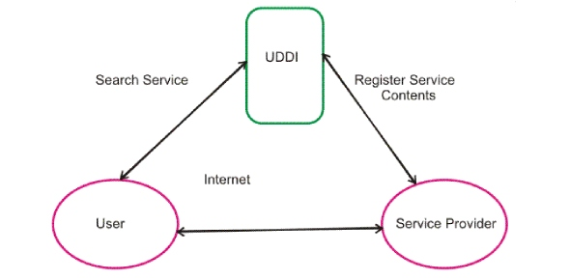
UDDI(http://uddi.xml.org/)

Slide 6
UDDI
UDDI (Universal Description, Discovery, and Integration) is an XML-based registry for businesses worldwide to list themselves on the Internet
It enable companies to find one another on the Web and make their systems interoperable.
UDDI is often compared to a telephone book. The project allows businesses to list themselves by name, product, location, or the Web services they offer.
Registry service for Web services. A UDDI registry service is a Web service that manages information about service providers, service implementations, and service metadata. Service providers can use UDDI to advertise the services they offer.
Service consumers can use UDDI to discover services that suit their requirements and to obtain the service metadata needed to consume those services.

