Slide 1
Grade Prediction Model
Team TA-DA✨
Toyesha Kaushik
Jingyi Qiu
Wayne Hann Ng
Suhirtha Ravindran
Jiawei Qi

Slide 2
Executive Summary
Our goal as Team TA-DA✨is to help both students and educators to identify students’ educational standing, allowing them to make adjustments effectively and accurately to maximise their potential. Students can use their predicted grades to understand where they fall behind, better themselves and get the most out of their education, while educators can use this information to identify any groups that may be disadvantaged and offer extra assistance.
This goal can be achieved by analysing the relationship between socioeconomic factors, lifestyle and academic results, using Python and Machine Learning. Our team managed to create a predictive algorithm that takes student features and predict their grade based on similar instances. We achieved the best results using Support Vector Regression (SVR) with a RMSE (Root Mean Squared Error) of 0.18.
We found that the features that affect grades the most are study time, failed classes and future plans. Conversely, we found that the least important features are availability of free time, consumption of alcohol on weekends, and family relationships.

Slide 3
Background Information
However, not all features are important…
Features:
Sex
Age
Address (Urban vs Rural)
Family size
Parental status
Guardian job
Travel time (to University)
Study time
Failed classes
Absences
Extra support
Extracurricular participation
Future plans
Internet access
Romantic involvement
Family dynamics
Availability of free time
Social interactions
Alcohol intake

Slide 4
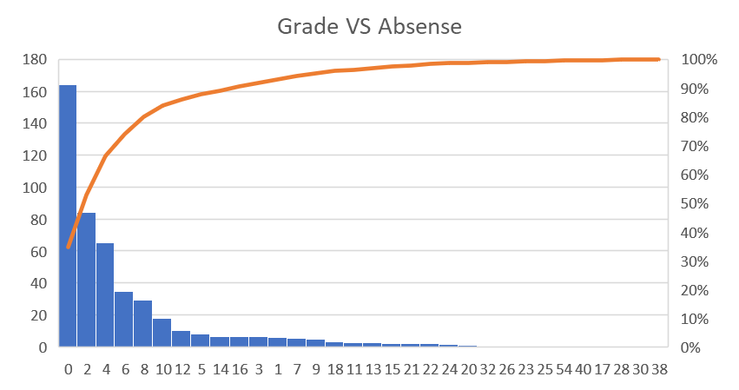
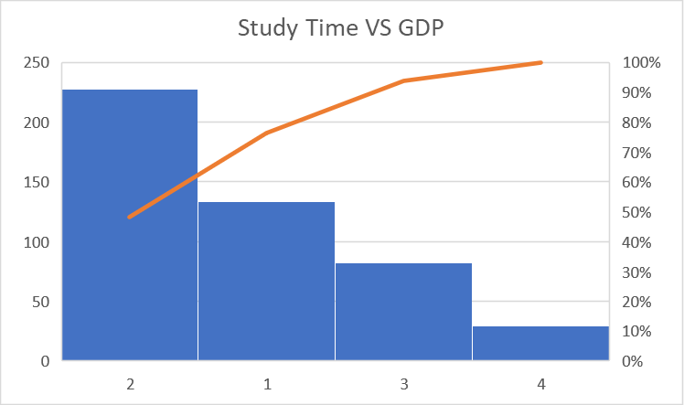
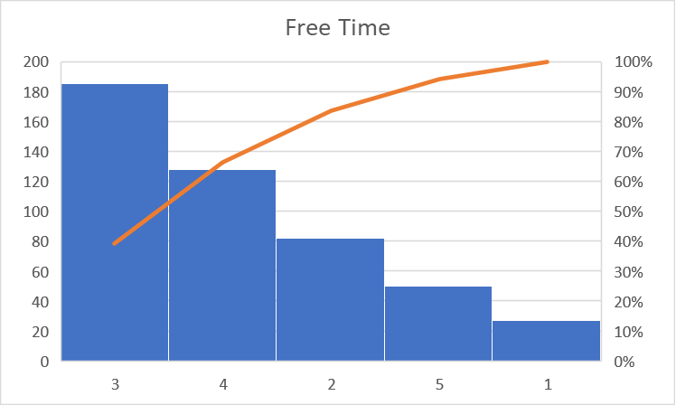
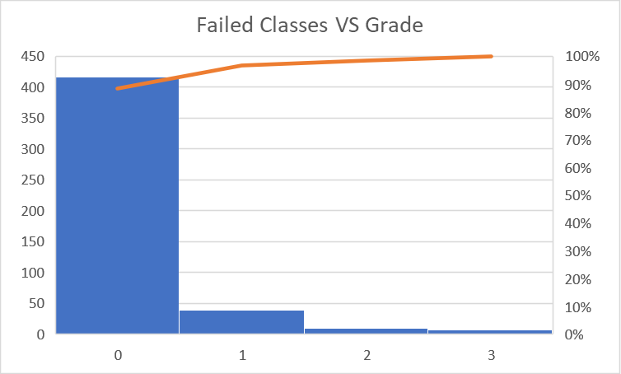
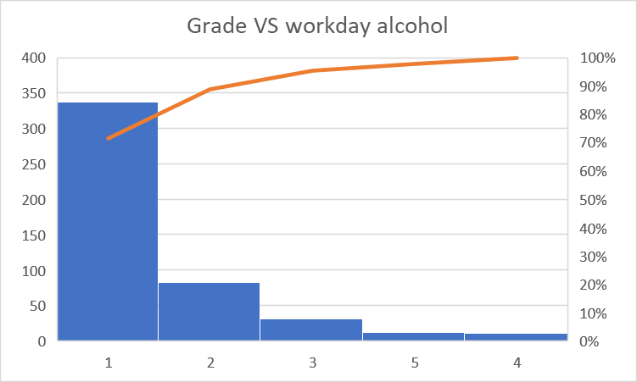
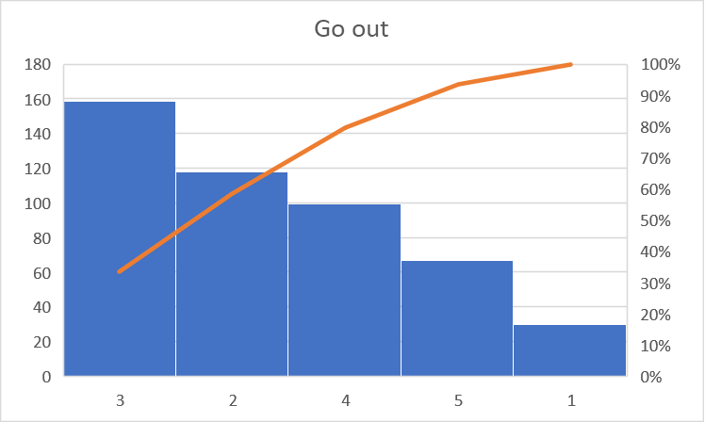
Key Insights - At first glance

Slide 5
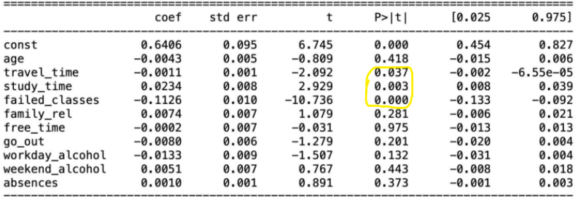
Key Insights - Numerical Analysis
P-Values
The strongest correlating features to the students’ grade are [failed_classes, study_time, travel_time]
The weakest correlating features are [free_time, weekend_alcohol, age]
A P-value is the probability of obtaining test results at least as extreme as the result actually observed, under the assumption that the null hypothesis is correct (Dr. Dahiru, T. 2008). A P-Value of less than 0.05 shows that it is unlikely results happened by chance.

Slide 6
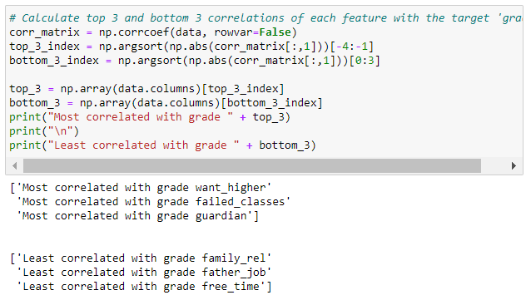
Key Insights - Numerical Analysis
Correlation Matrix
The strongest correlating features to the students’ grade are [want_higher, failed_classes, guardian]
The weakest correlating features are [family_rel, father_job, free_time]

Slide 7
Predictive Model - The Theory
Steps taken:
Data cleanup
Remove duplicate data
Convert to a numeric format for calculation
Replace invalid values with median values
Data selection
Find the most relevant features by finding correlation of features
Drop the lowest correlating features
Data splitting
Split the data into Training, Test and Validation sets
Pipeline creation
Validate the efficacy of the model
Find the model that gives the best RMSE with test data
Use the model for data prediction

Slide 8
Predictive Model - The Theory (cont.)
The Pipeline: What is SVR?
SVR (Support Vector Regression) is a type of SVM (Support Vector Machine) algorithm, used for classification and regression, the principle used to predict a value.
SVR is the best choice given that:
It gave the lowest RMSE value, which means the error between a predicted and real value is minimal
SVR is less sensitive to outliers, this is because SVR tries to fit the lie within a certain threshold, ensuring outliers don’t affect the general trend
SVR is flexible, it doesn’t assume a strictly linear relationship, allowing a more complex relationship to be captured

Slide 9
Predictive Model - The Code
Libraries and toolkits used:
Data access and processing
import pandas as pd
import numpy as np
from sklearn.preprocessing import StandardScaler
from sklearn.model_selection import train_test_split
Data plotting and observation
import matplotlib.pyplot as plt
from sklearn.metrics import mean_squared_error
Algorithm and pipeline creation
from sklearn.pipeline import Pipeline
from sklearn.pipeline import make_pipeline
from sklearn.linear_model import LinearRegression
from sklearn.svm import SVR

Slide 10
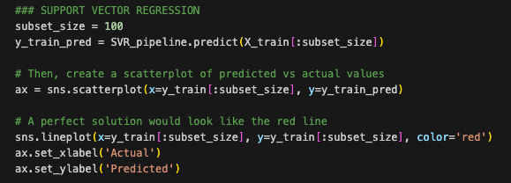
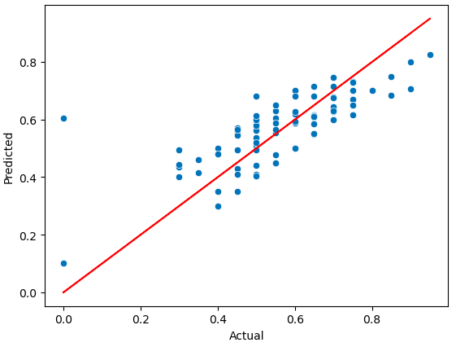
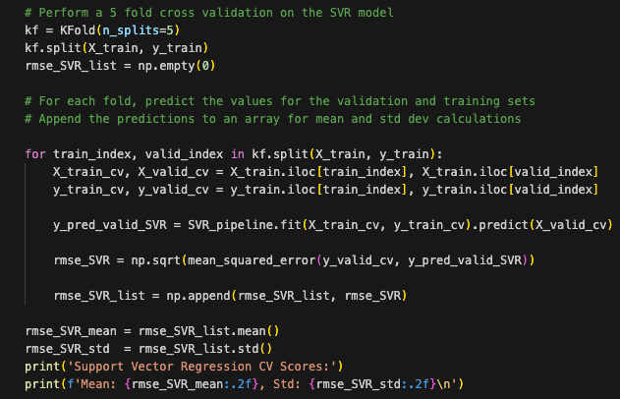
Predictive Model - The Code (cont.)

Slide 11
Thank you for your time, please contact Team TA-DA✨ for any enquiries

