Slide 1
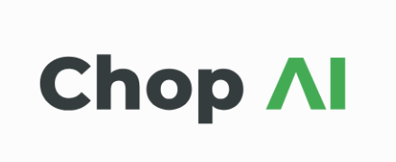
Comprehensive Hospital Outcome Prediction
AI assisted resource allocation and planning made easy

Slide 2
PITCH
In the medical sphere, predicting and allocating resources needed is a difficult task
Our vision is to help hospitals better plan and allocate resources
By developing a model that predicts patient outcomes, hospitals can make more efficient resource allocation decisions

Slide 3

Proposed Solution
Develop a model that can predict aspects of patient stay, including duration and risk of death
By having a better understanding of patient needs, hospitals can plan for resource allocation
This model will leverage patient information to make accurate predictions

Slide 4
Technologies Used
Python
Pandas
Scikit-learn
Numpy
Seaborn
Matplotlib
FastAPI
Uvicorn
W3 HTML Elements

Slide 5
Objectives
Dummy Hospital: Create a fake hospital with room, patient, and staff records
Data preparation: Extract and join relevant information from multiple CSV files
Develop a Predictive Model: Create a model capable of accurately predicting patient outcomes
Model Accuracy: Set a baseline of 80% for a successful model
Hospital Management System: Create a management suite for patient and staff management
Deploy Model: Integrate the model into the management software

Slide 6

Data Sources
MIMIC-IV Clinical Database: Provides comprehensive clinical information on patients
It contains data from patients admitted to Beth Israel Deaconess Medical Center

Slide 7

Models
Length of Stay: Random Forest Regression Model that explains 78% of the variance in the target variable
Death Prediction: Logistic Regression Model with 98% classification accuracy
Readmissions: Random Forest Classifier with 84% accuracy

Slide 8
Conclusion
The CHOP Model demonstrates the potential of machine learning in healthcare
Historical data provides actionable insights for informed decision-making
Improves patient outcomes and optimizes resource allocation
Demo dashboard provides useful metrics for hospital administrators

Slide 9
Thank you for your time and attention 🙂

