Slide 1

Comprehensive Hospital Outcome Prediction
AI assisted resource allocation and planning made easy
Presentation By
Calvine Dasilver, Christine Malinga, Ian Musau, Jacinta Chepkemoi, Tabitha Berum

Slide 2

Project Overview

Slide 3
Problem Statement
In the medical sphere, predicting and allocating resources needed is a difficult task
Our vision is to help hospitals better plan and allocate resources
By developing a model that predicts patient outcomes, hospitals can make more efficient resource allocation decisions

Slide 4
General Objective
Develop Predictive Models capable of accurately predicting patient outcomes. Outcomes predicted will be length of stay, chance of readmission and risk of death. This will be provided through an analytics dashboard and a callable API.
Specific Objectives
Dummy Hospital: Create a fake hospital with room, patient, and staff records
Data preparation: Extract and join relevant information from multiple CSV files
Model Accuracy: Set a baseline of 80% for a successful model
Hospital Management System: Create a management suite for patient and staff management
Deploy Model: Integrate the model into the management software

Slide 5

Data Sources
MIMIC-IV Clinical Database: Provides comprehensive clinical information on patients
It contains data from patients admitted to Beth Israel Deaconess Medical Center

Slide 6

Proposed Solution
Develop a model that can predict aspects of patient stay, including duration and risk of death
By having a better understanding of patient needs, hospitals can plan for resource allocation
This model will leverage patient information to make accurate predictions

Slide 7
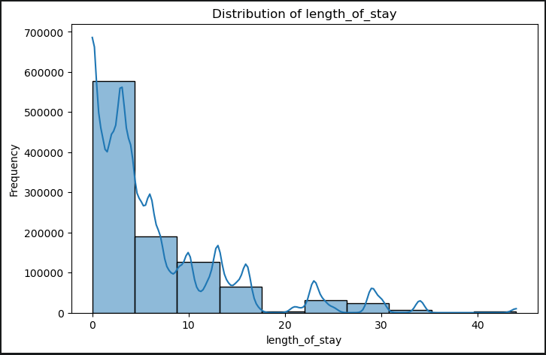
EDA Length of Stay Findings
On examining the distribution of the length of stay variable we found the vast majority of stays were 5 days or less.

Slide 8
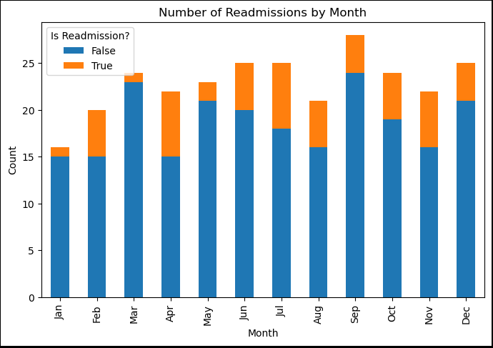
EDA Readmission Findings
The readmission variable shows no discernible patterns in terms of seasonality or raw numbers.

Slide 9

Models
Length of Stay: Random Forest Regression Model that explains 78% of the variance in the target variable
Death Prediction: Logistic Regression Model with 98% classification accuracy
Readmissions: Random Forest Classifier with 84% accuracy

Slide 10
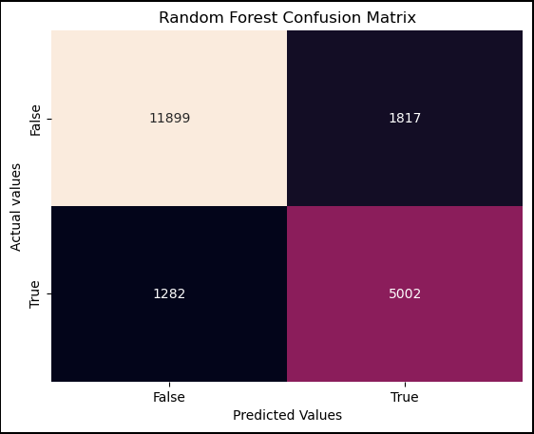
Readmission Model
The readmission model shows good accuracy in predicting the variable. Despite the class imbalance, it is still able to predict both classes well.

Slide 11
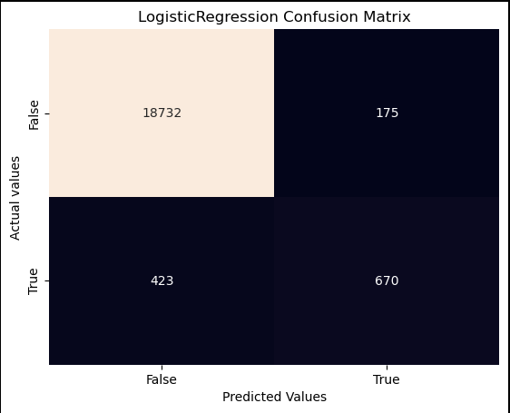
Death Model
The death model was very accurate in its predictions showing 97% accuracy. Even with the class imbalance of the True class, it still performs well in all classifications.

Slide 12

Recommendations
Training data: The models were trained on a small subset of the data (less than 1%). Using the full dataset would lead to even more accuracy on predictions.
Expanding Features: Including additional features such as patient lifestyle factors to improve prediction accuracy.
Number of predictions: More models can be trained to predict additional outcomes. This would give a more complete picture of the patient’s stay.
Personnel training: Administrators will have to be trained to use the system and showcase how it can be of help to their operations.

Slide 13
Conclusion
The CHOP Model demonstrates the potential of predictive models in healthcare
Historical data provides actionable insights for informed decision-making
Improves patient outcomes and optimizes resource allocation
CHOP dashboard provides useful metrics for hospital administrators

Slide 14
Thank you for your time

