Slide 1
Final project of the course
Mathematics for Computer Science and Introduction to Problem-Solving Techniques

Slide 2
Sławomir Jaciubek
40 y.o
I work as a UAV pilot at a thermal power plant.
I have a master’s degree in chemistry and environmental protection.
I am interested in science, programming, drones, history and motoring.
In my free time, I read popular science magazines and spend time in nature.

Slide 3
Block 1. Personal life optimization

Slide 4
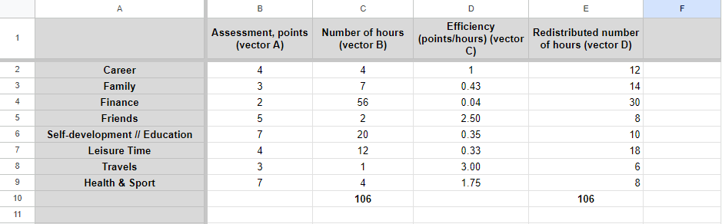
Actual and desired allocation of my time
Actual and desired allocation of my time:
Column C in this picture represent the actual allocation of my time, column E represent desired allocation of my time.

Slide 5
Necessary life changes, decisions made, action
Career:
Changing my job to a more satisfying one that allows you to maintain a balance with your free time
Family:
Planning more time for family
Finances:
Investing financial surpluses to obtain additional dividends
Friends:
Planning more time to meet friends and attend meetings.

Slide 6
Necessary life changes, decisions made, action
Self-development and education:
Setting more ambitious goals and achieving them. You participated in valuable courses providing new skills.
Free time:
Paying more attention to rest, greater involvement in your hobbies and developing your passions.
Travels:
Planning one longer trip in a selected direction at least once a year, e.g. during vacation. Planning short weekend trips to nearby locations throughout the year.
Health and sports:
Spending more hours on moderate physical exercise to improve the overall condition of the body for health prevention purposes

Slide 7
Results of changes implementation
Increasing your sense of happiness and fulfillment in life. improving mental health.
Increasing time devoted to the family will improve relationships within the family and improve family bonds.
Improving overall personal self-development, acquiring new extraordinary skills.
Improving the quality of life by increasing income to the family budget.
More optimal time management will increase the amount of free time that can be devoted to pleasures.
Increased physical activity will help keep your body in good health and fitness in the long run.

Slide 8
Block 2. Description of your project
The project involves creating and then implementing a website.
A team of employees works on the project, each of whom is responsible for a different part of the project.
The individual stages of the project concern the design and coding of the website, the implementation of advanced functions such as payment processing and testing the finished product.
The total duration of the project is approximately 20 weeks.

Slide 9
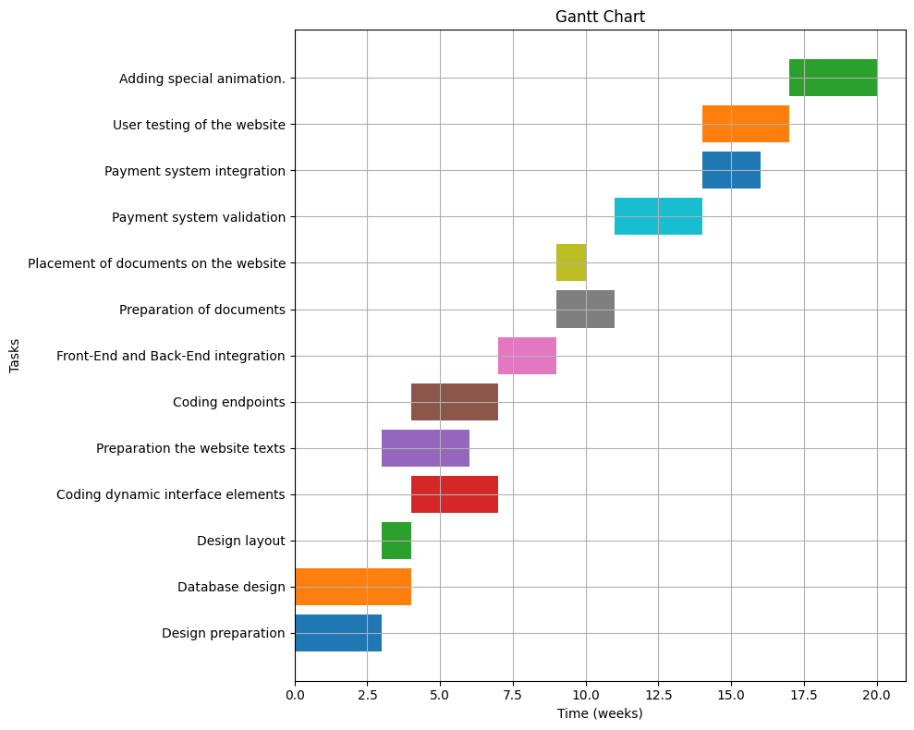
The Gantt chart

Slide 10
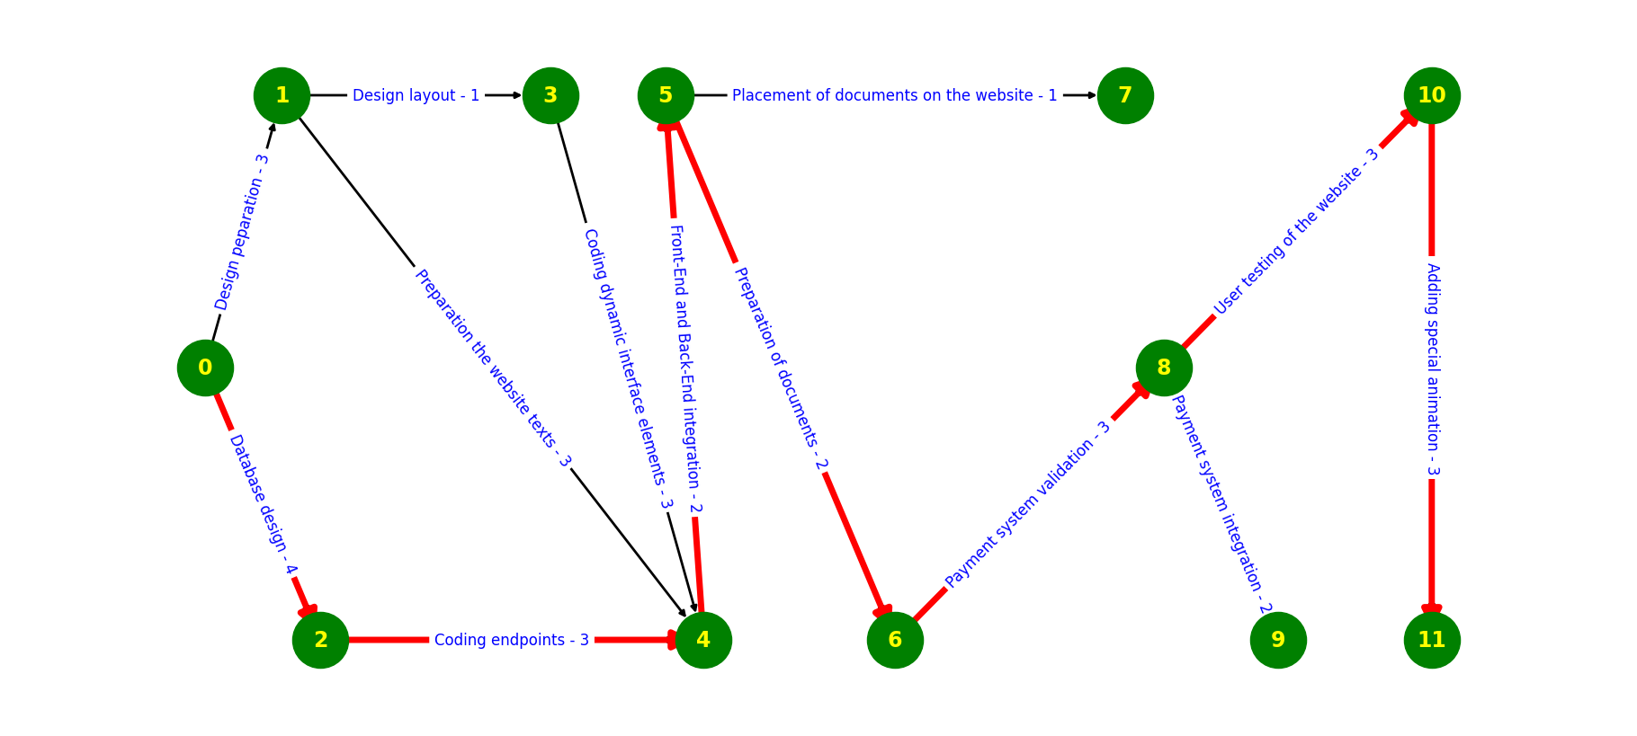
Critical project route

Slide 11
Conclusions (1/2)
Here's a suggested process for creating a web application based on the given stages:
Design Preparation:
Gather requirements from stakeholders and define the scope of the web application.
Create wireframes or mockups to visualize the layout and functionality of the application.
Database Design:
Design the database schema based on the data requirements of the application.
Choose the appropriate database management system (e.g., MySQL, PostgreSQL) and set up the database.
Design Layout:
Create the visual design of the web application, including colors, typography, and overall aesthetics.
Ensure the design is responsive and optimized for various screen sizes.
Coding Dynamic Interface Elements:
Develop dynamic elements of the user interface using front-end technologies such as HTML, CSS, and JavaScript.
Implement interactivity and user experience enhancements using libraries or frameworks like React, Angular, or Vue.js.
Preparation of Website Texts:
Write and prepare the content for the web pages, including text, images, and multimedia elements.
Ensure the content is engaging, informative, and aligned with the overall design and messaging of the application.
Coding Endpoints:
Develop server-side logic and APIs (Application Programming Interfaces) to handle data processing and communication with the client-side.
Choose a suitable server-side programming language and framework (e.g., Node.js with Express, Django, Flask).
Front-End and Back-End Integration:
Integrate the front-end and back-end components of the application to ensure seamless communication and data flow.
Test API endpoints and data retrieval mechanisms to ensure they function correctly.

Slide 12
Conclusions (2/2)
Here's a suggested process for creating a web application based on the given stages:
Front-End and Back-End Integration:
Integrate the front-end and back-end components of the application to ensure seamless communication and data flow.
Test API endpoints and data retrieval mechanisms to ensure they function correctly.
Preparation of Documents:
Compile and organize any necessary documents, such as user manuals, FAQs, or legal documents.
Ensure documents are accurate, up-to-date, and easily accessible to users.
User Testing of the Website:
Conduct usability testing and gather feedback from real users to identify any issues or areas for improvement.
Iterate on the design and functionality based on user feedback to enhance the user experience.
Placement of Documents on the Website:
Integrate documents into the web application, ensuring they are accessible from relevant pages or sections.
Implement navigation and search functionalities to help users find and access documents easily.
Payment System Validation:
Validate and test the payment system to ensure secure and reliable transaction processing.
Verify that payment-related functionalities such as checkout, payment gateways, and order processing work as expected.
Payment System Integration:
Integrate the payment system into the web application, enabling users to make purchases or payments seamlessly.
Ensure compliance with relevant payment regulations and standards (e.g., PCI DSS) for handling sensitive payment information.
Adding Special Animation:
Enhance the visual appeal and user experience by adding special animations or effects to the web application.
Use modern web technologies like CSS animations, SVG, or JavaScript libraries to implement animations tastefully without impacting performance.

Slide 13
Block 3. The cost of change in the long-term perspective
The process represents the company's revenue dynamics before and after implementing key investments.
The model shows the impact of decisions on the company's financial trajectory.

Slide 14
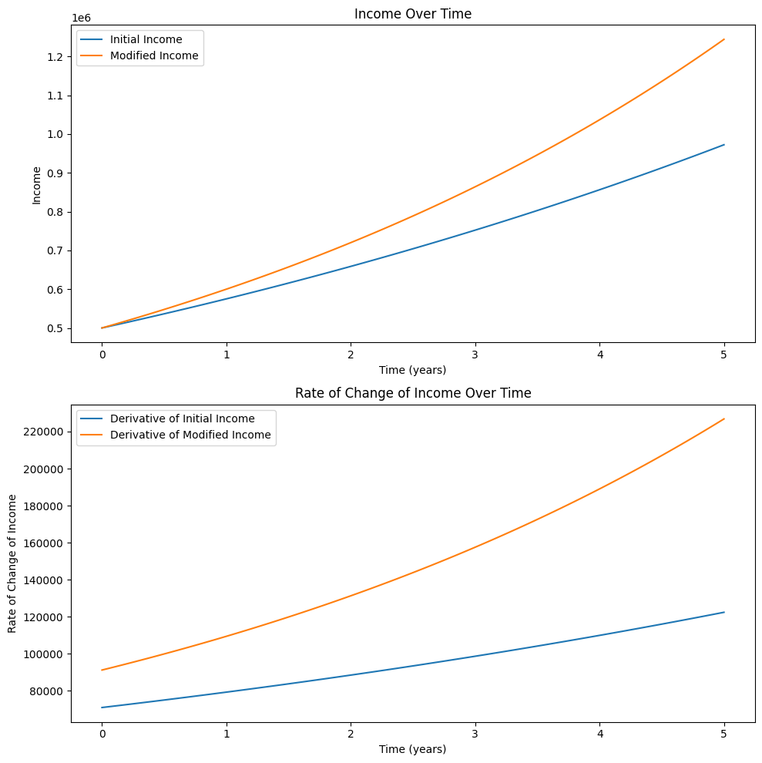
Graphing a function and its derivative to changes

Slide 15
The result before and after the changes and the cost of the solution
Total revenue before changes: $ 3 574 193
Total revenue before changes: $ 4 081 608
Cost of the decision: $ 507 415
The data presented show the increase in the company's revenues after taking into account the incurred costs.

Slide 16
Block 4: Probabilistic solution

Slide 17
Description of a probabilistic situation
Description of a probabilistic situation: you invest in a company, hire a new employee, etc. In terms of justification, you can consider decision-making in risk conditions.
Assessment of the probabilities of this event. Description and justification of your decision.

Slide 18
Assessment of event probabilities
Probability of Success (P(S)): There is a 70% chance that the new employee will meet the sales targets.
Probability of Failure (P(F)): There is a 30% chance that the employee will not meet the success

Slide 19
Description and justification of the decision
The value representing the average expected increase in monthly revenue after taking into account the probability of success and the risk of failure, or EMV for short, was $51,200.
Presumably, the new hire will help the company expand its market reach and customer base, which is crucial for long-term growth.

Slide 20
Block 5. Decision Optimization

Slide 21
Situation description
The design office is working on introducing a new line of men's suits and accessories dedicated to each set, such as footwear, watches and jewelry. The projects require extensive knowledge and commitment of employees, and work schedules overlap. The goal is to maximize productivity by optimizing employees' working time on individual project stages. For customer satisfaction, it is also necessary for work to be carried out on time without exceeding the total number of man-hours available.

Slide 22
Justification of the optimization task
The company employs a limited number of qualified employees.
The working hours limit for each of them is 40 hours per week.
Projects developed in the company have strict time frames because these are the clients' requirements.
These deadlines cannot be exceeded in order to maintain good customer relations and to ensure their satisfaction.
Optimizing employee working time can reduce empty working hours and increase employee productivity.

Slide 23
Solution
Optimal hours distribution among employees and projects:
Employee 1, Project 1: 20.0
Employee 1, Project 2: 20.0
Employee 2, Project 1: 40.0
Employee 2, Project 2: 0.0
Employee 3, Project 1: 0.0
Employee 3, Project 2: 40.0
Maximized productivity: $560.0

Slide 24
Conclusions
A maximum productivity of $560 will be achieved if projects 1 and 2 each receive 60 hours of work.

Slide 25
How I see my future ?
I would like to become a JavaScript and/or Python programmer or work in the broadly understood IT industry.
I would also like to develop in the UAV (drone) piloting services industry.

Slide 26
Thank you for watching…

