Slide 1


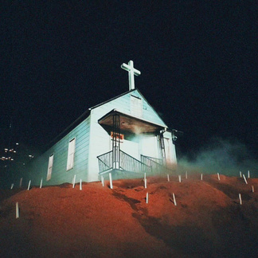

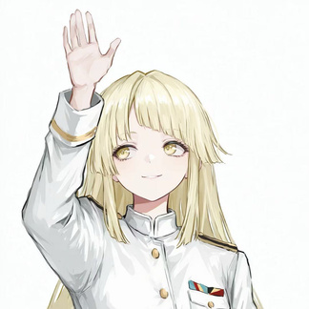


TagIt!
DECO MAY CRY
Caesar
Henry Lee
Chen Li
Responsible for communication and interviews
Responsible for prototype building
Graffiti painting and design
Eden Liang
Shino Peng
Focus on literature research and documental work
Interested in game design and gamification
OUR STRENGTHS
User Research & Domain Understanding
UI & Visual Design
Prototyping & Technical Development
Team Collaboration & Complementary Skills
Notes:
Hello everyone.
Our team name is Deco May Cry, which is a clear reference to the video game Devil May Cry, and our project is called TagIt!. The idea behind the name is that, just like tagging a wall with graffiti, our system will let people leave their own playful marks in urban environments — but in a digital and collaborative way.
We are a group of five students, with mixed backgrounds in IT and Computer Science. While our programs are similar, each of us focuses on different aspects: some are more interested in coding and prototyping, while others lean towards design, user experience, or collaboration.
As a team, our strengths can be seen in four main areas:
User Research and Domain Understanding – we want to explore how people interact in public spaces, and we plan to use interviews and observations to build this understanding.
UI and Visual Design – some members have already worked on visual-oriented projects. This gives us a foundation to explore the style of a digital graffiti system.
Prototyping and Technical Development – we have the ability to build interactive prototypes and translate ideas into working demos.
And finally, Team Collaboration and Complementary Skills – even though our studies overlap, our different interests mean we can support each other across design and technical work.
Overall, we believe our combined skills and interests will allow us to develop a creative and technically sound project.

Slide 2
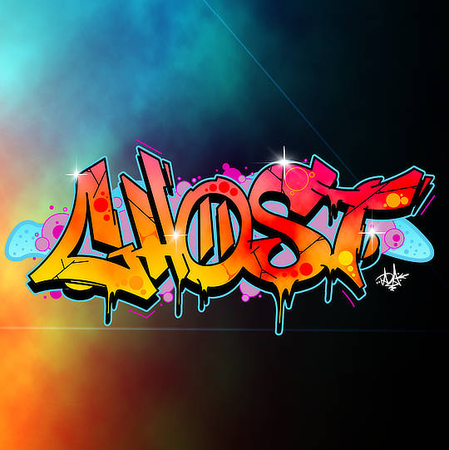
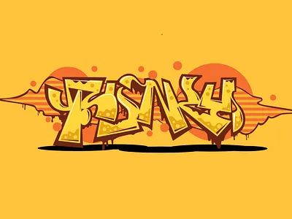
DOMAIN
Social creation of digital art in public spaces
Definition
It is a combination of technology and art creation in public areas.
This allows interaction with digital artworks in the community.
Encouraging diversive participation.
Enhances community engagement and belonging.
Potential problems
Limited butget for the maintenance of large scale of outdoor hardware.
Need to address respect of the local traditions
Encourage and attract particpants to take part in
Notes:
The domain of our project is Social creation of digital art in public spaces.
This involves combining technology and art creation in public areas, so that people can create their artworks together and exchange their ideas around those pieces.
It encourages diverse community participation, allowing people from different backgrounds to collaborate creatively. It also promotes community engagement and belonging by building stronger bonding in the community. On the other hand, this approach makes graffiti easier to approach, it allows people to experience with art, rather than just obersving it.
There are serveral challenges we need to address. First, there is limited butget for us to maintain and install the large scale of outdoor hardware. Moreover, it is necessary to address the respect of the local customs and values, so that everyone can feel welcome. Lastly, eye-catching design is essential to attract people to take part in this activity.
In conclusion, art is a common language of the world, it draws people in and encourages them to interact with one another. Although it requires a high-cost of installations and maintenance, it makes a community much more stronger and more inclusive.

Slide 3

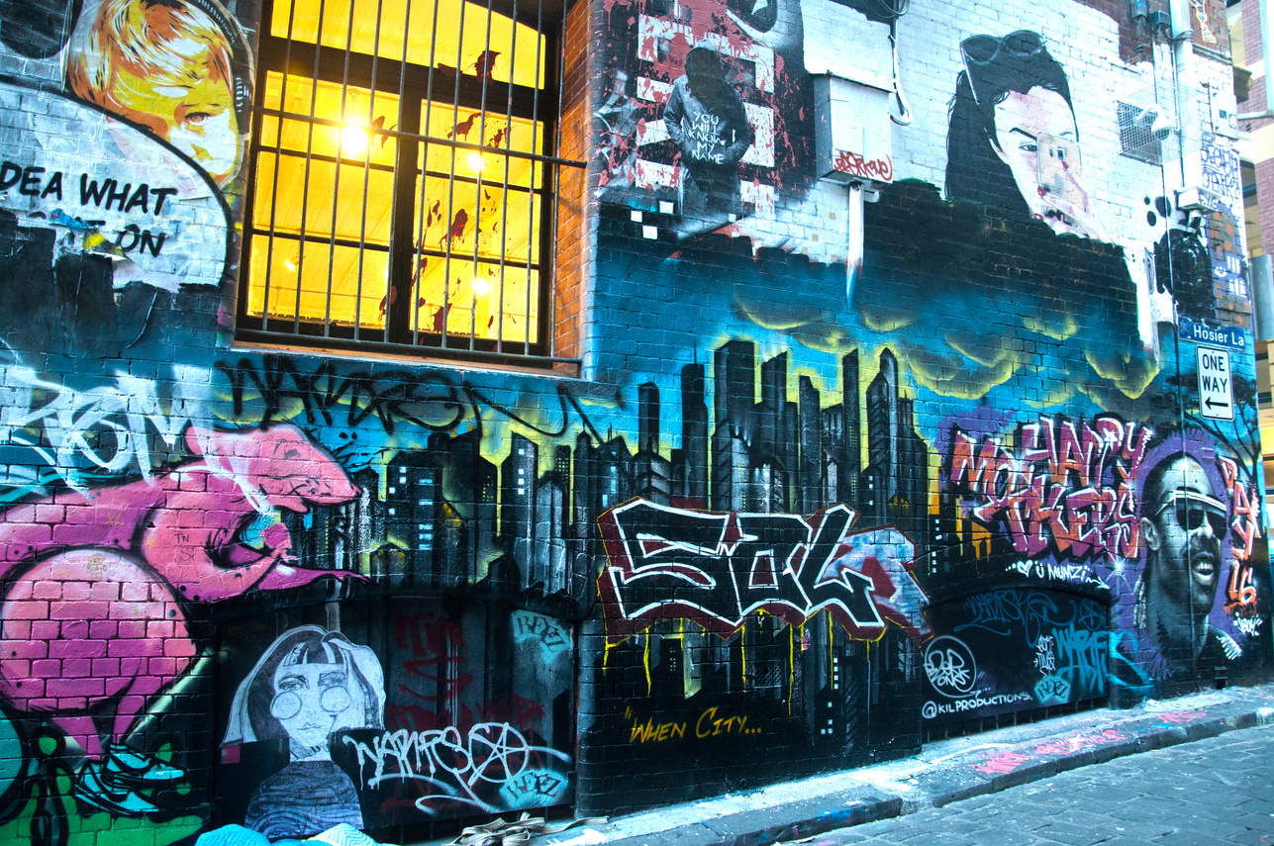
Inspiration
Based on Engaging Public Spaces: Designing for a Playful Live Community Experience (Hamid et al., 2024)
Opportunity
Provide a safe, legal, and low-barrier platform for public expression
Transform graffiti into a digital, playful, and interactive experience
Enable instant social interaction: artworks overlap, compete, and fade
Strengthen community identity & belonging through co-creation
Transform urban public spaces into inclusive, playful, and creative platforms where citizens can freely express, interact, and co-create.
Notes:
Our design opportunity is inspired by the paper Engaging Public Spaces: Designing for a Playful Live Community Experience by Hamid and colleagues in 2024
.
The authors highlight the concept of playful placemaking, which uses play and co-design to activate public spaces, foster social interaction, and build community identity. We build on this idea to imagine a new form of digital graffiti.
In many cities, graffiti is often seen as vandalism, with high costs and legal issues. But people, especially young citizens, still have a strong desire for creativity and expression. What is missing is a safe and accessible platform.
Our opportunity is to transform graffiti into a digital, playful, and interactive experience. Anyone can create on a public screen or with their phone. The artworks appear in real time, overlap with others, and slowly fade away. This not only recreates the temporary and competitive nature of graffiti, but also makes it legal and sustainable.
Through this, we see three opportunities: lowering the barrier so everyone can be an artist, enabling instant social interaction between strangers, and strengthening a sense of belonging in the community.
In short, our design opportunity is to use playful placemaking to transform urban spaces into inclusive and creative platforms where citizens can freely express, interact, and co-create.

Slide 4

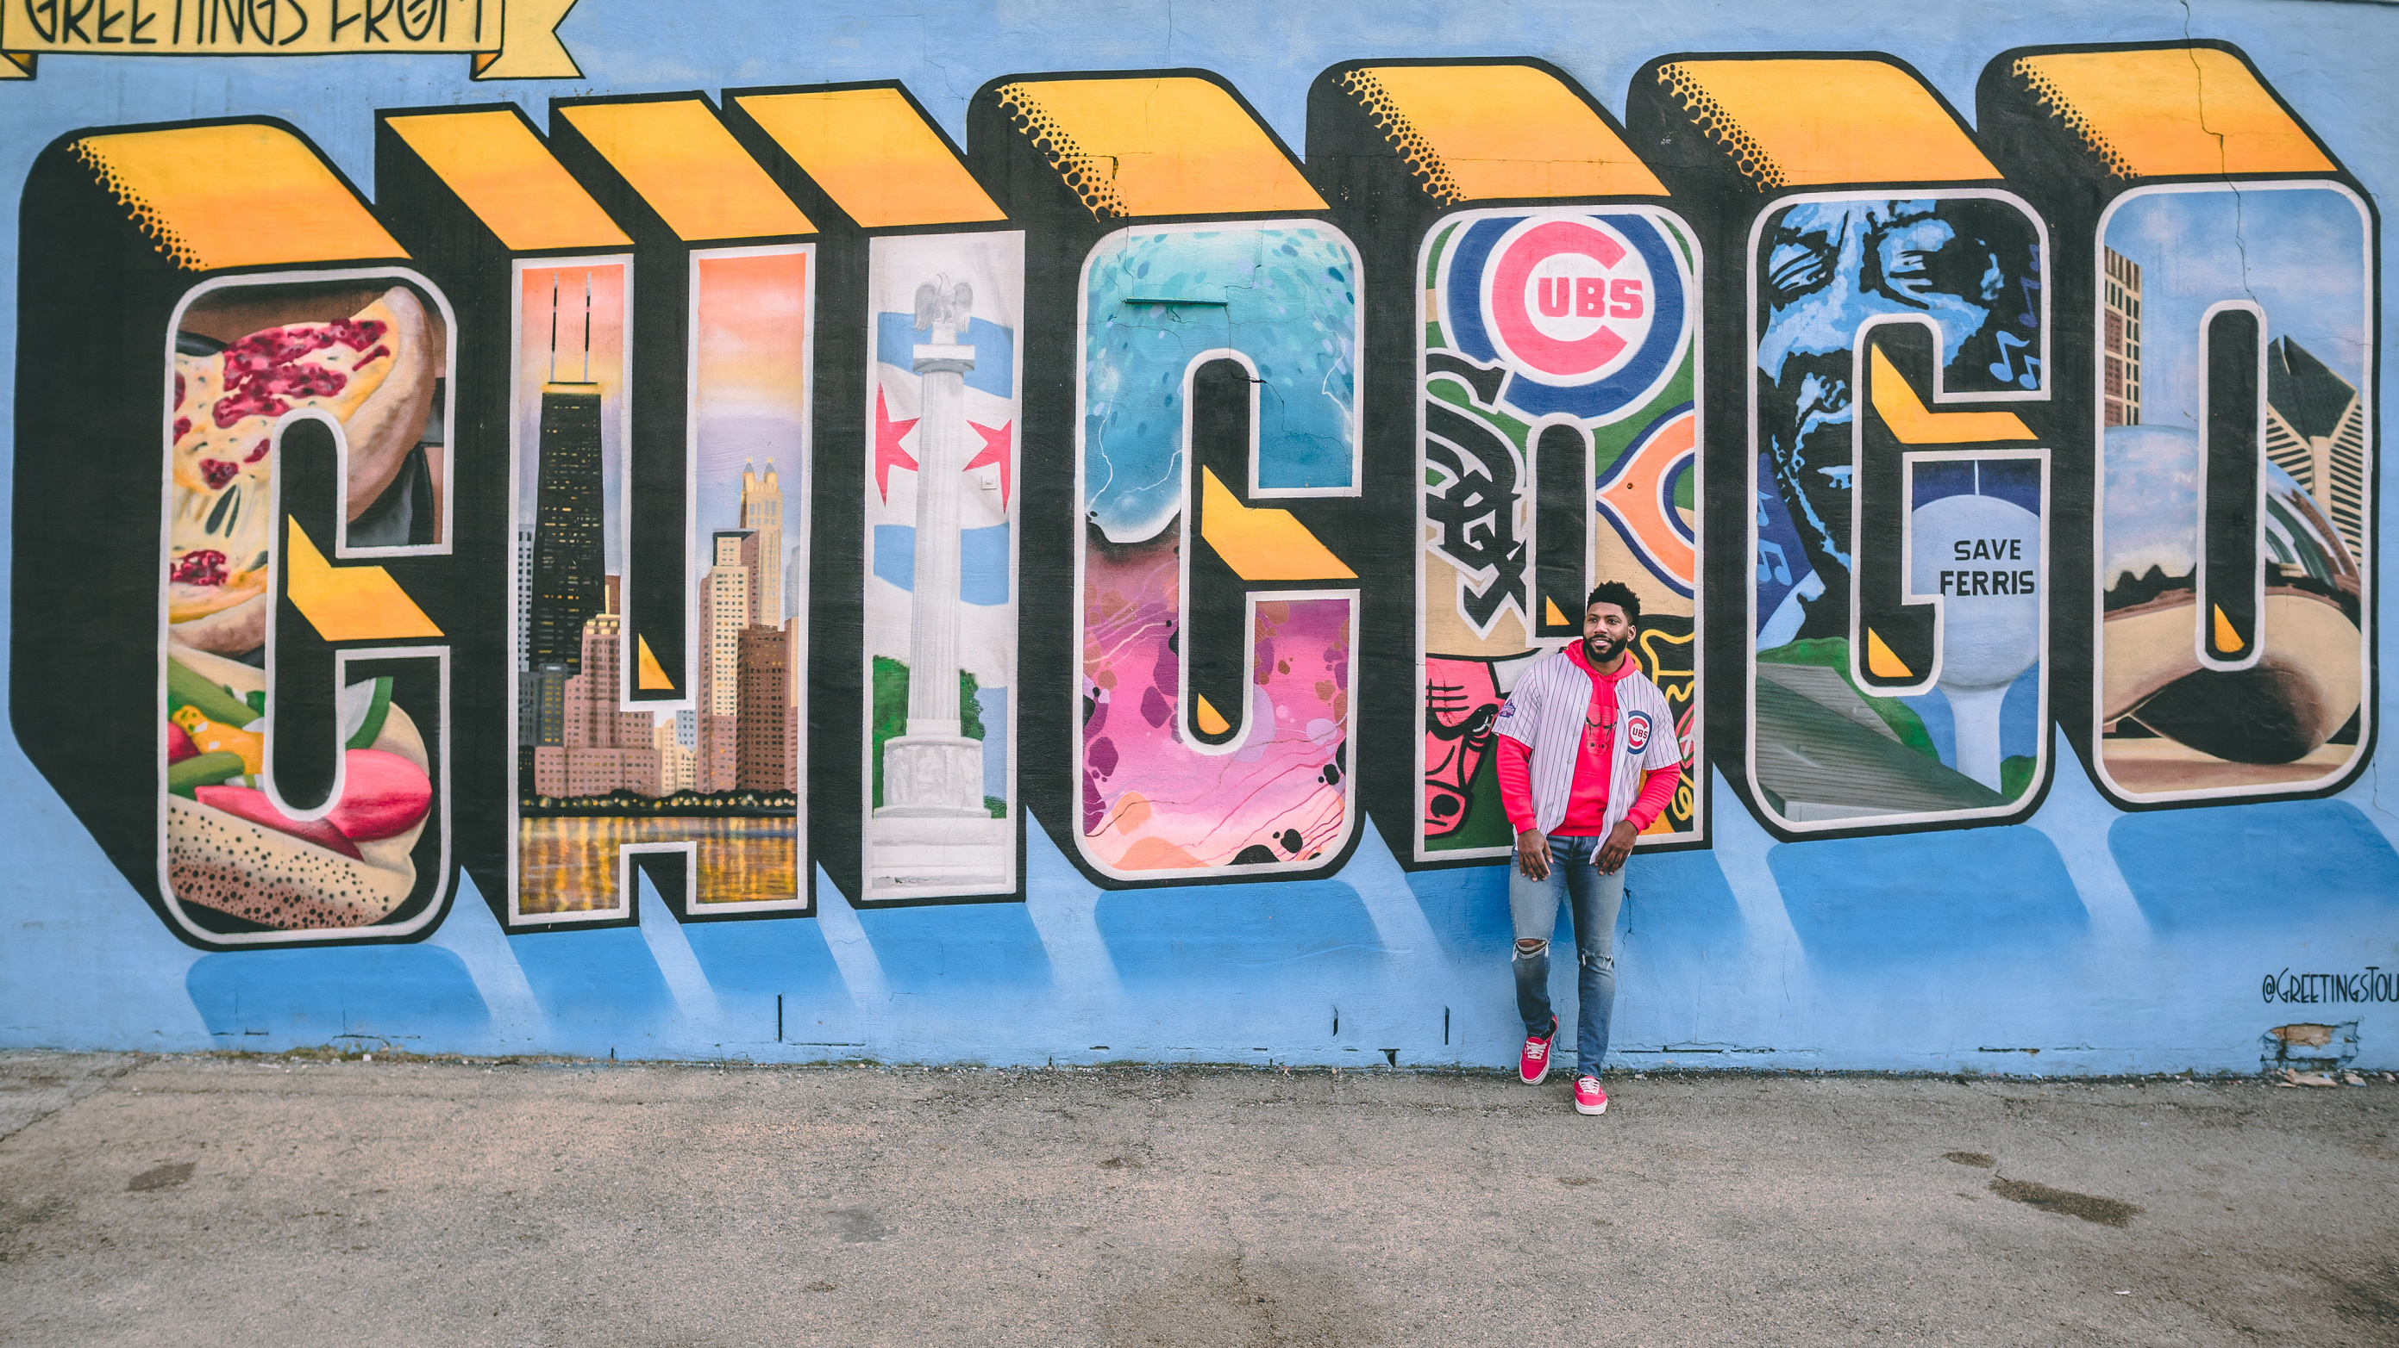

Audience
Passersby
Students
Residents
Spontaneous, Curious
Expressive, Social
Community identity, Belonging
Existing Attempts | Limitations | Our System
Traditional graffiti | Expression vs. Regulation conflict | Safe & legitimate expression
Digital installations | Interaction but no collaboration | Real-time co-creation
Public art projects | Often curated, less spontaneous | Open, playful, inclusive
Notes:
So for this slide, I want to talk about who our audience is, and what’s already out there.
We’re mainly designing for three groups: passersby, students, and local residents.
For passersby, it’s all about something quick and fun — they’re curious, they don’t stay long, but this gives them a way to instantly leave a mark.
For students, the focus is expression and being social. They like creative outlets, so this becomes a playful space to try things and connect with others.
And for residents, it’s more about community and belonging. Having the chance to leave something in a shared space helps them feel more connected to where they live.
Now, if we look at existing attempts, there are some clear problems.
Traditional graffiti feels authentic, but it often causes conflict with regulations.
Digital installations are cool, but usually they’re just individual interactions, not real collaboration.
And public art projects? They can be nice, but most of the time they’re curated, so people don’t really get to participate spontaneously.
That’s where our system comes in. We bring together the playfulness of graffiti, the social aspect of collaboration, and the creativity of public art. It’s a safe and legitimate way to express yourself, it supports real-time co-creation, and it’s open and inclusive for everyone. Basically, we’re trying to keep the spirit of graffiti alive, but in a way that’s more collaborative and community-driven.

Slide 5

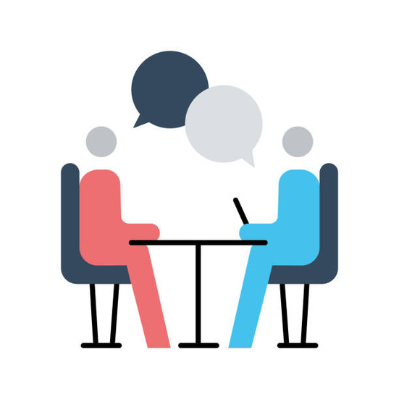
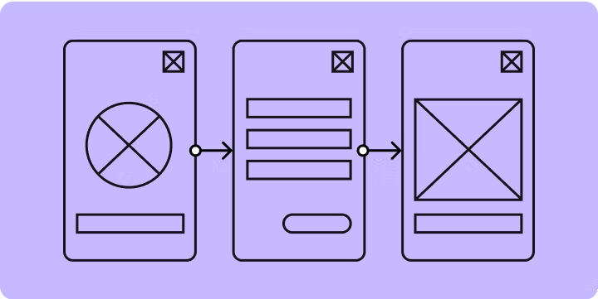

Research Method
Observation
Interview
Low-fidelity prototype
Notes:
Now I want to talk about our timeline and what research methods we will use
Before creating our prototype, we will conduct field observations. In Brisbane, we will look at graffiti—where it usually appears, what it looks like, and, if possible, how people create it.
After that, we will conduct small-scale interviews to collect data. We plan to talk both with people who have experience in graffiti and with those who have never done it but are interested in the topic. Their feedback will help us refine our project goals.
Next, we will build a simple low-fidelity prototype using cardboard, and let potential target users experience it. Based on their feedback, we will adjust the direction of our work.
Finally, we will develop a functional high-fidelity prototype before the week 12. This prototype will implement the core features we planned and serve as the final outcome for our course exhibition.

