Slide 1
Parallelization with OpenACC
Sid Achar, Jack Ansley, Samuel Talenti

Slide 2
Overview
API with compiler directives for C, C++ and Fortran Code
Offloads computation from CPU to attached accelerator
Allows parallelization without implementing low-level tasks
Interface is very similar to OpenMP and should be familiar to those who have worked with it

Slide 3
Note on usage
The CS Linux cluster’s version of GCC is not configured to work with OpenACC
Version 9.2 is stated to be compatible
We used the Pitt CRC cluster and the PGI module to run OpenACC
Since we used a different cluster for running OpenACC, all times used in the comparison are from running the Pthreads and OpenMP implementations are also run on the Pitt CRC cluster, and not the CS Linux cluster

Slide 4
Basic Pragmas and Clauses
Kernels: Instructs the compiler to attempt to identify parallelizable code in the following block
Safe, compiler ignores pragma if unsafe dependencies found
Useful for programmers less familiar with thread-safety
Can cause parallel code to be ignored unintentionally

Slide 5
Basic Pragmas and Clauses
Parallel: Explicitly tells the compiler to parallelize the code in the following block
Will not attempt to detect dependencies as with Kernels
Can be dangerous, programmer should pay extra attention to their parallel block to avoid thread-safety complications

Slide 6
Basic Pragmas and Clauses
Data: Tells the compiler the programmer wants to move data between host and devices using various data-clauses
Allows data movement similar to that in MPI

Slide 7
Basic Pragmas and Clauses
Common Data Clauses
Copy
Allocates memory on the GPU device, then copies data from host CPU to GPU device when entering a parallel region
Upon exiting the parallel region, copies data back to hos

Slide 8
Basic Pragmas and Clauses
Common Data Clauses
Copyin
Allocates memory on GPU device, then copies data from CPU to device upon entering the parallel region
Copyout
Allocates memory on GPU device, then copies data to the host upon exiting the parallel region

Slide 9
Basic Pragmas and Clauses
Common Data Clauses
Create
Allocates memory on GPU device
Does not copy data
Present
Notifies that data is already present on GPU device from another data-clause region

Slide 10
Basic Pragmas and Clauses
Common Data Clauses
Loop
Similar to the ‘for’-clause in OpenMP
Exception is it is run on the GPU

Slide 11
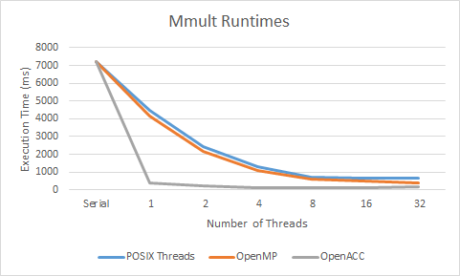
Matrix Multiplication
OpenACC considerably outperforms both OpenMP and POSIX Threads
At a single thread OpenACC completes in less than 1/10th the time as either other library

Slide 12
Matrix Multiplication
OpenACC has considerably more compilation and runtime optimization
Even low-numbers of threads beat out high-thread OpenMP and Pthread implementations

Slide 13
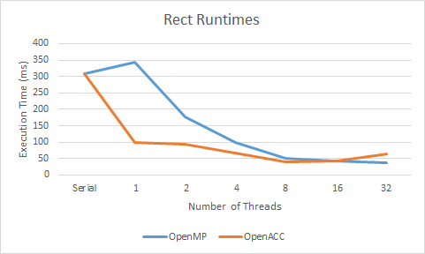
Riemann Sum Rectangle Approximation
OpenACC offers a large advantage at low threads as it had in Mmult
At 8 threads OpenACC achieved its’ fastest runtime
Roughly equal to OpenMP at 16

Slide 14
Riemann Sum Rectangle Approximation
OpenMP slightly beat out OpenACC’s fastest time (~3ms), yet it used four times as many threads
OpenACC’s performance did suffer from higher threads sooner than OpenMP

Slide 15
Discussion: What was the hardest part of the project?
The decidedly hardest part of getting OpenACC to work is using a compiler that is formatted to use it, as the GCC distribution used on the linux cluster is not compatible with OpenACC. In order to compile and run the implementations, our group needed to use the engineering crc cluster, which only a single member of our group had a login for. While we could install GCC on our personal computers, it is a large and complex installation, for which it states during installation that it should only be carried out by those who know explicitly what they are doing.

Slide 16
Discussion: Is this library better than Pthreads and OpenMP?
This library does offer a large performance advantage over Pthreads and OpenMP in runtime with almost all values of threads, along with having a decrease in performance occur at larger numbers of threads then either Pthreads or OpenMP. While this is the case, the complexity of the system is far more difficult to use than OpenMP, although it has more versatility than the latter.

Slide 17
Discussion: How much better/worse in terms of performance?
Running with lower-numbers of threads, the performance increase in OpenACC over OpenMP and Pthreads is remarkable; for a single thread in the matrix multiplication problem OpenACC completed in under a tenth the time it took either OMP or Pthreads. The Riemann Sum algorithm also ran considerably faster on OpenACC than OMP. For higher values of threads in the matrix multiplication problem OpenACC also beat out both other libraries by a considerable factor, with Pthreads and OpenMP approaching OpenACC’s time on one thread themselves using 32.

Slide 18
Discussion: How easy/difficult was the implementation of a parallel program?
OpenACC’s syntax is very similar to OpenMP’s, and basic parallelization of programs is as relatively easy as it is in OpenMP. However utilizing the data movement clauses and pragmas to create a more efficient parallelization is more difficult than utilizing some of the clauses in OpenMP.

Slide 19
Discussion: Is it a good idea to add the language as part of the class?
This language could possibly be included as part of this class if the linux cluster’s GCC version is updated to version 9.2, which is compatible with OpenACC. However, the concepts within the language are a relative mix of OpenMP and MPI, the former with the utilization of pragmas and the latter with data movement. This being the case, OpenACC is still far faster than either OpenMP or Pthreads in the tests we conducted, and could prove to be beneficial in demonstrating a modern efficiency boost from a parallel library.

Slide 20
Conclusion
Powerful parallelization library, large performance increase over OMP and Pthreads
Some difficulty with setting up OpenACC
Needed to use Pitt CRC cluster rather than CS linux cluster
Offers both easy-to-use parallelization tools and more detailed pragmas for data movement
A very beneficial library that can be used on real-world applications for a significant speedup

