Slide 1
Parallelization with OpenACC
Sid Achar, Jack Ansley, Samuel Talenti

Slide 2
Overview
API with compiler directives for C, C++ and Fortran Code
Offloads computation from CPU to attached accelerator
Allows parallelization without implementing low-level tasks
Interface is very similar to OpenMP and should be familiar to those who have worked with it

Slide 3
Basic Pragmas and Clauses
Kernels: Instructs the compiler to attempt to identify parallelizable code in the following block
Safe, compiler ignores pragma if unsafe dependencies found
Parallel: Explicitly tells the compiler to parallelize the code in the following block
Will not attempt to detect dependencies as with Kernels
Data: Tells the compiler the programmer wants to move data between host and devices using various data-clauses
Common Data Clauses
Copy, Copyin, Copyout
Create, Present, Loop

Slide 4
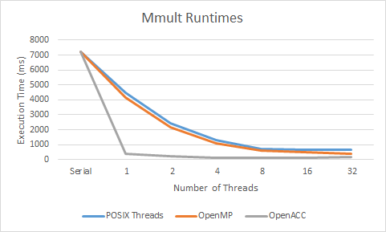
Matrix Multiplication
OpenACC considerably outperforms both OpenMP and POSIX Threads
At a single thread OpenACC completes in less than 1/10th the time as either other library
OpenACC has considerably more compilation and runtime optimization
Even low-numbers of threads beat out high-thread OpenMP and Pthread implementations

Slide 5
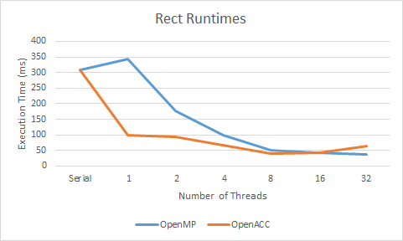
Riemann Sum Rectangle Approximation
OpenACC offers a large advantage at low threads as it had in Mmult
At 8 threads OpenACC achieved its’ fastest runtime
Roughly equal to OpenMP at 16
OpenMP slightly beat out OpenACC’s fastest time (~3ms), yet it used four times as many threads
OpenACC’s performance did suffer from higher threads sooner than OpenMP

Slide 6
Conclusion
Powerful parallelization library, large performance increase over OMP and Pthreads
Some difficulty with setting up OpenACC
Needed to use Pitt CRC cluster rather than CS linux cluster
Offers both easy-to-use parallelization tools and more detailed pragmas for data movement
A very beneficial library that can be used on real-world applications for a significant speedup

