Slide 1

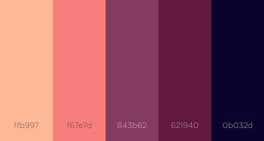
Overview
Color Theme
o + x
New Task
Overview
Analyze
Schedule
o + x
o + x
Exit

Slide 2
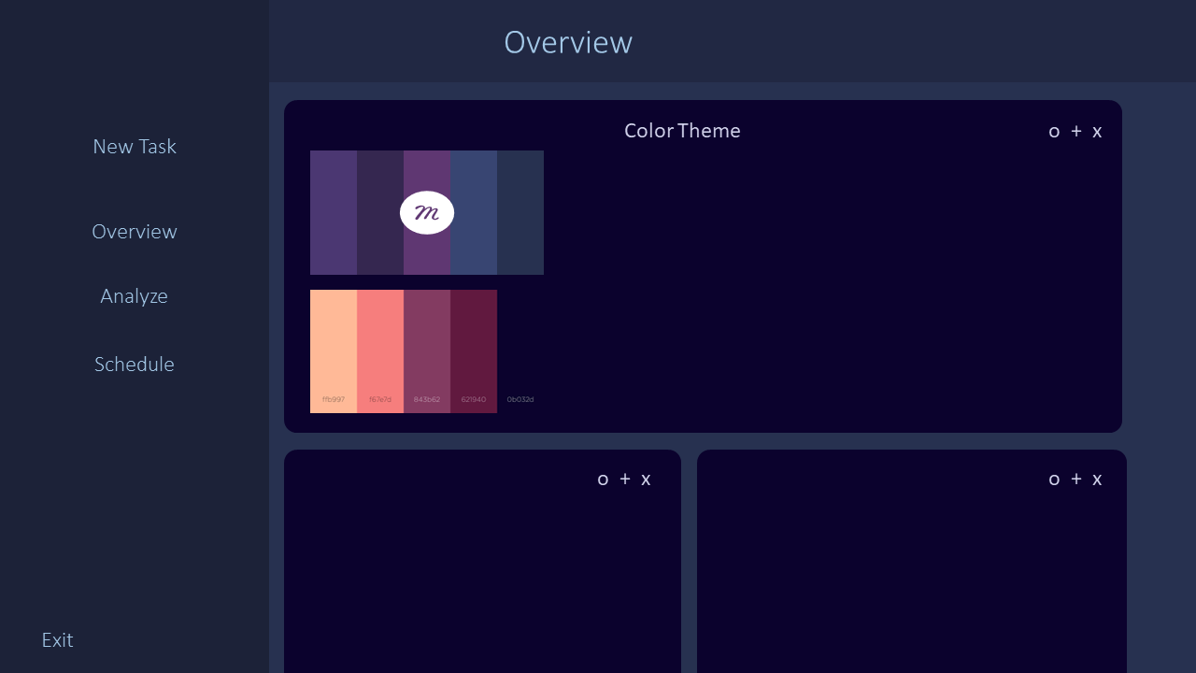
#212843
#1C2238
#1C2238
#1C2238
#A3C8E7

