Slide 1
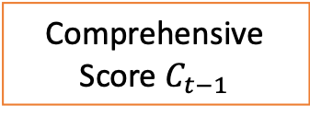

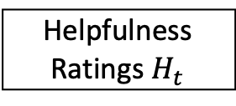
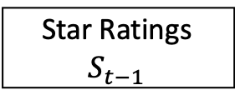




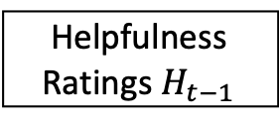

Pre-purchasing Evaluation
Post-purchasing Evaluation
Given Data
Aggregate
Star Ratings $S_{t−1}$
Star Ratings $S_{t}$
Reviews $R_{t−1}$
Reviews $R_{t}$
Coherent Consumer
Helpfulness
Ratings $H_{t−1}$
Helpfulness
Ratings $H_{t}$
Regression
Consumer Profile
Comprehensive
Score $C_{t−1}$
Product Sales $P_{t}$
Product Sales $P_{t−1}$
ARIMA
Purchase Decision
Boom Point $B_{t}$
Entity Recognition

