Slide 1
Ve 280 Programming and Elementary Data Structures
Linear List; Stack
Learning Objectives:
Understand what is a linear list and what is a stack
Know how they can be implemented
Discover some applications of the stack data structure

Slide 2
Outline
Linear List
Stack
Implementation
Application

Slide 3
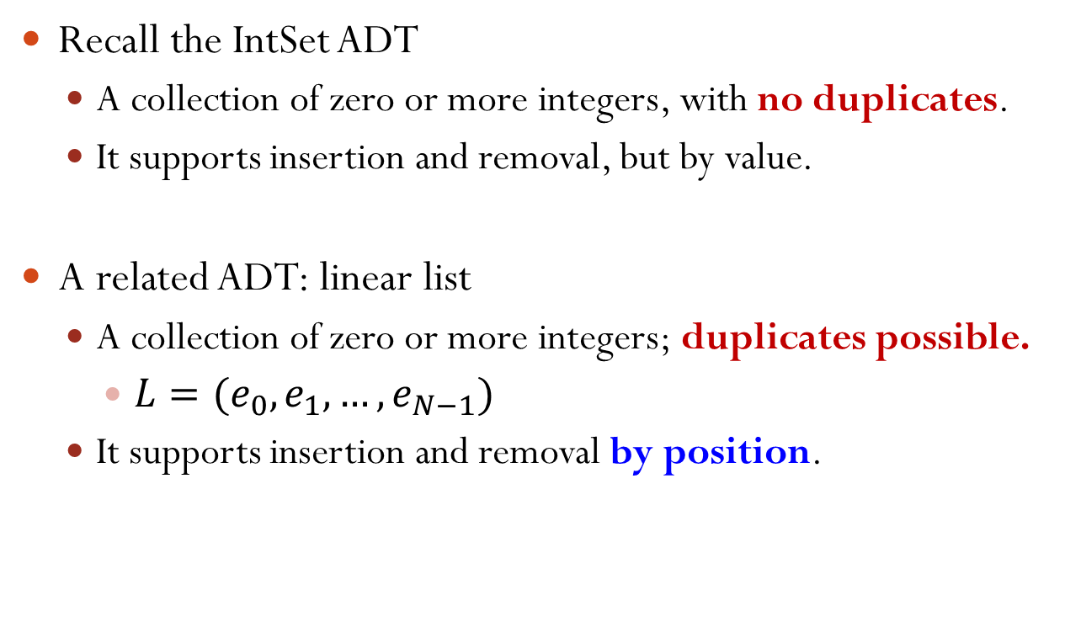
Linear List ADT
Recall the IntSet ADT
A collection of zero or more integers, with no duplicates.
It supports insertion and removal, but by value.
A related ADT: linear list
A collection of zero or more integers; duplicates possible.
$L=(e_{0},e_{1},…, e_{N−1})$
It supports insertion and removal by position.
Notes:
It supports insertion and removal by position: see next slides

Slide 4
Linear List ADT Insertion
void insert(int i, int v) // if 0 <= i <= N // (N is the size of the list), insert v at // position i; otherwise, throws BoundsError // exception.
Example: L1 = (1, 2, 3)
L1.insert(0, 5) = (5, 1, 2, 3);
L1.insert(1, 4) = (1, 4, 2, 3);
L1.insert(3, 6) = (1, 2, 3, 6);
L1.insert(4, 0) throws BoundsError
Notes:
Assume the first index is 0.
N corresponds to the index off the end.

Slide 5
Linear List ADT Removal
void remove(int i) // if 0 <= i < N (N is // the size of the list), remove the i-th // element; otherwise, throws BoundsError // exception.
Example: L2 = (1, 2, 3)
L2.remove(0) = (2, 3);
L2.remove(1) = (1, 3);
L2.remove(2) = (1, 2);
L2.remove(3) throws BoundsError

Slide 6


Which Answers Are Correct?
Suppose we want to implement a linear list ADT so that it can grow as large as the user wants. It can be implemented by:
A. a static array
B. a dynamic array
C. a singly-linked list
D. a doubly-linked list
Notes:
Correct answers: B, C, and D
Some implementations wouldn’t be very efficient.

Slide 7
Outline
Linear List
Stack
Implementation
Application

Slide 8
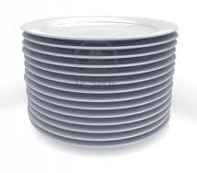
Stack
A “pile” of objects where new object is put on top of the pile and the top object is removed first.
LIFO access: last in, first out.
Restricted form of a linear list: insert and remove only at the end of the list.

Slide 9
Methods of Stack
size(): number of elements in the stack.
isEmpty(): checks if stack has no elements.
push(Object o): add object o to the top of stack.
pop(): remove the top object if stack is not empty; otherwise, throw stackEmpty.
Object &top(): return a reference to the top element.

Slide 10
Stacks Using Arrays
Maintain an integer size to record the size of the stack.
size(): return size;
isEmpty(): return (size == 0);
push(Object o): add object o to the end of the array and increment size. Allocate more space if necessary.
pop(): If isEmpty(), throw stackEmpty; otherwise, decrement size.
Object &top(): return a reference to the top element Array[size-1]
Array[MAXSIZE]:
2
3
1
4

Slide 11
Stacks Using Linked Lists
For single-ended linked list, which end is preferred to be the top? Why?
first
size(): LinkedList::size();
isEmpty(): LinkedList::isEmpty();
push(Object o): insert object at the beginning LinkedList::insertFirst(Object o);
pop(): remove the first node LinkedList::removeFirst();
Object &top(): return a reference to the object stored in the first node.
Notes:
We can implement stack using a single-ended, singly-linked list. “Top” of the stack is the front of the linked list.

Slide 12
LinkedList::size()
How to get the size of a linked list?
int LinkedList::size() {
int count = 0;
node *current = first;
while(current){
count++;
current = current->next;
}
return count;
}
first

Slide 13
Array vs. Linked List: Which is Better?
They both have advantages and disadvantages
Linked list
memory-efficient: a new item just needs extra constant amount of memory
not time-efficient for size operation
Array
time-efficient for size operation
not memory-efficient: need to allocate a big enough array

Slide 14
Outline
Linear List
Stack
Implementation
Application

Slide 15
Application of Stacks
Function calls in C++
Web browser’s “back” feature
Parentheses Matching

Slide 16
Web Browser’s “back” Feature
Visiting order
Web A
Web B1
Web C
Back (to Web B1)
Back (to Web A)
Web B2
Web D
Web A
Web B1
Web C
Web B2
Web D
Web D
Web C
Web B1
Web B2
Web A
Stack

Slide 17
Parentheses Matching
Output pairs (u,v) such that the left parenthesis at position u is matched with the right parenthesis at v.
( ( a + b ) * c + d – e ) / ( f + g )
0 1 2 3 4 5 6 7 8 9 10 12 14 16 18
Output is: (1, 5); (0, 12); (14, 18);
( a + b ) ) * ( ( c + d )
0 1 2 3 4 5 6 7 8 9 10 12
Output is
(0, 4);
Right parenthesis at 5 has no matching left parenthesis;
(8, 12);
Left parenthesis at 7 has no matching right parenthesis
Notes:
However, sometimes, there is no matching parenthesis. Then we should also report this.

Slide 18
How to Realize Parentheses Matching?
( ( a + b ) * c + d – e ) / ( f + g )
0 1 2 3 4 5 6 7 8 9 10 12 14 16 18
Scan expression from left to right.
When a left parenthesis is encountered, push its position to the stack.
When a right parenthesis is encountered, pop the top position from the stack, which is the position of the matching left parenthesis.
If the stack is empty, the right parenthesis is not matched.
If string is scanned over but the stack is not empty, there are not-matched left parentheses.

Slide 19
Parentheses Matching
( ( a + b ) * c + d – e ) / ( f + g )
0 1 2 3 4 5 6 7 8 9 10 12 14 16 18
1
0
(1, 5)
(0, 12)
(14, 18)
14
Stack

Slide 20

A Stack Can Be Used:
Select all the correct answers.
A. to manage any arithmetic expression
B. to undo operations (such as a text editor)
C. to reverse an array
D. to implement an output buffer
Notes:
Correct answers: A, B, C

Slide 21
Reference
Problem Solving with C++ (8th Edition), by Walter Savitch, Addison Wesley Publishing (2011)
Chapter 13.2 Stack

