Slide 1
### FEW-SHOT AUGMENTED CORRECTION PROTOCOL
**Task**: Predict {target_properties_list} for the target material using systematic analysis.
{reference_section}
**Target Material**:
{test_sample}
**Required Analysis Protocol**:
1. **Reference-Driven Baseline Establishment**:
- **Classification**: First, classify the general family of all materials involved (references and target).
- **Primary Baseline Selection**: From the provided `Reference Samples`, identify the single sample that is the **most analogous** to the `Target Material`. This sample and its `Known True Values` will serve as your **primary baseline**. Justify your choice.
- **Sanity Check (Optional but Recommended)**: Use your general knowledge of standard materials as a secondary check.
2. **Plausibility Assessment**:
- Assess the expected range for each target property based on your selected **primary baseline sample**.
Consider the relationships between properties when applicable (e.g., strength-ductility trade-offs).
3. **Interpolative Correction & Justification**:
- Formulate corrected values for each property.
Your reasoning must be an **interpolation or extrapolation** from the primary baseline. Quantify how the **differences in characteristics** between the target and the baseline sample translate into specific property adjustments.
- Use fundamental materials principles to support *why* these differences lead to your calculated adjustments.
Provide your systematic analysis and end with EXACTLY this JSON format
{{
"predictions": {{
{predictions_json_template}
}},
"reasoning": "<your_analysis_summary>"
}}

Slide 2
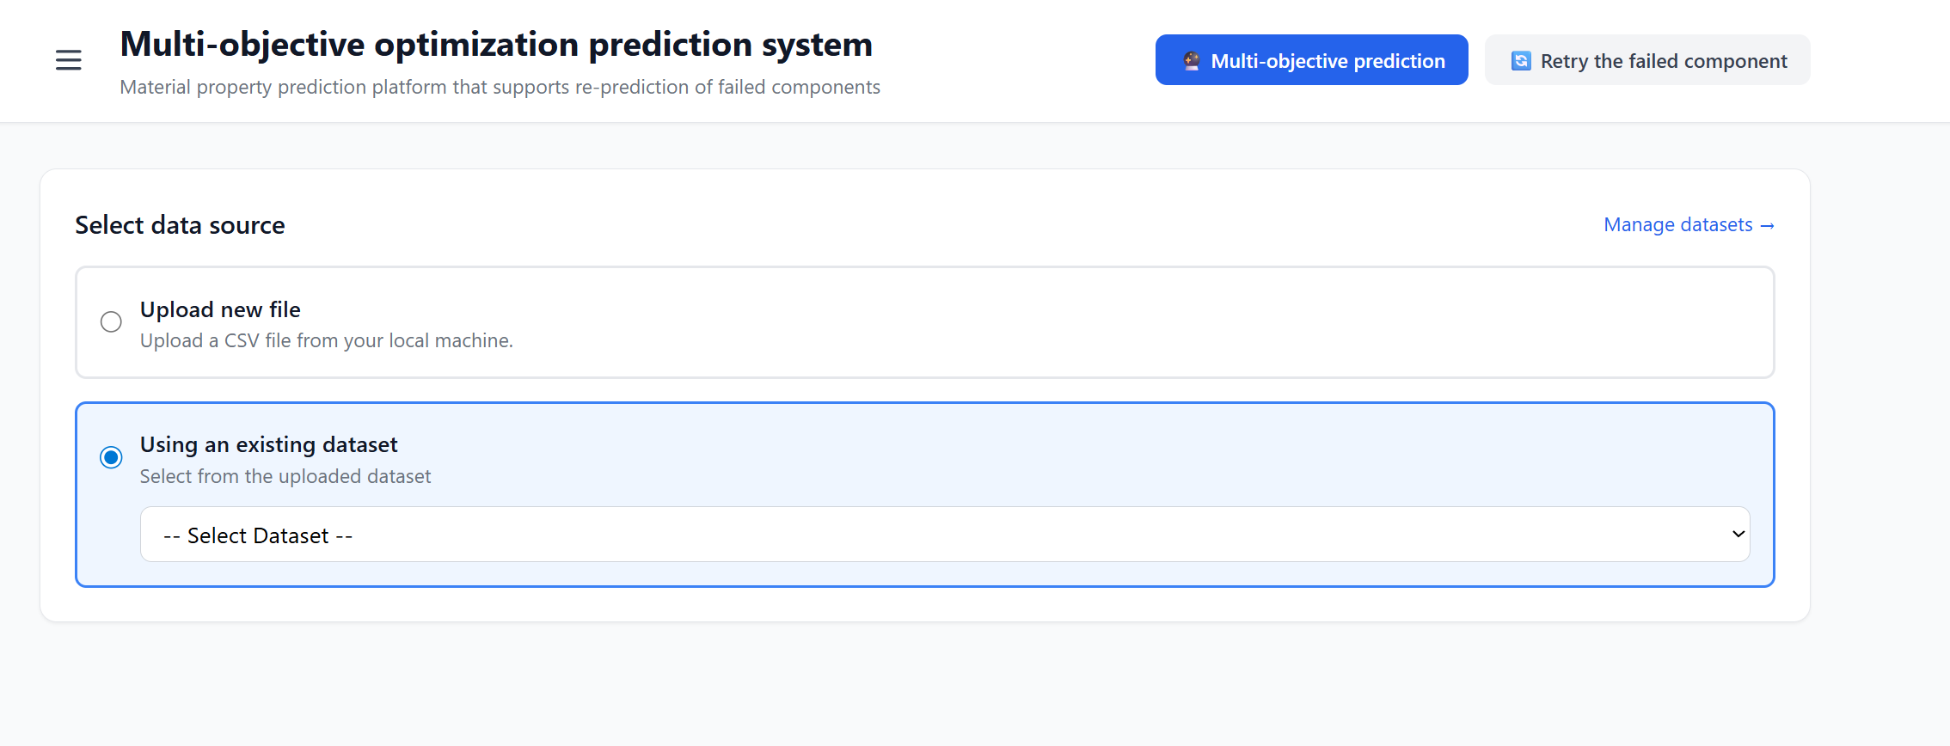
1.Upload the dataset then select the dataset, such as HEA data from Yasir

Slide 3
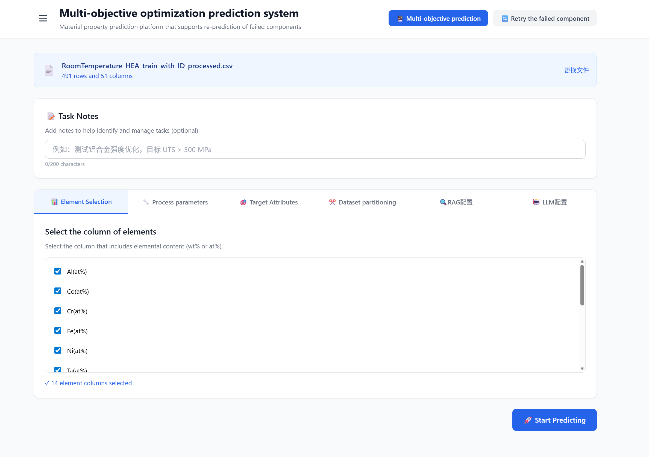
2.Choose the compostion, processing and target property columns

Slide 4
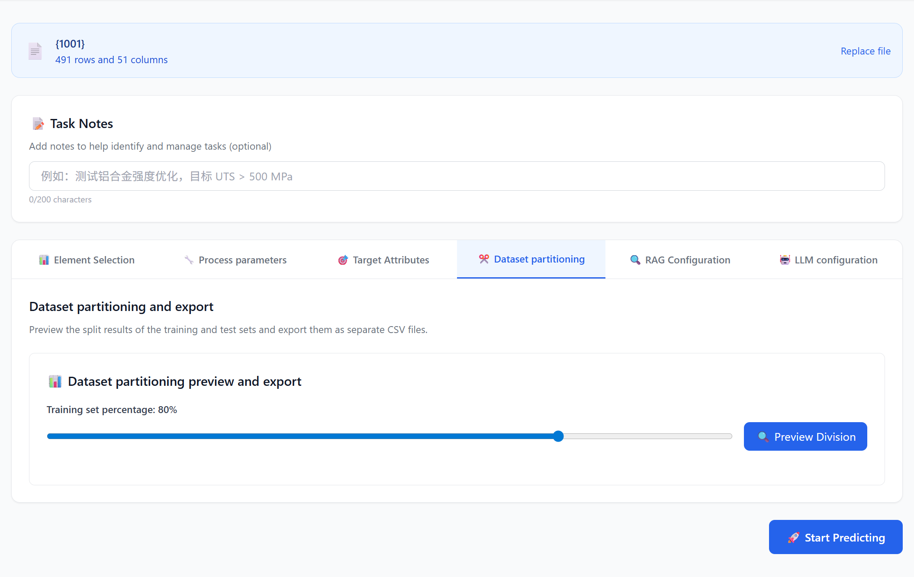
3. Divide the data set into training set and test set

Slide 5
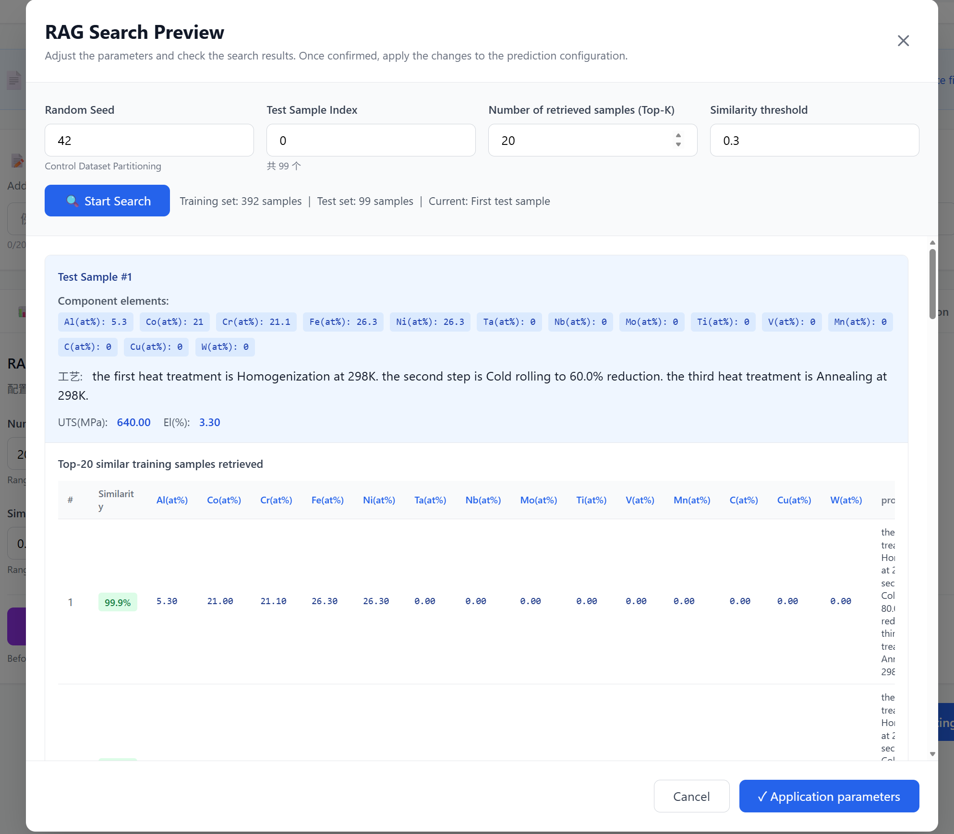
4.Preview the sample through RAG

Slide 6
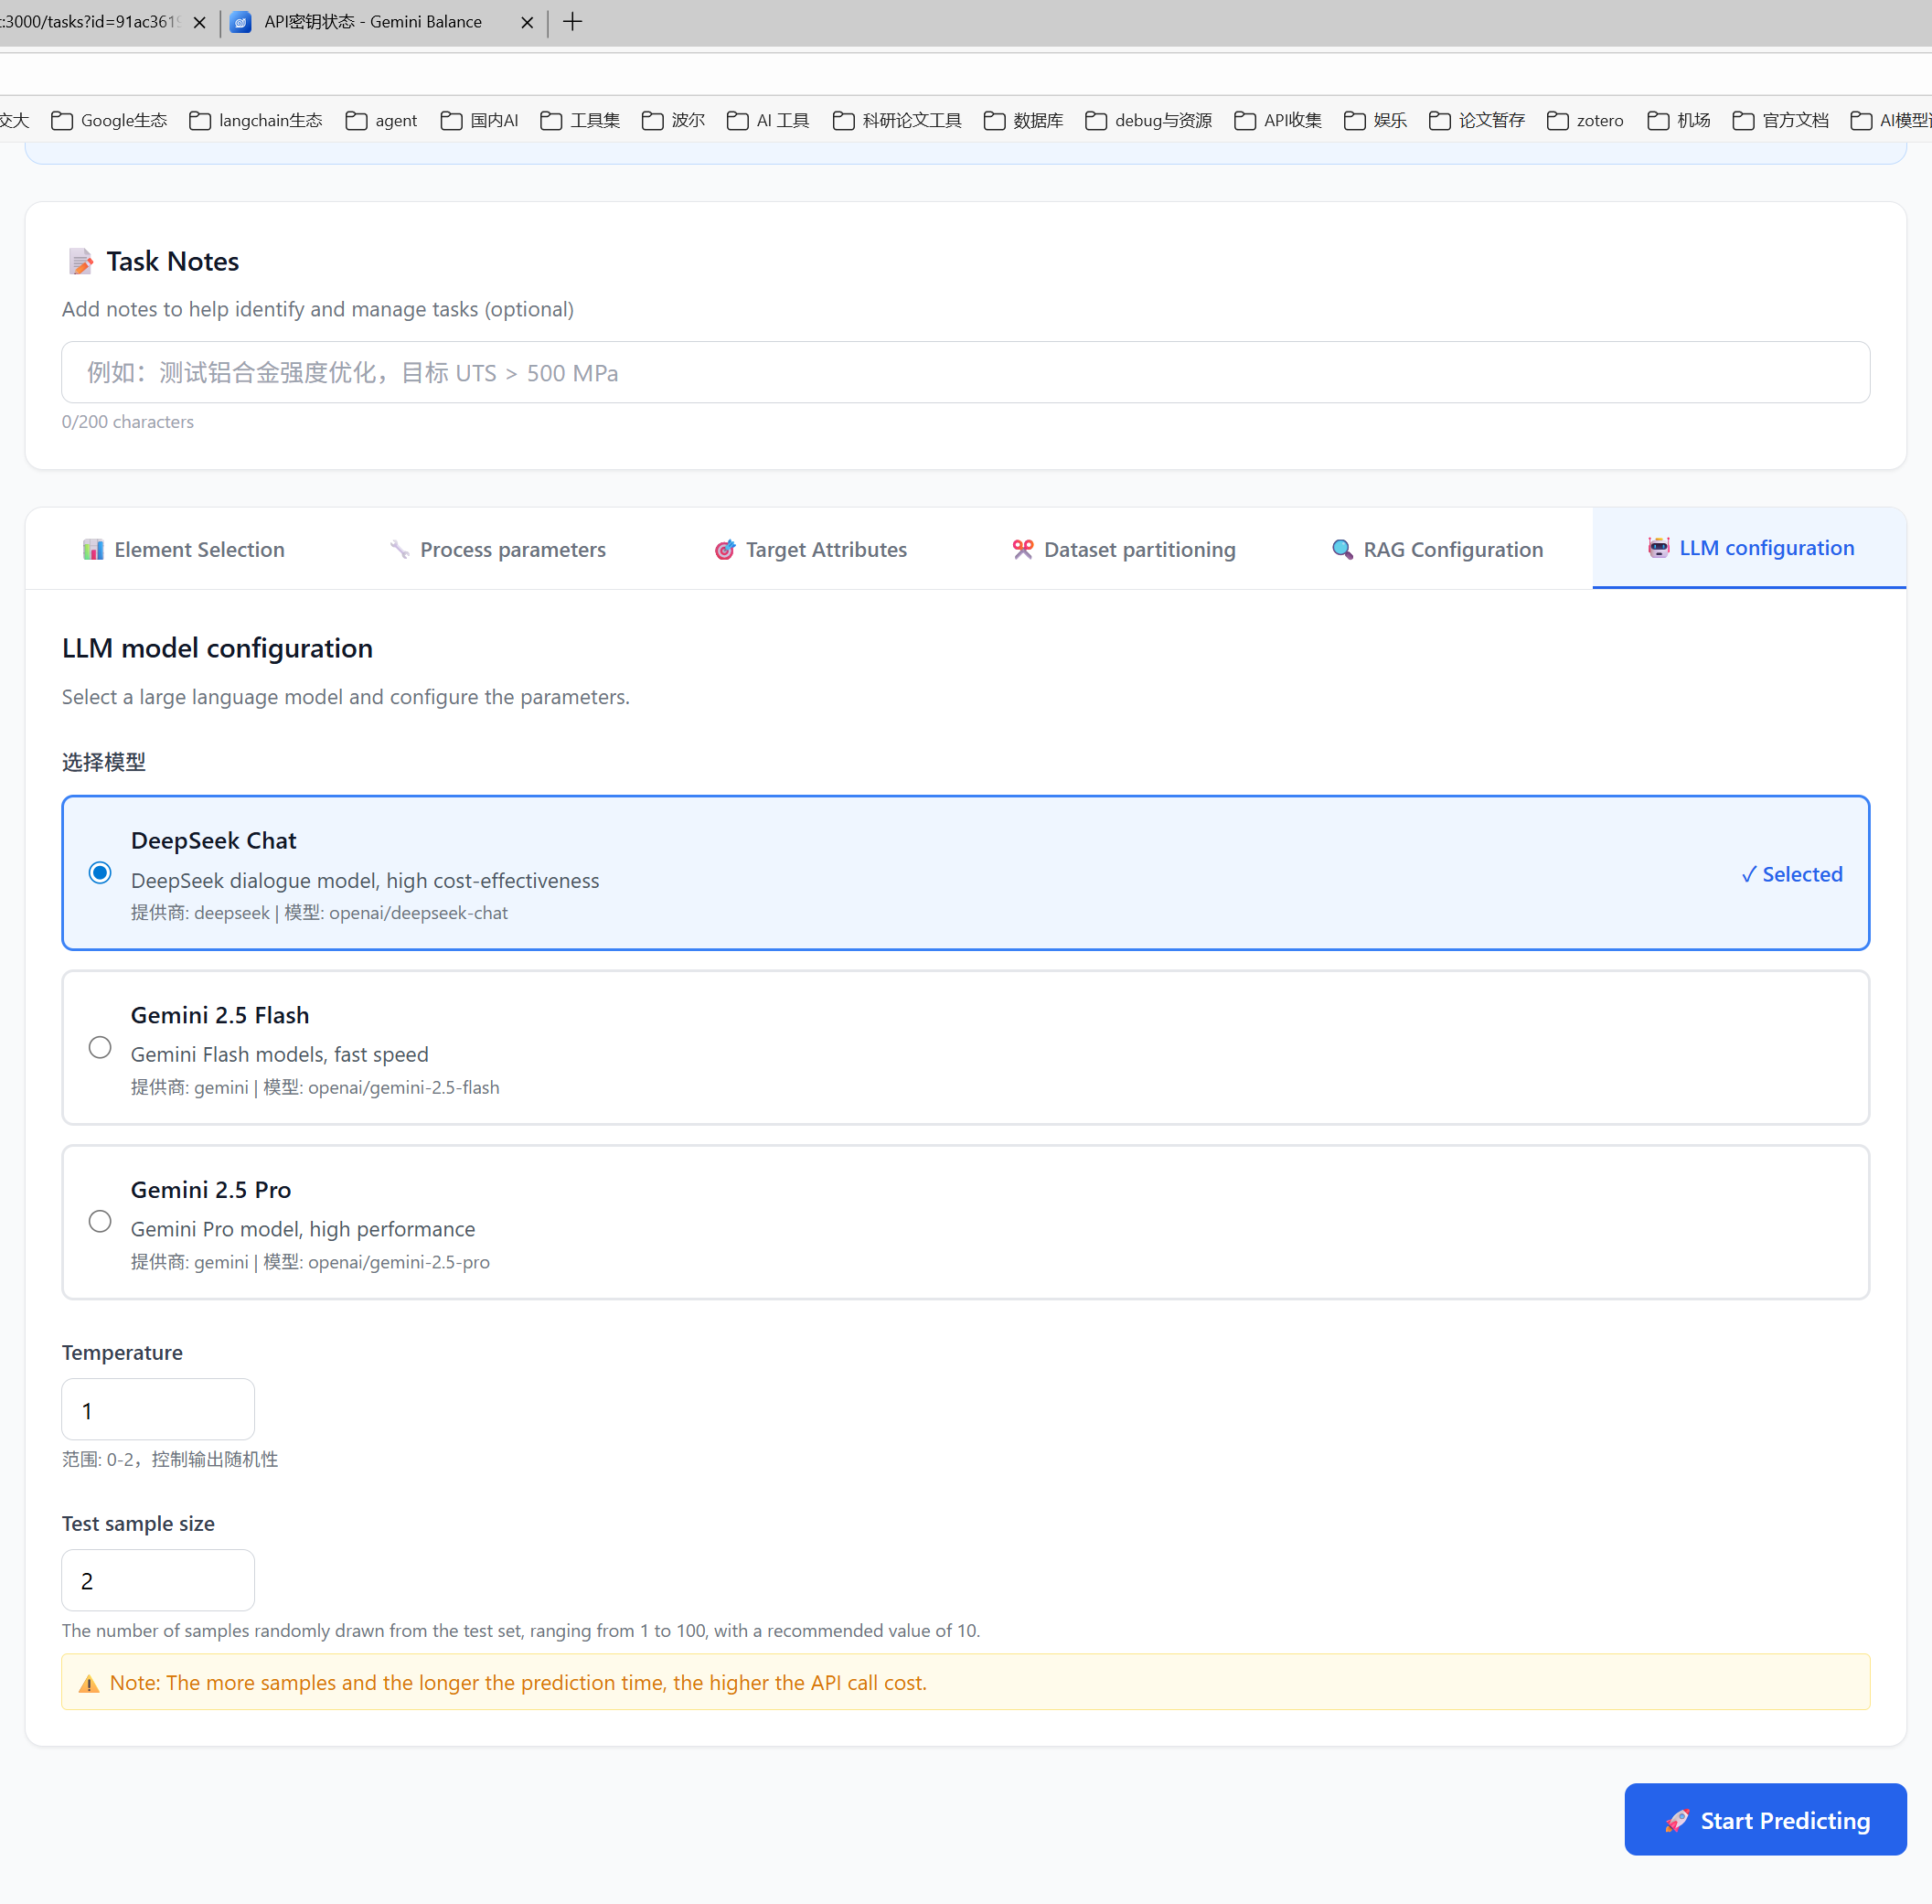
5.Choose the LLM

Slide 7
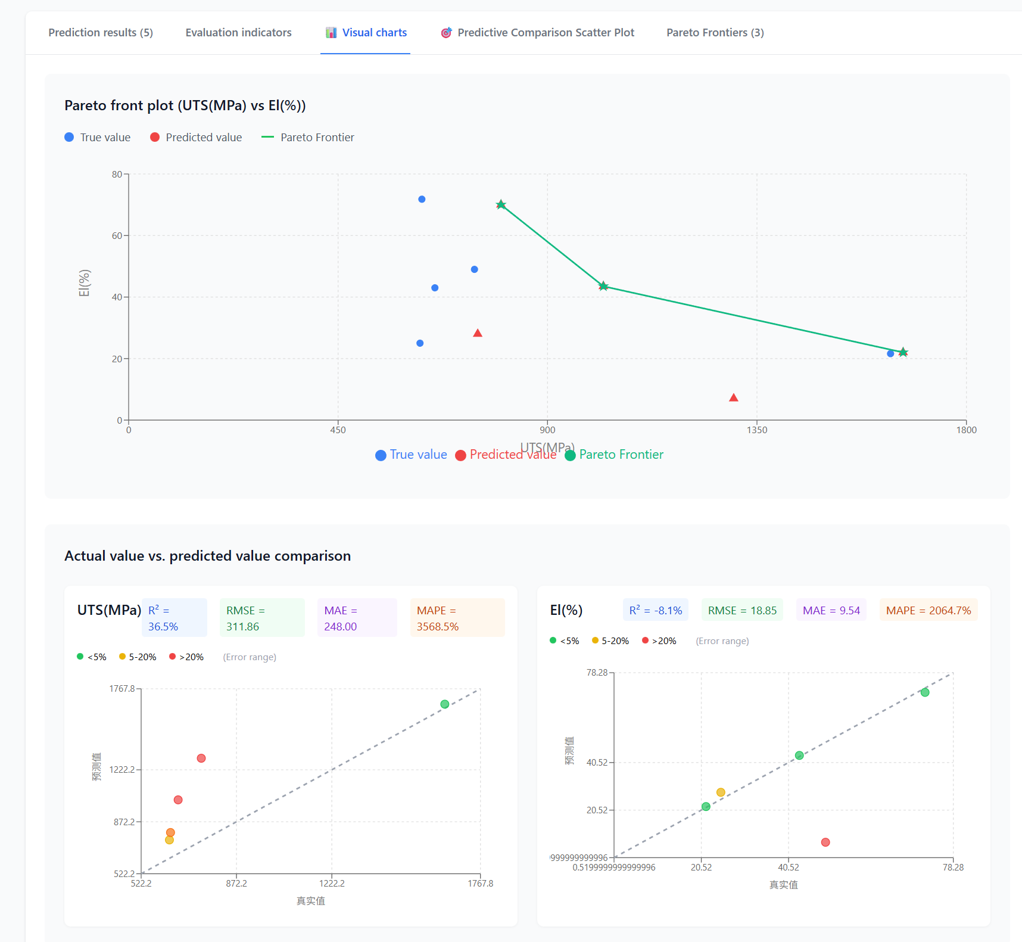

Slide 8
