Slide 1
NP Complete Reduction
Subset Sum Problem to the Partition Problem
By: Jack Lukomski
CIS-263

Slide 2
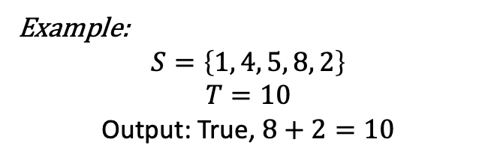

Introduction (Subset Sum Problem)
Given a set of positive integers, $S$, and a target value $T$, can we find a subset of $S$, who's sum equals $T$?
Example:
$$S=\left\{1, 4, 5, 8, 2\right\}$$
$$T=10$$
Output: True, $8+2=10$

Slide 3


Introduction (Partition Problem)
Given a set $S$, of positive integers, can the set be divided into two subsets, $S_{1}$and $S_{2}$ such that the sum of the numbers in $S_{1}$ equal the sum of numbers in $S_{2}$
Example:
$$S=\left\{1, 4, 5, 2\right\}$$
Output: True
$$S_{1}=\left\{1, 5\right\}=6$$
$$S_{2}=\left\{4, 2\right\}=6$$

Slide 4

Reduction
Suppose we have an instance of the Subset Sum Problem with a set $S=\{s_{1},s_{2},…, s_{n}\}$, and target sum $T$. Now, we want to construct an instance of the Partition Problem such that if we solve this instance, we also solve the original Subset Sum Problem.

Slide 5
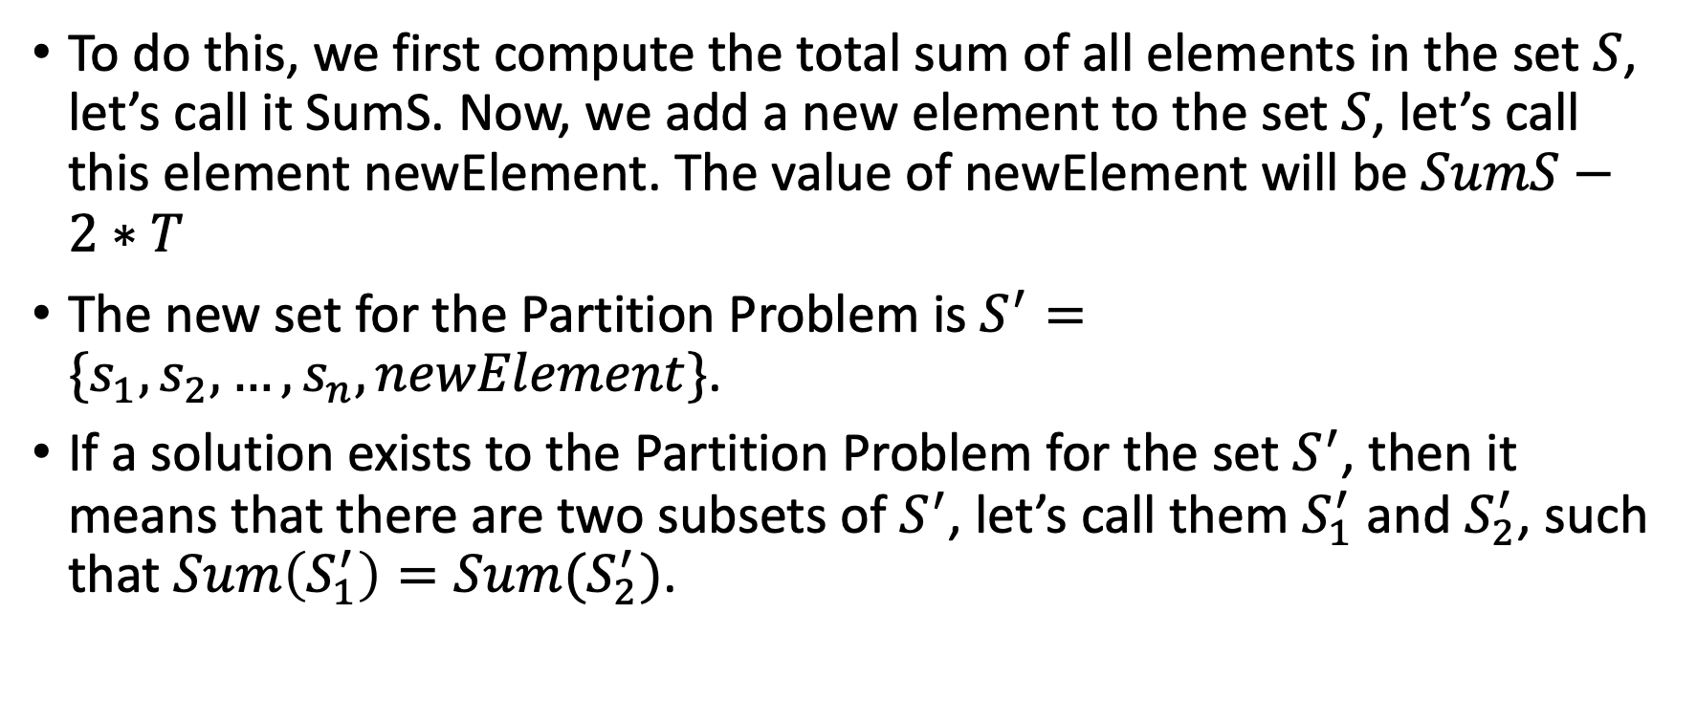
Reduction (Continued)
To do this, we first compute the total sum of all elements in the set $S$, let’s call it SumS. Now, we add a new element to the set $S$, let’s call this element newElement. The value of newElement will be $SumS−2∗T$
The new set for the Partition Problem is $S^{′}=\{s_{1},s_{2},…, s_{n}, newElement\}$.
If a solution exists to the Partition Problem for the set $S^{′}$, then it means that there are two subsets of $S^{′}$, let’s call them $S_{1}^{′}$ and $S_{2}^{′}$, such that $Sum\left(S_{1}^{′}\right)=Sum(S_{2}^{′})$.

Slide 6
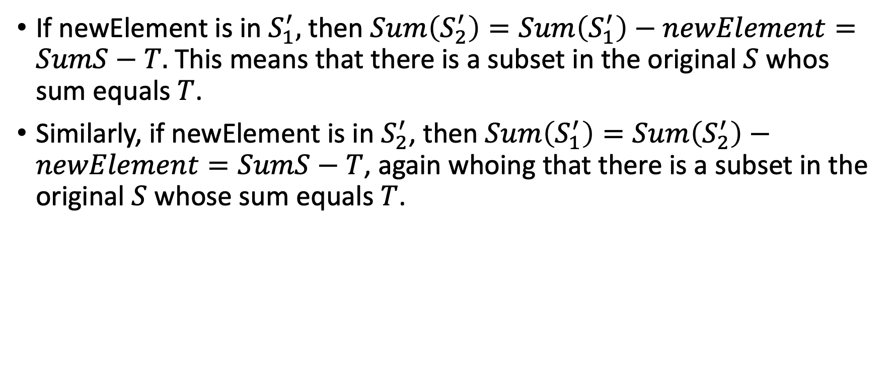
Reduction (Continued)
If newElement is in $S_{1}^{′},$then $Sum\left(S_{2}^{′}\right)=Sum\left(S_{1}^{′}\right)−newElement=SumS−T.$ This means that there is a subset in the original $S$ whos sum equals $T$.
Similarly, if newElement is in $S_{2}^{′}$, then $Sum\left(S_{1}^{′}\right)=Sum\left(S_{2}^{′}\right)−newElement=SumS−T$, again whoing that there is a subset in the original $S$ whose sum equals $T$.

Slide 7

Reduction (Conclusion)
So, a solution to the Partition Problem on $S^{′}$ gives us a solution to the original Subset Sum Problem on $S$. Therefore, we have successfully reduced the Subset Sum Problem to the Partition Problem.

