Slide 1
Goals for today’s lecture
By the end of today’s lecture, you should be able to:
write C code to control pixels on an LCD matrix display
describe the concept of structured design
describe Unified Markup Language tools developed for system design
produce a UML state diagram to describe your project design concept
produce a specifications requirements document
begin work on your embedded system design document

Slide 2
Verification vs Validation
Validation: DONE FIRST!
Does your specification meet customer intent
Each requirement from the customer (your professor) should be reviewed
Some requirments may bedome multiple requirements
Verification
Does your product meet the requirement as you defined it?

Slide 3
The SYstem Requirements Specification
What you need to do:
You will work in groups of 2 on the final project
Get with your partner and decide what your design must accomplish
The core requirements use the key word “must”*
the extra features use the key word “may”
Number the requirements
Write the System Requirements Specification document with the following parts:
Introduction with purpose and goals of your embedded system
A block diagram showing the major components
A “walk through” of the user interface
A list of requirements written as described in the previous slide
A verification method for each requirement
A timeline for the project with weekly milestones

Slide 4
Defining your requirements
REMEMBER- these are what YOU are signing up for- not the customer requirements.
WHY are requirements important?
Building something before you design it results in wasted material and time.
Disagreements among team members

Slide 5
Defining your requirements
Why is it so hard?
Inconstant needs
Impossible wants
Obsession with bigger and better
Time crunch
Mistakes don’t seem like a big deal now
Just wing it
Obsessed with latest and greatest
Notes:
Time crunch- we want everthing now

Slide 6
Capturing requirements
First, workout scenarios on how your product might work
Identify interfaces to rest of the world (Web, Sensors, Buttons..
Write down rationale for each requirement!
Develop hierarchy- so subsystems can be described as part of a bigger system- helping traceability.
Can each requirement be verified on its own?
(Quicker way to finish)
BASELINE!

Slide 7
Writing GOOD requirements
What do you want to eat?
Something good
Something cheap
Anything without tomatoes.
Each answer is a requirement that is up to interpretation.
Requirements define something that is NEEDED

Slide 8
Writing GOOD requirements
VERIFIABLE
Test
Inspection
Analysis
ATTAINABLE
Electrical/computer/mechanical/production
CLEAR
Simple
Short (no long explanations)
Positive (limit negative requirements)
Hard to verify that something does not happen
Easier to verify that something does happen

Slide 9
Common Requirement Mistakes
Making Assumptions (especially the bad kind)
Assuming the customer agrees or knows risks
Don’t design! Limit writing how to do something- just what is needed.
Limits how implementation may be accomplished
Define what an operator must do.
Define product requirements- not people requirements
Use ambiguous terms
“et cetera”, “etc”, “as needed”, “and/or”…
Bad Grammar
Unverifiable
Wastes time at the end!
“sufficient”, “adequate”,”easily”, “often”, “user-friendly”

Slide 10
Verification
Each Requirement should have a verification method (use a matrix!)
MOST methods should be “TEST”
If the requirement defines an action and a result
= TEST!
Define all Verification methods when requirements are complete- but BEFORE implementation!!!
Analysis requirements are usually used for “testable” items that aren’t easily tested
(cost, time)
Notes:
Will operate in normal environment
Must use I2C to communicate between processors
Life vest shall be warn by individuals

Slide 11
Developing a System Architecture
Describing an embedded system’s behavior
Unified Modeling Language (UML) was developed as a computer science standard to develop object-oriented system design (and is used in other areas)
One tool, a state machine diagram (statechart), is used for modeling system behavior through finite state transitions.
This will be a useful tool in developing your embedded system design

Slide 12
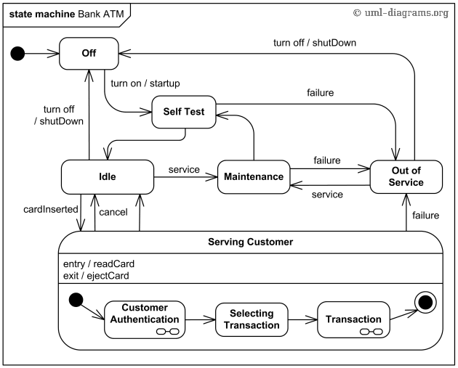
System Architecture – UML Statechart Diagram
state nodes connected with transitions triggered by events
models dynamic aspects of a system
models how the system reacts to inputs
describes different states of the system
defines a state machine to model the system

Slide 13

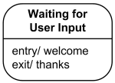
UML Behavioral State Machine
In extending the finite state machine structure
A state models a situation during which some condition holds.
a static situation such as an object waiting for some external event to occur.
the event is said to “trigger” an action
a dynamic conditions such as the process of performing some behavior.
enters the state when the behavior commences and leaves it as soon as the behavior is completed
The UML defines the following kinds of states:
simple state,
composite state.

Slide 14
UML Behavioral State Machine
A simple state is a state that does not have sub states.
Drawn as a rectangle with rounded corners and the state name inside the rectangle.
Simple state may have compartments:
name compartment
internal activities compartment
holds a list of internal actions or state activities that are performed while in the state
activity label identifies the circumstances under which the behavior will be invoked.

Slide 15
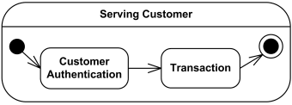
UML Behavioral State Machine
A composite state is defined as state that has sub states
Composite state will have the following:
name compartment
internal activities compartment
“decomposition compartment” (sub state sequence)
The first two compartments are the same as for simple state.
Decomposition refers to the nested structure of the state, diagrammed with internal states and transitions.

Slide 16

UML Behavioral State Machine
If a large number of states are inside a composite state, they may not fit in the graphical space available for the diagram.
In that case, use a simple state graphic with a special "composite" icon.
This icon is a visual cue that the state has a decomposition that is not shown.
The contents of the composite state are shown in a separate diagram (could be on a different page)

Slide 17


UML Behavioral State Machine
An initial pseudostate represents the symbol for a transition to the initial or default state.
An initial pseudostate is shown as a small solid filled circle.
Final state is a special kind of state signifying that the enclosing region (e.g., composite state) is completed.
E.g.,

Slide 18
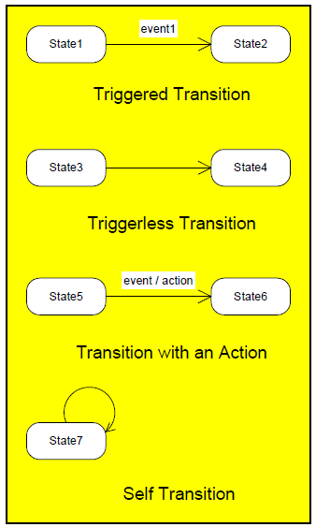
UML Behavioral State Machine
A transition is a directed relationship between a source state and a target state.
Transitions between states
Reflect change in system from one state to another
Expressed as an arrow directed from source to destination
Transition occurs when
Event of interest to system occurs (triggered transition)
System has completed some action and is ready to move to next state (triggerless transition)
An action may be associated with the the transition, or it may be a transition to self

Slide 19
UML Behavioral State Machine
Top level state machine Bank ATM is initially turned off. After the power is turned on, ATM performs startup action and enters Self Test state.
If the test fails, ATM goes into Out of Service state, otherwise there is triggerless transition to the Idle state.
In this state ATM waits for customer interaction.
The ATM state changes from Idle to Serving Customer when the customer inserts banking or credit card in the ATM's card reader.
On entering the Serving Customer state, the entry action readCard is performed.
The transition from Serving Customer state back to the Idle state could be triggered by cancel event or final state
from http://www.uml-diagrams.org

Slide 20
UML Behavioral State Machine
Serving Customer state is a composite state with sequential sub states Customer Authentication, Selecting Transaction and Transaction.
Customer Authentication and Transaction are composite states by themselves which is shown with hidden decomposition indicator icon.
Serving Customer state has triggerless transition back to the Idle state after transaction is finished.
The state also has exit action ejectCard which releases customer's card on leaving the state, no matter what caused the transition out of the state.
from http://www.uml-diagrams.org

Slide 21
Describing a system as a state machine
List all possible states
Declare all variables
For each state, list possible transitions, with conditions, to other states
For each state and/or transition, list associated actions
For each state, ensure exclusive and complete exiting transition conditions
No two exiting conditions can be true at same time
Otherwise, nondeterministic state machine
One condition must be true at any given time
Here’s a couple of examples of a free drawing tools to support making UML behavioral state diagrams
https://wiki.gnome.org/action/show/Apps/Dia?action=show&redirect=Dia
http://argouml.tigris.org/

Slide 22
Software Implementation of State Machine
#define S0 0
#define S1 1
...
#define SN N
void StateMachine() {
int state = S0; // or whatever is the initial state.
while (1) {
switch (state) {
case S0:
// Insert S0’s actions here & Insert transitions T_{i} leaving S0:
if( T₀’s condition is true ) {state = T₀’s next state; /*actions*/ }
if( T₁’s condition is true ) {state = T₁’s next state; /*actions*/ }
...
if( T_{m}’s condition is true ) {state = T_{m}’s next state; /*actions*/ }
break;
case S1:
// Insert S1’s actions here
// Insert transitions T_{i} leaving S1
break;
...
case SN:
// Insert SN’s actions here
// Insert transitions T_{i} leaving SN
break;
}
}
}

