Slide 1

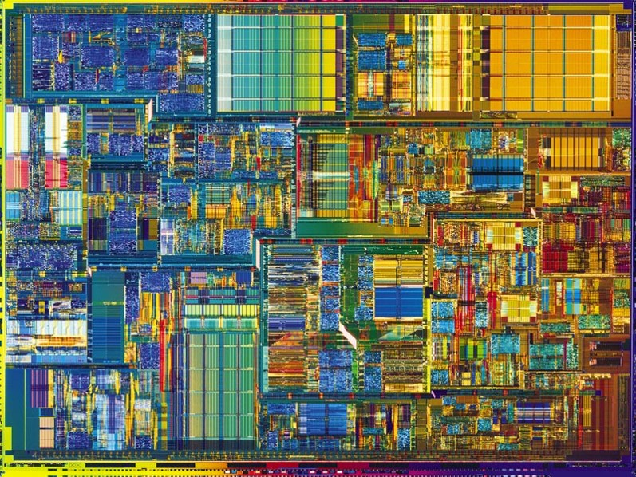
Introduction to Digital Systems
EGR326
Lecture_12
The MSP432 Microcontroller
Dr. Nabeeh Kandalaft EGR226 Grand valley State University

Slide 2



Slide 3
Topics for today’s lecture
After today’s lecture you should be able to:
describe the Power Supply System monitor and how it will detect and act on a “brown-out” condition
describe reasons for the move toward lower voltage logic systems
describe how a watchdog timer works and why it is useful
describe the sleep modes and how they save power
Dr. Nabeeh Kandalaft EGR226 Grand valley State University

Slide 4
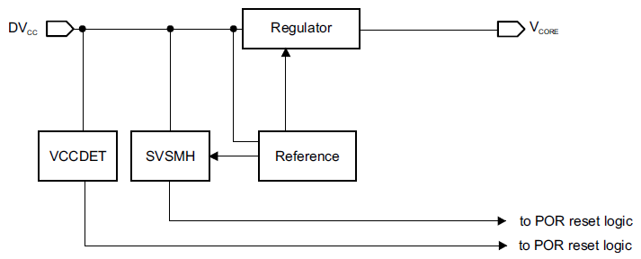
Microcontroller Features
MSP432 Power Supply System (PSS)
- manages all functions related to the power supply and its supervision
provides supervision of the voltage applied to the device (DV_{CC})
generates a supply voltage for the core logic
SVSMH ➔ Supply voltage supervisor and monitor
POR ➔ Power on Reset
Dr. Nabeeh Kandalaft EGR226 Grand valley State University

Slide 5
Microcontroller Features
MSP432 Power Supply System (PSS)
Wide supply voltage range: 1.62 V to 3.7 V, 1.65 V required at start-up
Detection of power on or off condition through VCCDET
Generation of voltage for the device core (VCORE)
Supply voltage supervisor and monitor (SVSMH) for VCC
Software accessible power-fail indicators available via the Reset Controller registers
1.3V
1.4V
SVSMH ➔ Supply voltage supervisor and monitor
POR ➔ Power on Reset
Dr. Nabeeh Kandalaft EGR226 Grand valley State University

Slide 6
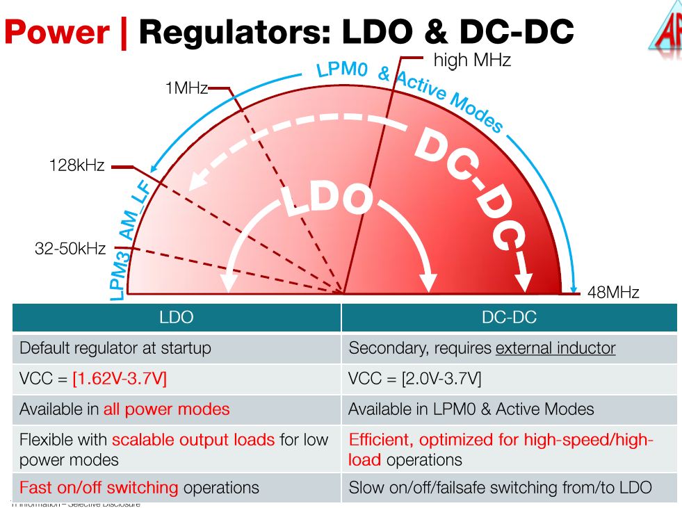
Microcontroller Features
Two internal core voltages
1.12V: 1- 2MHz operation
1.4V: 1-48MHz operation
Dr. Nabeeh Kandalaft EGR226 Grand valley State University

Slide 7
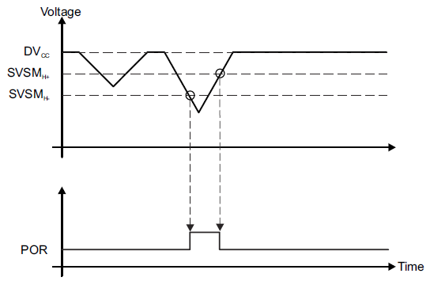
MSP432 Power Supply System (PSS)
The term “brownout” refers to a lowering of the voltage below a set value.
hysteresis built into the thresholds,
depends on whether the voltage rail is going up or down
Power
on Reset
Brownout protection circuit RESETS the device when the operating voltage (DVcc) is lower than the brownout voltage.
RAM and EEPROM can be corrupted when written while the voltage is below standard
Dr. Nabeeh Kandalaft EGR226 Grand valley State University

Slide 8
The move to low voltage parts
Since automotive applications were an initial driving force behind microcontroller development, and 5 Volts is very easy to do in a car
Most microcontrollers initially supported 4.5 - 5.5 V operation.
As consumer goods began to drive a major segments of the microcontroller market the requirement for 3 volt (and lower) microcontrollers has become important
Portability -> battery
Light weight -> fewer batteries
3 volts = 2 battery solution
lower voltage = longer battery life
Dr. Nabeeh Kandalaft EGR226 Grand valley State University

Slide 9
The move to low voltage parts
Many MCUs and logic devices are now designed to operate at 3.3V (and lower), which offer comparable performance of the 5V devices.
There are a few interesting rules of thumb regarding transistors:
1) power dissipated is proportional to size (half as big, dissipates half as much power)
2) propagation delay is proportional to size (half as big, twice as fast)
3) cost is proportional to the square of size (half as big, cost one quarter as much)
If you make a transistor smaller, you improve the power, speed, and cost.
The only drawback is that they are harder to make.
Dr. Nabeeh Kandalaft EGR226 Grand valley State University

Slide 10
The move to low voltage parts
Because the transistors were large on early parts, there was little danger damaging the transistor by putting 5V across it.
However, now that the transistors are getting so small, 5V will actually fry them.
The only way around this is to start lowering the voltage.
This is why some parts are 3.3 V logic (and lower), it isn't just because of batteries.
Dr. Nabeeh Kandalaft EGR226 Grand valley State University

Slide 11
Watchdog Timer
No piece of software is free from bugs, the application could get stuck in endless loops.
The Watchdog Timer (WDT) runs independent of the rest of the system, causing system resets whenever it times out.
The application software should ensure that the timeout never occurs by resetting the WDT periodically as long as the software is in a known healthy state.
If the system hangs or program execution is corrupted, the WDT will not receive its periodic reset, and will eventually time out and cause a system reset.
“The built-in watchdog timer on the TI MSP432 must be employed to confirm that the program is operating as designed.”
Dr. Nabeeh Kandalaft EGR226 Grand valley State University
Notes:
“Well designed watchdog timers fire off every day, quietly saving systems and lives without the esteem offered to human heroes.” - Jack Ganssle.

Slide 12
Watch Dog Timer (WDT_A) on the MSP432
Primary function is to perform a controlled system restart after a software problem
If the selected time interval expires, a system reset is generated
If the watchdog function is not needed, it can be configured as an interval timer and to generate interrupts at selected time intervals
Normally, the watchdog timer would be reset in the main program periodically so that it would never time out
8 software-selectable time intervals
Selectable clock source (SMCLK, ACLK, VLOCLK, BCLK)
Password-protected access to the watchdog timer control (WDTCTL) register
Dr. Nabeeh Kandalaft EGR226 Grand valley State University
Notes:
The primary function of the watchdog timer (WDT_A) module is to perform a controlled system restart
after a software problem occurs. If the selected time interval expires, a system reset is generated. If the
watchdog function is not needed in an application, the module can be configured as an interval timer and
can generate interrupts at selected time intervals.
Features of the watchdog timer module include:
• Eight software-selectable time intervals
• Watchdog mode
• Interval timer mode
• Password-protected access to the Watchdog Timer Control (WDTCTL) register
• Selectable clock source
• Can be stopped to conserve power

Slide 13
Watch Dog Timer (WDT_A) on the MSP432
Principle.
watchdog timer has a 16 bit timer which counts from 0x00 to 0xffff.When it hits the max value of OXFFFF the watchdog resets the controller.
Our job is to prevent this from happening and we’ve to keep resetting the timer.
If the code hangs then the timer is not reset and the watchdog timer overflows and resets the timer.
Timer Mode
The watchdog can also be configured to be a timer which provides interrupts instead of the reset of the controller. But the time delay can be varied to a great extent. It can be varied by varying the clock sources itself or varying the division factors.
Dr. Nabeeh Kandalaft EGR226 Grand valley State University
Notes:
The primary function of the watchdog timer (WDT_A) module is to perform a controlled system restart
after a software problem occurs. If the selected time interval expires, a system reset is generated. If the
watchdog function is not needed in an application, the module can be configured as an interval timer and
can generate interrupts at selected time intervals.
Features of the watchdog timer module include:
• Eight software-selectable time intervals
• Watchdog mode
• Interval timer mode
• Password-protected access to the Watchdog Timer Control (WDTCTL) register
• Selectable clock source
• Can be stopped to conserve power

Slide 14
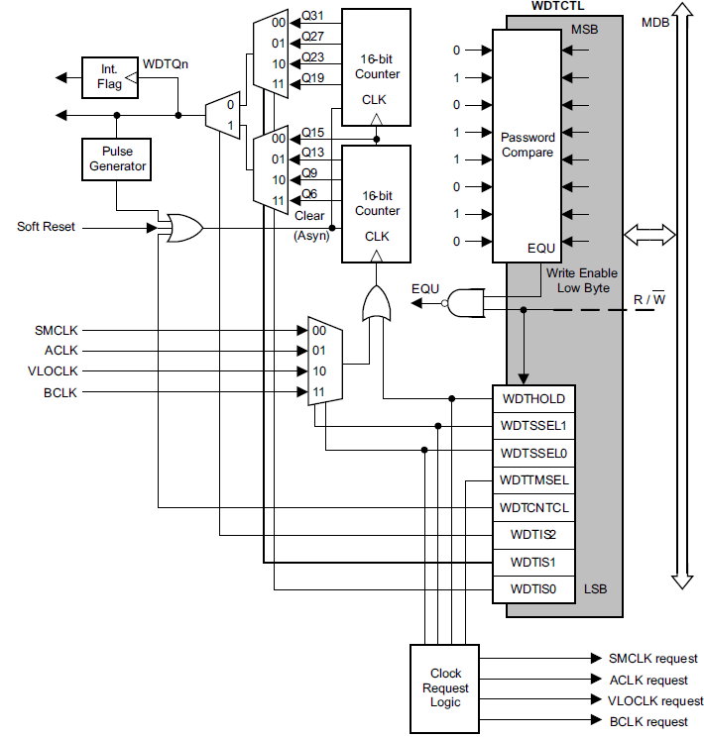
Watchdog Timer
WDTCTL is a 8-bit password-protected read/write register
Any read or write access must use half- word instructions, and write accesses must include the write password 05Ah in the upper byte.
A write to WDTCTL with any value other than 05Ah in the upper byte is a password violation and causes a system RESET.
Dr. Nabeeh Kandalaft EGR226 Grand valley State University
Notes:
Watchdog Timer Counter (WDTCNT)
The WDTCNT is a 32-bit up counter that is not directly accessible by software. The WDTCNT is controlled
and its time intervals are selected through the Watchdog Timer Control (WDTCTL) register. The WDTCNT
can be sourced from SMCLK, ACLK, VLOCLK, and BCLK. The clock source is selected with the
WDTSSEL bits. The timer interval is selected with the WDTIS bits. This counter is automatically reset on a
Soft Reset (or higher class of reset).

Slide 15
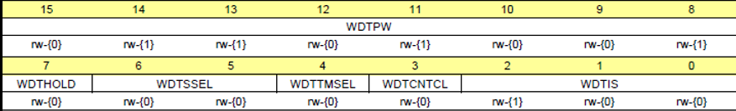
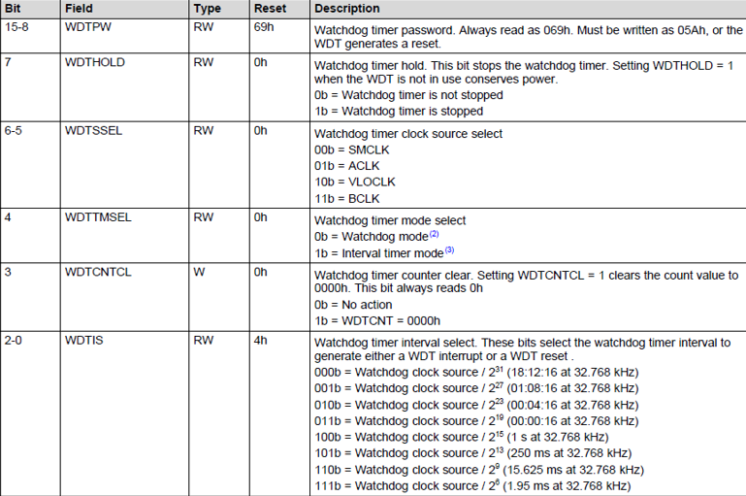
Watchdog Timer
Dr. Nabeeh Kandalaft EGR226 Grand valley State University
Notes:
Watchdog Timer Counter (WDTCNT)
The WDTCNT is a 32-bit up counter that is not directly accessible by software. The WDTCNT is controlled
and its time intervals are selected through the Watchdog Timer Control (WDTCTL) register. The WDTCNT
can be sourced from SMCLK, ACLK, VLOCLK, and BCLK. The clock source is selected with the
WDTSSEL bits. The timer interval is selected with the WDTIS bits. This counter is automatically reset on a
Soft Reset (or higher class of reset).
Watchdog timer interval select. These bits select the watchdog timer interval to
generate either a WDT interrupt or a WDT reset .
000b = Watchdog clock source / 231 (18:12:16 at 32.768 kHz)
001b = Watchdog clock source / 227 (01:08:16 at 32.768 kHz)
010b = Watchdog clock source / 223 (00:04:16 at 32.768 kHz)
011b = Watchdog clock source / 219 (00:00:16 at 32.768 kHz)
100b = Watchdog clock source / 215 (1 s at 32.768 kHz)
101b = Watchdog clock source / 213 (250 ms at 32.768 kHz)
110b = Watchdog clock source / 29 (15.625 ms at 32.768 kHz)
111b = Watchdog clock source / 26 (1.95 ms at 32.768 kHz)

Slide 16

Watchdog Timer
After a system reset, the WDT_A module is automatically configured in the watchdog mode with a count value of $2^{15}$ using the SMCLK (3MHz default) as the source.
The application must set up or halt the WDT before the initial reset interval expires.
As an example, if the SMCLK is default sourced by the DCO, which is set to 3 MHz, this results in an approximate 10.92-ms watchdog interval window
A system reset resets the watchdog timer to its default condition.
Dr. Nabeeh Kandalaft EGR226 Grand valley State University
Notes:
After a system reset, the WDT_A module is automatically configured in the watchdog mode
with a count value of 215, using the SMCLK as the source. The application must set up or halt
the WDT before the initial reset interval expires. As an example, if the SMCLK is default
sourced by the DCO, which is set to 3 MHz, this results in an approximate 10.92-ms
watchdog interval window. If the DCO frequency is changed, the application must control the
watchdog time-out within the modified interval (

Slide 17
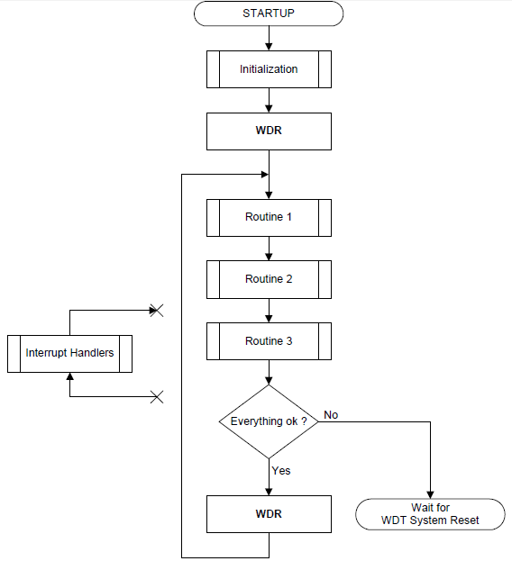
Watchdog Timer
The timeout period must be chosen so that it is longer than the longest possible execution path through the main loop of your application
This includes expected interrupt handlers as well.
If your main loop is very large, several checkpoints could be inserted inside the loop to accommodate the WDT timeout period.
Dr. Nabeeh Kandalaft EGR226 Grand valley State University

Slide 18
Reset Modes
'Power On/Off Reset' (POR)
any type of reset that can help gain control of a device in a completely uninitialized (or random) state.
A POR may be required by the device in any of the following cases:
application or removal of power to the device
a 'voltage exception' condition that is generated by the power supply system (PSS)
exit from “shutdown sleep” mode of operation
a user-driven full chip reset initiated either through the RSTn pin, through the debugger, through the SYSCTL.
DCO short-circuit fault in external resistor mode of operation.
All components in the device are reset:
debugger loses connection to the device and control of it,
the device undergoes a full reboot,
on-chip SRAM values are not ensured to be retained.
Dr. Nabeeh Kandalaft EGR226 Grand valley State University

Slide 19
Reset Modes
Hard Reset initiated under user application control
application wishes to re-initialize the system as a reaction to a particular event or condition.
restart without rebooting due to a catastrophic event detected by application, or a debug scenario (debug connection maintained)
resets the processor and all application configured peripherals in the system.
Soft Reset initiated under user application control
resets only the execution-related components of the system.
all other application related configuration is maintained
peripherals that are configured by the application continue their operation
Dr. Nabeeh Kandalaft EGR226 Grand valley State University

Slide 20
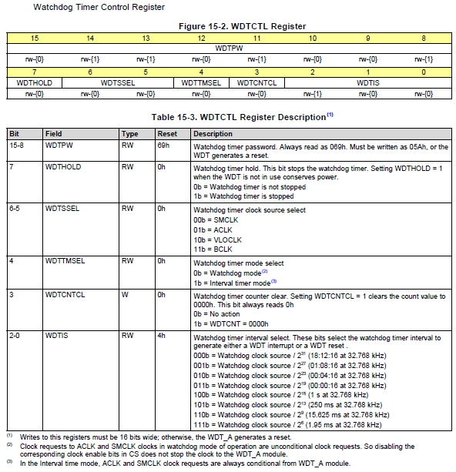
Watch Dog Registers

Slide 21
Sample code to enable watchdog
WDT_A->CTL = 0x5A00 // Watchdog Password
| 1<<5 //Set to ACLK
| 0<<4 //Set to Watchdog mode
| 1<<3 // Clear Timer
| 3; //Set to 2^19 interval (16 seconds)

Slide 22
Minimizing power consumption on the MSP432
Two primary elements of the MSP432 control the power settings of the device
and hence the power consumption of the device
the Clock System (CS)
and the Power Supply System (PSS)
Higher MCLK speeds require higher VCORE voltages
Higher clock speed also dissipates more power since current switches more frequently between on/off states
An external inductor based switching regulator can provide core voltage with lower power consumption at high clock frequencies
Low power modes can be specified in software that turn off clocks to unused peripherals
Dr. Nabeeh Kandalaft EGR226 Grand valley State University

Slide 23
Sleep Mode
Special instructions place the microcontroller into a very low-power sleep mode in which no instructions are executed.
The current consumption is on the order of microamps.
A standard 1200 mAh battery (like NiMH rechargeables) will maintain a device in sleep mode (consuming 1 μA of current) for months
After putting parts of the MCU to sleep, you need something to wake them up
(an internal or external interrupt or event)
Set System Control Register for sleep, deep sleep, or shutdown mode, then enter using WFI or WFE instruction.
The processor can automatically go back to sleep after an ISR completes by
issuing a Sleep-on-exit instruction.

Slide 24
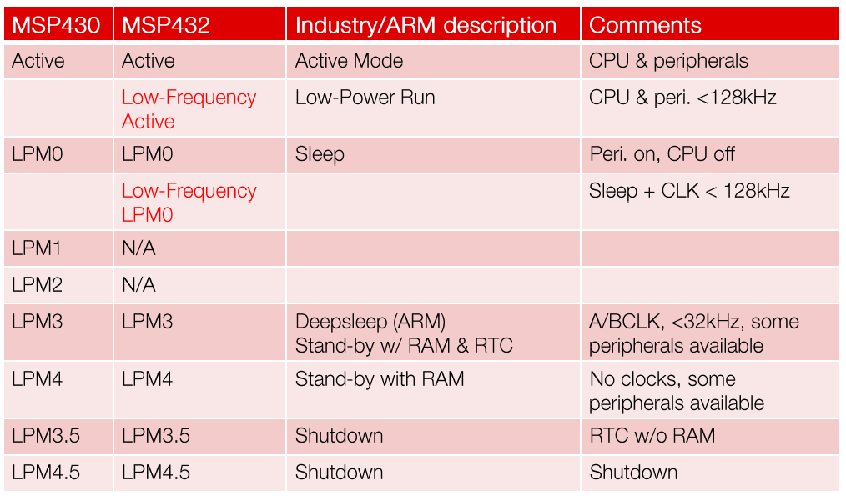
Microcontroller Features
Low voltage Performance Tradeoff
enables the application to shut down unused modules, saving power

Slide 25
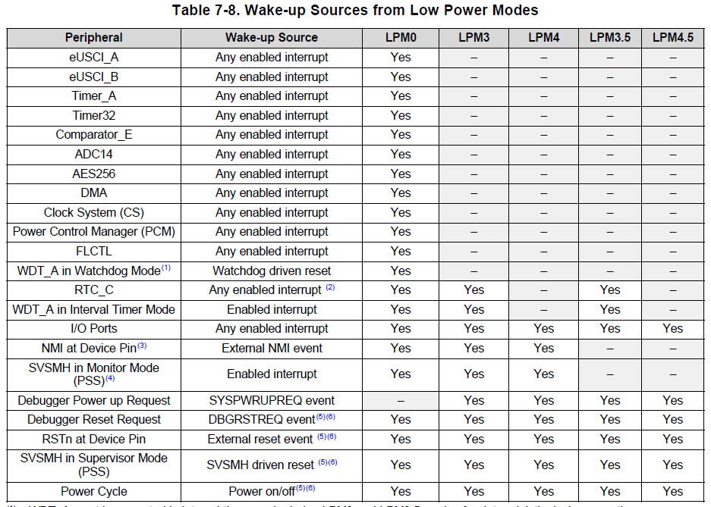

Dr. Nabeeh Kandalaft EGR226 Grand valley State University

Slide 26
WDT 250ms, ACLK, interval timer
WDT_A->CTL = WDT_A_CTL_PW |
WDT_A_CTL_SSEL__ACLK |
WDT_A_CTL_TMSEL |
WDT_A_CTL_CNTCL |
WDT_A_CTL_IS_5;
Dr. Nabeeh Kandalaft EGR226 Grand valley State University

Slide 27
From: MSP432P4xx Family Technical Reference Guide

