Slide 1
Objectives for today’s lecture
After today’s lecture you should be able to:
Describe the three types of memory used in most microcontrollers
Describe the basic structure and operation of volatile RAM memory
Describe the basic structure and operation of non-volatile flash and EEPROM memory
Use program (flash) memory on the MSP432 to store constants to free up RAM
Write to and read from flash memory on the MSP432 to save information in non-volatile storage

Slide 2
Embedded system architecture
Inputs
Processing and Control
Outputs
analog
sensors
A/D
converter
D/A
converter
analog
actuators
power
supply
display
micro
controller
digital
inputs
digital
actuators
inter-process
communication
timers
memory
Dr. Nabeeh Kandalaft EGR226 Grand valley State University

Slide 3
Memory Terminology
Random Access Memory (RAM)
- Memory in which the access time is the same for any location
Read
- The operation whereby the binary word stored in a specific memory location is sensed and transferred
Write
- The operation whereby a new word is placed into a particular memory location
Read/Write Memory (RWM)
- Any memory that can be read from and written (duh!)
Read-Only Memory (ROM)
Memory that is designed for applications where the content does not change (written once)

Slide 4
Microcontroller Memory Types
There are three kinds of memory in most MCUs:
Random Access Memory (RAM),
EEPROM (Electrically Erasable Programmable Read-Only Memory).
Program Memory,
Each has different characteristics and uses:
RAM is where variables are stored that change during program operation, it is volatile (contents go away when power is removed)
EEPROM will retain its information during periods of no power (non-volatile memory)
It’s used for storing data such as device parameters and system configuration at runtime so that it can persist between MCU resets
Program memory (also known as flash, a type of EEPROM) is where the executable code is stored and retained
Contents of program memory is write protected and usually is modified by the bootloader or an “In System Programmer”

Slide 5
Static Random Access Memory SRAM
Electrically Erasable Programmable Read-Only Memory (EEPROM)
– is designed to be written to infrequently and read often
Volatile
- Any type of memory that requires the continual application of electrical power in order to store information
Static Random Access Memory (SRAM)
- memory that uses bistable latching circuitry to store each bit.
The term static differentiates it from dynamic RAM (DRAM) which must be periodically refreshed by continually applying a voltage.

Slide 6
Static Random-Access Memory SRAM
SRAM and DRAM are volatile in that data is eventually lost when the memory is not powered.
SRAM is more expensive and less dense than DRAM and is therefore not used for high-capacity, low-cost applications such as the main memory in personal computers
SRAM used with moderately clocked microprocessors draws very little power and can have a nearly negligible power consumption when sitting idle

Slide 7
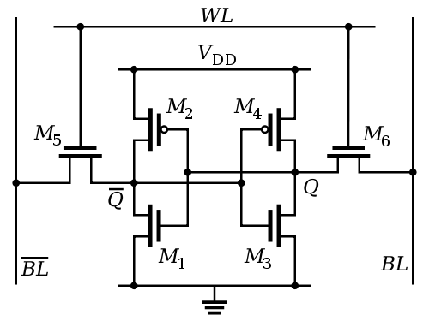
How SRAM Works
Access to each memory bit cell is enabled by the word line (WL) which controls the two access transistors M₅ and M₆ which, in turn, control whether the cell should be connected to the bit lines: BL and BL.
They are used to transfer data for both read and write operations.
Both the BL signal and its inverse are used together to improve noise margins.
During read accesses, the bit lines are actively driven high and low by the inverters in the SRAM cell.
The symmetric structure of SRAMs allows for differential signaling
---makes small voltage swings more easily detectable.
Note: each pair of MOSFETs
(e.g., M₁ and M₂)
look like a push-pull inverter and cross connected they make a latch

Slide 8
How SRAM Works
Reading - assume that the content of the memory is a 1, stored at Q. The read cycle is started by precharging both the bit lines to a logical 1, then asserting the word line WL, enabling both the access transistors.
Values stored in Q and Q are transferred to the bit lines by leaving BL at its precharged value and discharging BL through M₁ and M₅ to a logical 0.
On the BL side, the transistors M₄ and M₆ pull the bit line toward V_{DD}, a logical 1.
If the content of the memory was a 0, the opposite would happen
and BL would be pulled toward 1 and BL toward 0.
BL and BL lines will have a small voltage difference between them
A sense amplifier will sense which line has the higher voltage.

Slide 9
How SRAM Works
Writing - The start of a write cycle begins by applying the value to be written to the bit lines.
To write a 0, set BL to ”1” and BL to ”0.”
This is like applying a reset pulse to an SR-latch, which causes the it to acquire a 0 state.
A ”1” is written by inverting the values of the bit lines.
WL is then asserted and the value that is to be stored is latched in.
The bit line drivers are designed to be much stronger than the relatively weak transistors in the cell itself, so that they can easily override the previous state of the cross-coupled inverters.

Slide 10
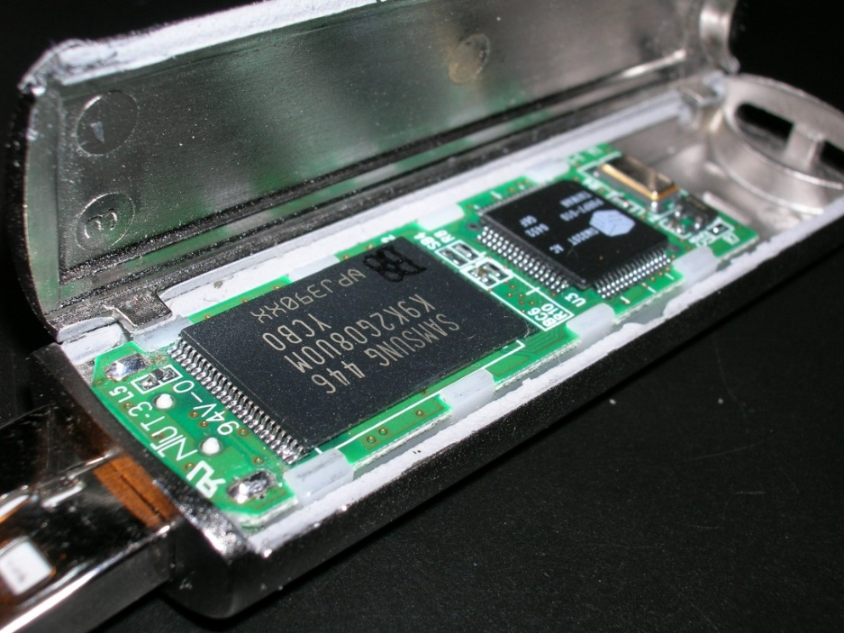
Flash Memory
A USB flash drive.
Chip on left is flash memory, the controller is on the right
Flash memory is technically a type of EEPROM
"EEPROM" generally refers to non-flash EEPROM which is erasable in small blocks (bytes).
Because erase cycles are slow, the large block sizes used in flash memory erasing give it a significant speed advantage over non-flash EEPROM when writing large amounts of data.
flash memory costs much less than byte-programmable EEPROM
http://en.wikipedia.org/wiki/Flash_memory

Slide 11
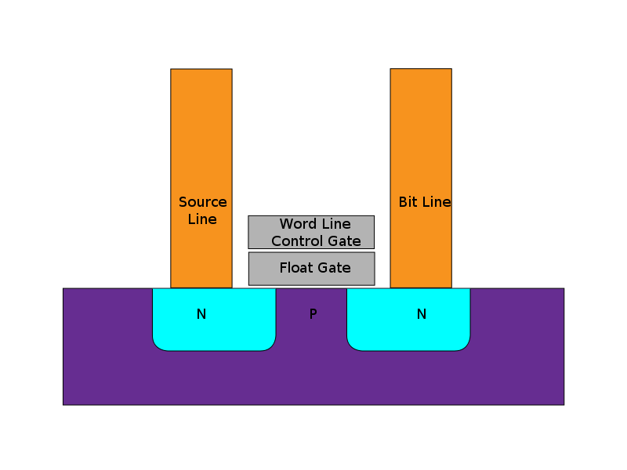
How Flash Memory Works
Flash stores information in an array of memory cells made from floating-gate transistors.
In traditional single-level cell devices, each cell stores only one bit of information.
Each memory cell resembles a standard MOSFET, except with two gates instead of one.
On top is the control gate (CG), and below this is a floating gate (FG) insulated all around by an oxide layer.
The FG is interposed between the CG and the MOSFET channel.
The FG is electrically isolated by its insulating layer, any electrons placed on it are trapped there
under normal conditions, it will not discharge for many years.
Notes:
the name "flash" was suggested by a colleague of the inventor at Toshiba because the erasure process of the memory contents reminded him of the flash of a camera

Slide 12
How Flash Memory Works
When FG holds a charge, it partially cancels the electric field from the CG
This modifies the threshold voltage (V_{T}) of the cell
more voltage has to be applied to the CG to make the channel conduct.
For read-out, a voltage intermediate between the possible threshold voltages is applied to the CG,
the MOSFET channel's conductivity is tested
which is influenced by the FG.
Current flow through the MOSFET channel is sensed
forms a binary output, reproducing the stored data

Slide 13
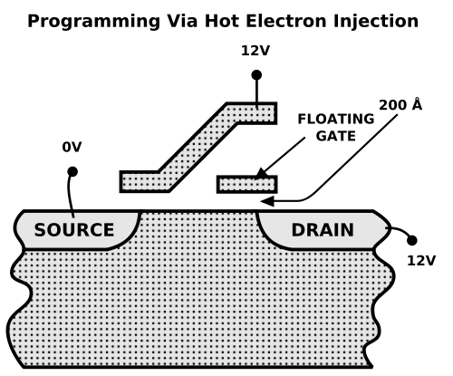
How Flash Memory Works
Programming - virtually all flash chips require only a single supply voltage, and produce the high voltages via on-chip charge pumps
A single-level flash cell in its default state is logically equivalent to a binary "1" value,
A flash cell can be programmed, or set to a binary "0" value, by:
applying an elevated on-voltage to the CG
the channel is now turned on, so electrons can flow from the source to the drain (assuming NMOS)
the source-drain current is sufficiently high to cause some high energy electrons to jump through the insulating layer onto the FG, via a process called hot-electron injection

Slide 14
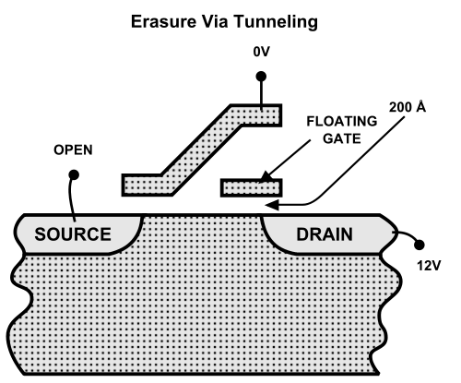
How Flash Memory Works
Erasing a flash cell (resetting it to the "1" state)
To erase a flash cell:
the CG is at 0V and source terminal is opened,
pulling the electrons off the FG through quantum tunneling.
flash memory chips are divided into erase segments (often called blocks or sectors).
so that all the cells in an erase segment can be erased together.

Slide 15
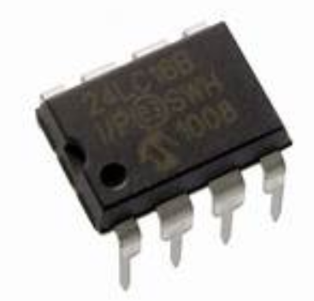
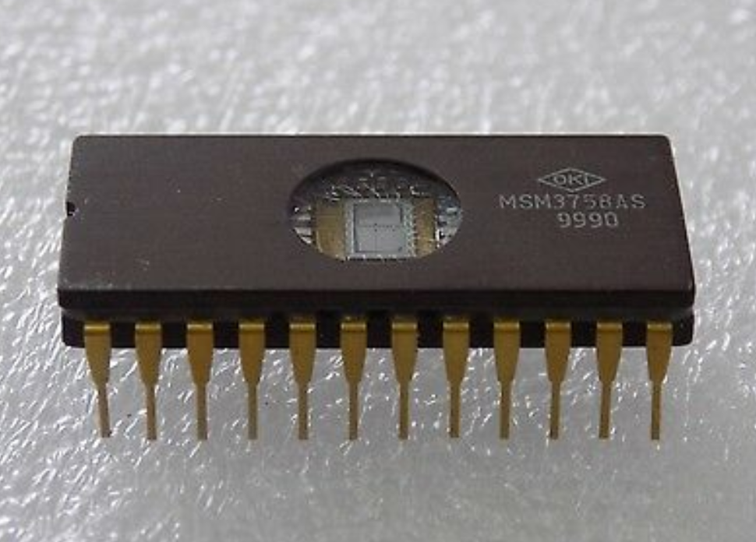

Slide 16
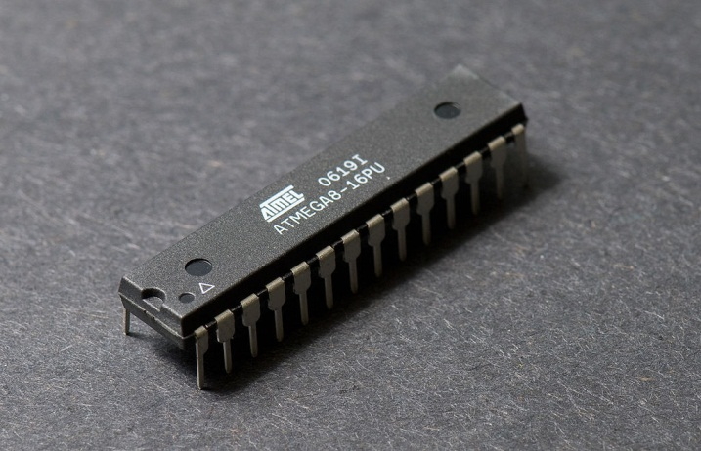
AVR Memory Usage
The AVR was one of the first microcontroller families to use on-chip flash memory for program storage
as opposed to one-time programmable ROM, EPROM, or EEPROM used by other microcontrollers at the time (1996).
Flash, EEPROM, and SRAM are all integrated onto a single chip, removing the need for external memory in most applications.
e.g., on Atmega328P there is far more program memory (32 KB) than RAM (2 KB) or EEPROM (1 KB)
It can be beneficial to store values that don’t change while the code runs (e.g., constants) in program memory instead of RAM
System parameters that initialize customized system operation are stored in EEPROM

Slide 17
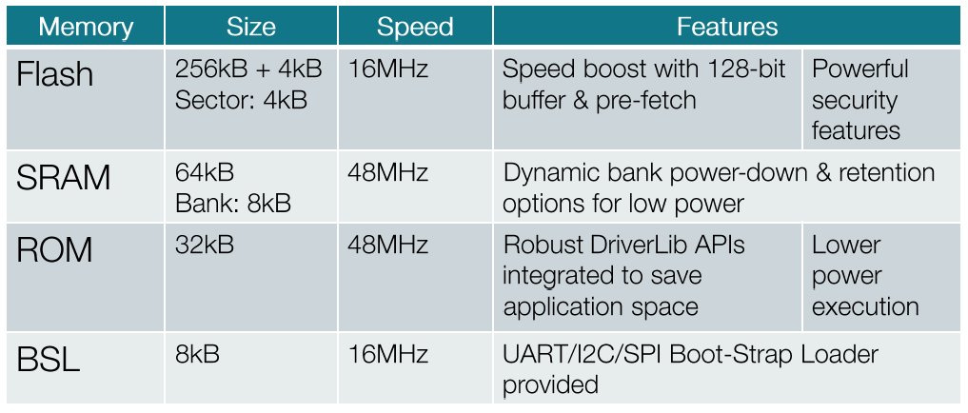
MSP432 Memory Types
The amount of memory on the MSP432 is significantly greater.
Note: flash is slower than ROM or RAM, therefore, wait states need to be set when operating the CPU higher than 16 MHz.
from: MSP432 Deep Dive Training Lectures (see Classic Resource Explorer in CCS)

Slide 18
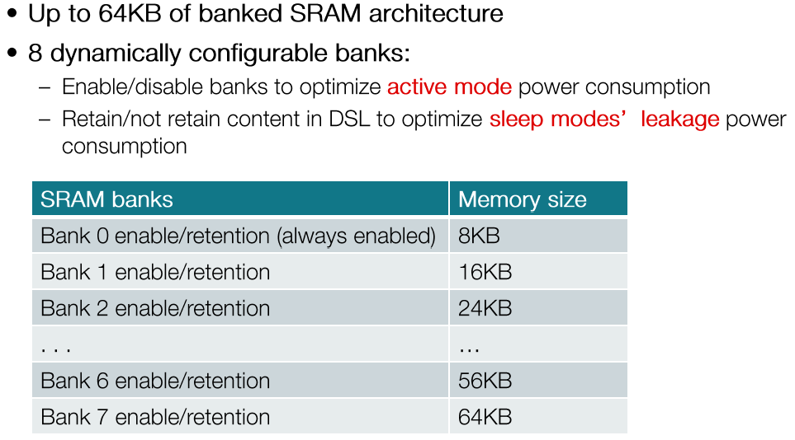
MSP432 Memory Types
The RAM space is divided up into banks of 8KB.
from: MSP432 Deep Dive Training Lectures (see Classic Resource Explorer in CCS)

Slide 19
RAM Usage
RAM is used by the program code to store values for the variables that change when the program runs
RAM is volatile, which means it can be changed by the program.
It also means anything stored in this memory is lost when power is switched off.
MSP432 has less RAM (64 KB) than program memory (256 KB), but, still has much more than many MCUs.

Slide 20
Using Flash Memory To Store Constants
The MSP432 is a Harvard architecture processor, where flash is used for the program, RAM is used for data, and they each have separate address spaces.
The C Language was not designed with Harvard architectures in mind, it was designed for Von Neumann architectures where code and data exist in the same address space.
In C, using the const keyword will tell the compiler to place the data in the Program Memory (Flash), e.g.,
const uint16_t Logo[] = {
0xFFFF, 0xFFFF, 0xFFFF, 0xFFFF, …
}
By storing data in flash that does not change during program operation, you preserve the more limited amount of SRAM for other program purposes.

Slide 21
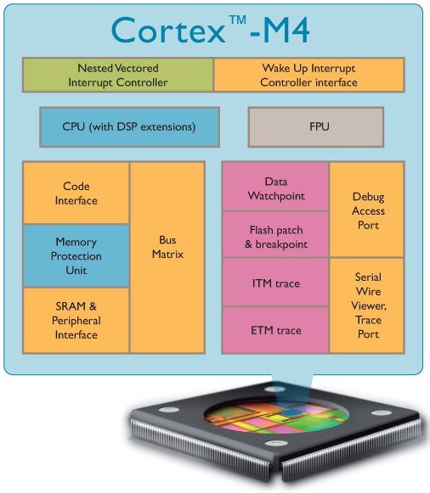
The Cortex-M4 Architecture Supports Debug
Serial wire or JTAG debug
Serial Wire Data is used to program flash and RAM with the XDS-110 debug probe running on the aux MCU on the Launchpad
When a debug probe is not used, a boot loader program on the MSP432 will accept commands from a PC to load flash
Cortex M3 Total 60k* Gates

Slide 22
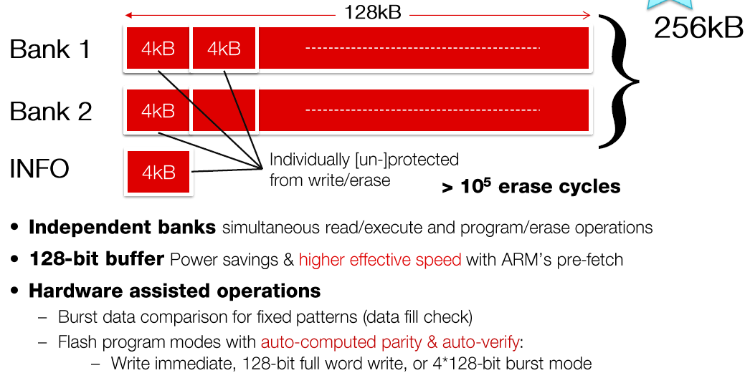
MSP432 Flash Memory
The flash memory is divided into two independent banks
And an INFO section is intended for TI and customer data
the MSP432p401r has 16 kB of Info space, 8 kB on each bank
from: MSP432 Deep Dive Training Lectures (see Classic Resource Explorer in CCS)

Slide 23
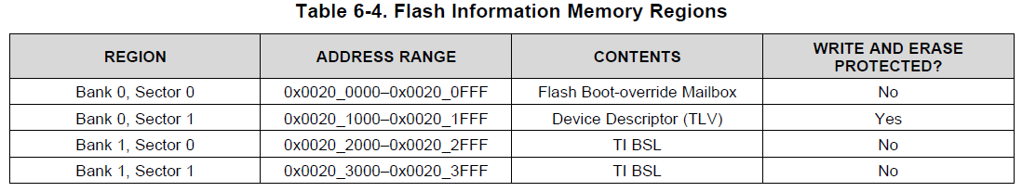
MSP432 Flash Memory
The banks on the MSP432p401r are referred to as Bank 0 and Bank 1
Note that the Bank 1 Sector 0 and Bank 1 Sector 1 INFO sections contain the Boot System Loader (BSL)
Since Bank 0 Sector 1 is write protected and Bank 1 contains the BSL, we’ll use Bank 0, Sector 0 for the project to write saved data to flash
The main flash sectors (the rest of flash) are erased before download of a new program, so this area would not be a good candidate for saved data.
from: MSP432p401x data sheet

Slide 24
Boot Strap Loader (BSL) Code
The MSP432 bootloader (BSL) program in the INFO section of flash can load a user program into programmable memory (flash) and data memory (RAM)
To invoke the bootloader, a BSL entry sequence must be applied to dedicated pins (we’ve been using the debug probe instead)
The MSP432 BSL can use UART, I2C, and SPI serial interfaces.
In MSP432 devices, the BSL can select the interface used to communicate (from information in the Boot-override Mailbox)
To avoid accidental overwriting of the BSL code, the code is protected in the INFO flash area by default
A script running on a PC is used to send boot commands to the BSL program to control programming of flash and RAM
e.g., a Peripheral Interface (PI) packet

Slide 25
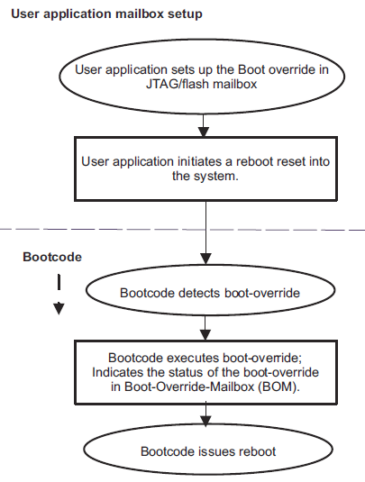
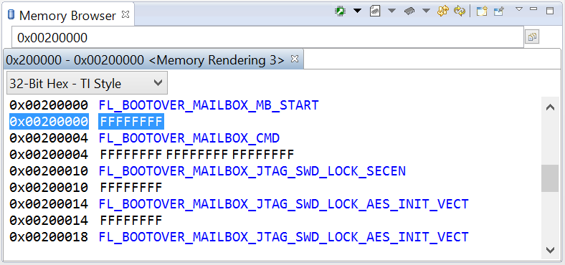
Boot Override Flash Mailbox
To instruct the boot-code to execute special boot override functions, a flash sector is used by the boot strap loader to pass in information and configuration data to be accessed by the boot-code.
Mail box start (0x0115ACF6) has to be programed by the user for the boot code to determine a valid flash boot override mailbox (so erase and then don’t use)
We will use this flash area to store data

Slide 26
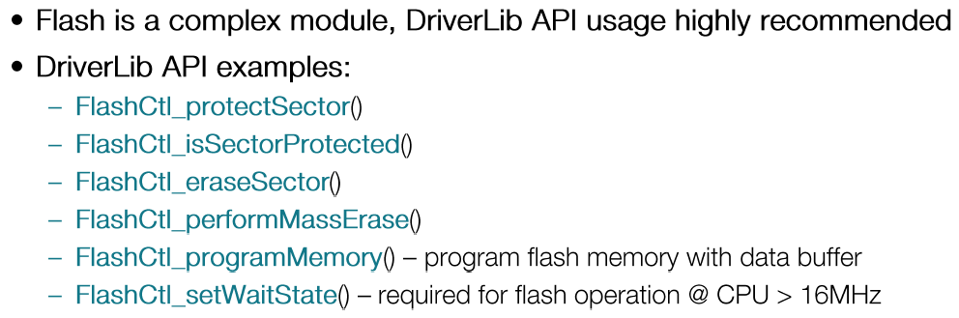
MSP432 Flash DriverLib API
The smallest amount of flash that can be erased is 1 sector (4 KB)
An erased flash bit is a 1, each flash bit can only be programmed from 1 to 0, to program from 0 to 1 requires an erase cycle
Each sector to be programmed must first be unprotected
from: MSP432 Deep Dive Training Lectures (see Classic Resource Explorer in CCS)

Slide 27
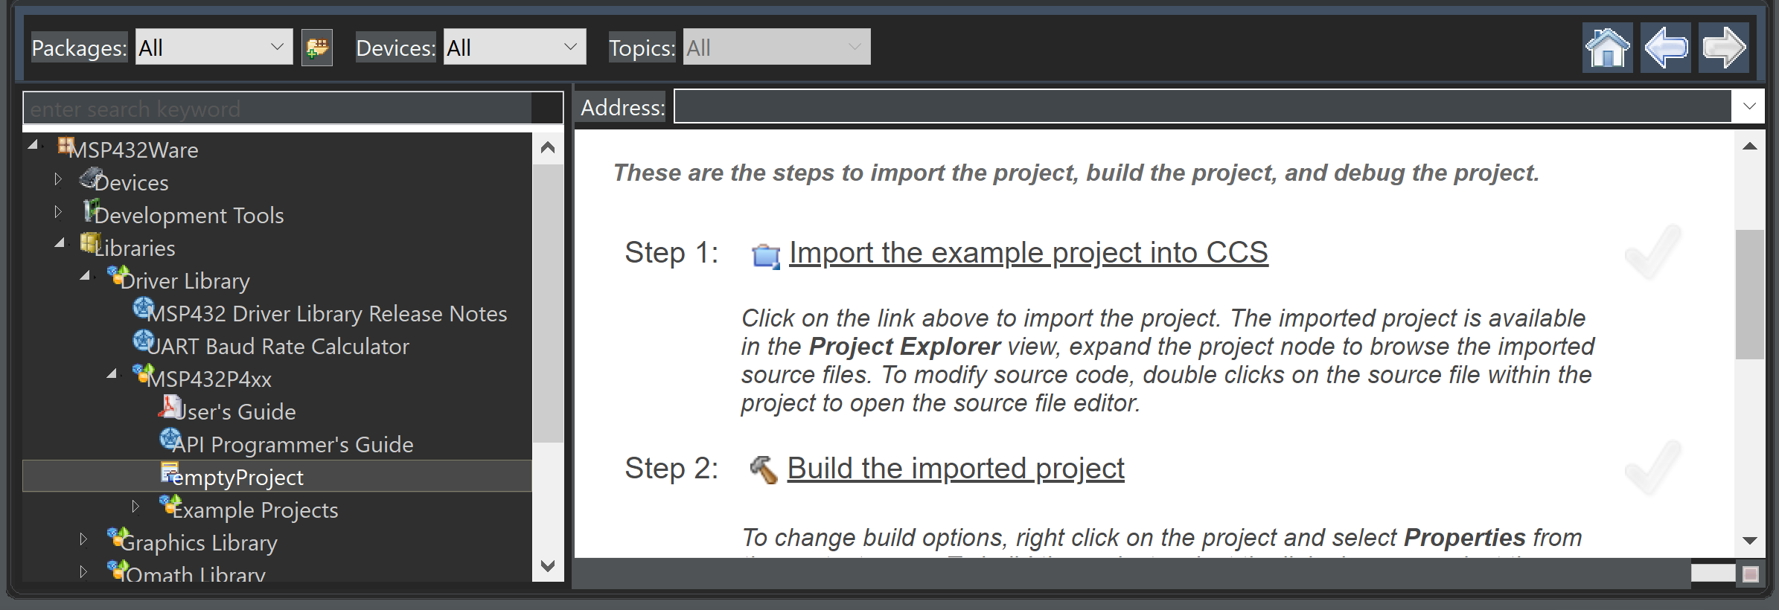
MSP432 Flash DriverLib API
space.
You CANNOT use DriverLib commands unless the project has been built and linked using Driver libraries

Slide 28
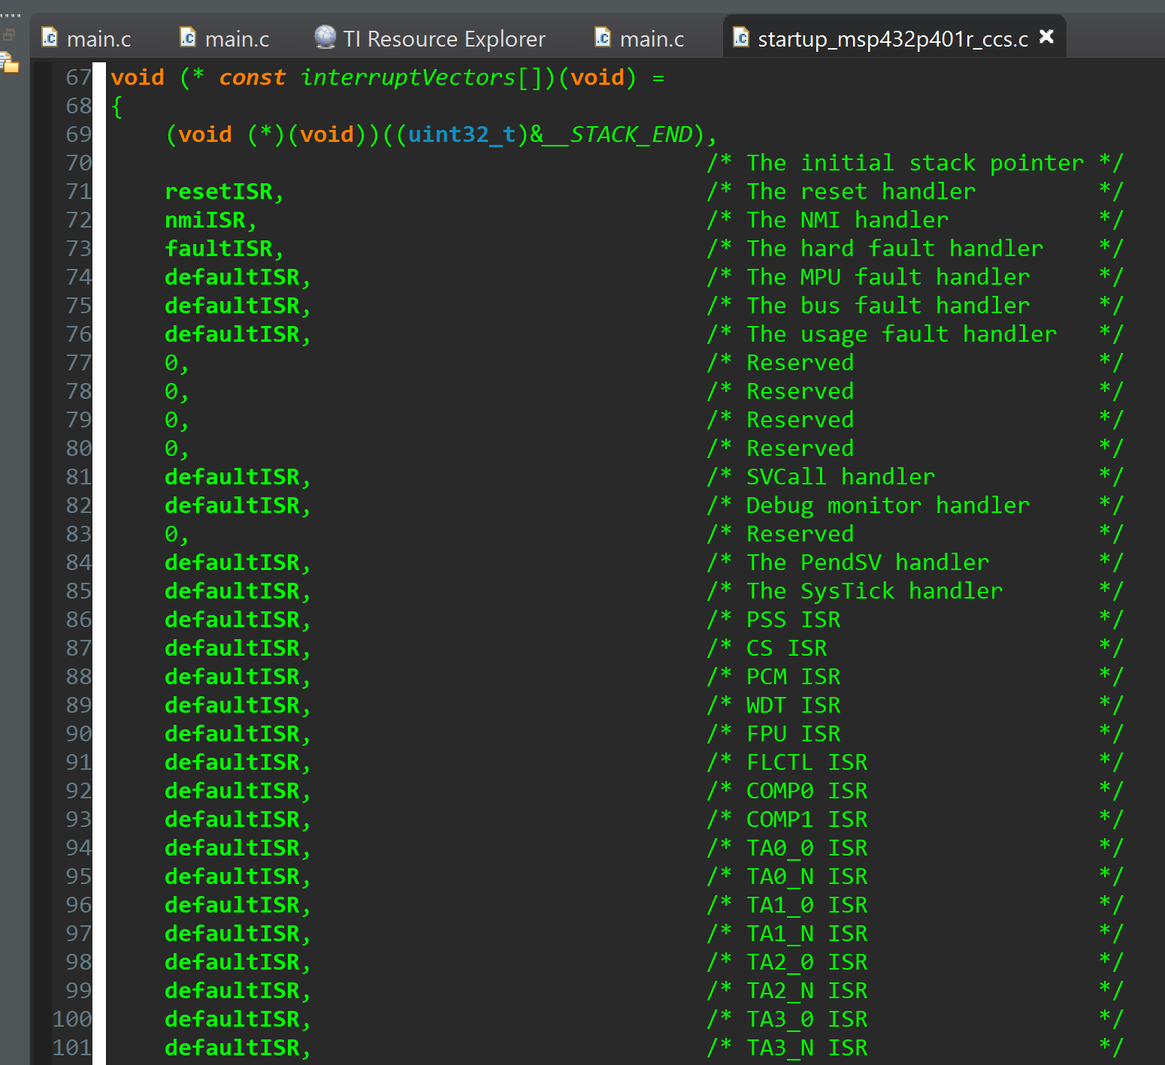
MSP432 Flash DriverLib API
Note:
When defining a project using DriverLib,
The startup_mps432p401r_ccs.c is cleared out!

Slide 29
Example Code Reading/Writing Flash Memory
#define CALIBRATION_START 0x000200000
const uint8_t simulatedCalibrationData[]="test data block"; // array to hold data
uint8_t read_back_data[16]; // array to hold values read back from flash
uint8_t* addr_pointer; // pointer to address in flash for reading back values
int main(void)
{
uint8_t i; // index
// halting the watch dog is done in the system_msp432p401r.c startup
clockInit48MHzXTL();// Setting MCLK to 48MHz for faster programming
addr_pointer = CALIBRATION_START+4; // point to address in flash for saving data
for(i=0; i<16; i++) {// read values in flash before programming
read_back_data[i] = *addr_pointer++;
}
/* Unprotecting Info Bank 0, Sector 0 */
MAP_FlashCtl_unprotectSector(FLASH_INFO_MEMORY_SPACE_BANK0,FLASH_SECTOR0);
/* Erase the flash sector starting CALIBRATION_START. */
while(!MAP_FlashCtl_eraseSector(CALIBRATION_START));
/* Program the flash with the new data. */
while (!MAP_FlashCtl_programMemory(simulatedCalibrationData,
(void*) CALIBRATION_START+4, 16 )); // leave first 4 bytes unprogrammed
/* Setting the sector back to protected */
MAP_FlashCtl_protectSector(FLASH_INFO_MEMORY_SPACE_BANK0,FLASH_SECTOR0);
addr_pointer = CALIBRATION_START+4; // point to address in flash for saved data
for(i=0; i<16; i++) {// read values in flash after programming
read_back_data[i] = *addr_pointer++;
}
while(1); // trap here when completed
}

