Slide 1

Topics for today’s lecture
Analyze three analog circuit models for a digital logic output stage
Establish a digital output stage’s ability to source and sink current
What is meant by “output contention”
Open collector/drain outputs
Output enabled gates

Slide 2
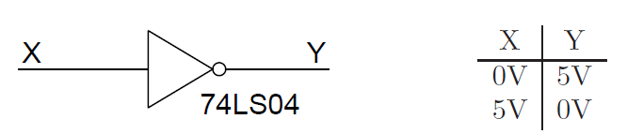
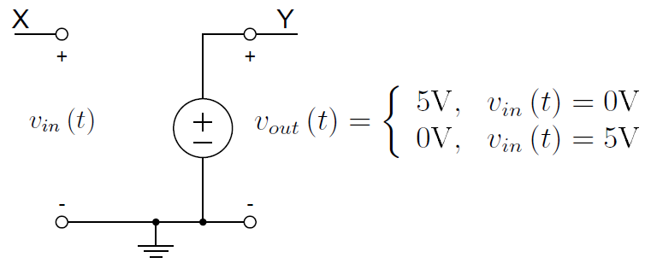
Digital Logic Output Models
An ideal logic gate has only two output voltage levels
and can be represented by an ideal circuit voltage supply model
What happens when v_{in} is between 0 and 5 V, say 2.5V?
Can the output act like an ideal voltage source with unlimited current?

Slide 3
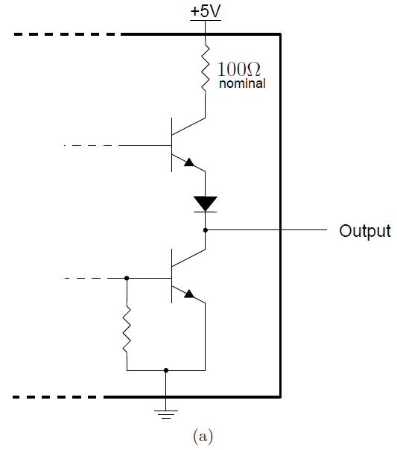
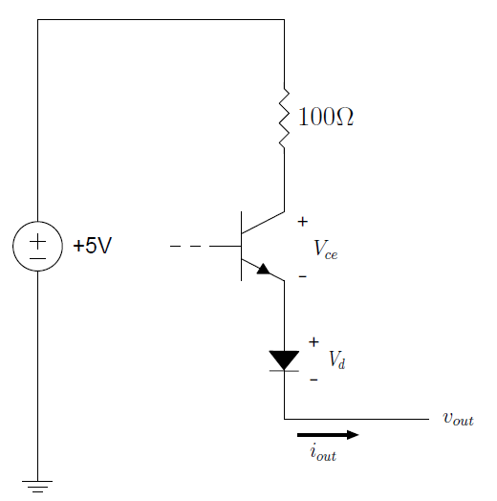
Digital Logic Output Models
Output stage for a standard TTL logic gate
- State: driven high (lower transistor is off)

Slide 4
Digital Logic Output Models
v_{out} = +5V − 100 · i_{out} − V_{ce} − V_{d}
i_{out} : current flowing out of the output pin
V_{ce} : collector-to-emitter voltage drop across the transistor, which depends on i_{out}
V_{d} : voltage drop across the diode, which also depends on i_{out}
Some important observations are:
The output high voltage ≠ +5V
The output voltage will depend upon the output current.
The output pin will be a source of current.
Equivalent circuit model for a standard TTL device while driving high, i.e., sourcing current

Slide 5
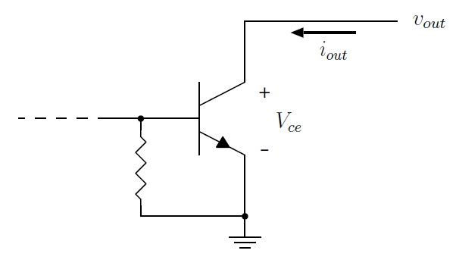
Digital Logic Output Models
Output stage for a standard TTL bi-polar and a model of the output when driven low (upper transistor is off)

Slide 6
Digital Logic Output Models
The output voltage v_{out} will be V_{ce}, the voltage drop across the bottom transistor
The output low ≠ 0V
The output voltage will depend upon the output current i_{out}
The output pin must be able to sink current to ground.
Equivalent circuit model for a standard TTL device while driving low, i.e., sinking current

Slide 7
Digital Logic Output Models
i_{out} refers to the current flowing :
into the gate (when driving low) or
out of the gate (when driving high)
Positive (+) i_{out} flows into the gate.
Negative (-) i_{out} flows out of the gate.
If i_{out} = 2.5mA, then the device is driving low and sinking 2.5mA to ground.
if i_{out} = −1mA, then the device is driving high and sourcing 1mA from +5V.

Slide 8
Digital Logic Output Models
This output stage is called a push-pull stage, since it is capable of both sourcing (“pushing”) and sinking (“pulling”) current.
Another name for this output stage is a totem-pole driver, since the two transistors and diode stacked on top of one another resemble a totem pole.
Another form of output stage can only sink current, an open-collector or open-drain output stage.

Slide 9
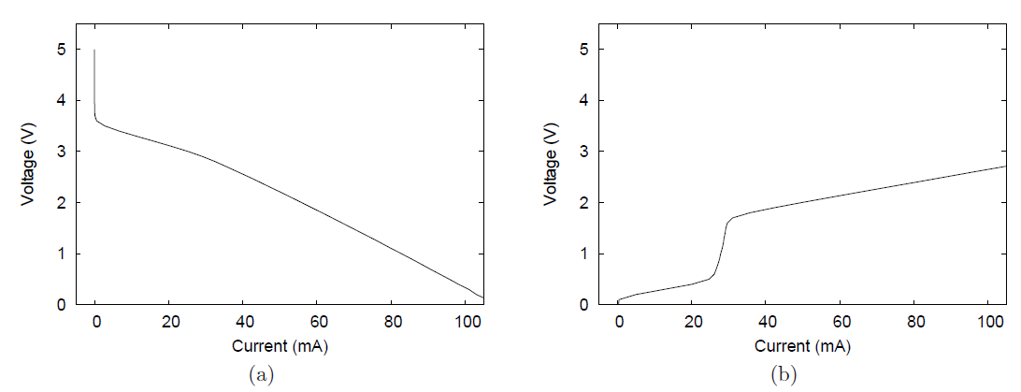
Digital Logic Output Models
The relationship between output voltage and current is very non-linear
These plots are from the IBIS (I/O Buffer Information Spec) models for a SN74ALS04 inverter published by the device manufacturer
Typical output voltages plotted against input current for a 74ALS04 inverter.

Slide 10
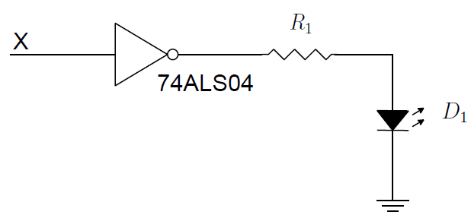

Digital Logic Output Models
Ex. calculate a value for R₁ to provide 20mA to light the LED that has a forward voltage V_{f} of 1.5 V.
From the IBIS chart, the output voltage of the inverter is approximately V_{out} = 3.1V when sourcing 20mA
Power Dissipated in chip = (5 − 3.1) · 0.02 = 38mW
could overheat if all 6 inverters are driving LEDs

Slide 11
Digital Logic Output Models
Many modern microcontrollers specifically boast that their digital I/O pins can directly drive LED’s.
For example, for the MSP432, 4 of the I/O pins can source or sink up to 20 mA (the rest only 6 mA)
Other devices may drive up to 40 mA (e.g., ATmega 328P)
You must still consider the total power dissipation of the device
The microcontroller datasheet will typically contain limits on how much total current can flow into and out of the V_{CC} pins.
E.g., total max current for the ATmega 328P between V_{CC} and ground is 200 mA according to the data sheet.

Slide 12
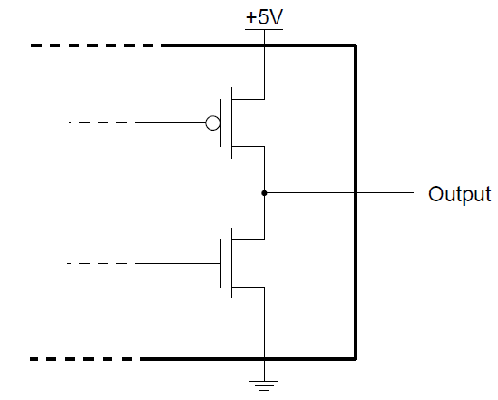
Digital Logic Output Models
A CMOS logic gate output circuit
When output is driven high, v_{out} = +5V − i_{out} · R_{DS(on)}
Since R_{DS(on)} (the drain-source resistance when MOSFET is on) is small, the output voltage as a function of current will look different than for a BJT

Slide 13
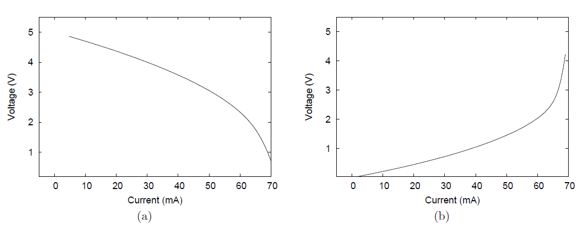
Digital Logic Output Models
Output voltage vs. current for CMOS logic gate

Slide 14
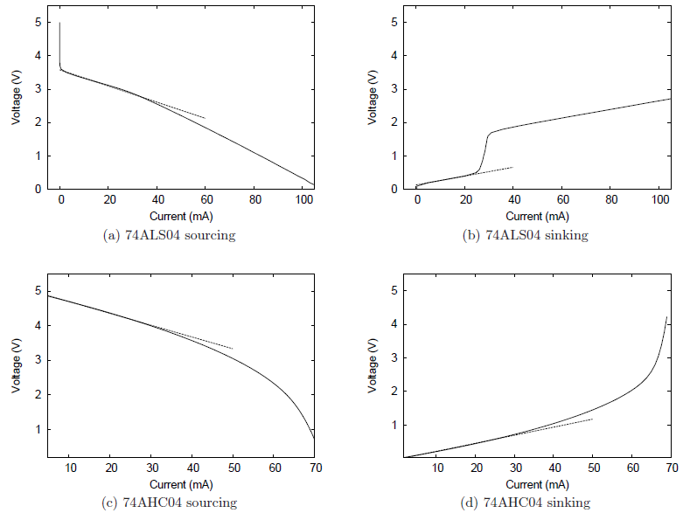
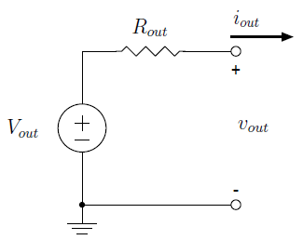
Digital Logic Output Models
While clearly non-linear, voltage-current characteristic of digital output stages is nearly linear over a limited range of current values
At relatively low currents (below 20mA), a digital output stage can be reasonably well approximated as shown above

Slide 15
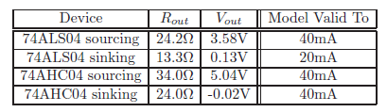
Digital Logic Output Models
Output resistances tend to be lower for sinking current and higher for sourcing current.
What does this say about “driving” an output (sink or source)?

Slide 16
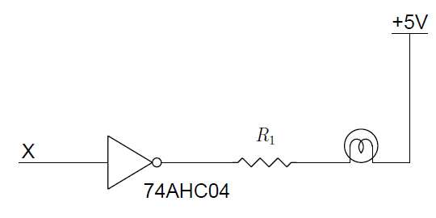
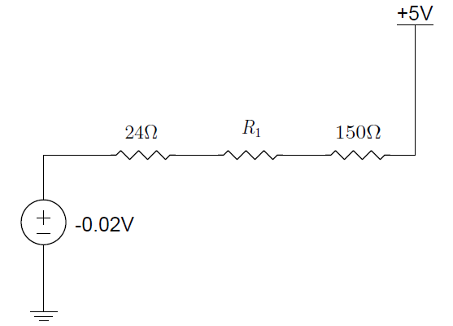

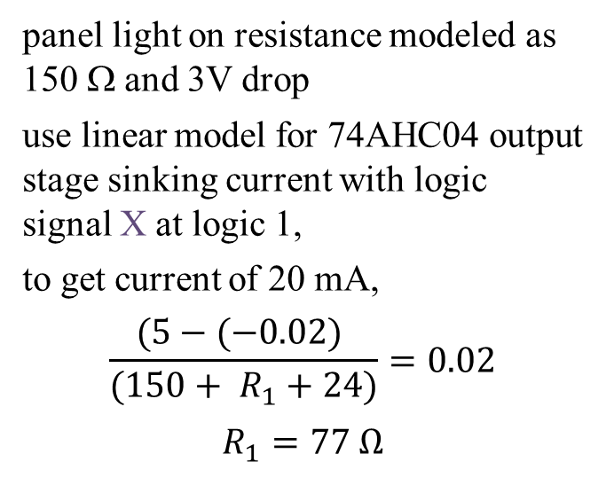
Digital Logic Output Models
ex., turn on a panel light when logic signal X goes to logic 1
design for current of 20 mA
panel light on resistance modeled as 150 Ω and 3V drop
use linear model for 74AHC04 output stage sinking current with logic signal X at logic 1,
to get current of 20 mA,
$$\frac{(5−(−0.02) }{(150+ R_{1}+24)}=0.02$$
$$R_{1}=77 Ω$$
power dissipated in gate is
$$P_{D}={(0.02)}^{2}∗24=9.6mW$$

Slide 17
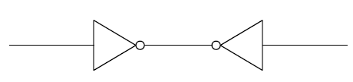
Digital Logic Output Models
Connecting two outputs together like this should not be done!
Output Contention
to see why this can create problems, substitute the output models

Slide 18
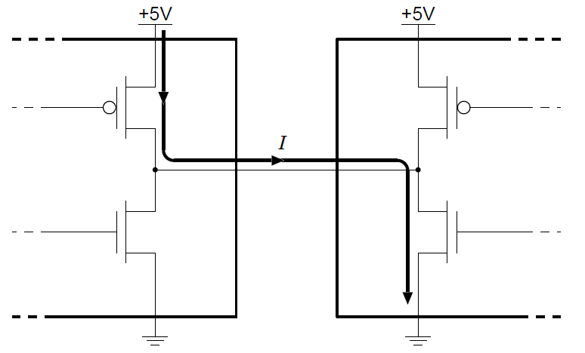
Digital Logic Output Models
Problem with tying two CMOS gate outputs together when one is driving high and the other driving low
Same problem exists for BJT outputs on TTL gates

Slide 19
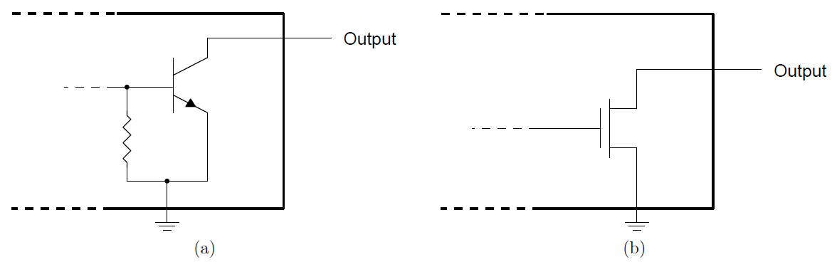
Digital Logic Output Models
Versions of gates exist without the upper transistor on output
Open collector device (a) and open drain device (b)
Can drive low, to sink current, but when transistor is off the output is floating (said to be in high impedance state)
Therefore, it cannot drive current to a load!

Slide 20
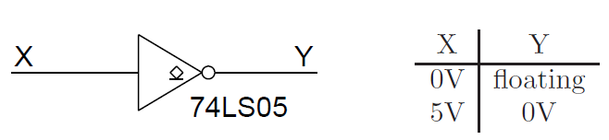
Digital Logic Output Models
Open collector inverter output “floats” for logic low input
Note the special symbol designating open collector (or drain)
The 74LS05 is an open collector version of the 74LS04 inverter

Slide 21
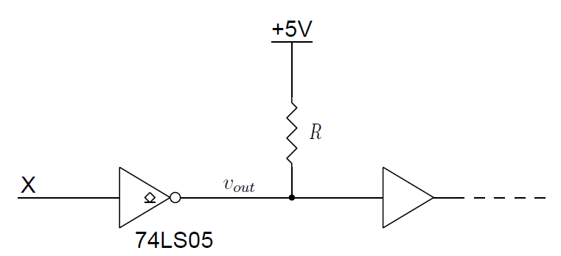
Digital Logic Output Models
Add pull-up R to open drain output
When output goes low, 74LS05 will draw (5-v_{out})/R current
This results in wasted power as long as output is low
When output floats, next gate sees about 5V due to pull-up R
Why bother with open collector (drain) outputs?

Slide 22
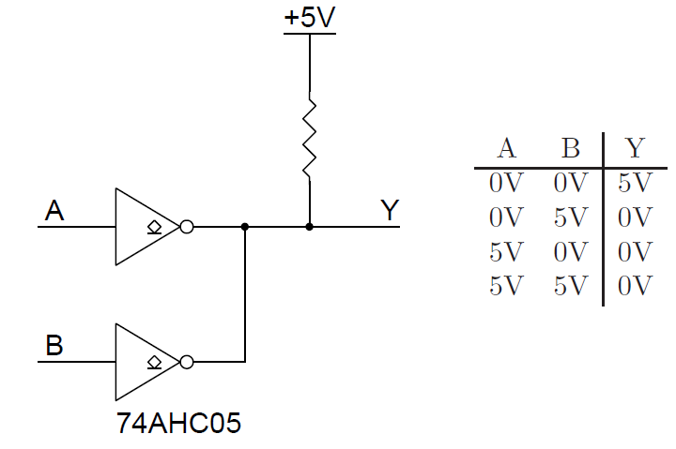
Digital Logic Output Models
You were told it was a bad thing to connect gate outputs, but,
these open drain inverter outputs can implement a NOR function without an additional gate
Note: neither gate can source current, so we don’t have a contention problem

Slide 23
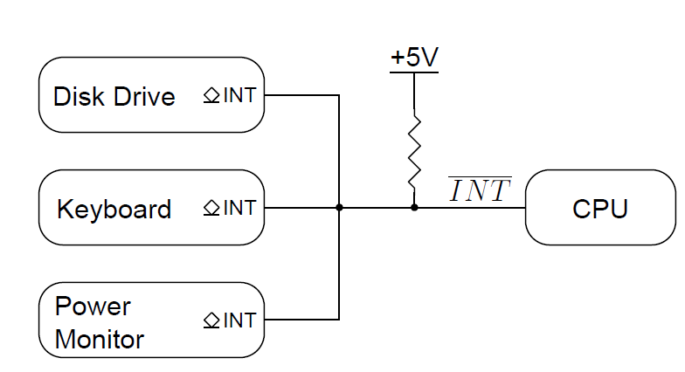
Digital Logic Output Models
Open drain inverting outputs on peripherals enable simple signaling (asserted low)
virtual NOR gate
Note: could add several more peripheral open drain outputs with no hardware modification!

Slide 24
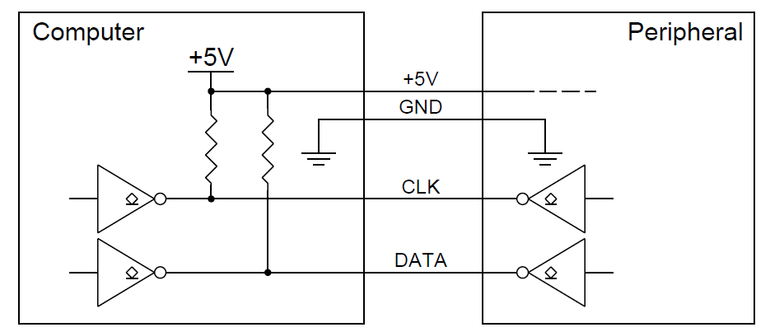
Digital Logic Output Models
Bi-directional communication
The I²C communications protocol implements an interface between a microcontroller and multiple peripheral devices using 2 wires (plus ground)

Slide 25
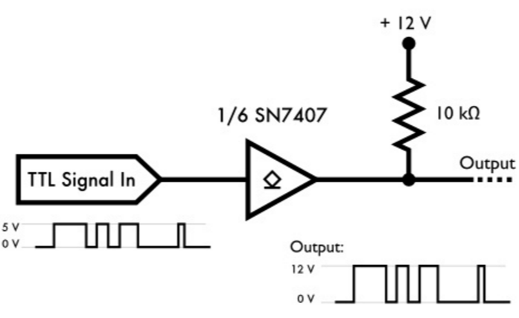
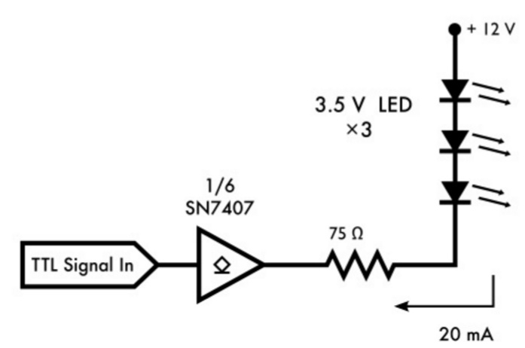
Digital Logic Output Models
Output voltage level shifting
Driving devices that require
higher voltage

Slide 26
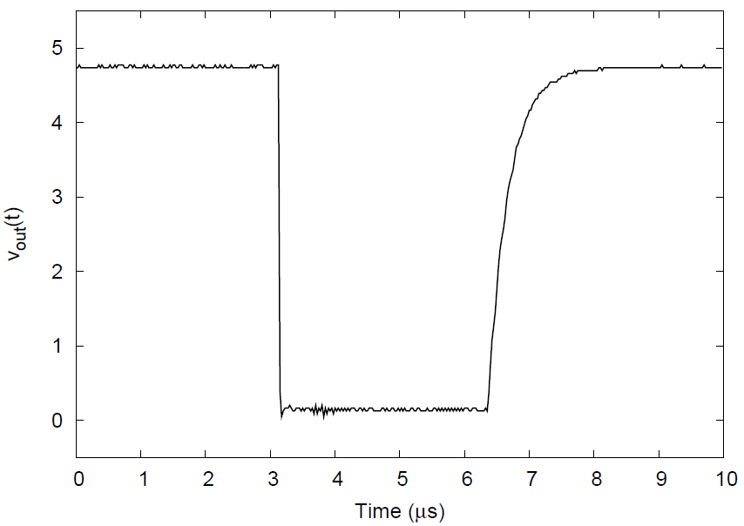
Digital Logic Output Models
Drawback of open collector(drain) gates:
when driven low they have quick response
when pulled high, the output experiences an RC charge curve

Slide 27
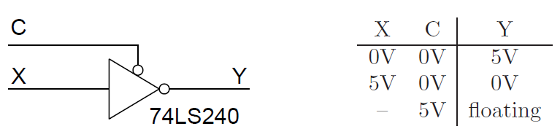
Digital Logic Output Models
Output enabled gates
Some gates have all three output states (tri-state outputs)
Several microcontrollers make good use of them

Slide 28
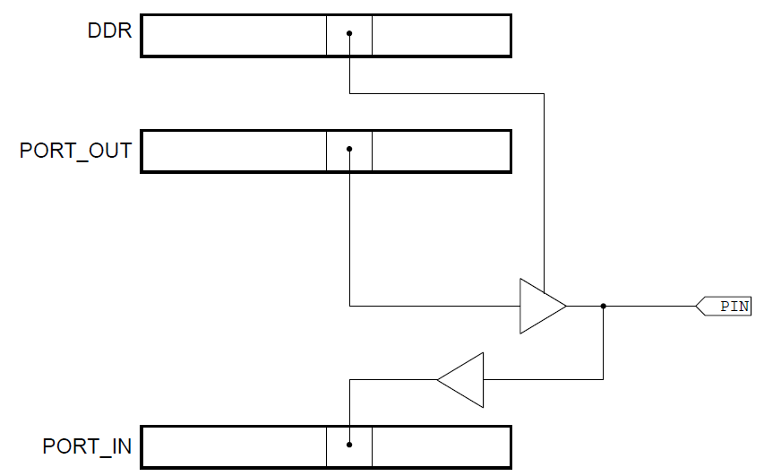
Digital Logic Output Models
output enabled gates used for dual purposing a microcontroller bi-directional I/O pin controlled by the DIR register bit
DIR

Slide 29
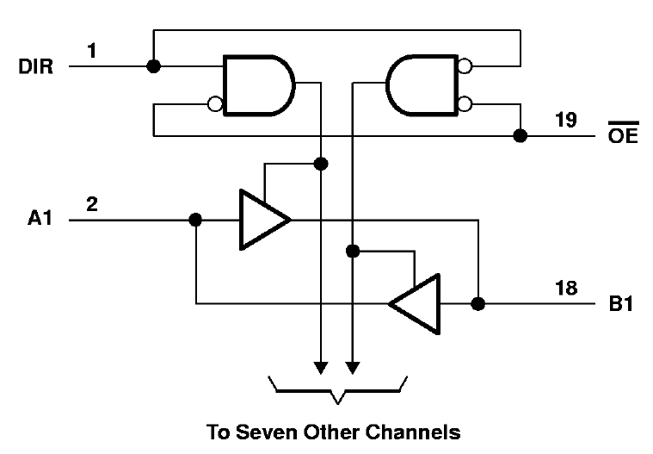
Digital Logic Output Models
Example of a 74AHC245 transceiver using output enabled gates
DIR controls direction of data flow from source A or source B

Slide 30
Digital Outputs
In summary,
understand how the transistor output stage affects gate operation
output contention is bad
open collector (drain) outputs overcome contention and are useful for implementing practical interfaces
tri-state outputs commonly used in microcontrollers to repurpose limited number of I/O pins

