Slide 1
Objectives for today’s lecture
You should be able to:
describe the difference between a linear regulator and a switching regulator
describe how a “buck” switching regulator works
describe how a “boost” switching regulator works
describe the relative advantages and disadvantages between switching and linear regulators

Slide 2
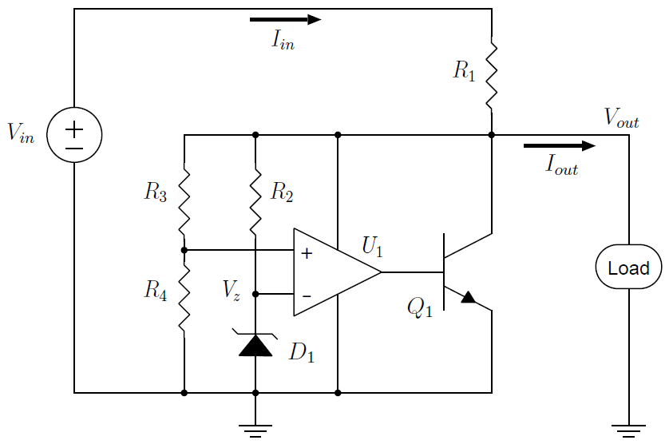
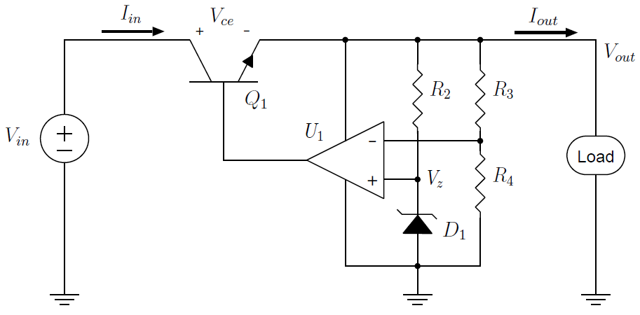
Switching Voltage Converters
Linear shunt and series regulator circuits are based on the principle of dropping a DC voltage across either a resistor, diode, or transistor.
No matter how the voltage V_{in} is reduced to the voltage V_{out}, the dropping element will dissipate at least P_{D} = (V_{in} − V_{out}) · I_{out} watts
a waste if you want your battery to last
a source of heat (difficult to remove)

Slide 3
Switching Voltage Converters
Although the linear regulator can achieve fairly good efficiencies when V_{in} − V_{out} is low (e.g., using a LDO linear regulator),
switching regulators can achieve efficiencies of over 90%.
Linear Example: 9V battery to 5V supply, the efficiency is
~ V_{out}/V_{in} = 56% (assuming I_{out} ~ I_{in})

Slide 4
Switching Voltage Converters
Another benefit of the switching regulator concept is that it is able to increase the voltage V_{in} to a higher voltage V_{out}.
A switching regulator, for example, can power a +5VDC circuit from a single AA battery, boosting the typical 1.0V-1.5V battery voltage up to the necessary 5V.
A switching regulator incorporates two circuit concepts:
temporary energy storage in inductor or capacitor elements
feedback that tightly adjusts the output voltage by controlling a switch

Slide 5
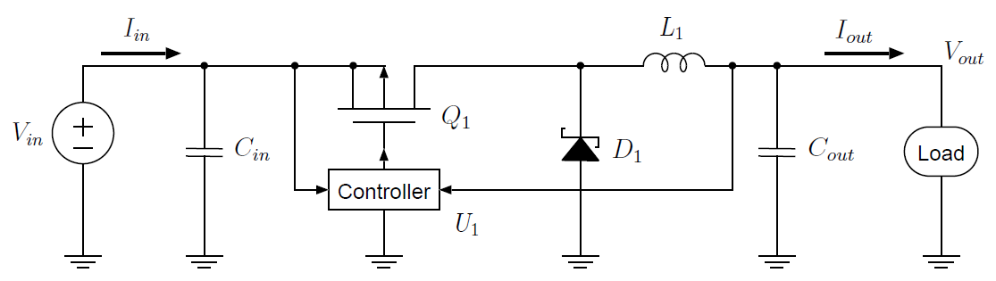
Step Down Switching Regulator
Is similar in appearance to the discrete pass element linear regulator except:
addition of inductor L1 and Schottky diode D1 (not a zener!)
controller device U1 for a switching regulator is different
the transistor Q1 in the switching regulator is always either fully-on or fully-off, not kept in its linear region

Slide 6
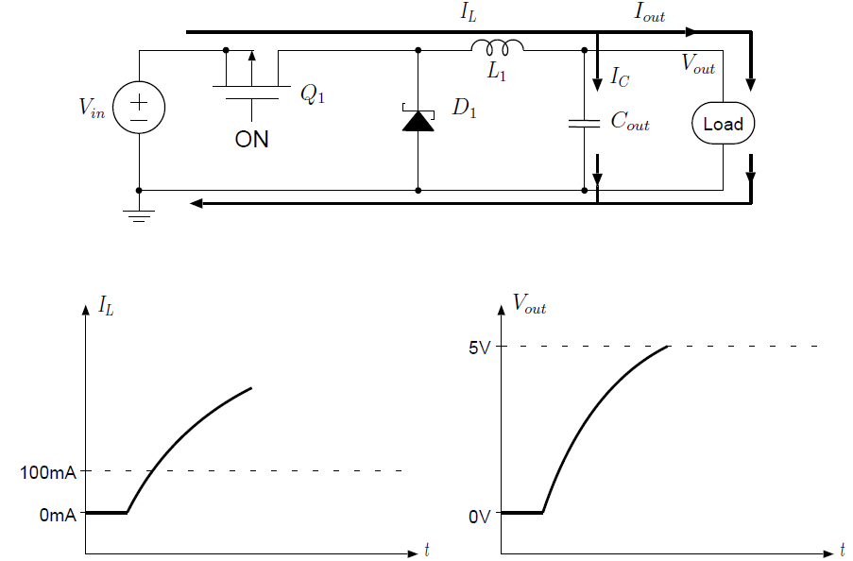

Step Down Switching Regulators
Example of regulating a 9V input down to 5V with a load current of 100mA
When the system is first powered, the controller U1 fully turns on Q₁. Inductor L₁ prevents any instantaneous changes in I_{L}
Current not consumed by load will charge C

Slide 7
Step Down Switching Regulators
As long as Q₁ remains on, then, current will continue to flow and V_{out} will continue to rise
The controller device U₁ must turn Q₁ off once V_{out} reaches the target voltage, Schottky diode D₁ does not conduct current in this phase.
Current not consumed by load will charge C

Slide 8
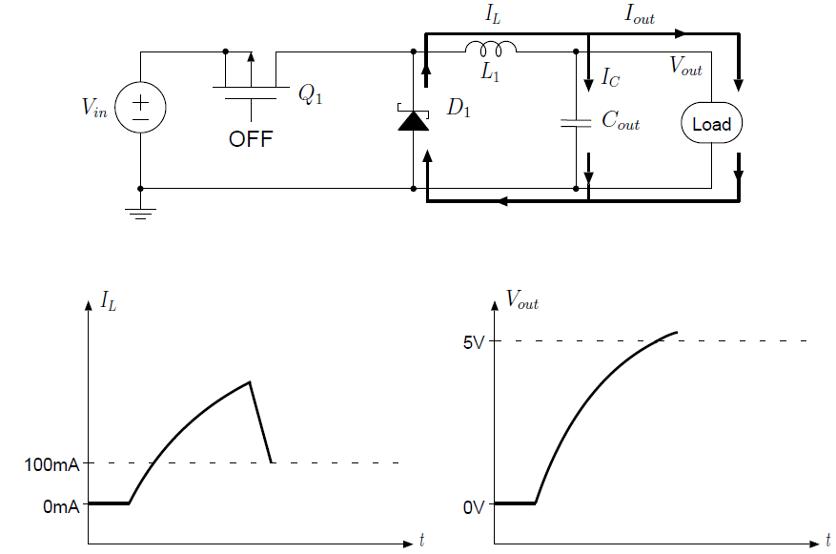
Step Down Switching Regulators
Once Q₁ turns off because V_{out} has reached 5V, the inductor current I_{L} cannot change instantaneously
current continues flowing through L₁ and as long as it is greater than
I_{out}, the excess current flows into C_{out} and continues to raise V_{out}.

Slide 9
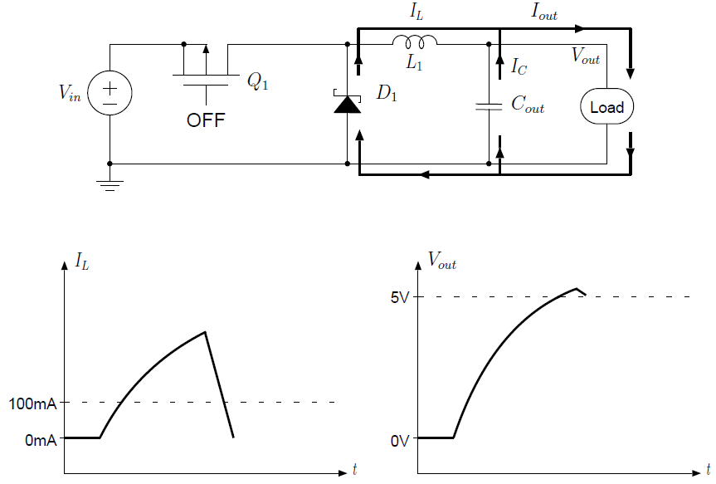
Step Down Switching Regulators
Once I_{L} decays to below I_{out}, the capacitor C_{out} begins to discharge to maintain the output current.
The discharge of current from C_{out} means that its voltage V_{out} starts to drop.

Slide 10
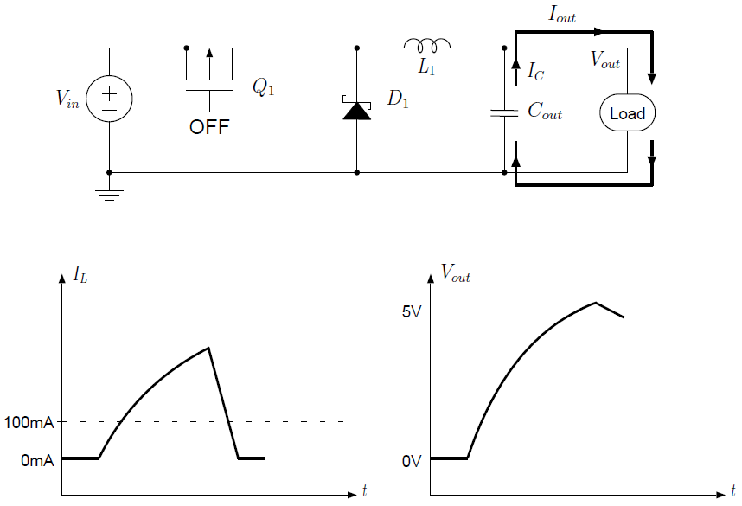
Step Down Switching Regulators
The inductor current I_{L} eventually decays to 0, at which time the load is supplied solely by the capacitor C_{out}.
This causes V_{out} to decay even further. The controller sees V_{out} < 5V and turns on Q₁

Slide 11
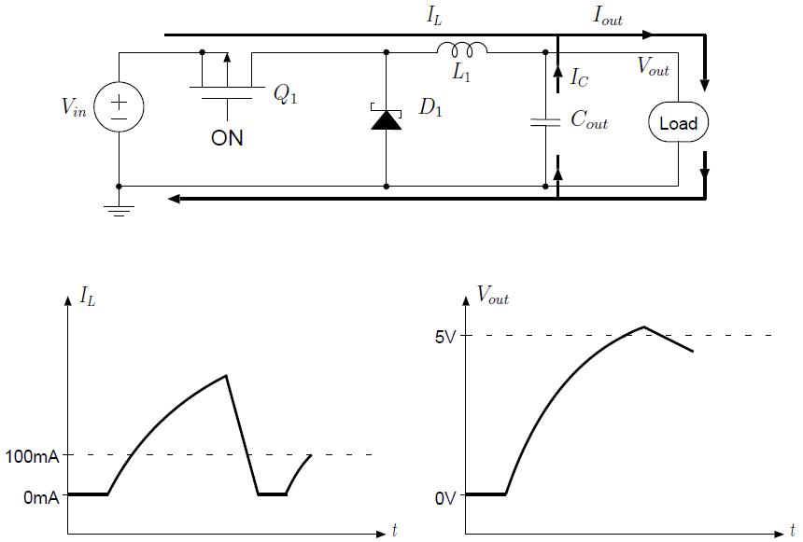
Step Down Switching Regulators
When Q₁ is turned on, inductor current I_{L} ramps up and starts providing current to the load
capacitor C_{out} continues providing load current as well until I_{L} reaches I_{out}. Since current is flowing out of C_{out}, V_{out} continues to decrease

Slide 12
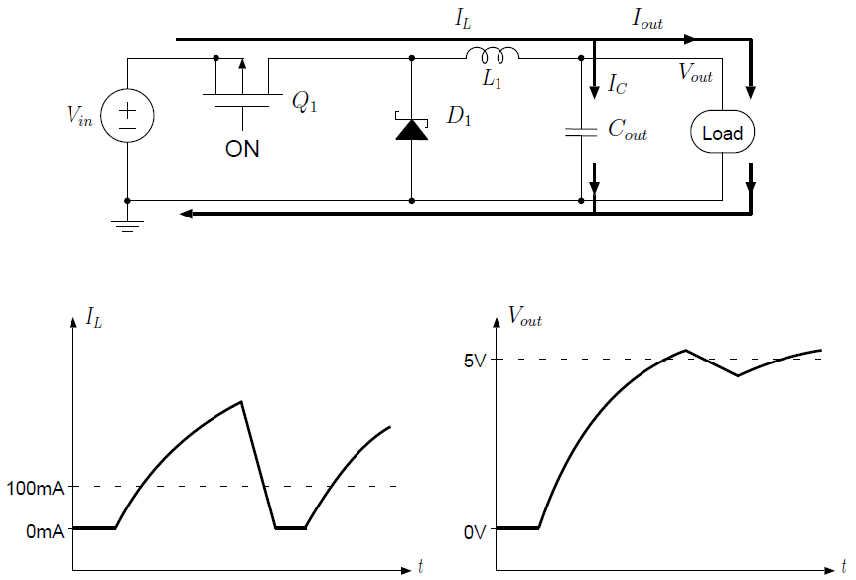
Step Down Switching Regulators
Once the inductor current exceeds 100mA it both powers the load and charges C_{out}, thus causing the output voltage to rise.
Once V_{out} is high enough, the controller device turns off Q₁ and the process cycles through the stages described above.

Slide 13
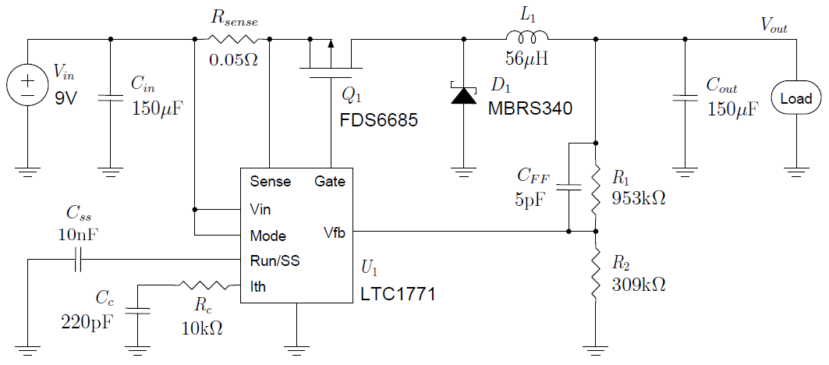
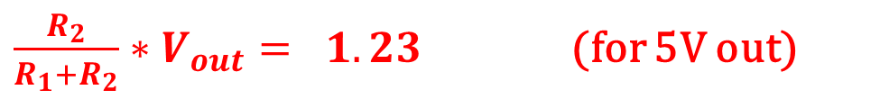
An example of a step-down switching regulator circuit
(provides control)
$\frac{R_{2}}{R_{1}+R_{2}}∗V_{out}= 1.23$ (for 5V out)
Designed to supply 5V at 100mA from a 7V-10V source
The simulation program LTspice provided by Linear Technologies was developed to encourage switching regulator design their products.
Notes:
• Rsense is used to sense and limit the current IL to give the designer some control over how much
current can be drawn from the source. The maximum current is limited by the LTC1771 controller
to approximately 0.1/Rsense, thus 2A in our circuit.
• A resistor divider formed from resistors R1 and R2 is used to design for an output voltage of 5V.
The LTC1771 regulates by maintaining the voltage at the Vfb pin to be 1.23V. If we want the
output voltage to be 5V, then we must choose R1 and R2 such that 5V · R2/ (R1 + R2) = 1.23.
• Capacitor Css is used to provide “soft-start” operation, in which the current drawn from the source
is gradually increased to its steady-state maximum.
• The components Rc and Cc limit how quickly the regulator responds to changes in Vout in order to
maintain stable operation.
• The capacitor CFF is recommended for minimizing output voltage ripple.

Slide 14
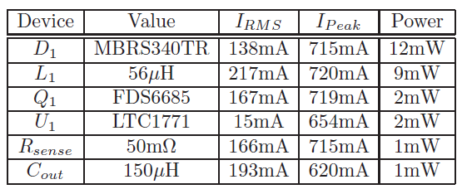
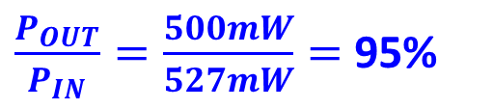
A step-down switching regulator
Current and power calculated from LTSpice simulation
$\frac{P_{OUT}}{P_{IN}}=\frac{500mW}{527mW}=$ 95%
Notes:
Note that 0.5W of power was delivered to the load (5V at 100mA), and 0.527W of power was delivered by the source, for an efficiency of 94.9%. The total wasted power in the regulator circuitry was only 27mW.
Note the high peak currents in this circuit
The appreciable RMS currents in L1 and Cout argue for selecting devices with low series resistances to minimize power dissipation

Slide 15
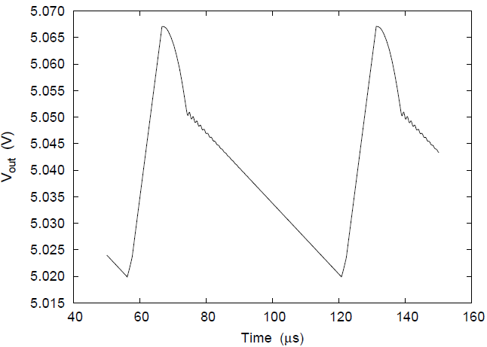
A step-down switching regulator
The circuit maintains an output voltage with only
50mV of ripple (0.1% of 5V).
The switching frequency of the circuit is 15.5 kHz
Plot from LTSpice simulation.

Slide 16
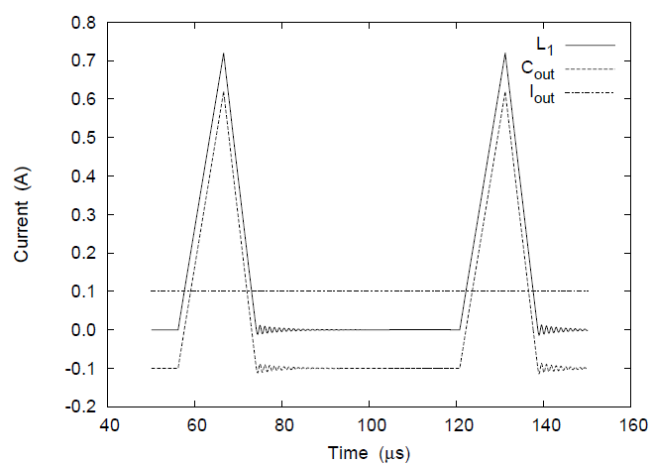
A step-down switching regulator
Inductor current
I_{L} and capacitor C_{out} current I_{C}
have high peaks.
Positive capacitor current means the capacitor is charging, while negative current indicates capacitor discharge.

Slide 17
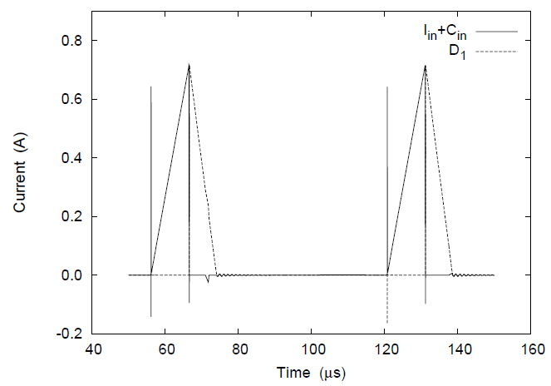
A step-down switching regulator
The power source V_{in} and input filter capacitor C_{in} provide
instantaneous bursts of current
I_{in} + C_{in} that peaks at over 700mA and then drops to 0mA where it remains until the next cycle.
Plot from LTSpice simulation
Notes:
While the transistor Q1 is on, the current IL builds up in the inductor. Once
the transistor turns off and the source current drops to 0, the graph shows how the inductor current IL
continues flowing through catch diode D1 as it decays to 0.

Slide 18
A step-down switching regulator
Fast-changing currents in switching regulators is a reason for not using them in a system design
Fast-changing currents can lead to problems such as crosstalk, ground bounce, and electro-magnetic interference.

Slide 19
A step-down switching regulator
Main considerations related to fast-changing currents in switching regulators:
The circuit board layout is important, fast-changing high-current paths must be routed away from sensitive paths in regulation feedback loop
Since switching regulators are a source of electro-magnetic interference (EMI), their use must be considered carefully in applications with noise-sensitive signals.
When an application cannot tolerate the effects that switching currents have on system behavior, a linear regulator must be used.

Slide 20
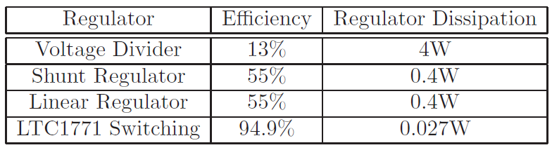
Step-down Switching Regulators
Compare efficiency and power dissipation in various regulator types for a 9V-to-5V regulator at 100mA load current, assume:
The input voltage will always be 9V, with no variation
The load current will always be 100mA, with no variation
The output voltage must be 5V ± 5%
all cases, the power delivered to the load is 0.5W

Slide 21
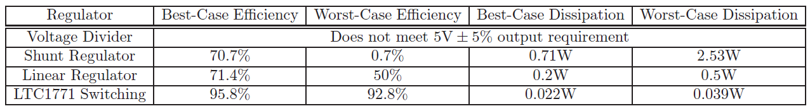
Step-down Switching Regulators
Efficiency and power dissipation in the regulator for a 9V-to-5V regulator at 100mA load current with more uncertainty in the operating parameters:
The input voltage may be between 7V and 10V
The load current may be between 1mA and 100mA
The output voltage must be 5V ± 5%
power delivered to the load varies from 0.00475W to 0.525W
Compared to a $0.60 linear regulator like the 7805, the LTC1771 currently costs about $5.00

Slide 22
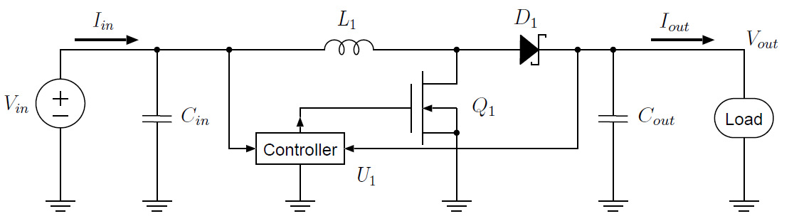
Step Up Switching Regulators
Switching regulators are unique among the other regulator structures by their ability to actually increase voltage
The only difference in components is that Q₁ is now an N-channel MOSFET used as shunt instead of a P-channel MOSFET used as pass
The arrangement of components makes a voltage increase from V_{in} to V_{out} possible

Slide 23
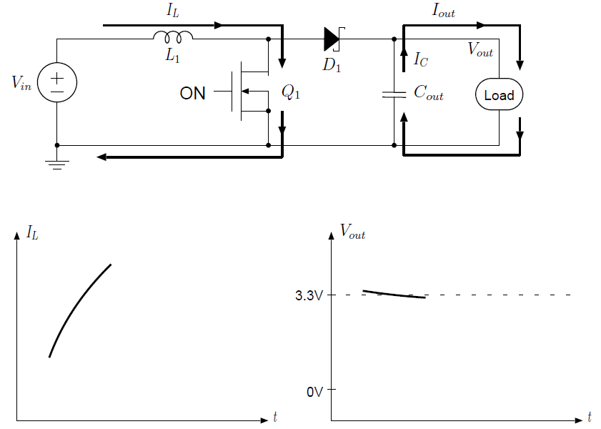
Step Up Switching Regulators
E.g., this step-up converter could be used to power a 3.3V circuit from a single rechargeable AA battery (about 1.2V)
Assume C_{out} initially charged, when transistor Q₁ turns on, inductor current I_{L} increases while capacitor C_{out} provides current to the load

Slide 24
Step Up Switching Regulators
Since transistor Q₁ is on and has a very low drain-to-source resistance, the drain of the transistor is nearly 0V.
The inductor L₁, then, sees a potential V_{in} across it and its current increases

Slide 25
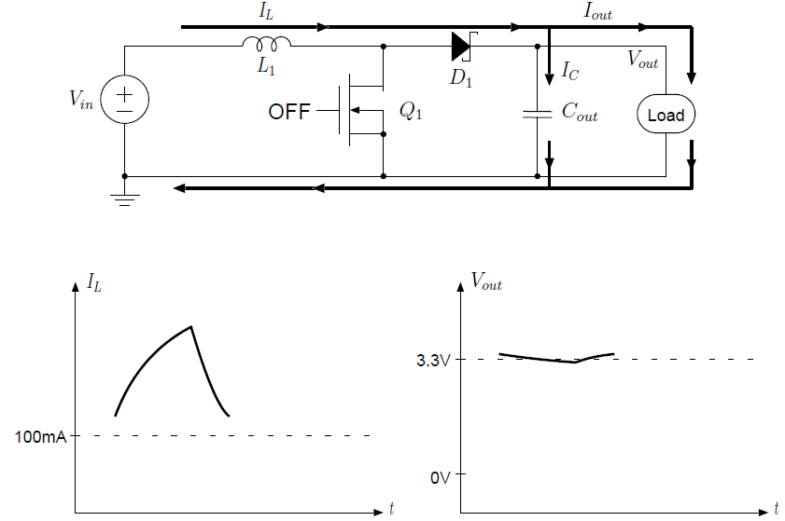
Step Up Switching Regulators
Once the inductor L₁ has “charged up”, then Q₁ turns off and the current flowing through L₁ continues through D₁ to the load and charges C_{out} for the next cycle when Q₁ turns on again.
The frequency of switching is fixed, the output voltage is controlled by the amount of time that Q₁ is on.
Longer on times enables L₁ to reach a higher voltage when Q₁ turns off.

Slide 26
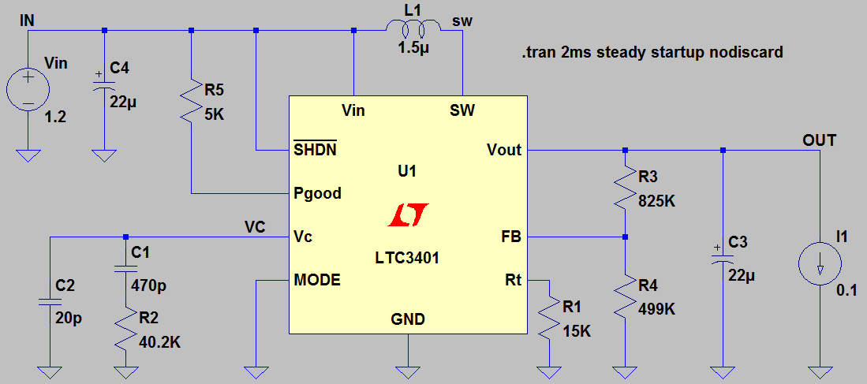
Step Up Switching Regulators
A practical boost regulator circuit 3.3V at 100 mA from a 1.2V source (note: MOSFET and diode are included in IC).
D1 and Q1 are contained in device U1.
LTspice can simulate its startup behavior and compute the steady state efficiency.

Slide 27
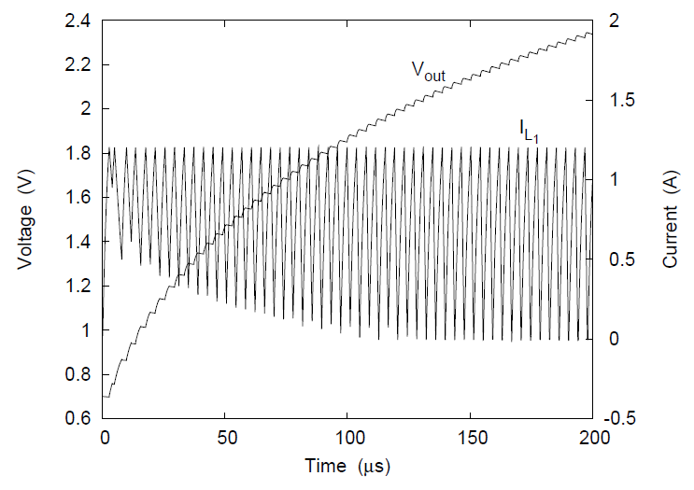
Step Up Switching Regulators
Startup behavior of the LT3401 regulator.
Output voltage is quickly increased by supplying L₁ with high current.
∼90% efficiency

Slide 28
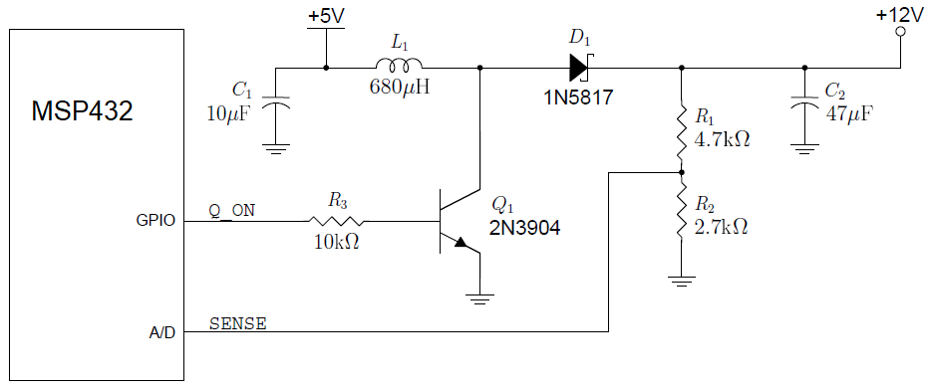
Step Up Switching Regulators
You can construct a boost converter using spare I/O connections on your microcontroller.

Slide 29
Switching Regulator Voltage Regulation
The main difference between switching and linear regulators is:
In a switching regulator transistors are turned completely ON or OFF.
When transistor is on: lots of current can flow but there is almost no voltage across the transistor therefore the transistor dissipates very little power.
When the transistor is off there is usually a voltage across the transistor but there is no current so again there is very little power.
Energy is stored and filtered through inductors and capacitors
Regulation is controlled by varying the duty cycle resulting in very little heat or wasted power making this design capable of being very efficient. (PWM!!!)
However, switching regulators cause spikes in current that can lead to unacceptable levels of noise in some applications!

Slide 30
Switching Regulator Voltage Regulation
In a linear series regulator the pass transistor is turned partly on so as to control current to the load
The load always sees the same voltage, no current spikes.
There is a definite voltage drop across the regulating transistor, therefore, power is being dissipated which turns into heat.
This heat is wasted power and leads to inefficiencies.

