Slide 1

Topics for today’s lecture
Signal cross talk and how to avoid it
Ground “bounce” (change in reference potential) and how to design to minimize it
How to use decoupling capacitors for limiting power transients and how to select them
PCB design considerations that preserve signal integrity

Slide 2
Signal Integrity – Crosstalk
Crosstalk refers to one signal inducing a voltage in a nearby signal.
There are two mechanisms by which this may occur:
mutual capacitance
mutual inductance.
..
Zo
Zo
Zo
Zo
far
far
Cm
Lm
Zs
near
near
Zo
Zs
Zo

Slide 3
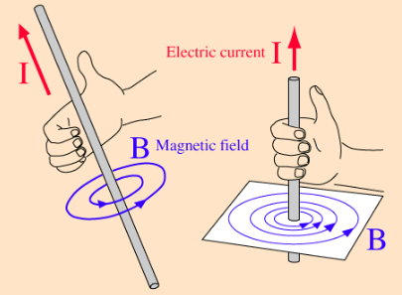

Signal Integrity – Crosstalk
Consider a wire or PCB trace carrying a steady current I
For a simple straight wire, magnetic flux at a point away from the wire is
The magnetic flux density some distance away from a conductor
is proportional to current,
and inversely proportional to distance.
A steady current produces a steady magnetic flux density.

Slide 4



Signal Integrity – Crosstalk
This magnetic flux density can induce a voltage in another wire or PCB trace.
By Faraday’s Law:
-integral around some contour
(a closed loop of wire, like a PCB trace and its return)
= dot-product between generated electric field intensity and a differential section of the contour
= the rate of change in magnetic flux that passes through the surface defined by the contour integral.
= Electro Motive Force (EMF)

Slide 5


Signal Integrity – Crosstalk
For a long, straight wire, the changing magnetic flux density is approximately
Conclude the following about crosstalk:
• It all depends on dI/dt.
(e.g., no change in current, no change in magnetic flux, no induced voltage in another wire)
• The magnetic flux passing through some surface is a strong function of the geometry of the wire carrying the current
• The amount of magnetic flux that induces an EMF in a second wire is a strong function of how that wire is oriented with respect to it
These are topics further explored in EGR 343,
where L_{m} is called mutual inductance

Slide 6
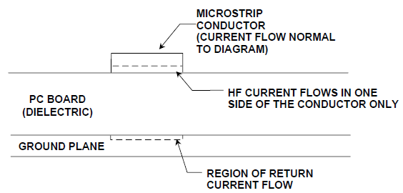
Signal Integrity – Crosstalk
Some design guidelines to reduce crosstalk
Magnetic Flux Management
enclose the conductor in a grounded shield, such as in a coax cable.
Impractical for traces on a circuit board
Ground planes help contain fields
Two conductors on opposite sides of a ground plane (i.e., on different circuit board layers) will not see much of each others’ magnetic flux.

Slide 7
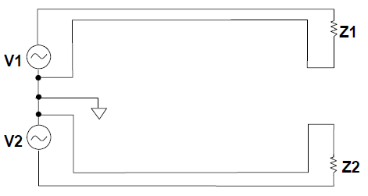
Signal Integrity – Crosstalk
Some design guidelines to reduce crosstalk
Magnetic Flux Management
reduce the amount of magnetic flux generated
reduce dI/dt
run a signal and return path very close to each other
- current flowing in one wire creates flux with a particular value and direction
- current flowing in the return wire will have nearly the same value but the opposite sign
- the overall magnetic flux contributions will tend to cancel

Slide 8
Signal Integrity – Crosstalk
Some design guidelines to reduce crosstalk
Mutual Inductance Management
It’s all about the geometry
ensure traces and their return paths form small “loop areas” (e.g., run close to each other)
keep the traces of different signals far apart (magnetic flux decays with distance)
employ guard traces (extra conductor traces that are well-grounded)

Slide 9
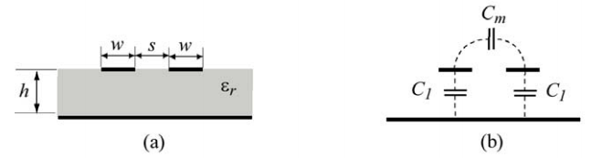

Signal Integrity – Crosstalk
Some design guidelines to reduce crosstalk
Mutual Capacitance
can cause crosstalk via electric field coupling
limit rise time to keep dV/dt on the signal trace as low as possible
increase distance between different signal conductors

Slide 10
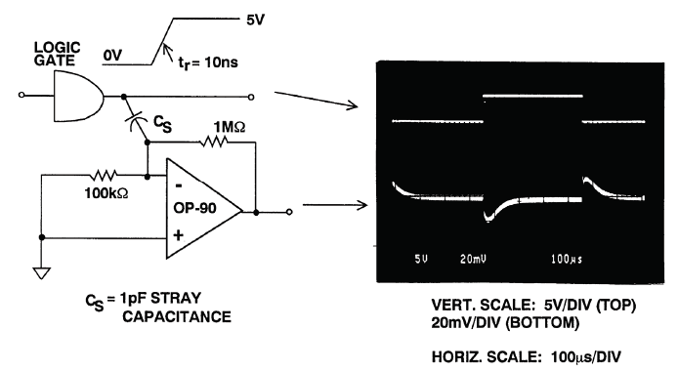
Signal Integrity – Ground Planes
Some design guidelines to reduce crosstalk
keep analog circuits isolated from digital signals

Slide 11
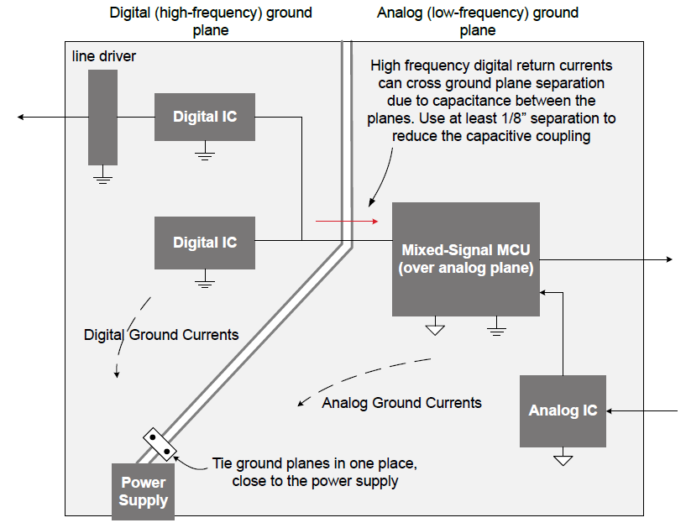
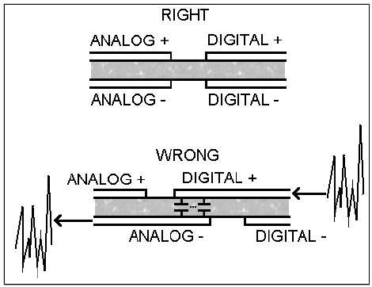
Signal Integrity – Ground Planes
Some design guidelines to reduce crosstalk
use a separate ground plane for analog and digital signals
don’t let them overlap, but they must be tied together at one point

Slide 12
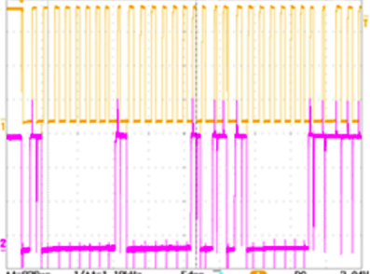
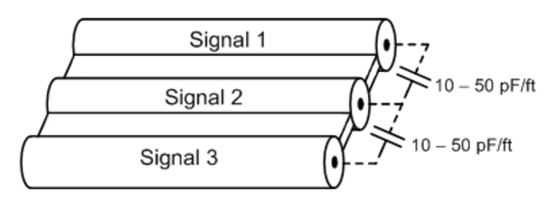
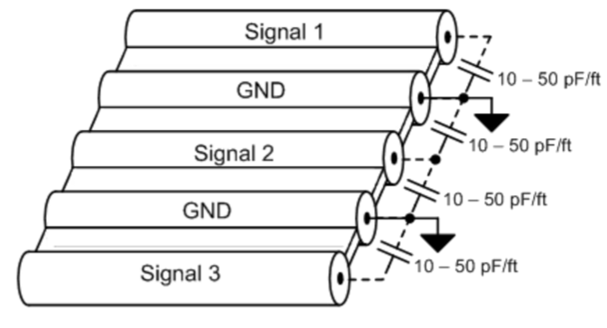
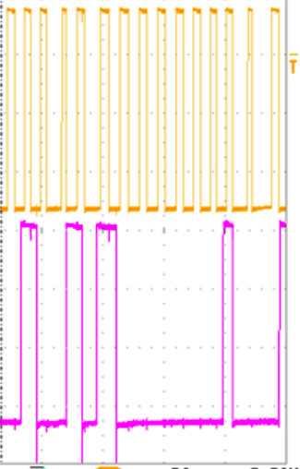
Signal Integrity – Ribbon Cable
Some design guidelines to reduce crosstalk
use a ground wire between each signal conductor for high speed digital signals
https://e2e.ti.com/blogs_/b/precisionhub/archive/2013/12/12/how-to-minimize-crosstalk-in-cable-designs

Slide 13
Signal Integrity – Crosstalk
Summary of ways to reduce crosstalk
Keep high-speed signal wires/traces as short as possible
Use a ground plane
Place a ground between parallel conductors
Keep different signals far apart (on opposite sides of a ground plane where possible)
Use slow rise times (limit “slew rate” dV/dt)
Minimize loop areas by running signals close to their return paths

Slide 14
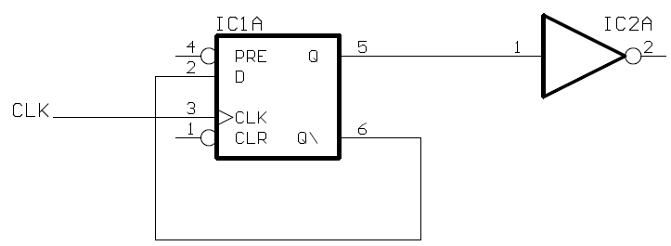
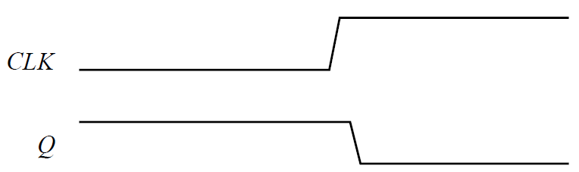
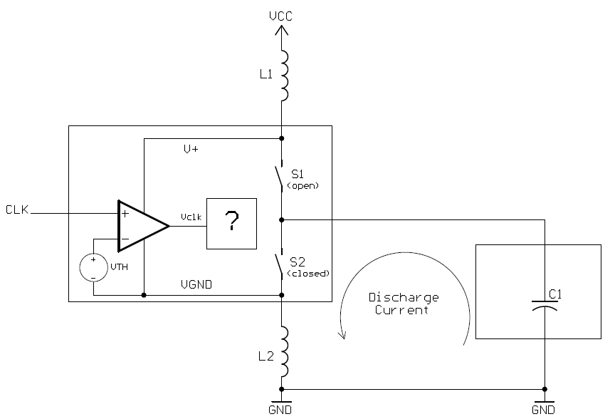
Signal Integrity – Ground Bounce
Consider the simple digital circuit below with its timing diagram.
model the output push-pull
stage of the flip flop,
the input capacitance of the inverter
circuit,
the inductances of wires (traces)
connecting to power supply and
ground.

Slide 15
Signal Integrity – Ground Bounce
A key observation is that the ground inside the flip flop will not always be at the exact same ground voltage as the system ground
Internal to the chip, V_{TH} is relative to
VGND, not to GND.
The switches S1 and S2 model the
push-pull outputs.
When the output
goes to 0 after
the clock edge, S1
opens and S2 closes.
The logic gate input is
modeled by its input capacitance C1
which has been fully charged since the
Q flip-flop output was 1 prior to the
clock edge.
+++

Slide 16


Signal Integrity – Ground Bounce
After the Q output becomes 0 (i.e., S2 closes) the capacitor discharges through S2 and L2 to GND (probably a ground plane)
The voltage developed across an
inductor is proportional to rate of
change of current, so
where
VGND will be the second derivative
of capacitor voltage, hence will
“bounce” above GND, then below
GND, then eventually return to equal GND.

Slide 17
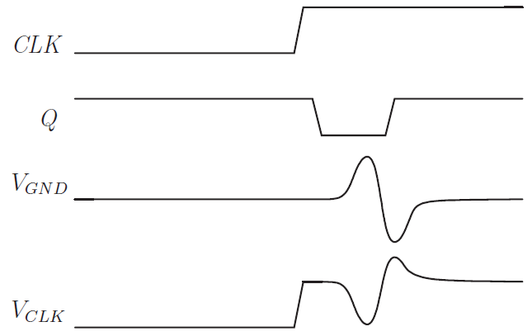
Signal Integrity – Ground Bounce
V_{GND} is changing and the reference voltage for the input comparator for CLK is changing.
This means that the
output of the comparator
V_{CLK} will change,
not because of CLK but
because of V_{GND}!
The second rising edge very shortly after
the first rising edge is due
to V_{GND} bouncing.
Clearly, this can lead to incorrect behavior, as in this example where the flip-flop goes right back to 1 instead of staying at 0

Slide 18
Signal Integrity – Ground Bounce
Things that can be done to minimize ground bounce:
Ensure that a circuit does not drive into an excessively high capacitance.
The larger the capacitance, the larger the discharge current.
Ensure that the fall time of the circuit is not too fast.
The shorter the fall time, the higher the magnitude of dI(t)/dt
Ensure that the parasitic inductance is kept to a minimum:
Chip packaging (wire bonds, lead inductance, etc.)
Grounding (i.e., minimize the inductance from the chip pin to the ground plane).

Slide 19
Signal Integrity – Ground Bounce
Proper grounding is something you can affect directly by
ensuring that you use a ground plane so there is a very low inductance path from one device ground to another,
ensuring that each chip connects to this ground plane through a very short connection, preferably directly to it by through-hole plating.
The per-unit-length inductance of a 10 mil microstrip of 1 oz. copper is about 730 nH/m, or 18.5 nH/in.
A 14-pin DIP connected directly to a ground plane has ground bounce proportional to 8 nH of lead inductance.
A 14-pin DIP with no ground plane and 3 inches of circuit trace connecting the ground lead of the flip-flop gate with the ground lead of the inverter gate has ground inductance of 64 nH!

Slide 20
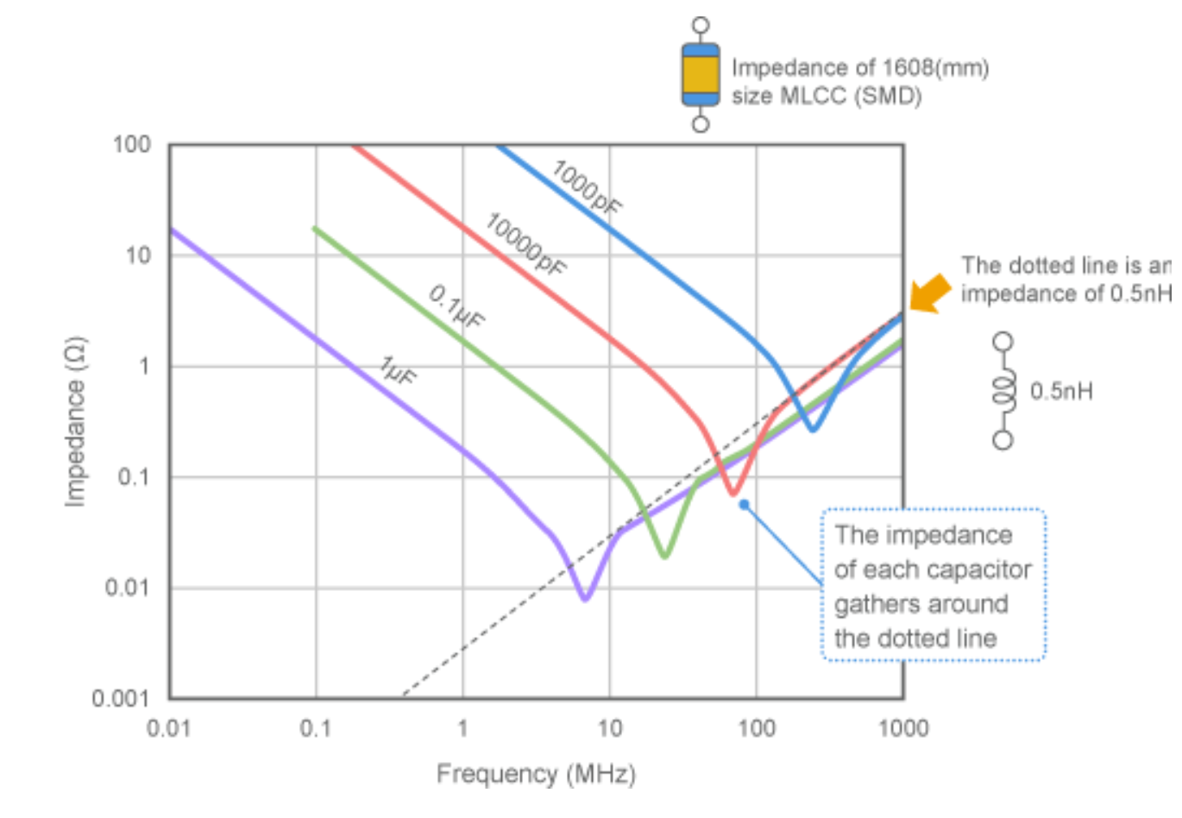
Decoupling issues
Capacitors start behaving like inductors at high frequencies-

