Slide 1
Objectives for today’s lecture
By the end of today’s lecture, you should be able to:
describe how to provide a stable DC voltage from an AC to DC voltage converter
describe terms like line and load regulation, efficiency, drop-out and how they are measured
describe the difference between shunt and series linear regulators
describe when it is justified to pay more for a Low Drop Out (LDO) regulator

Slide 2
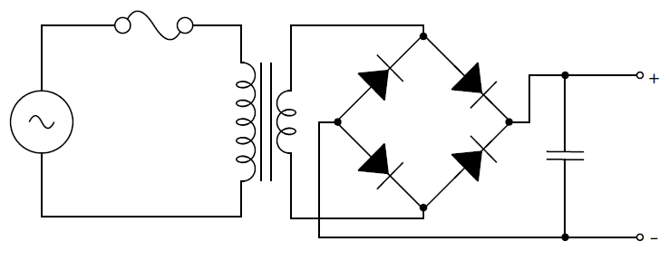
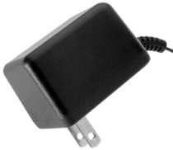
AC Power Sources
Representative circuitry of a wall-mount transformer (or “wall-wart”).
The step-down transformer reduces a high AC voltage input (wall outlet voltage) to a lower AC voltage.
The four diodes form a bridge rectifier, producing a DC voltage that is smoothed out by the capacitor.
The output terminals provide an unregulated source of DC power.

Slide 3
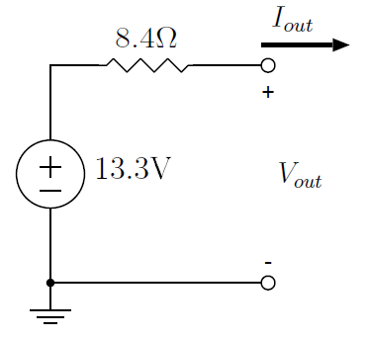
AC Power Sources
Representative circuitry of a wall-mount transformer.
The open circuit voltage of a 9V system rated at 500 mA is actually around 13 V ! Why?
Since the secondary winding and diodes have some R, this circuit should be modeled with a Thevenin equivalent shown above.
The voltage decreases linearly with increasing load (current) to a voltage of 9V at 500 mA (V_{out} = V_{Thev} – I_{out} R_{Thev})

Slide 4
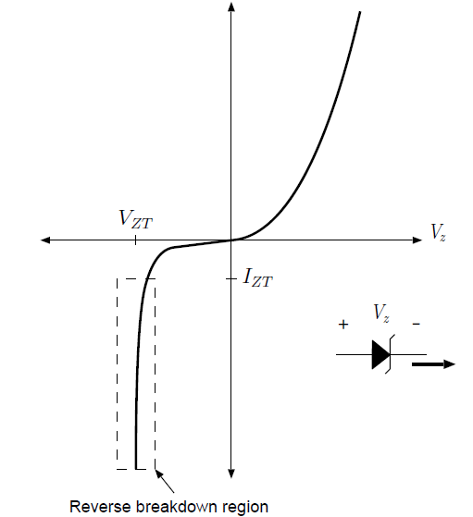
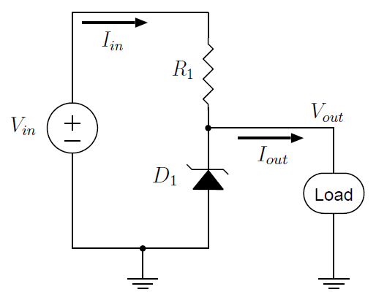
Shunt Voltage Regulators
Assume that the zener diode voltage is always V_{out} = V_{ZT} = 5.1V as long as the diode is reverse biased with at least I_{ZT} = 1mA.
Why V_{out} = 5.1V ?
This is a standard Zener diode breakdown voltage and is close enough to 5V
for most typical applications.

Slide 5


Shunt Voltage Regulators
What should R₁ value be to maintain V_{out} = 5.1V for I_{out} = 0-100 mA?
Assume V_{in} can range from 7 to 10 V and I_{ZT} = 1 mA
If V_{in} = 7V, I_{out} = 0 mA
If V_{in} = 7V, I_{out} = 100 mA
If V_{in} = 10V, I_{out} = 0 mA
R₁ = 4.9KΩ
If V_{in} = 10V, I_{out} = 100 mA
R₁ = 48.5Ω
or lower
The most stringent requirement on R₁ is that it be 18.8 Ω or less.

Slide 6
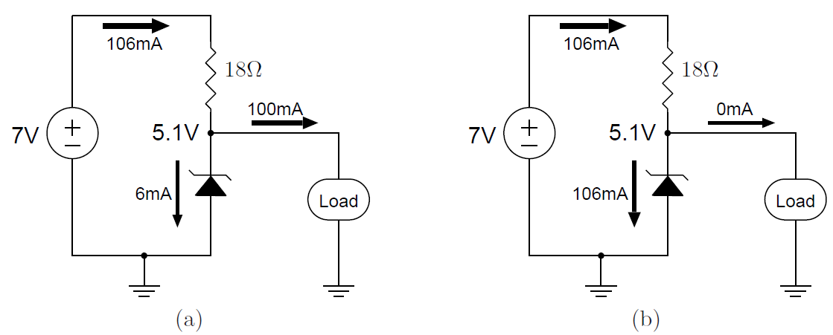

Shunt Voltage Regulators
A shunt voltage regulator draws a fixed amount of current
from the source under varying load conditions.
The efficiency at 100 mA load is
What is the efficiency at no load?

Slide 7
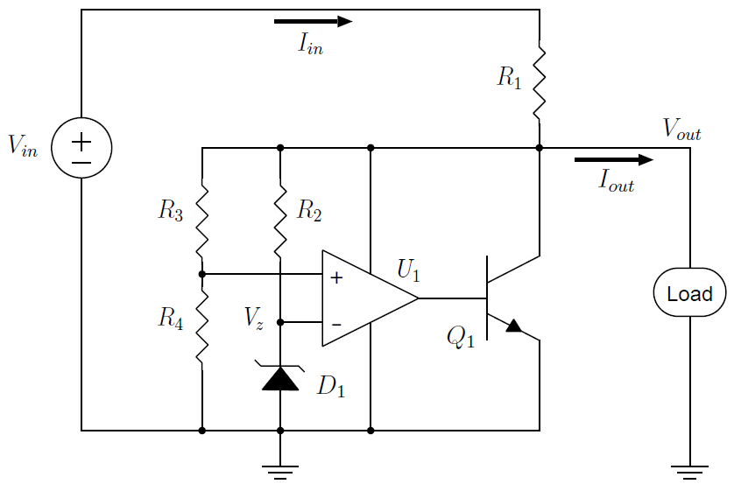
Shunt Voltage Regulators
A shunt voltage regulator with adjustable output voltage.
The transistor Q1 takes on the role of shunting current to ground when not needed by the load.

Slide 8
Shunt Voltage Regulators
e.g., use V_{Z} = 2.5V zener diode, and set R₃ = R₄
voltage at the non-inverting terminal of U₁ will always be V_{out} /2
the op amp tries to keep the voltages at the inverting and non-inverting amplifier terminals equal,
it will control current through Q₁ so that V_{out}/2 = 2.5V, or V_{out} = 5V.

Slide 9

Shunt Voltage Regulators
Other target voltages V_{out} can be regulated by choosing R₃ and R₄
The behavior of the regulator does not depend upon the voltage-current characteristic of the Zener diode

Slide 10
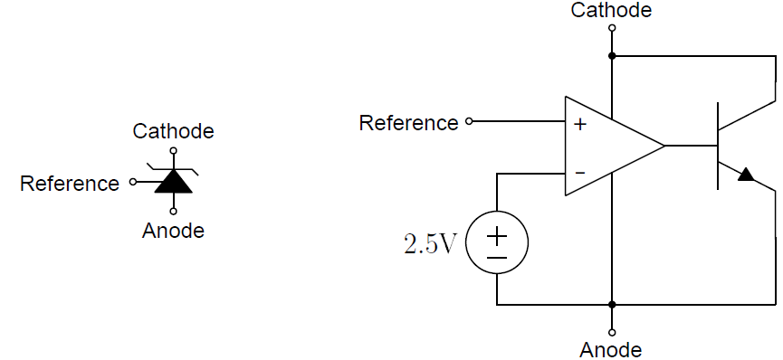
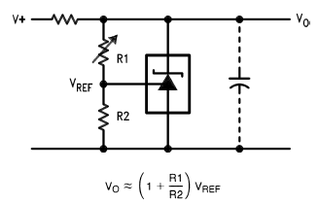
Shunt Voltage Regulators
Packaged in a single device such as the LM431
operation from 2.5V to 36V,
maximum current of 100mA,
nominal accuracy of ±0.5%
TL131
The principal application area is precision voltage reference

Slide 11
Voltage Regulation
voltage regulation is described by:
load regulation - ability to maintain a tightly-controlled output voltage under varying load current demands (unregulated output V decreases as load increases)
line regulation - ability to maintain a tightly-controlled output voltage under varying input voltage conditions
efficiency - the ratio of power delivered to the load to power supplied from the source
The shunt regulator:
can reach high efficiencies when designed for low load currents
draws a constant load from the source and what is not used by the load is shunted through the Zener diode or transistor
There are more practical approaches to DC voltage regulation.

Slide 12
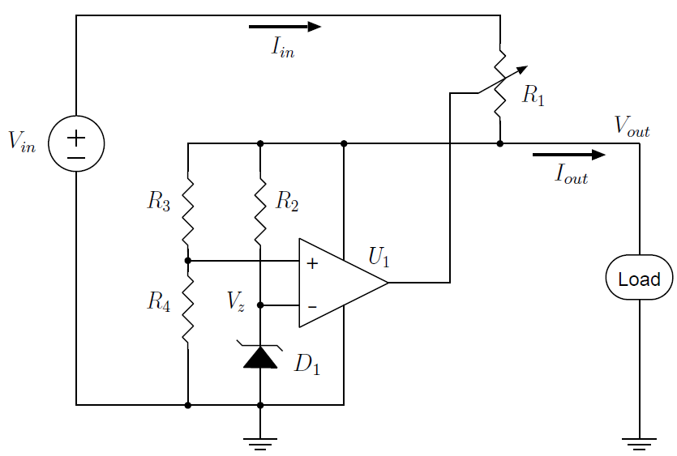
Series Linear Voltage Regulators
Another way to control V_{out} is to adjust the value of R₁.
Use the same negative-feedback control circuitry as the voltage reference to monitor V_{out}, and then somehow adjust the resistance R₁.
Note the shunt is gone, thus I_{out} = I_{in} and there is never any wasted current (if neglect I_{ZT} , U₁ current, and make R₃ and R₄ large)!

Slide 13

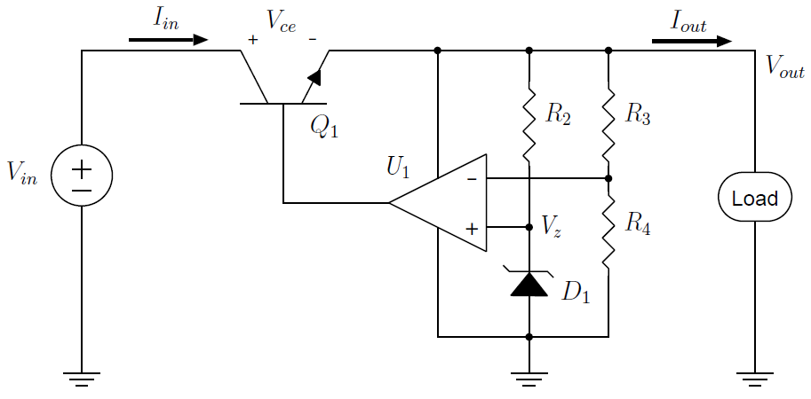
Series Linear Voltage Regulators
A practical implementation uses a transistor in place of a resistor
The voltage from the collector to the emitter, V_{ce}, depends on the base voltage driven by the amplifier U₁.
As the base voltage increases, V_{ce} decreases (to a limit), V_{out} increases.

Slide 14
Series Linear Voltage Regulators
Transistor Q₁ acts as a series-pass transistor, i.e., in series with the power source and load, and it controls how much current can pass.

Slide 15

Series Linear Voltage Regulators
The efficiency (under the assumption that I_{out} = I_{in} ) is:
e.g., regulating 7V-10V down to 5V, efficiencies range 71.4% to 50%
This is a common method of providing a regulated source of DC power.

Slide 16
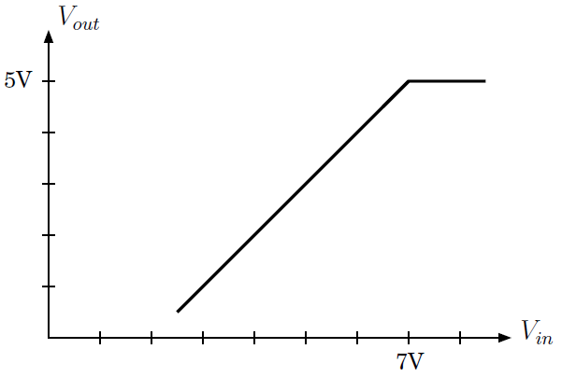
Series Linear Voltage Regulators
What if the input voltage falls below the minimum V_{ce} above the desired output V?
V_{out} = V_{in} − V_{ce}
minimum V_{ce}=2V
(typical of IC regulators)
A linear regulator will have some dropout voltage such that when V_{in} falls below that voltage, it cannot provide the desired output.

Slide 17
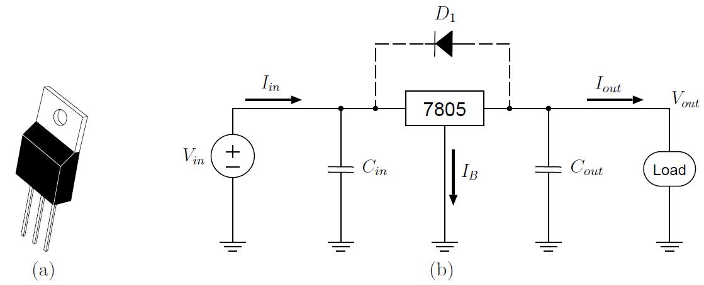
Using the 7805 Linear Voltage Regulator
An inexpensive alternative to discrete components for accurate linear regulation.
<- replaces ->
You should measure the characteristics of the 7805 (dropout, line & load regulation) of this device since it could be used in your design project.

Slide 18
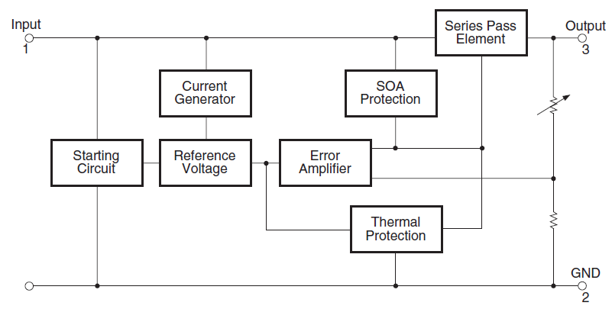
LM78XX Circuit
The “XX” in LM78XX refers to the regulation voltage, e.g., 05 for 5V, 12 for 12V
adds short circuit and “safe operating area” protection
solves start up problem when Vout is initially 0V
internal R trimmed for precision
adds thermal protection

Slide 19
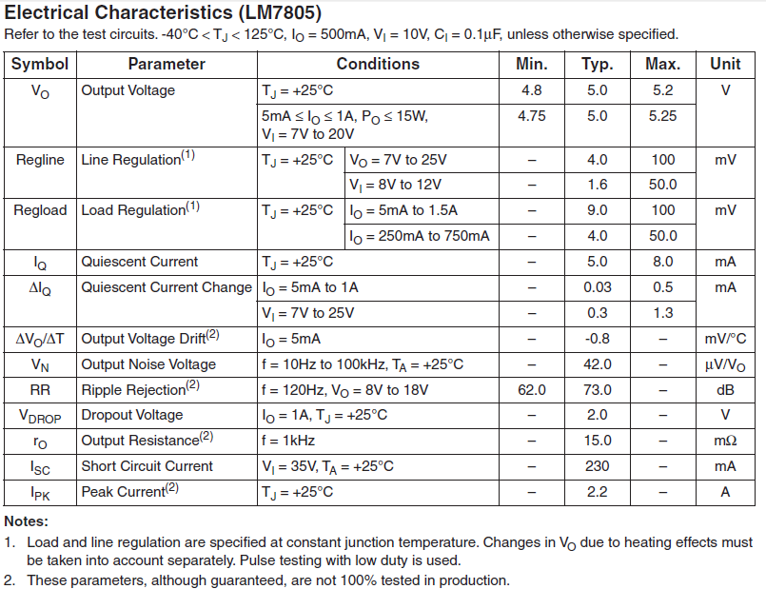
The 7805 Linear Voltage Regulator

Slide 20
Using the 7805 Linear Voltage Regulator
D₁ provides an alternate path for current when input is shorted
A typical circuit for linear voltage regulation.
provides current during input variations
provides current during load variations

Slide 21
Regulator Transient Response
A feedback control system monitors the output voltage and adjusts the voltage drop of a pass element.
It takes time to sense the output voltage, compare it to a reference, adjust the drive voltage or current to the pass element, and for the pass element to respond.
A fast change in load current might prevent the output from adjusting fast enough to maintain regulation.

Slide 22
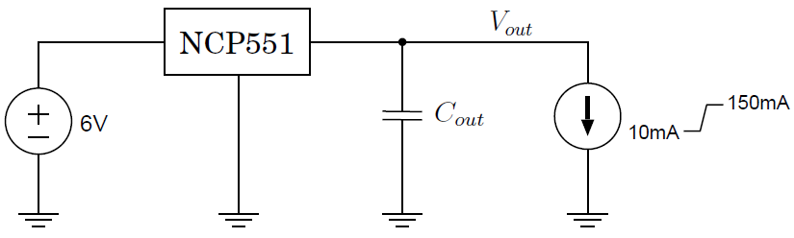
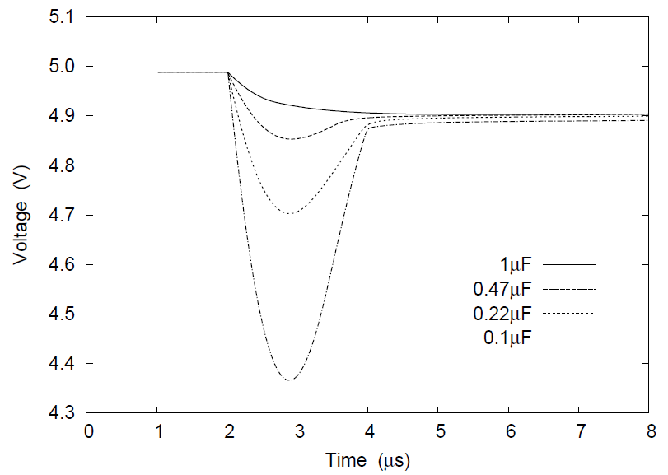
Load Transient Response
E.g., initially, the load current I_{out} is set to 10mA and then
abruptly changes to 150mA

Slide 23
Load Transient Response
Why does the 1μF capacitor allow the output voltage to remain well-regulated even during sharp current transients?
The capacitor acts as a small reservoir of charge that can provide a short-duration supply of current to the load
The regulator can “catch up” and adjust its pass element appropriately to respond to the new current demands.

Slide 24
Line Transient Response
The need for an input terminal capacitor C_{in} is similar.
This capacitor helps the regulator maintain output voltage regulation when the input voltage changes.
The input to a regulator so far has been considered to be a stable DC voltage but in fact may be highly variable.

Slide 25
Low Dropout Linear Regulators
The dropout voltage is a limitation of traditional regulators
e.g., a battery powered system with 6 standard AA batteries
Individual AA size battery voltage ranges from 0.9V to 1.6V depending on charge level.
Wiring 6 batteries in series, the input voltage can be assumed to range from 5.4V to 9.6V.
Standard 7805 linear regulators have a typical dropout voltage of 2V, meaning that we won’t get a 5V output when the average battery voltage falls below 7V/6 = 1.17V.
Either:
• add 2 more batteries (voltage ranges from 7.2V to 12.8V), increasing the mass contributed by the batteries by 33%, and also increasing the power dissipation in the regulator
• use a regulator with a dropout voltage of 0.4V or lower

Slide 26
Low Dropout Linear Regulators
Low drop-out regulators (LDO) exist that can meet this dropout requirement, but, they are significantly more expensive.
The Texas Instruments TPS77601 has a maximum dropout voltage of only 200mV at 500mA.
~$2.30 for the TPS77601 vs. ~$0.60 for a 7805 (source: Digi-Key, quantity 1)

Slide 27
Voltage Regulation
In summary,
a shunt regulator uses a zener diode to set a reference voltage
current is shunted through this zener or a pass transistor to maintain the desired voltage
dropout voltage is the minimum incremental voltage above the input voltage necessary to maintain regulation
load regulation describes the ability of a regulator to maintain a desired voltage during changes in load current
line regulation describes the ability of a regulator to maintain a desired voltage during changes in input voltage
efficiency is a measure of how much power is delivered to the load compared with how much power is available at the input (the rest is dissipated as heat)
series voltage regulators do not shunt current (much), therefore, I_{out} ~ I_{in}
the efficiency of a series linear regulator is determined by the ratio of output voltage to input voltage and is limited by the dropout voltage.

