Slide 1

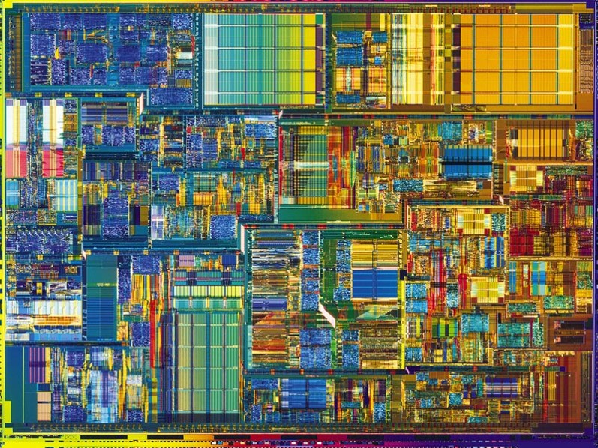
Introduction to Digital Systems
EGR226
Lecture_18
The MSP432 Microcontroller
Dr. Nabeeh Kandalaft EGR226 Grand valley State University

Slide 2
Topics for today’s lecture
After today’s lecture you should be able to:
Setup the MSP432 for Capture mode
Implement TimerA for as a stopwatch
Configure the ADC registers
Read an analog voltage on a port pin
(up to 3.3V!)
Dr. Nabeeh Kandalaft EGR226 Grand valley State University

Slide 3
Using a Microcontroller for Timing
precise input timing
precise output timing
TIMER
Output Compare
Input Capture
Generate Delays/PWM
Measure
Intervals
Dr. Nabeeh Kandalaft EGR226 Grand valley State University

Slide 4
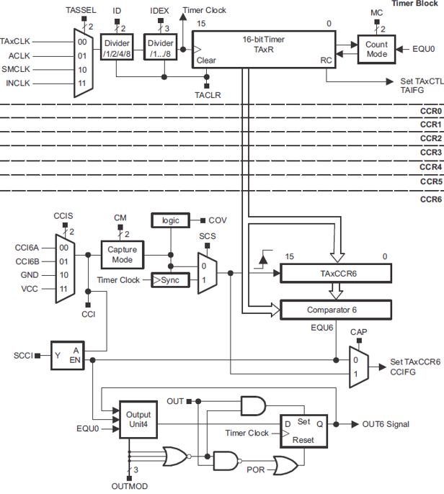
Precise Input Timing
Same Timer_A discussed last lecture!
Dr. Nabeeh Kandalaft EGR226 Grand valley State University

Slide 5
Precise Input Timing
Set appropriate control bits for TimerA capture mode and the hardware will look for rising edges on P2.4
When a rising edge occurs, the value of at the exact time the edge occurred is stored in a register known as TAxCCRn
(Count and Compare Register n of TimerA instance x)
Then save the value of this register in a C variable (before the next rising edge happens) as it represents the exact time at which the rising edge occurred.
CLK
TAxR
The main timer register TAxR continues counting, but TAxCCRn remains unchanged until the next rising edge.
Read and store the value of TAxCCRn in a C variable at the next rising edge and the timing measurement between edges will be precise.
16
TAxCCRn
Load
TAxCCTLn
.CCIFG
Dr. Nabeeh Kandalaft EGR226 Grand valley State University

Slide 6
Precise Input Timing - Limitation
What if the period of the signal is only a few clock cycles?
Values of TAxCCRn can’t be read and saved when two rising edges are just
a few clock cycles apart.
What if the period of the signals is measured in seconds?
The TAxR counter will “roll over” giving meaningless results.
TAxR value
TAIFG=1
TAIFG=1
0xFFFF
1500
65535
Rollover
300
0
The maximum period of TAxCCRn when it counts by 1 every 0.333μs (for a 3MHz clock) is ~21.8 ms.
representing a signal frequency of 45.9 Hz or higher.
Any frequencies lower than 45.9 Hz will give incorrect results.
Dr. Nabeeh Kandalaft EGR226 Grand valley State University

Slide 7
Precise Input Timing - Limitation
TimerA has a clock source selection multiplexer and a two stages of clock divider that can be used to extend the maximum period
Hence lower the minimum frequency, at the expense of resolution.
For example, a 1:8 clock divider setting on the default SMCLK source running at the default 3 MHz will allow encoder signal frequencies down to ~5.7 Hz,
But, with a resolution of ±2.666μs rather than the resolution of ±0.333μs afforded by a 1:1 divider setting.
Dr. Nabeeh Kandalaft EGR226 Grand valley State University

Slide 8
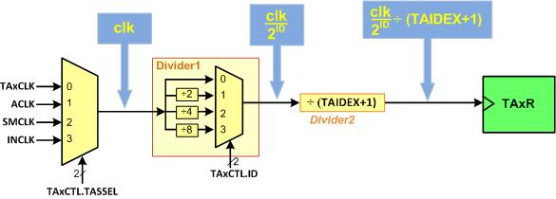


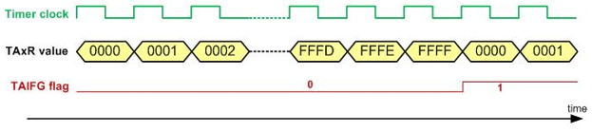


Selecting and Dividing the Clock in Timer_A
$$\frac{clk}{2^{16}}$$
$\frac{clk }{2^{16}} ÷(TAIDED+1)$
TAxR value
TAIFG=1
TAIFG=1
0xFFFF
0
TAIFG flag changing
Dr. Nabeeh Kandalaft EGR226 Grand valley State University

Slide 9
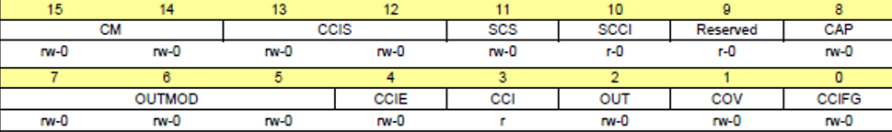
Input Edge Time Capturing
CLK
TAxR
CCIS
Capture/Compare Input Select
16
CM
Capture Mode
2
TAxCCRn
0
1
2
3
Load
CCInA
CCInB
GND
VCC
2
Capture Mode
0
1
TAxCCTLn
.CCIFG
Sync
Timer Clock
2
SCS
Synchronize Capture Mode
TAxCCTLn
Dr. Nabeeh Kandalaft EGR226 Grand valley State University

Slide 10
TAxCCTLn Register
bit | Name | Description
15-14 | CM | Capture mode 00: No capture 01: Capture on rising edge 10: Capture on falling edge 11: Capture on both rising and falling edges
13-12 | CCIS | Capture/compare input select. These bits select the TAxCCR0 input signal: 00: CCIxA 01: CCIxB 10: GND 11: VCC
11 | SCS | Synchronize capture source. This bit is used to synchronize the capture input signal with the timer clock. 0: Asynchronous capture 1: Synchronous capture
Dr. Nabeeh Kandalaft EGR226 Grand valley State University

Slide 11
TAxCCTLn Register
bit | Name | Description
10 | SCCI | Synchronized capture/compare input. The selected CCI input signal is latched with the EQUx signal and can be read via this bit.
8 | CAP | Capture mode 0: Compare mode 1: Capture mode
7-5 | OUTMOD | Output mode. Modes 2, 3, 6, and 7 are not useful for TAxCCR0 because EQUx = EQU0 000: OUT bit value 001: Set 010: Toggle/reset 011: Set/reset 100: Toggle 101: Reset 110: Toggle/set 111: Reset/set
Dr. Nabeeh Kandalaft EGR226 Grand valley State University

Slide 12
TAxCCTLn Register
bit | Name | Description
4 | CCIE | Capture/compare interrupt enable. This bit enables the interrupt request of the corresponding CCIFG flag. 0: Interrupt disabled 1: Interrupt enabled
3 | CCI | Capture/compare input. The selected input signal can be read by this bit.
2 | OUT | Output. For output mode 0, this bit directly controls the state of the output. 0: Output low 1: Output high
1 | COV | Capture overflow. This bit indicates a capture overflow occurred. COV must be reset with software. 0: No capture overflow occurred 1: Capture overflow occurred
0 | CCIFG | Capture/compare interrupt flag 0: No interrupt pending 1: interrupt pending
Dr. Nabeeh Kandalaft EGR226 Grand valley State University

Slide 13
Port pin assignment of Timer_A
Timer_A | Port Pin | Timer_A | Port Pin | Timer_A | Port Pin | Timer_A | Port Pin
TA0.0 | P7.3 | TA1.0 | P8.0 | TA2.0 | P8.1 | TA3.0 | P10.4
TA0.1 | P2.4 | TA1.1 | P7.7 | TA2.1 | P5.6 | TA3.1 | P10.5
TA0.2 | P2.5 | TA1.2 | P7.6 | TA2.2 | P5.7 | TA3.2 | P8.2
TA0.3 | P2.6 | TA1.3 | P7.5 | TA2.3 | P6.6 | TA3.3 | P9.2
TA0.4 | P2.7 | TA1.4 | P7.4 | TA2.4 | P6.7 | TA3.4 | P9.3
Dr. Nabeeh Kandalaft EGR226 Grand valley State University

Slide 14
Measuring Period and Pulse Width
Description:
Use TIMERA0_2 to capture a period on PORT2 pin 5.
The # of the period cycles will be printed in the while loop.
Use rising edge capture
MCLK
No dividers
Synchronous capture
UP Mode // ???????????????
This program works only for periods from 0-21ms Otherwise the clock must be changed to ACLK
Dr. Nabeeh Kandalaft EGR226 Grand valley State University

Slide 15
TimerA Capture Mode Configuration
#include "msp.h"
#include "stdio.h"
unsigned short lastedge, currentedge, period;
int main(void)
{
WDT_A->CTL = WDT_A_CTL_PW | WDT_A_CTL_HOLD; // Stop watchdog timer
P2->SEL0 |= BIT5; // TA0.CCI2A input capture pin, second function
P2->SEL1 &= ~ BIT5; // TA0.CCI2A input capture pin, second function
P2->DIR &= ~ BIT5;
TIMER_A0->CTL |= TIMER_A_CTL_TASSEL_2 | // Use SMCLK as clock source,
TIMER_A_CTL_CONTINIOUS | // Start timer in UP mode
TIMER_A_CTL_CLR; // clear TA0R
TIMER_A0->CCTL[2] =TIMER_A_CCTLN_CM_1 | // Capture rising edge,
TIMER_A_CCTLN_CCIS_0 | // Use CCI2A=ACLK,
TIMER_A_CCTLN_CCIE | // Enable capture interrupt
TIMER_A_CCTLN_CAP | // Enable capture mode,
TIMER_A_CCTLN_SCS; // Synchronous capture
NVIC->ISER[0] = 1 << ((TA0_?_IRQn) & 31); // Enable interrupt in NVIC vector
__enable_irq ( ); // Enable global interrupt
while (1)
{
printf ("the # OF CYCLES for one period is %d", period);
}
}
Dr. Nabeeh Kandalaft EGR226 Grand valley State University

Slide 16
TimerA Capture Mode Configuration
void TA0_N_IRQHandler(void) // Timer A0 interrupt service routine
{
currentedge = TIMERA0_->CCR[2];
period = currentedge – lastedge;
lastedge = current edge;
TIMER_A0->CCTL[2] &= ~(TIMER_A_CCTLN_CCIFG); // Clear the interrupt flag
}
Dr. Nabeeh Kandalaft EGR226 Grand valley State University

Slide 17
TimerA Capture Mode Configuration
Description:
Use TIMERA0_2 to capture a period on PORT2 pin 5.
The # of the period cycles will be printed in the while loop.
The frequency detected will be printed in the while loop
Use rising edge capture
MCLK
Divide by 8 to get 375KHz to be able to detect 10 and 14 Hz
Synchronous capture
UP Mode
Dr. Nabeeh Kandalaft EGR226 Grand valley State University

Slide 18
TimerA Capture Mode Configuration
#include "msp.h"
#include "stdio.h"
uint8_t detect10Hz, detect14Hz;
unsigned short lastedge, currentedge, period;
int main(void)
{
WDT_A->CTL = WDT_A_CTL_PW | WDT_A_CTL_HOLD; // Stop watchdog timer
P2->SEL0 |= BIT5; // TA0.CCI2A input capture pin, second function
P2->SEL1 &= ~BIT5; // TA0.CCI2A input capture pin, second function
P2->DIR &= ~ BIT5;
TIMER_A0->CTL |= TIMER_A_CTL_TASSEL_2 | // Use SMCLK as clock source,
TIMER_A_CTL_MC__UP | // Start timer in UP mode
TIMER_A_CTL_ID_3 | // divide by 8 375KHz to capture 10 & 14 Hz
TIMER_A_CTL_CLR; // clear TA0R
TIMER_A0->CCTL[2] =TIMER_A_CCTLN_CM_1 | // Capture rising edge,
TIMER_A_CCTLN_CCIS_0 | // Use CCI2A=ACLK,
TIMER_A_CCTLN_CCIE | // Enable capture interrupt
TIMER_A_CCTLN_CAP | // Enable capture mode,
TIMER_A_CCTLN_SCS; // Synchronous capture
NVIC->ISER[0] = 1 << ((TA0_0_IRQn) & 31); // Enable interrupt in NVIC vector
__enable_irq ( ); // Enable global interrupt
while (1)
{
printf ("the # OF CYCLES for one period is %d", period);
printf (“detect10Hz = %d detect14Hz = %d, detect10Hz, detect14Hz);
}
}

Slide 19
TimerA Capture Mode Configuration
void TA0_N_IRQHandler(void) // Timer A0 interrupt service routine
{
currentedge = TIMERA0_->CCR[2];
period = currentedge – lastedge;
lastedge = current edge;
if ( ( 35635 <period ) && ( period < 39375 ) ) // within 5% of 10Hz period
detect10Hz=1;
if ( ( 25446 < period ) && ( period < 28055 ) ) // within 5% of 14Hz period
detect14Hz=1;
TIMER_A0->CCTL[2] &= ~(TIMER_A_CCTLN_CCIFG); // Clear the interrupt flag
}
Dr. Nabeeh Kandalaft EGR226 Grand valley State University

Slide 20
Analog
To Digital Convertor
ADC
Dr. Nabeeh Kandalaft EGR226 Grand valley State University

Slide 21
Embedded system architecture
Inputs
Processing and Control
Outputs
analog
sensors
A/D
converter
D/A
converter
analog
actuators
power
supply
display
micro
controller
digital
inputs
digital
actuators
inter-process
communication
timers
memory
Dr. Nabeeh Kandalaft EGR226 Grand valley State University

Slide 22
Analog to Digital Conversion
Analog world
(Temperature, pressure, …
Most naturally occurring phenomena are analog in nature
Transducer
Convert physical quantity into an electrical signal
Signal conditioning
Conditions the electrical signal through amplification, filtering, DC offset
ADC
Samples the electrical signal periodically and converts samples of the analog signal into a binary number
Microprocessor
Manipulates the digital (binary) samples
Dr. Nabeeh Kandalaft EGR226 Grand valley State University

Slide 23
C
o
r
t
e
x
M
4
S
y
s
t
i
c
k
MSP432
Architecture
S
y
s
t
e
m
B
u
s
I
n
t
e
r
f
a
c
e
N
V
I
C
G
P
I
O
P
o
r
t
1
G
P
I
O
P
o
r
t
6
P
1
.
7
/
U
C
B
0
S
C
L
T
i
m
e
r
A
P
6
.
7
/
T
A
2
.
4
/
/
U
C
B
3
S
C
L
P
1
.
6
/
U
C
B
0
S
D
A
P
6
.
6
/
T
A
2
.
3
/
U
C
B
3
S
D
A
P
1
.
5
/
U
C
B
0
C
L
K
P
6
.
5
/
U
C
B
1
S
C
L
P
P
1
.
4
/
U
C
B
0
S
T
E
e
U
S
C
I
e
U
S
C
I
P
6
.
4
/
U
C
B
1
S
D
A
P
1
.
3
/
U
C
A
0
T
X
D
P
6
.
3
/
U
C
B
1
C
L
K
P
1
.
2
/
U
C
A
0
R
X
D
P
6
.
2
/
U
C
B
1
S
T
E
1
.
1
/
U
C
A
0
C
L
K
A
D
C
1
4
P
6
.
1
/
A
1
4
General-Purpose I/O (GPIO):
78 pins
10 ports
P
1
.
0
/
U
C
A
0
S
T
E
P
6
.
0
/
A
1
5
G
P
I
O
P
o
r
t
2
G
P
I
O
P
o
r
t
7
P
2
.
7
/
T
A
0
.
4
P
7
.
7
/
T
A
1
.
1
/
C
0
.
2
P
2
.
6
/
T
A
0
.
3
T
i
m
e
r
A
P
7
.
6
/
T
A
1
.
2
/
C
0
.
3
P
2
.
5
/
T
A
0
.
2
P
7
.
5
/
T
A
1
.
3
/
C
0
.
4
P
2
.
3
/
P
2
.
4
/
T
A
0
.
1
T
i
m
e
r
A
P
7
.
4
/
T
A
1
.
4
/
C
0
.
5
Pins are multiplexed between
std I/O and peripherals
P
2
.
2
/
U
C
A
1
T
X
D
P
7
.
3
/
T
A
0
.
0
P
2
.
1
U
C
A
1
R
X
D
e
U
S
C
I
P
7
.
2
/
C
1
O
U
T
/
T
A
1
C
L
K
P
2
.
/
U
C
A
1
C
L
K
P
7
.
1
/
C
0
O
U
T
/
T
A
0
C
L
K
0
/
U
C
A
1
S
T
E
P
7
.
0
/
S
M
C
L
K
/
D
M
A
E
0
G
P
I
O
P
o
r
t
3
G
P
I
O
P
o
r
t
8
Only 67 pins are available
P
3
.
7
/
U
C
B
2
S
C
L
P
8
.
7
/
A
1
8
P
3
.
6
/
U
C
B
2
S
D
A
A
D
C
1
4
P
8
.
6
/
A
1
9
P
3
.
5
/
U
C
B
2
C
L
K
P
8
.
5
/
A
2
0
P
P
3
.
4
/
U
C
B
2
S
T
E
e
U
S
C
I
P
8
.
4
/
A
2
1
P
3
.
3
/
U
C
A
2
T
X
D
T
i
m
e
r
A
P
8
.
3
/
T
A
3
C
L
K
/
A
2
2
3
.
2
/
U
C
A
2
R
X
D
P
8
.
2
/
T
A
3
.
2
/
A
2
3
P
3
.
1
/
U
C
A
2
C
L
K
e
U
S
C
I
P
8
.
1
/
U
C
B
3
C
L
K
/
T
A
2
.
0
Almost 32
ADC Channels
P
3
.
0
/
U
C
A
2
S
T
E
P
8
.
0
/
U
C
B
3
S
T
E
/
T
A
1
.
0
G
P
I
O
P
o
r
t
4
G
P
I
O
P
o
r
t
9
P
4
.
7
/
A
6
P
9
.
7
/
U
C
A
3
T
X
D
P
4
.
6
/
A
7
e
U
S
C
I
P
9
.
6
/
U
C
A
3
R
X
D
P
4
.
5
/
A
8
P
9
.
5
/
U
C
A
3
C
L
K
P
4
.
3
/
R
T
C
C
P
4
.
4
/
A
9
A
D
C
1
4
P
9
.
4
/
U
C
A
3
S
T
E
P
4
.
2
/
T
A
2
C
L
K
/
A
1
0
T
i
m
e
r
A
P
9
.
3
/
T
A
3
.
4
P
L
K
/
A
1
1
P
9
.
2
/
T
A
3
.
3
4
.
1
/
A
1
2
A
D
C
1
4
P
9
.
1
/
A
1
6
4
.
0
/
A
1
3
P
9
.
0
/
A
1
7
G
P
I
O
P
o
r
t
5
G
P
I
O
P
o
r
t
1
0
P1.0, P1.2, P1.3, P2.0, P2.1, P2.2,
P3.1, & P3.4 are available on jumpers,
P1.1, P1.4, P8.1 are not)
P
5
.
7
/
T
A
2
.
2
T
i
m
e
P
T
i
m
e
r
A
P
1
0
.
5
/
T
A
3
.
1
/
C
0
.
6
P
5
.
6
/
T
A
2
.
1
r
A
P
1
0
.
4
/
T
A
3
.
0
/
C
0
.
7
P
5
.
5
/
A
0
P
1
0
.
3
/
U
C
B
3
S
C
L
P
5
.
4
/
A
1
e
U
S
C
I
P
1
0
.
2
/
U
C
B
3
S
D
A
P
5
.
3
/
A
2
A
D
C
1
4
P
1
0
.
1
/
U
C
B
3
C
L
K
P
5
.
2
/
A
3
P
1
0
.
0
/
U
C
B
3
S
T
E
P
5
.
1
/
A
4
T
i
m
e
r32
P
5
.
0
/
A
5
P
e
r
i
p
h
e
r
a
l
B
u
s
R
T
C

Slide 24
How many bits?
n-bit | # steps | Step size
8 | 256 | 3.3V/256= 12.9 mV
10 | 1024 | 3.3V/1024 = 3.22 mV
12 | 4096 | 3.3V/4096 = .806 mV
14 | 16384 | 3.3V/16384= .201 mV
n-bit | # steps | Step size
8 | 256 | 5.0V/256= 19.53 mV
10 | 1024 | 5.0V/1024 = 4.88 mV
12 | 4096 | 5.0V/4096 = 1.2 mV
14 | 16384 | 5.0V/16384= .305 mV

Slide 25
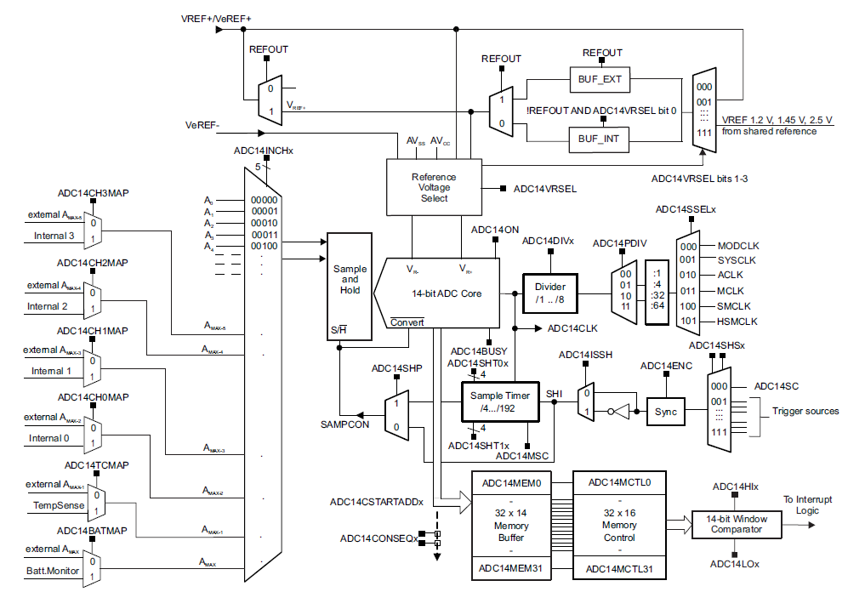

Slide 26
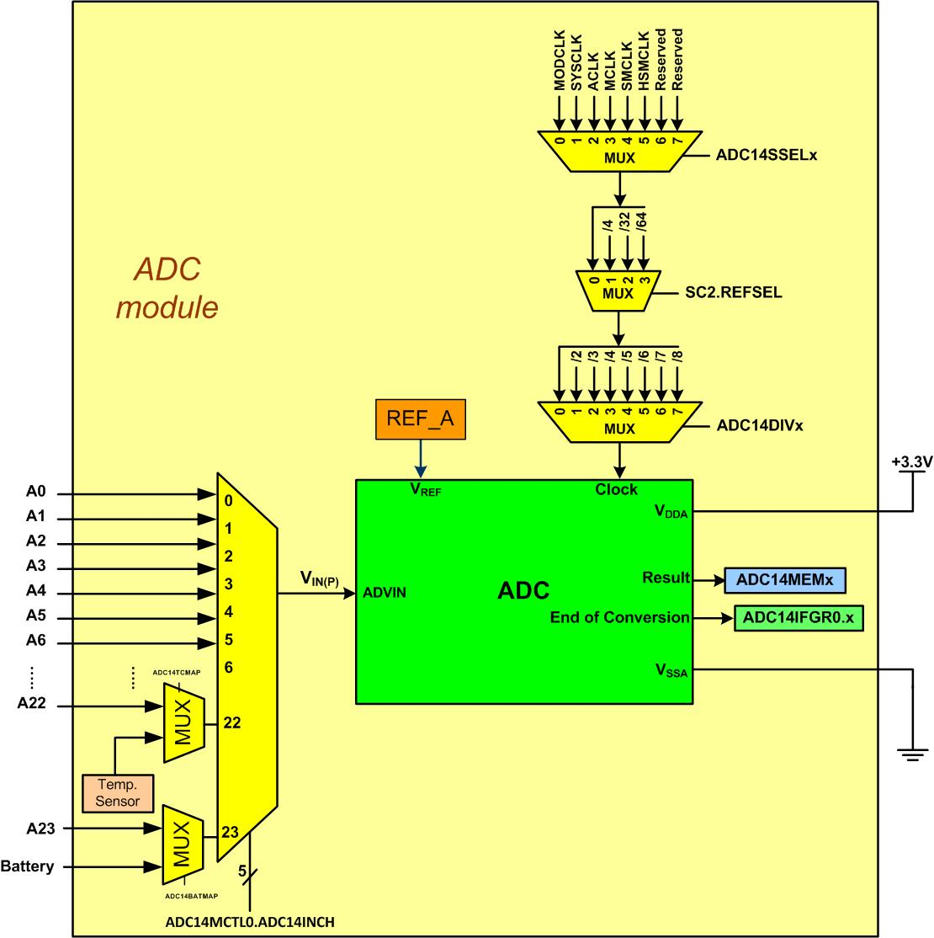
Simplified Block Diagram of MSP432 ADC
Select clock
signal
Select a voltage reference
Select
clock divider
Select
input pin
+3.3v
A0
A1
A2
A3
A4
A5
A6
.
.
.
A22
A23
battery
Output
memory
location
Flag Bit
Dr. Nabeeh Kandalaft EGR226 Grand valley State University

Slide 27
ADC14 Registers
Table 20-3 shows the ADC14 registers and the address offset of each register. Refer to the device specific data sheet for the base address of the module.
Table 20-3. ADC14 Registers
ADC14CTL0 Control 0 Register Section 20.3.1
ADC14CTL1 Control 1 Register Section 20.3.2
ADC14LO0 Window Comparator Low Threshold 0 Register Section 20.3.3
ADC14HI0 Window Comparator High Threshold 0 Register Section 20.3.4
ADC14LO1 Window Comparator Low Threshold 1 Register Section 20.3.5
ADC14HI1 Window Comparator High Threshold 1 Register Section 20.3.6
ADC14MCTL0 Memory Control 0 to Memory Control 31 Register Section 20.3.7
to ADC14MCTL31
ADC14MEM0 Memory 0 to Memory 31 Register Section 20.3.8
to ADC14MEM31
ADC14IER0 Interrupt Enable 0 Register Section 20.3.9
ADC14IER1 Interrupt Enable 1 Register Section 20.3.10
ADC14IFGR0 Interrupt Flag 0 Register Section 20.3.11
ADC14IFGR1 Interrupt Flag 1 Register Section 20.3.12
ADC14CLRIFGR0 Clear Interrupt Flag 0 Register Section 20.3.13
ADC14CLRIFGR1 Clear Interrupt Flag 1 Register Section 20.3.14
ADC14IV Interrupt Vector Register Section 20.3.15
Dr. Nabeeh Kandalaft EGR226 Grand valley State University

Slide 28
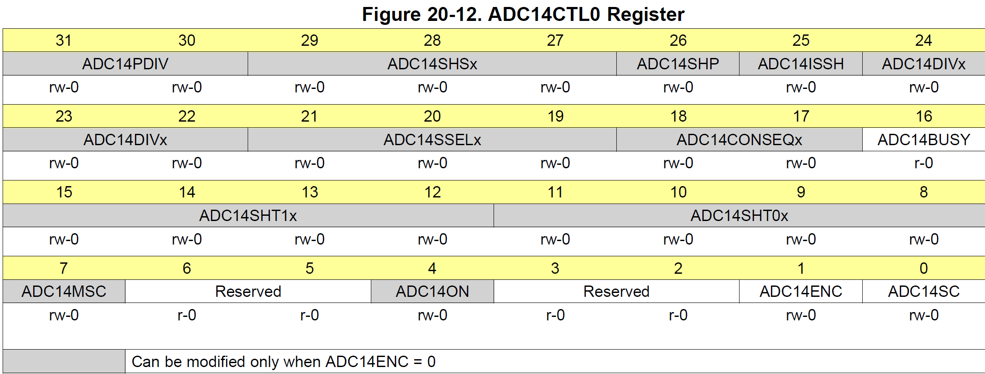
First ADC control register (ADC14CTL0)
Enable conversion (ADC14ENC)
On/Off bit (ADC14ON)
Clock source (ADC14SSELx) (Use MCLK = 011b)
Clock divider (ADC14DIVx) (00b = x1)

Slide 29
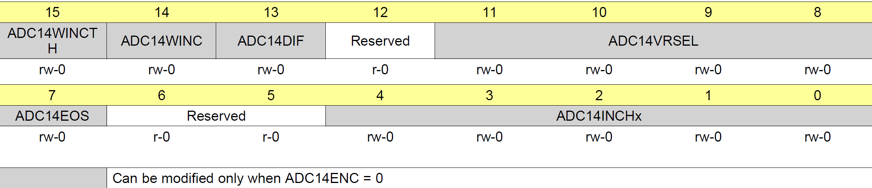
Conversion Memory control (ADC14MCTLx)
Select which ADC channel (A0-A23) to store in this memory register
NOTE: SEL0 and SEL1 bits must be set to “1” for selected input
Vref selection (3.3v? 2.5v?, external pin?)

Slide 30
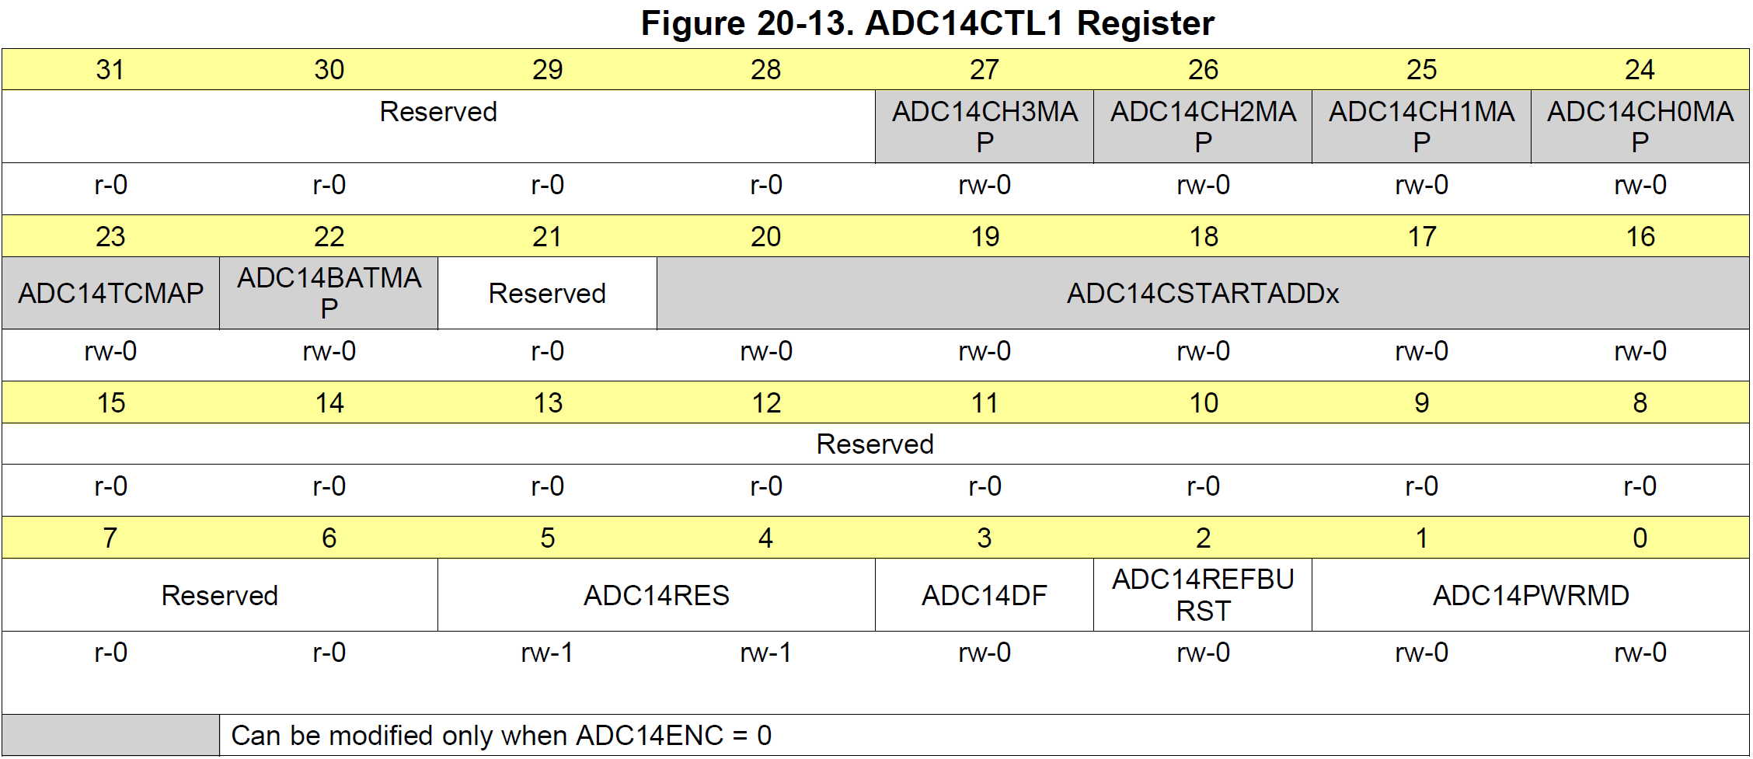
Second ADC control register (ADC14CTL1)
Regular or low power mode
8, 10, 12 or 14-bit resolution

Slide 31
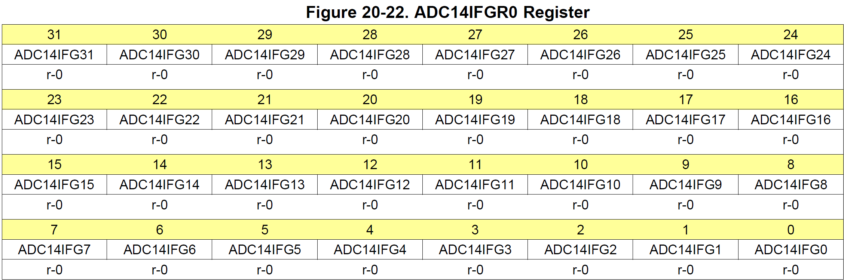
Interrupt Flag (ADC14IFGx)
Each ADC input has an interrupt flag.
This is reset when the ADC14MEMx location is read

Slide 32
Example (1) Sensing ambient light level using a photo cell and ADC
Connect a photo conductive cell in a simple analog circuit designed to create a voltage that increases with increased light level.
A0 P5.5 …….. mem0 ➔ MCTL[0]
16 sample clocks per conversion
SMCLK
Repeat single channel
IF YOU use mem5 ➔ MCTL[5]
;
void PortADC_init (void)
{
P5->SEL0 |= BIT5; // configure pin 5.5 for A0 input
P5SEL1 |= BIT5;
}
Assuming SysTick
has been initialized
void ADC14_init (void) {
ADC14 -> CTL0 &=~ ADC_CTL0_ENC; // disable ADC converter during initialization
ADC14->CTL0 |= 0x04200210; // S/H pulse mode, SMCLK, 16 sample clocks
ADC14->CTL1 = 0x00000030; // 14 bit resolution
ADC14->CTL1 |= 0x00000000; // convert for mem0 register
ADC14->MCTL[0] = 0x00000000; // ADC14INCHx = 0 for mem[0]
// ADC14->CTL0 |= 0x00000002; // starts the ADC after configuration
ADC14->CTL0 |= ADC14_CTL0_ENC; // enable ADC14ENC, Starts the ADC after confg.
}
Dr. Nabeeh Kandalaft EGR226 Grand valley State University

Slide 33
#include "msp.h“
void delaysetup(void);
void delayms(uint16_t delay);
void ADC14_init(void);
int main(void)
{
static volatile uint16_t result;
float nADC;
WDT_A->CTL = WDT_A_CTL_PW | WDT_A_CTL_HOLD; // Stop WDT
PortADC _init ( );
ADC14_init ( );
while (1)
{
ADC14->CTL0 |= ADC14_CTL0_SC; //start conversation
while ( !ADC14->IFGR0 & BIT0) ); //wait for conversation to complete
result = ADC14->MEM[0]; // get the value from the ADC
nADC = (result * 3.3) / 16384;
printf ("Value is:\n\t%d\n\t%f\n", result, nADC );
delayms(2000); // SysTick delay has been configured
}
}
Assuming SysTick
has been initialized
Dr. Nabeeh Kandalaft EGR226 Grand valley State University

Slide 34
Example (2) (Adding to the previous example (1) )
measure ambient light intensity with the photocell and microcontroller ADC and use that information to control the light intensity of the LED such that when the ambient light decreases (it gets darker) the intensity of the LED also decreases (it gets dimmer).
Connect the LED to pin P2.7 for TIMER_A0.4
void LED_init (void)
{
P2->SEL0 |= BIT7; // Set GPIO
P2->SEL1 &=~ BIT7;
P2->DIR |= BIT7; // Set P2.7 / LED to output
P2->OUT &=~ BIT7; // Clear LED to start
}
//Since we used P2.7 A0_4 …… CCR[4] and CCTL[4] will be used.
void TIMER_A0_init (void) {
TIMER_A0->CCR[0] = 50000; // period = f of 60Hz
TIMER_A0->CCR[4] = 500; // 500 = 1% Duty cycle
TIMER_A0->CCTL[4] = TIMER_A_CCTLN_OUTMOD_7; // Reset/set
TIMER_A0 -> EX0 = 0x0000; //Gain 1:1 divider
TIMER_A0->CTL = TIMER_A_CTL_TASSEL_2 | // SMCLK
TIMER_A_CTL_MC_1 | // Up Mode ... Count up
TIMER_A_CTL_CLR; // clear TA0R Register
}
Dr. Nabeeh Kandalaft EGR226 Grand valley State University

Slide 35
#include "msp.h“
int main(void)
{
static volatile uint16_t result;
float nADC;
WDT_A->CTL = WDT_A_CTL_PW | WDT_A_CTL_HOLD; // Stop WDT
LED_init ( );
PortADC _init ( );
ADC14_init ( );
TIMER_A0_init ( );
while (1)
{
ADC14->CTL0 |= ADC14_CTL0_SC; //start conversation or write ADC14->CTL0 |= 1
while ( ! (ADC14->IFGR0 & BIT0 ) ); //wait for conversation to complete
result = ADC14->MEM[0]; // get the value from the ADC
nADC = (result * 3.3) / 16384;
printf ("Value is:\n\t%d\n\t%f\n", result, nADC );
Delayms (500); // SysTick delay has been configured
bright = nADC / 3 * 50000; // 3 was the highest voltage from the cell not 3.3
TIMER_A0->CCR[4] = bright; //Set new Duty Cycle
}
}
Assuming SysTick
has been initialized
Dr. Nabeeh Kandalaft EGR226 Grand valley State University

