Slide 1
Objectives for today’s lecture
After today’s lecture you should be able to:
describe analog circuit models for the input stage of TTL and CMOS logic
describe what is meant by leakage current and how it affects input logic levels
describe logic switching thresholds and what is meant by the “digital contract”
describe digital logic noise margins and why they’re important
explain why it’s not a good idea to let digital inputs “float”

Slide 2
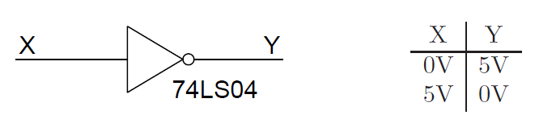
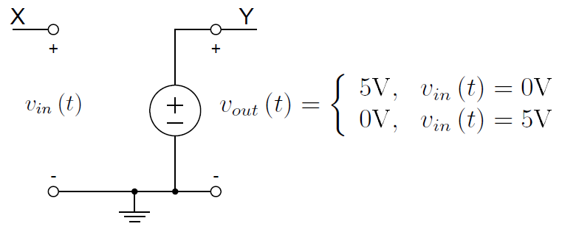
Digital Logic Input Models
An ideal logic gate can be modeled as
and can be represented by an ideal circuit voltage supply model
but what happens when v_{in} is between 0 and 5 V?

Slide 3
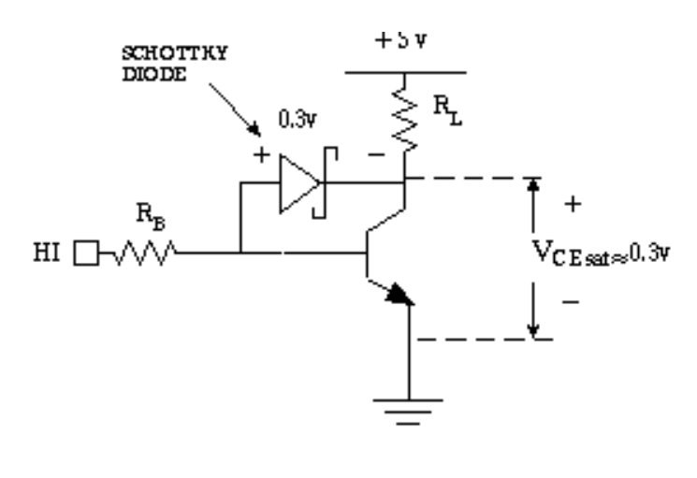
Digital Logic Input Models
Input stage implemented with a BJT and Schottky diodes in a TTL ALS (Advanced Low-power Schottky) logic family gate
When input is at logic 0, the NPN BJT is cutoff and Schottky diodes are reversed biased
but some reverse leakage current flows (~20 mA)
when input is logic 1,NPN transistor is biased on
base of transistor designed for low current (~200 mA)
Notes:
The collector is ”clamped”by a Schottky diode. This prevents the transistor reaching deep saturation. High speed variant of TTL
Schottky transistors which have faster switching speed
Schottky-barrier diode connected from base to collector to prevent transistor from going into saturation
BASIC SCHOTTKY TTL NAND GATE Features:
Transistors: all clamped with Schottky diode except Q4 (this does not saturate)Input diodes:
high-speed clamping of input signal excursions below ground

Slide 4
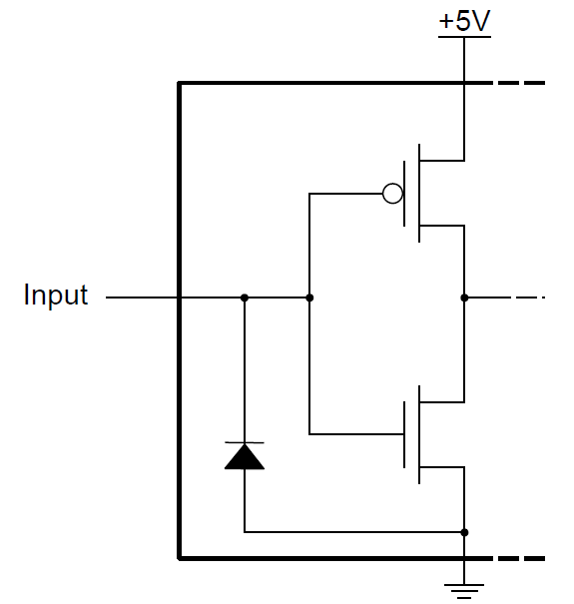
Digital Logic Input Models
Input stage of AHC (Advanced High-speed CMOS)
logic family technology
When input is at logic 1, the lower NMOS transistor is on (upper one off)
When input is logic 0, the upper PMOS transistor is on (lower one off)
Input is connected to gate of both FETs (and reverse biased protection diode), only very low current flows (~1 uA)

Slide 5
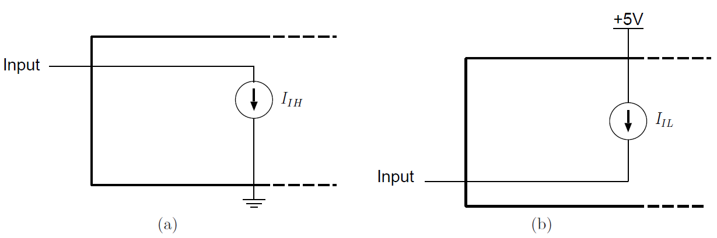
Digital Logic Input Models
Model for input current when driven high (a)
only a small amount of leakage current I_{IH} flows to ground (~20 mA for BJT, ~1 uA for CMOS)
and driven low (b)
only a small amount of leakage current I_{IL} flows from the supply (~200 mA for BJT, ~1 uA for CMOS)

Slide 6
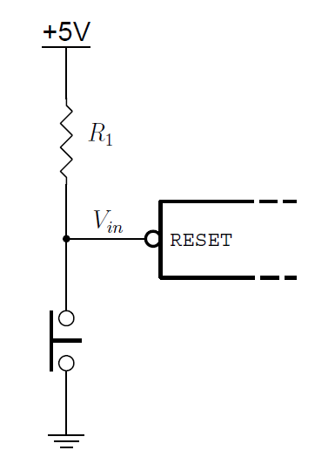
Digital Logic Input Models
Normally, aren’t concerned with leakage currents on input when logic gates are connected.
However, need to consider it when other devices are connected, e.g.,
Normally, want to pick R₁ to minimize current draw from supply
If R is too large, flow of leakage current through input stage will drop V below threshold for logic 1
V_{in} = 5 − I_{IH} · R₁
(e.g., I_{IH} = 20 μA, 20x10⁻⁶ * 150K =3V!)
so, circuits with pull-up resistors must consider input stage leakage current

Slide 7
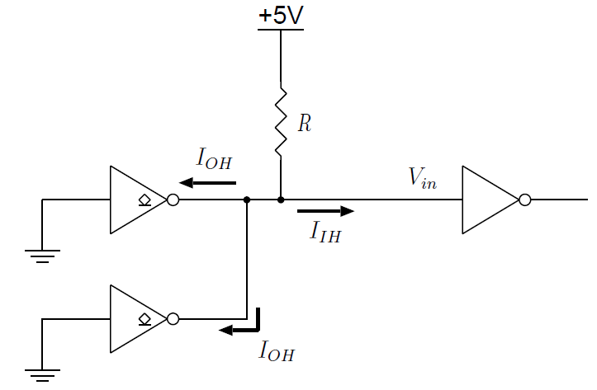
Digital Logic Input Models
Open drain output devices exhibit current leakage when their outputs are high (e.g., I_{OH} = 100μA for 74LS05).
This leakage current must be considered in addition to digital input leakage current in circuits when considering the value of pull-up R
What value of R should you choose to keep V_{in} above 3.9V?
I_{IH} = 20 mA
V_{in} = 5 − ( I_{IH} + 2 I_{OH} )· R= 3.9
R = (5-3.9)/220x10⁻⁶ =5000

Slide 8
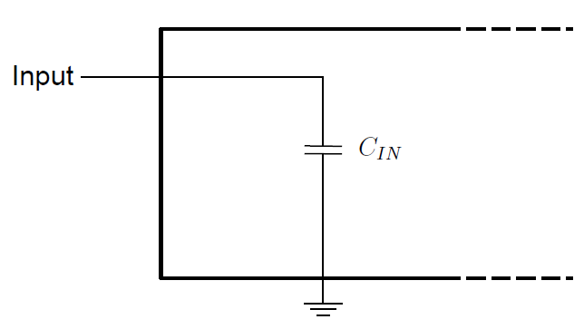
Digital Logic Input Models
Even if there are no actual capacitors present at digital inputs, there is effective capacitance due to the internal components.
During rising and falling edges, this capacitance has an effect on the circuit, so it should be considered:
two consequences:
• rising and falling edges are slowed down by the need to charge or discharge this
capacitance
• rising and falling edges dissipate power proportional to the amount of
capacitance being driven

Slide 9
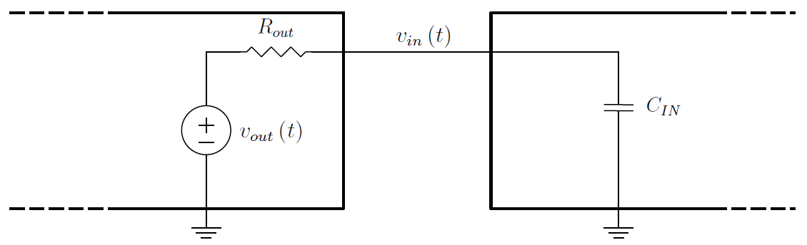
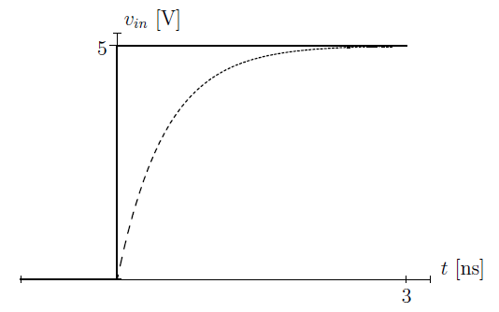
Digital Logic Input Models
For currents of a few milliamps, digital output stages can be well modeled as a voltage source in series with a resistance
Capacitance of digital inputs slows edges as shown for an ideal step of a rising edge (solid line)
dashed line represents typical values of R_{out} = 50W and C_{IN} = 10pF
Note: there is a delay before input V reaches logic 1 threshold V
This limits max switching speeds

Slide 10
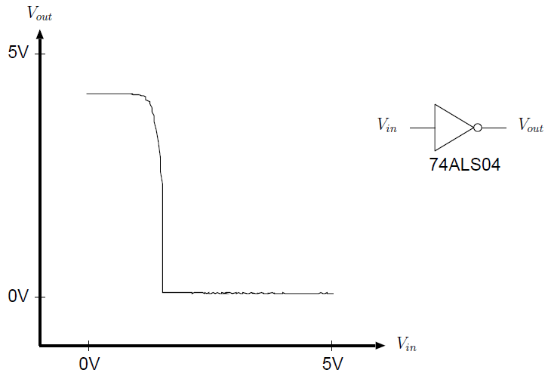
Digital Logic Switching Thresholds
For “mature” technology devices (e.g., TTL LS), an output V_{out} will switch rapidly from logic 1 to logic 0 when V_{in} reaches a threshold voltage.
Note: the max V_{out} is not quite 5V for TTL

Slide 11
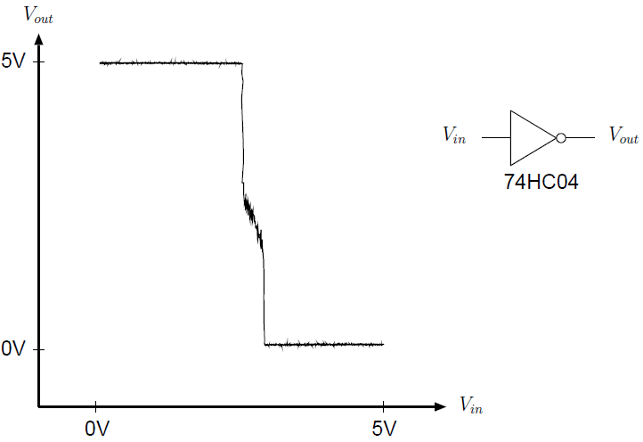
Digital Logic Switching Thresholds
Here’s an example for a CMOS device.
Note: the max V_{out} is much closer to 5V.
V_{out} switches at a higher V_{in}
However, there is much variation in the threshold V from device to device

Slide 12
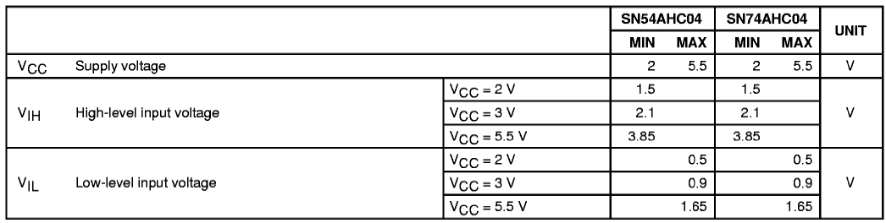
Digital Logic Switching Thresholds
To accommodate the variations in logic switching thresholds
The device manufacturer specifies a parameter,
V_{IL} - the maximum level for V_{in} that will be recognized as logic low
V_{IH} - the minimum level for V_{in} that will be recognized as logic high
The V_{IH} and V_{IL} parameters are documented in the device data sheet

Slide 13
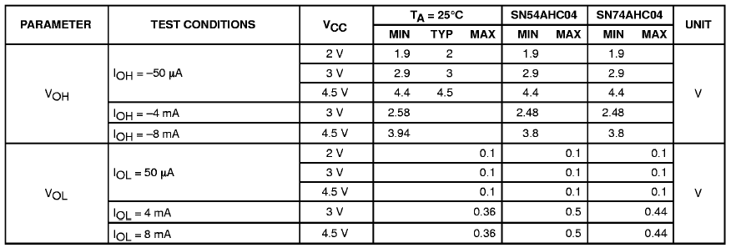
Digital Logic Switching Thresholds
Similarly, the device manufacturer specifies a parameter,
V_{OL} - the maximum level for V_{out} when driven to logic low
V_{OH} - the minimum level for V_{out} when driven to logic high
The V_{OH} and V_{OL} parameters are also documented in the device data sheet and are dependent on output current

Slide 14
The “Digital Contract”
The V_{IH} and V_{IL} parameters are requirements that apply to the digital device’s inputs.
The VOH and VOL parameters are requirements that apply to the digital device’s outputs.
Example of “the contract” for a 74xx04 inverter:
“If you give me a voltage of V_{IL} or lower, I guarantee to drive an output voltage of V_{OH} or higher.
If you give me a voltage of V_{IH} or higher, I guarantee to drive an output voltage of V_{OL} or lower.
If you give me a voltage in between V_{IL} and V_{IH} , I cannot guarantee what output voltage I will drive.”

Slide 15
Digital Logic Noise Margins
Input voltage requirements (V_{IH} and V_{IL}) and output voltage guarantees (V_{OH} and V_{OL}) are not the same voltage levels.
Why not make V_{IH} = V_{OH} ?
The difference exists to provide some tolerance to noise and to ground potential imbalance.
If, for example,
a digital driver and receiver are separated by some appreciable distance
the ground pin of both devices may be separated by a small potential (depends on trace impedance and current).
the digital signal could pick up some noise.

Slide 16
Digital Logic Noise Margins
Consider: a 0.1V ground imbalance and 0.2V of additive noise
There will be times at which the received signal will appear to be 0.3V lower.
If the digital output drives 2.0V and the receiver has V_{IH} = 2.0V, the signal may be misinterpreted as a logic low since the receiver will may only see 1.7V.
If, however, the digital output drives 2.4V, the receiver will see 2.1V and correctly interpret the signal as a logic high level.
The difference V_{OH} −V_{IH} is called the noise margin when driving high.

Slide 17
Digital Logic Noise Margins
For TTL logic, there is V_{OH} − V_{IH} = 2.4V − 2.0V = 0.4V of “margin” to guard against ground imbalances and induced noise.
When driving low, there is V_{IL} − V_{OL} = 0.8V − 0.4V = 0.4V of noise margin for TTL.
CMOS devices typically have V_{OH} = 4.44V and V_{OL} = 0.5V.
For CMOS, V_{IL} is typically 30% of VCC (1.5V if VCC=5V) and V_{IH} is 70% of VCC (3.5V)
This makes the noise margins V_{OH} − V_{IH} = 4.44V − 3.5V = 0.94V when driving high
and V_{IL} − V_{OL} = 1.5V − 0.5V = 1.0V when driving low.
These noise margins are more than twice as high as those for TTL logic.

Slide 18
Mixed Logic Device Technologies
Two device technologies can be mixed if the driver’s V_{OH} is greater than the receiver’s V_{IH ,}
and the driver’s V_{OL} is lower than the receiver’s V_{IL}
Some CMOS device technologies have been designed specifically to allow TTL and CMOS devices to interoperate.
Examples include the HCT, AHCT, and ACT device technologies which are based on HC, AHC, and AC technologies, respectively.
The difference between HC and HCT devices is that the HCT device will use TTL voltage thresholds on the input side but still use CMOS voltage thresholds on the output side.
.4

Slide 19
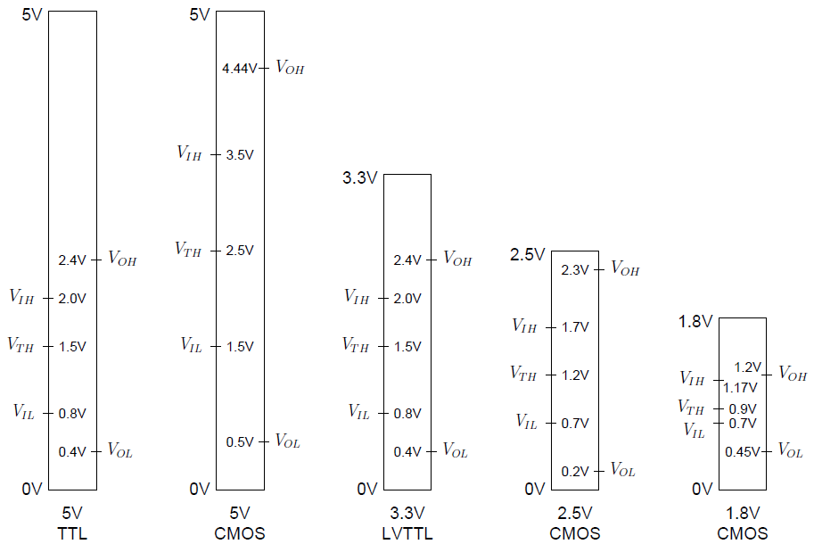
Digital Logic Input Models
“Digital Contract” voltage levels for different logic families that work at various supply voltages.
lower voltages reduce power

Slide 20
Floating Inputs
When a digital input is physically unconnected to any other signal or device, its voltage is determined by leakage currents within the device.
Floating pins on TTL-technology devices (such as LS, ALS, etc.) tend to float above the switching threshold.
CMOS-technology devices (such as HC, AC, etc.) tend to float near the switching threshold voltage.

Slide 21
Floating Inputs
When the input pin is left floating and its voltage floats near the switching threshold voltage both transistors are partially turned on.
This condition presents a current path from VCC to ground that has a much lower impedance than when one of the two transistors is fully off.

Slide 22
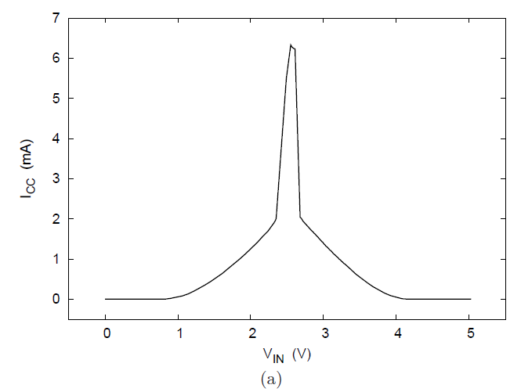
Floating Inputs
Current that flows when V_{IN} is varied for a 74HC04, see what happens if unconnected it “floats” near the threshold voltage.

Slide 23
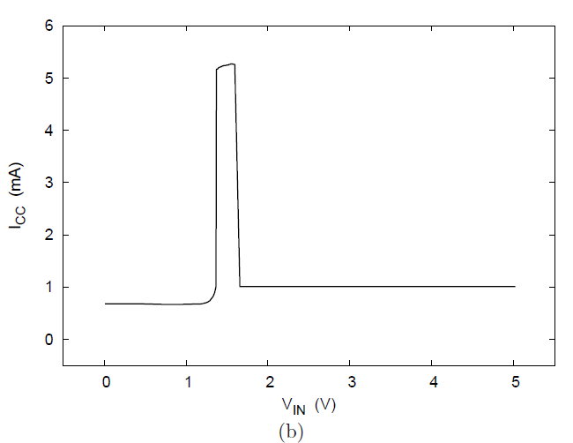
Floating Inputs
Current that flows when V_{IN} is varied for a 74ALS04. At threshold there is a current spike, however, unconnected it will float above this level.

Slide 24
Floating Inputs
Floating inputs should not be allowed in a circuit, especially one with CMOS devices.
The consequences of a floating input
excessive ICC current for the devices in the circuit
possible oscillations on outputs
even device destruction.
Remedy by using pull-up or pull-down resistors (judiciously chosen with leakage currents in mind).

