Slide 1
Objectives for today’s lecture
After today’s lecture you should be able to:
Describe common design problems that can lead to device failures
Describe methods of protecting your circuit from too much current
Describe methods of protecting your circuit from too much voltage

Slide 2
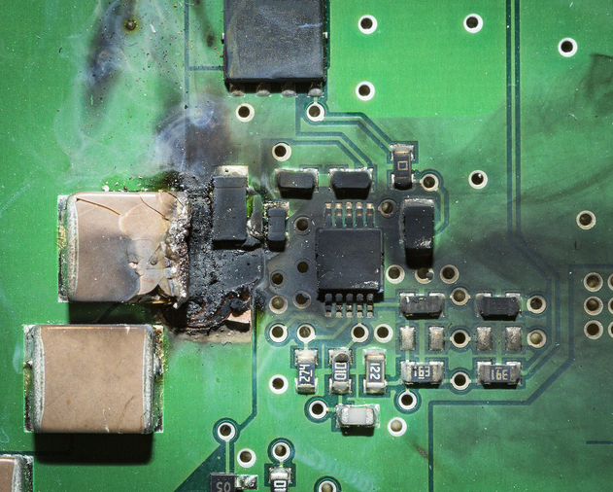
Current Protection
Excessive current destroys electronic devices.
Limiting maximum current is one of the most important things you can do to protect your design.
Notes:
Talanium

Slide 3
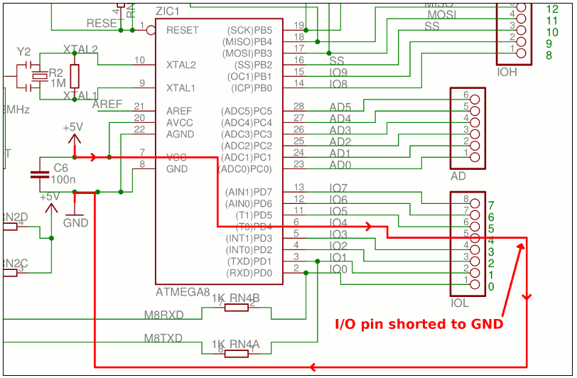
Current Protection
Consider what can happen if one of the I/O pins on a MCU is accidentally shorted to ground.
With a typical internal resistance of about 25W, the 5/25=0.2 A would be enough to damage or destroy the internal port circuit.

Slide 4
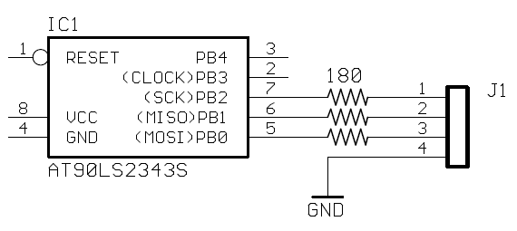
Current Protection
A solution could be to place a small resistor in series with the device pins.
A common value to use is 560 Ohm
Now the short circuit current would be limited by the resistor to
Vcc / 560 or for a 3.3V supply, 3.3/ 560 = 5.9 mA
This will guard against unfortunate circumstances such as:
probing the output and it slips and shorts to a nearby grounded pin (if you’re probing the output signal at the connector pin)
wiring the output pin and accidentally touching the wire to gnd
connecting through a connector that is improperly wired to gnd

Slide 5
Current Protection
Series limiting resistors ensure that shorted pins don’t cause device destruction.
The drawbacks to these resistors
they take up extra board space,
they add to the total system cost,
they incur a voltage drop,
and they increase signal rise time.
For a digital input signal, the current is typically very low (on the order of microamps) so voltage drop across a 560 resistor will be negligible.
For digital outputs, the current should be limited anyway (e.g., driving a LED).

Slide 6
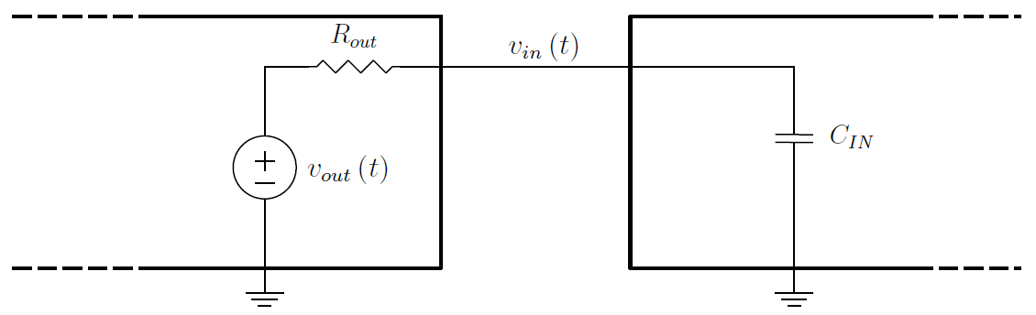
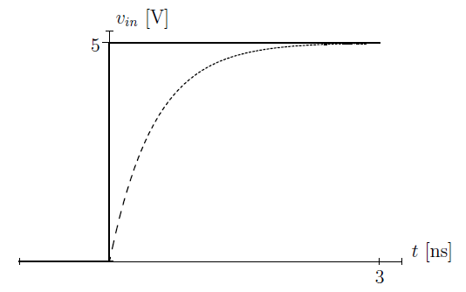
Current Protection
The connections between a digital input and output can be modeled as:
Capacitance of digital inputs slows edges as shown and now we are adding significantly more resistance.
R_{out} = 50, R_{series}=560and C_{IN} = 10pF
The new time constant (R_{out} +R_{series} ) C_{IN} may preclude using high digital signal frequencies (e.g., > 400 MHz).
RC timeconstant ~ 5.7uS

Slide 7
Current Protection
No series limiting resistor is added to the GND connector pin.
The ground path can carry 10s of milliamps of current (or more) and a resistor in this path can cause great imbalances between the ground references of the various system components.
Similarly, a series limiting resistor on the VCC supply is uncommon (because it may cause the supply voltage to drop too much)

Slide 8
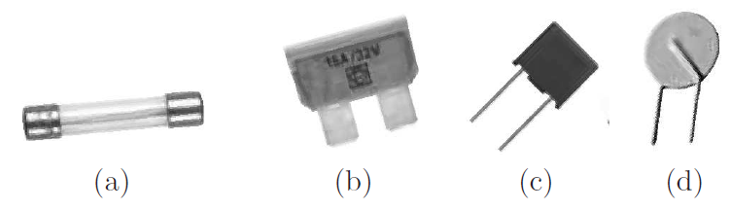
Current Protection
Sometimes you want to create an open circuit when too much current flows.
Fuses serve this purpose by using an element that melts and creates an open circuit when excessive current flows.
The cheapest and most common is a thin wire in a glass tube.
Most fuses blow too slowly to protect semiconductors from damage, so they are usually employed for system wide protection.
The most widely recognized purpose is to prevent fires.
Some common fuses: (a) 5x20mm glass fuse (b) blade fuse commonly used in automotive applications (c) miniature PCB-mount fuse (d) resettable

Slide 9
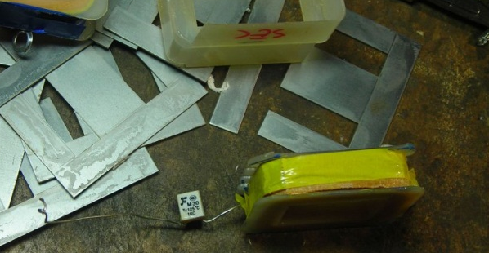
Current Protection
Limiting current with a fuse on the primary side of a power supply transformer is common.
Here the primary is protected by a thermal fuse which cuts out at 125°C. It's a non-resettable fuse - there's a small piece of metal alloy inside which melts and breaks the connection.

Slide 10
Current Protection
Current handling and fusing time
a 1A fuse will conduct 1A indefinitely
will open after 10 seconds at 1.5A,
open after 100ms at 2A,
and open after 1ms at 3A
There are “fast acting” and “slow blow” versions
“slow blow” take longer to open for a given current
These are appropriate for circuits with temporary surge currents (like motor startup currents)
refer to the manufacturer’s charts for guidance

Slide 11
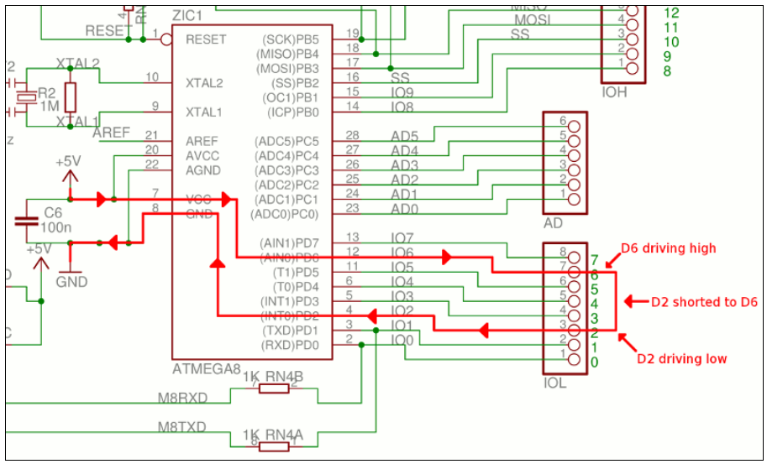
Current Protection Application Example
Configure two I/O pins to be outputs then set one high and the other one low. Now connect the pins together and you have an overcurrent condition on both I/O pins and they will be destroyed.
Some protection can be provided by putting a 30mA resettable fuse in series with every I/O pin.

Slide 12
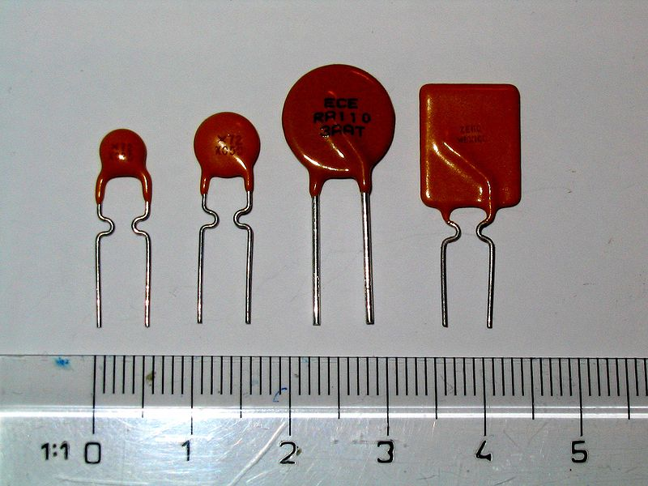

Current Protection
A resettable fuse is a protective current limiting device that is a positive temperature coefficient (PTC) thermistor.
A PTC consists of a piece of polymer material loaded with conductive particles (usually carbon black).
At room temperature the polymer is in a semi-crystalline state and the conductive particles touch each other, forming multiple conductive paths and providing low resistance.
When current passes through the PTC it dissipates power, its temperature increases, it expands breaking the connections between the conductive particles.
e.g., trip rating 20 mA to 1.6A
for Vmax ranging 6V to 30V

Slide 13
Current Protection
Using a positive temperature coefficient (PTC) thermistor
As long as the current is less than its rated hold current (I_{hold}), the PTC will remain in a low-resistance state
When the current exceeds I_{trip}, the PTC heats up suddenly.
The polymer changes state and expands, breaking the connections between the conductive particles.
This causes the resistance to increase rapidly by several orders of magnitude.
When the power and fault are removed, the PTC device will cool.
As the device cools, it regains its original crystalline structure and returns to a low resistance state where it can hold the current as specified for the device.
Demoing a PTC fuse ttps://www.youtube.com/watch?v=uAJTTGHYj4A

Slide 14
Current Protection
Using an active current limiting device
A fuse is fundamentally a passive, mechanical device.
They don’t provide much control over current limiting.
You cannot specify a fuse that allows a circuit to operate at up to 200mA and to completely shut off the circuit at 210mA.
If this level of protection is needed for sensitive electronics, an active form of overcurrent protection is required.
This approach requires sensing the current flow and throttling the power supply in the case of an overcurrent.

Slide 15
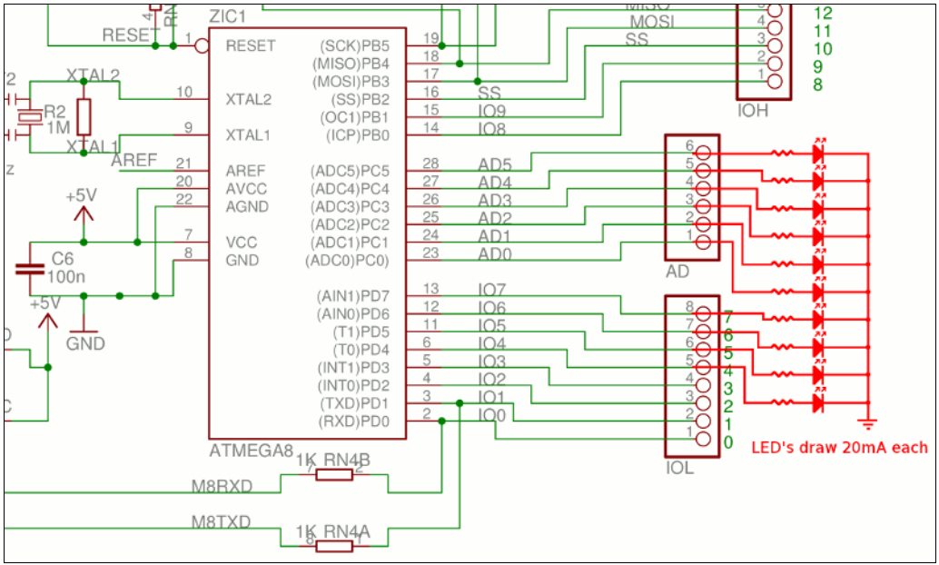
Current Protection
It’s not enough to limit the current of each I/O pin -- the total current sourced from all I/O pins must not exceed 200mA, according to the ATmega328P datasheet.
from http://ruggedcircuits.com

Slide 16
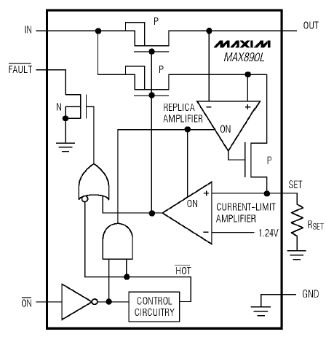
Active Current Protection
Maxim MAX890
It employs a P-channel MOSFET that is either on to allow the input voltage to pass through to the output,
or is off in the case of an overcurrent condition.
A parallel MOSFET and amp is used to sense the output current (/1110) and drive the current set resistor R_{SET}
R_{SET} resistor is used to set the max allowable current, up to 1.2A
A FAULT open-drain output can indicate an overcurrent condition to an external device such as a microcontroller or LED

Slide 17
Voltage Protection
Although it is current that destroys semiconductors, excessive voltage leads to breakdown effects that cause excessive current.
For example, a microcontroller may consume a few milliamps at a VCC of 5V, but when 10V is applied, breakdown occurs and a large amount of current starts flowing into the device, destroying it.
Circuit protection can be achieved through protection against over voltage directly avoids voltage drops in current limiting resistors.

Slide 18
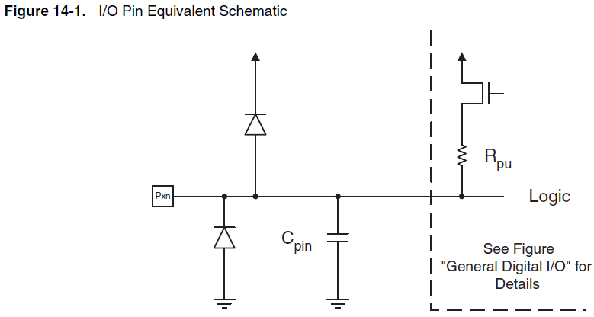
Voltage Protection
Common protection mechanism seen on many MCU digital I/O pins.
A sustained over voltage will cause the diodes to conduct lots of current, heat up, and the device will eventually be destroyed.
Protection should be implemented outside the chip as well.
Diodes clamp the voltage at the pin below GND and above VCC.
These diodes are internal to the device, to protect against transients.

Slide 19
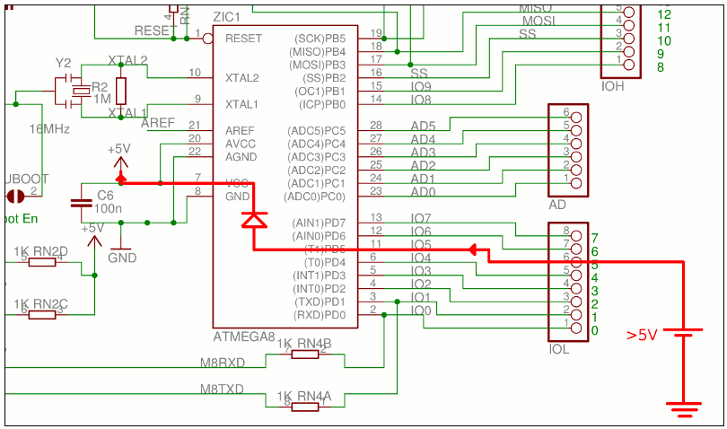
Voltage Protection
This diagram shows the flow of current when overvoltage is applied to an I/O pin of a MCU.
If the internal protection diode fails open, then the overvoltage destroys the I/O pin.
If the protection diode fails by shorting out, the overvoltage is applied to the +5V supply and will affect other devices on the board.

Slide 20
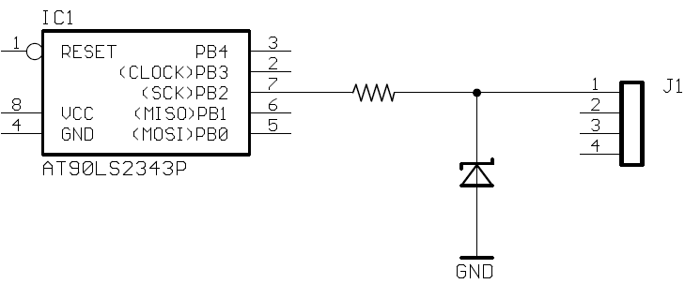
Voltage Protection
A single zener diode instead of two regular diodes avoids this problem since overvoltages and reversed voltages are both shunted to GND.
If the signal voltage drops below GND, the zener diode will be forward-biased, begins conducting, and clamps the voltage to one diode drop below GND.
Unlike a regular diode, a zener diode undergoes reverse-voltage breakdown without damage at its rated zener voltage Vz.
If the signal rises above Vz, the diode enters its reverse-breakdown region and starts conducting to GND.

Slide 21
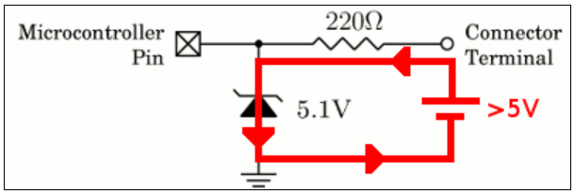
Voltage Protection
It’s possible to protect every I/O pin with a 30mA resettable fuse (with built-in 220 ohm resistance) and a 5.1V zener diode that together serve to limit the pin voltage.
Not only is the current safely limited to 30mA under all conditions, but the built-in 220 ohm resistance of the fuse naturally limits the current to 5V/220 = 23mA.
Now, instead of current flowing through the microcontroller’s internal protection diode, it flows safely through the zener diode, to ground, and back to the source of the overvoltage.
The PTC fuse limits this current to 30mA so the 5.1V zener diode does not dissipate excessive power.
from http://ruggedcircuits.com

Slide 22
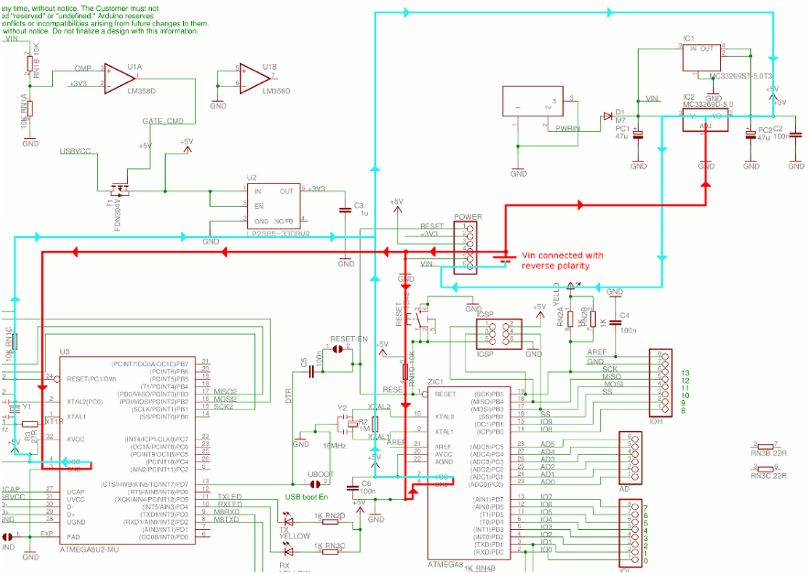
Voltage Protection
no reverse-voltage protection on voltages applied to the Vin
from http://ruggedcircuits.com

Slide 23
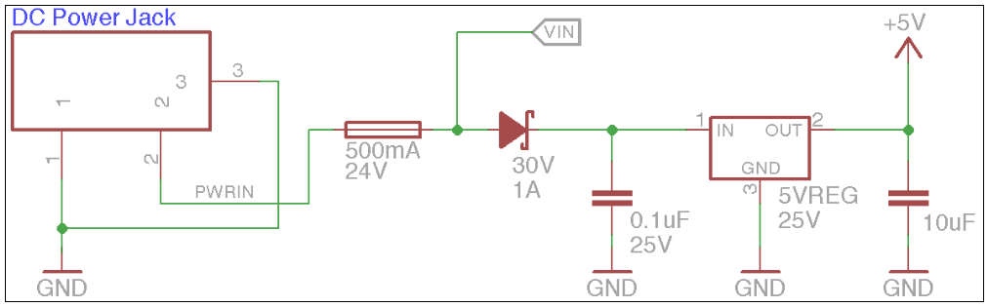
Reverse Voltage Protection
In this example, the V_{IN} pin is protected by a 30V reverse-blocking diode.
You can apply as much as 30V of reverse-polarity voltage on the V_{IN} pin without causing any damage.
Note also a 500mA PTC resettable fuse in series with the DC power input circuit to protect supply in case of a short on the board.
NOT A ZENER!
from http://ruggedcircuits.com

Slide 24
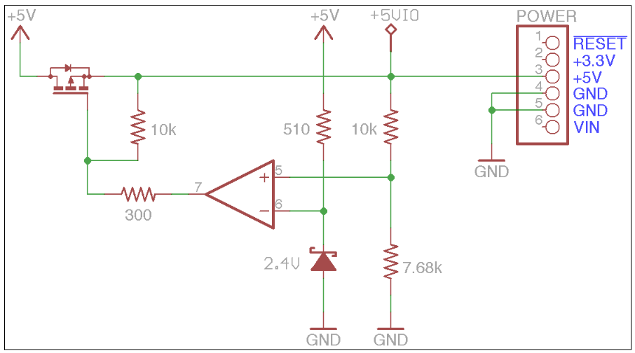
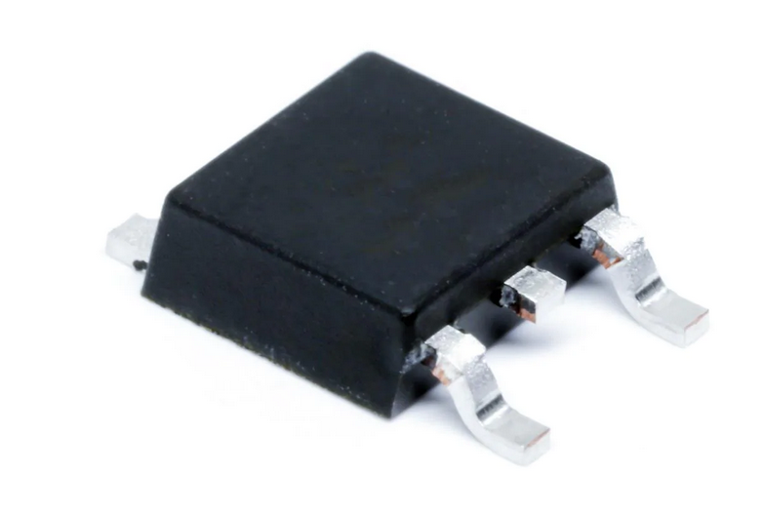
Voltage Protection
Over voltage protection on an external connector pin is also a good idea.
For example, this voltage cutoff circuit makes sure that the 5V connector pin is disconnected if it exceeds 5.5V.

Slide 25
In summary
Expect the possibility of human error
shorted inputs and outputs
overloaded outputs
reversed power connections
And design your circuit with them in mind by
current protection
voltage protection

