Slide 1

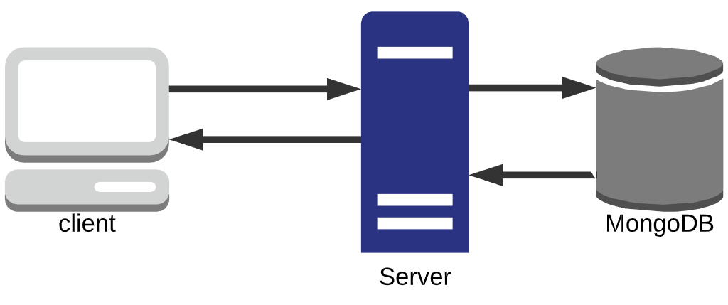
E-Music Box
Jack Madden
G00338579
Operation:
The client requests the server for some audio files, which are in a MongoDB database. The server retrieves them and sends them to the client. The user can then save them and combine them into one file.
Software:
Node.js and Express
For running the server
MongoDB and GridFS
For storing audio files

