Slide 1


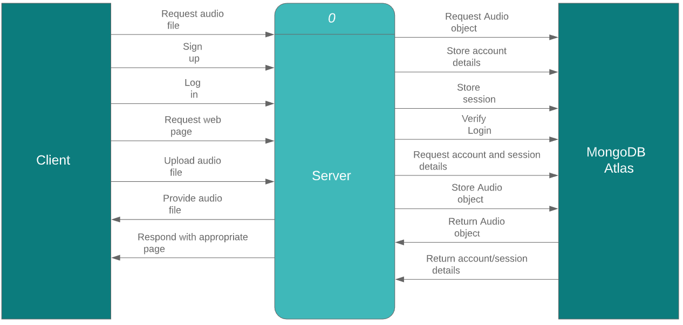
Jack Madden—G00338579
BEng (Hons) Software & Electronic Engineering
E-Music Box
Operation
The user can sign up using an email. When logged in, they can upload an audio file to the database, which they can later delete. Once uploaded, anyone can listen and download it.
Due to the size of audio files, only their paths are stored in the database; the files themselves are stored on the server.
Software
Node.js and Express for powering the server
Mongoose/JSON for modelling schemas
EJS templating engine for marking up web pages
MongoDB Atlas for storing audio files, account details and sessions
Results
MongoDB storing audio file pathways and retrieving files
Signup, login and session creation working
Uploading successfully limited to signed in users
File deletion privilege restricted to creator of a file
Conclusion
A system such as this could prove useful to professional video makers who lack the time or means to compose their own music, though as it is, it would need further development before being ready for real-world deployment.

