Slide 1


Organized by the folks at Moov2
ShareUp Soton
World One Powerful Presentation Template

Slide 2

Jack Davies | Junior Developer | Moov2
You are all creators
How you’ve been creating your whole life and why you should share your creations.

Slide 3


LEGO
The most popular toy to ever exist on the planet
How many of you have played with LEGO?

Slide 4
OVER 400 MILLION PEOPLE
So odds are you’ve played with LEGO at some point.

Slide 5
NEVER PLAYED LEGO?

Slide 6
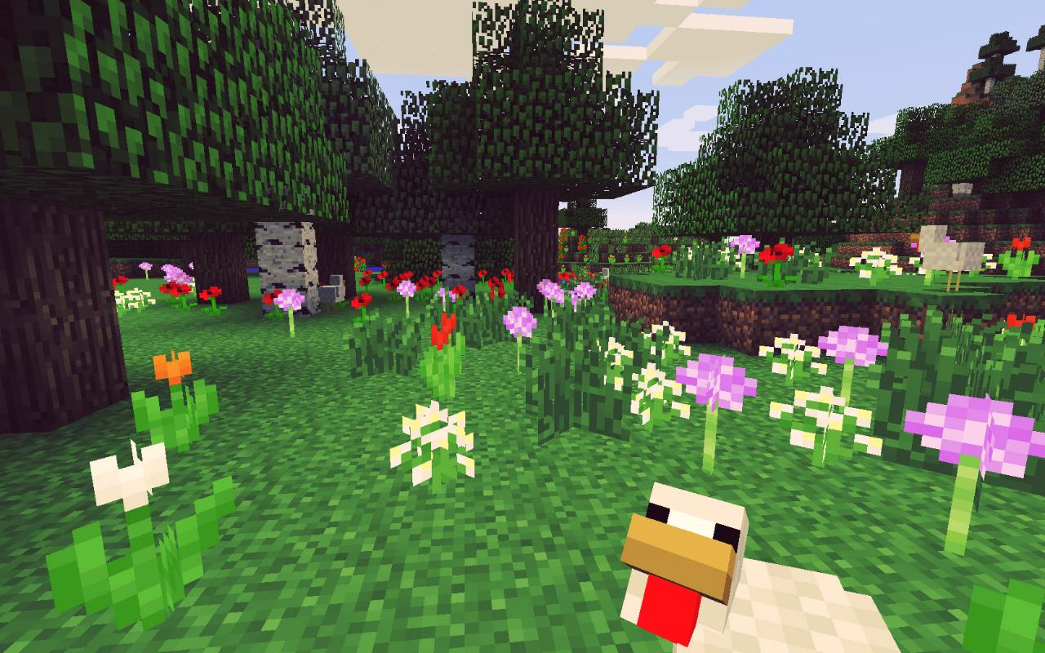
MINECRAFT
How about one the most popular games of all time?
How many of you have played Minecraft?

Slide 7
OVER 24 MILLION PEOPLE
If you like video games, you’ve played Minecraft at some point in time.

Slide 8

Which means…
YOU’RE A CREATOR

Slide 9
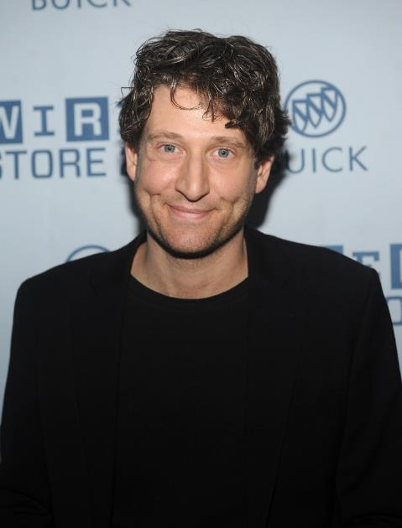
NATHAN SAWAYA (BEFORE 2004)
LAWYER IN NEW YORK

Slide 10
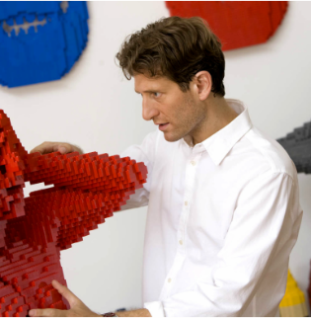
NATHAN SAWAYA
PROFFESIONAL LEGO BUILDER
Who said LEGO was for kids?
“Sawaya was the first contemporary artist to ever take LEGO® into the art world as a medium. His work is obsessively and painstakingly crafted and is both beautiful and playful.“
http://www.nathansawaya.com/

Slide 11

Another Example?
Jack Davies (Me!)

Slide 12
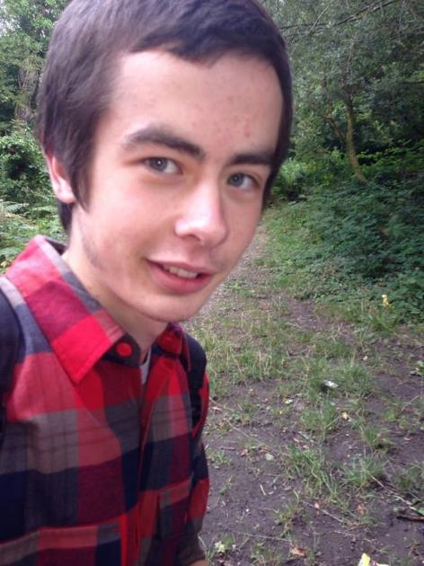
JACK DAVIES (BEFORE SOUTHAMPTON)
NAIVE ASPIRING DEVELOPER

Slide 13
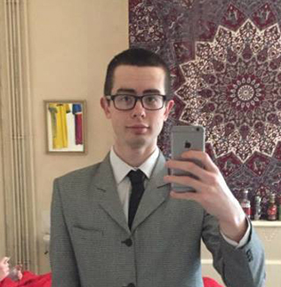
JACK DAVIES (NOW)
NAIVE ASPIRING DEVELOPER
YouTuber
Designer
Developer
3D Artist
Animator
Illustrator
Photographer
Painter
I realised having a passion for being a creator is great, it’s what you need to be successful in my line of work. However, I realised even though it is great, it isn’t enough on its own. To truly be successful or employable you need to be sharing your creations.
To see what else I do, you can check out my personal website.
http://www.whatjackhasmade.co.uk

Slide 14






Slide 15
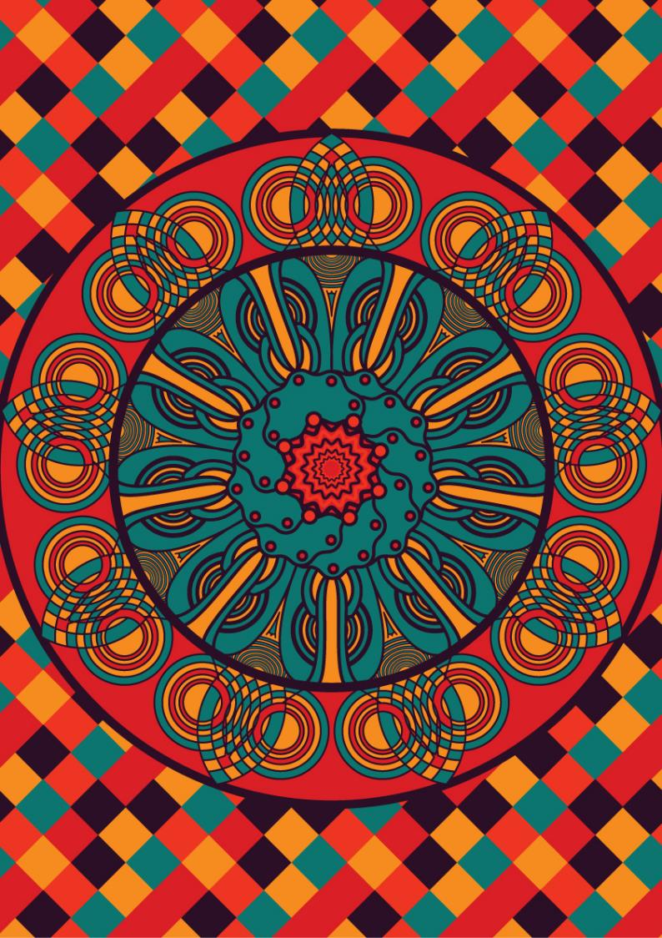




Slide 16
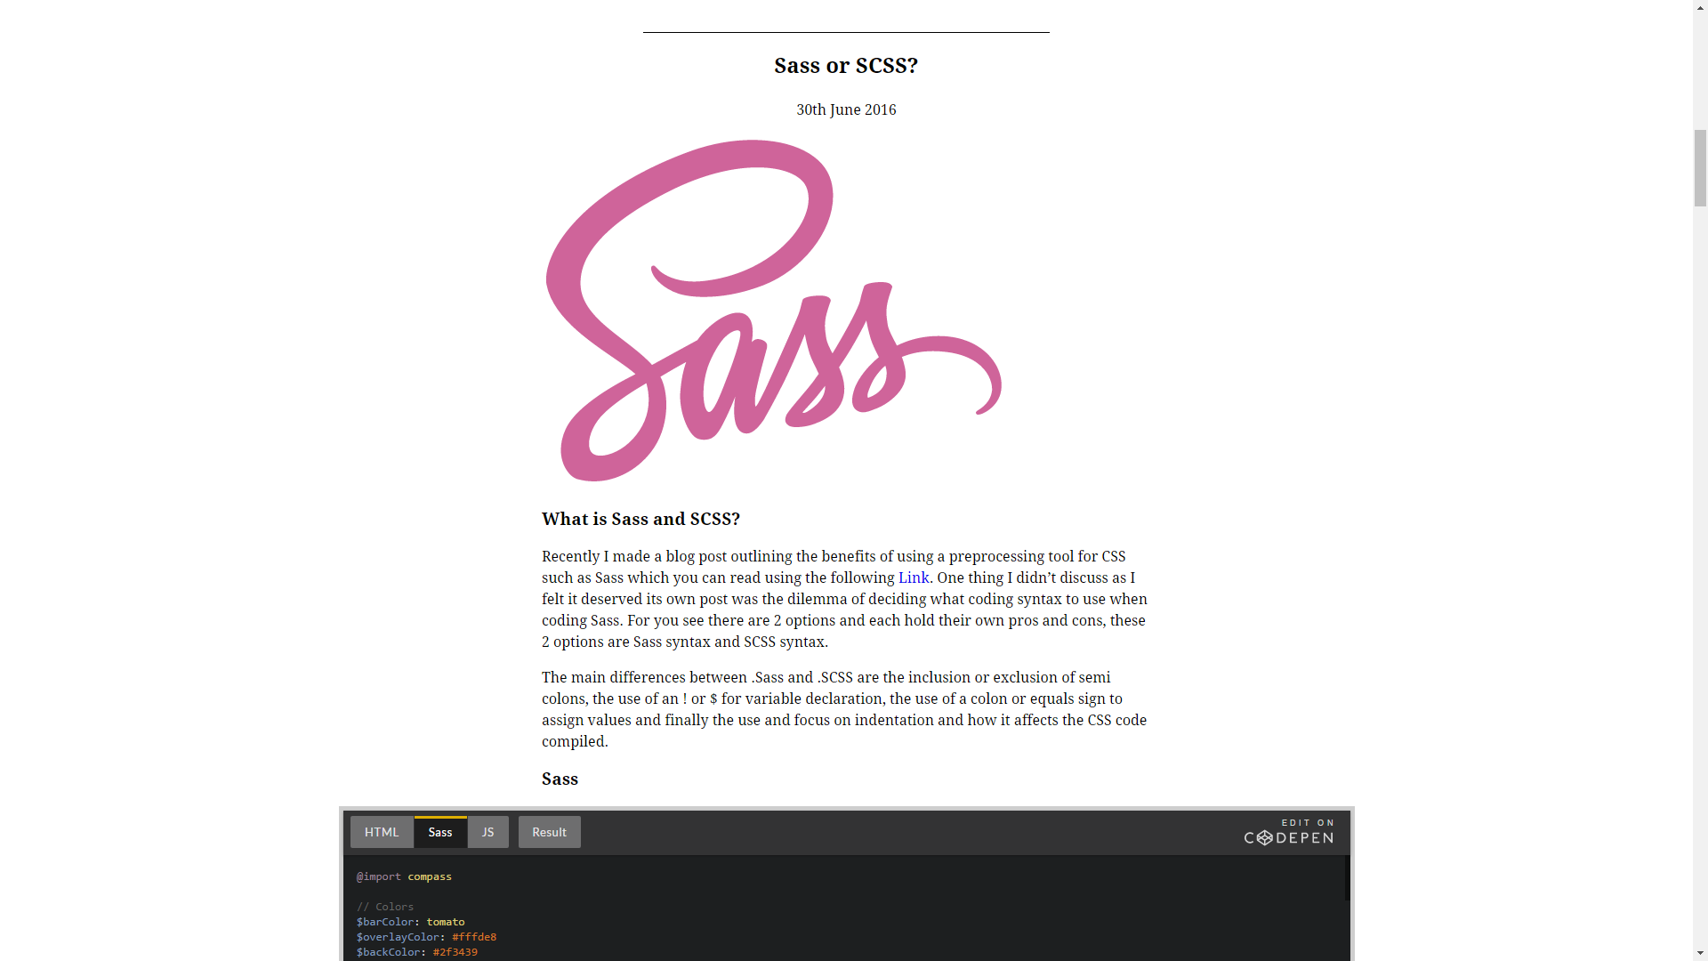


Slide 17
So…..
WHAT’S STOPPING YOU?

Slide 18
But I don’t think I’m good enough
Most people don’t

Slide 19
What now?
Pick your idea

Slide 20
Finally
Make your idea a reality

Slide 21

Thanks for listening
ShareUpSoton.co.uk
WhatJackHasMade.co.uk
Moov2.com

