Slide 1
Chapter 26: Architectures for the Cloud

Slide 2
Chapter Outline
Basic Cloud Definitions
Service Models and Deployment Options
Economic Justification
Base Mechanisms
Sample Technologies
Architecting in a Cloud Environment
Summary

Slide 3
Basic Cloud Definitions (from NIST)
On-demand self-service. A resource consumer can unilaterally provision computing services, such as server time and network storage, as needed automatically without requiring human interaction with each service’s provider.
Ubiquitous network access. Cloud services and resources are available over the network and accessed through standard networking mechanisms that promote use by a heterogeneous collection of clients.
Resource pooling. The cloud provider’s computing resources are pooled.
Location independence. The location of the resources need not be of concern to the consumer of the resources.
Rapid elasticity. Capabilities can be rapidly and elastically provisioned.
Measured service. Resource usage can be monitored, controlled, and reported so that consumers of the services are billed only for what they use.
Multi-tenancy. Applications and resources can be shared among multiple consumers who are unaware of each other.

Slide 4
Basic Service Models
Software as a Service (SaaS). The consumer in this case is an end user. The consumer uses applications that happen to be running on a cloud. E.g. mail services or data storage services.
Platform as a Service (PaaS). The consumer in this case is a developer or system administrator. The consumer deploys applications onto the cloud infrastructure using programming languages and tools supported by the provider.
Infrastructure as a Service (IaaS). The consumer in this case is a developer or system administrator. The capability provided to the consumer is to provision processing, storage, networks, and other fundamental computing resources where the consumer is able to deploy and run arbitrary software, which can include operating systems and applications.

Slide 5
Deployment Models
Private cloud. The cloud infrastructure is owned solely by a single organization and operated solely for applications owned by that organization.
Public cloud. The cloud infrastructure is made available to the general public or a large industry group and is owned by an organization selling cloud services.
Community cloud. The cloud infrastructure is shared by several organizations and supports a specific community that has shared concerns.
Hybrid cloud. The cloud infrastructure is a composition of two or more clouds (private, community, or public) that remain unique entities.

Slide 6
Economic Justification
Economies of scale
Utilization of equipment
Multi-tenancy

Slide 7
Economies of Scale
Large data centers are cheaper to operate (per unit measure) than small data centers.
Large in this context means 100,000+ servers
Small in this context means <10,000 servers.

Slide 8
Reasons for Economies of Scale
Cost of power. The cost of electricity to operate a data center currently is 15 to 20 percent of the total cost of operation.
Per-server power costs are lower in large data centers
Sharing of items such as racks and switches.
Negotiated prices. Large power users can negotiate significant discounts.
Geographic choice. Large data centers can be located where power costs are lowest.
Acquisition of cheaper power sources such as wind farms and rooftop solar energy.
Infrastructure labor costs. More efficient utilization of system administrators
Small data center administrators service ~150 servers.
Large data center administrators service >1000 servers.

Slide 9
More Reasons for Economies of Scale
Security and reliability. Maintaining a given level of security, redundancy, and disaster recovery essentially requires a fixed level of investment. Larger data centers can amortize that investment over their larger number of servers.
Hardware costs. Operators of large data centers can get discounts on hardware purchases of up to 30 percent over smaller buyers.

Slide 10
Utilization of Equipment
Use of virtualization technology allows for easy co-location of distinct applications and their associated operating systems on the same server hardware. The effect of this co-location is to increase the utilization of servers.
Variations in workload can be managed to increase utilization.
Random access. End users may access applications randomly. The more likely that the randomness of their accesses will end up imposing a uniform load on the server.
Time of day.
Co-locate those services that are workplace related with those that are consumer related.
Consider time differences among geographically distinct locations.
Time of year. Consider yearly fluctuations in demand.
Holidays, tax preparation season
Resource usage patterns. Co-locate heavier CPU services with heavier I/O services.
Uncertainty. Consider spikes in usage.
news events, marketing events, sporting events

Slide 11
Multi-tenancy
Some applications such as salesforce.com use a single application for multiple different consumers.
This reduces costs by reducing costs of
Help desk support
Upgrade once, simultaneously, for all consumers
Single version of the software from a development and maintenance perspective.

Slide 12
Basic Mechanisms
Hypervisor
Virtual Machine
File system
Network

Slide 13
Virtual Memory Page Table
Virtual memory for non-virtualized application
Physical address inside current address space
Fetch next instruction from physical address
Page table used to convert target address to physical address
CPU
Target address of next instruction
Physical address outside current address space
Fetch next instruction from interrupt handler

Slide 14
Hypervisor Manages Virtualization
Host Server
VM₁
VM_{n}
next instruction
Page
Table
Page
Table
Hypervisor
Target address of next instruction
CPU
Host Page table points to VM page table

Slide 15
Virtual Machine
A virtual machine has an address space isolated from any other virtual machine.
Looks like a bare metal machine from the application perspective.
Assigned an IP address and has network capability.
Can be loaded with any operating system or applications that can execute on the processor of the host machine.

Slide 16
File System
Each virtual machine has access to a file system.
We will present HDFS (Hadoop Distributed File System) – a widely used open source cloud file system.
We describe how HDFS uses redundancy to ensure availability.

Slide 17
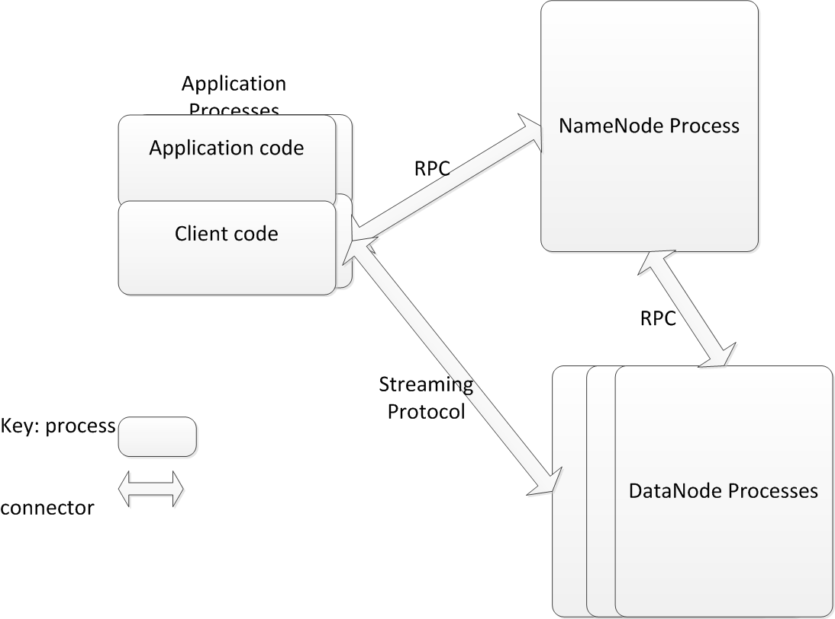
HDFS Components

Slide 18
HDFS Write – Sunny Day Scenario
Application writes as to any file system
Client buffers until it gets 64K block
Client informs NameNode it wishes to write a new block
NameNode returns list of three DataNodes to hold block
Client sends block to first DataNode and informs DataNode of other two replicas.
First DataNode writes block and sends it to second DataNode. Second DataNode writes block and sends it to last DataNode.
Each DataNode reports to client when it has completed its write
Client commits write to NameNode when it has heard from all three DataNodes.

Slide 19
HDFS Write – Failure Cases
Client fails
Application detects and retries
Write is not complete until committed by Client
NameNode fails
Backup NameNode takes over
Log file maintained to avoid losing information
DataNodes maintain true list of which blocks they each have
Client detects and retries
DataNode fails
Client (or earlier DataNode in pipeline) detects and asks NameNode for different DataNode.
Since each block is replicated three times, a failure in a DataNode does not lose any data.

Slide 20
Network
Every Virtual Machine is assigned an IP address.
Every message using TCP/IP includes IP address in header.
Gateway for cloud can adjust IP address for various purposes.

Slide 21
Sample Technologies
IaaS
PaaS
DataBases

Slide 22
IaaS
An arrangement of servers that manages the base technologies.
Servers are arranged in clusters
May be thousands of servers in a cluster
Some servers are used as the infrastructure of the IaaS
Every server has a hypervisor as its base.

Slide 23
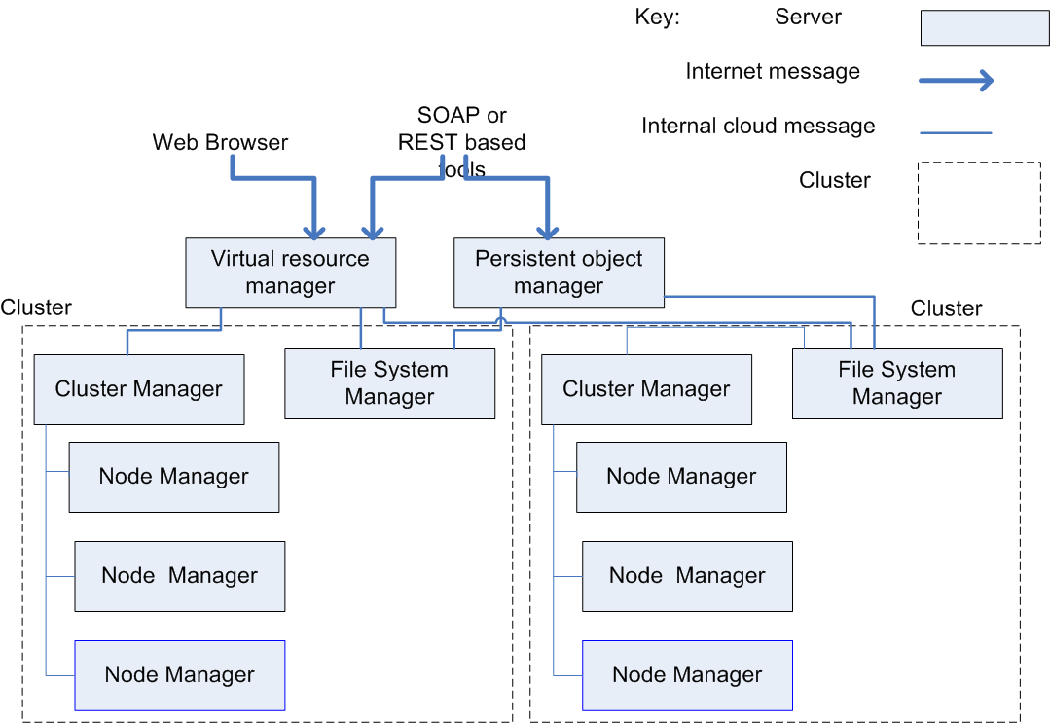
IaaS Architecture

Slide 24
IaaS Architecture Components
Cluster Manager responsible for managing each cluster
Persistent Object Manager manages persistence
Virtual Resource Manager manages other resources. It acts as a gateway for messages.
The File System Manager is similar to HDFS. It manages the network wide file system.

Slide 25
Services Provided by IaaS
Automatic reallocation of IP addresses in the case of a failure of the underlying virtual machine instance.
Automatic Scaling. Create or delete new virtual machines depending on load.

Slide 26
PaaS
Provides an integrated stack for developer.
E.g. LAMP stack
Linux, Apache, MySQL, Python
The developer writes code in Python and the PaaS manages assignment to underlying layers of the stack.

Slide 27
Databases
Why relational databases came into question
Massive amounts of data are collected from web systems. Much of this data is processed sequentially and so RDBMSs introduce overhead, especially during creation and maintenance.
The CAP Theorem shows that it is not possible to simultaneously achieve consistency, availability, and partitioning.
The relational model is not the best model for some applications.
Caused the introduction of new data models
Key-value
Document centric

Slide 28
Key Value – HBase
One column designated as a key. The others are all values
No schema so data can have key + any other values. The values are identified by their variable name.
Data values are also time stamped
Hbase does not support transactions. Time stamps are used to detect collisions after the fact.

Slide 29
Document Centric – MongoDB
Stores objects rather than data
Access data through containing object
Objects can also contain links to other objects
No concept of primary or secondary index. A field is indexed or it is not.

Slide 30
What is Omitted From These DBs
Transactions. No locking is performed. The application must detect interference with other users.
Schemas. No predefined schemas. The application must use correct name.
Consistency. The CAP theorem says something must give. Usually consistency is replaced by “eventual consistency”
Normalization and Joins. Performing a join requires that the join field is indexed. Because there is not a guaranteed index field, joins cannot be performed. This means normalization of tables is not supported.

Slide 31
Architecting in a Cloud Environment
Quality attributes that are different in a cloud
Security
Performance
Availability

Slide 32
Security
Multi-tenancy introduces additional concerns over non-cloud environments.
Inadvertent information sharing. Possible that information may be shared because of shared use of resources. E.g. information on a disk may remain if the disk is reallocated.
A virtual machine “escape”. One user can break the hypervisor. So far, purely academic.
Side channel attacks. One user can detect information through monitoring cache, for example. Again, so far, purely academic.
Denial of Service attacks. One users can consume resources and deny them to other users.
Organizations need to consider risks when deciding what applications to host in the cloud.

Slide 33
Performance
Auto-scaling provides additional performance when load grows.
Response time for new resources may not be adequate
Architects need to be aware of resource requirements for applications
Build that knowledge into the applications
May applications self aware so that they can be proactive with respect to resource needs.

Slide 34
Availability
Failure is a common occurrence in the cloud
With 1000s of servers, failure is to be expected
Cloud providers ensure that the cloud itself will remain available with some notable exceptions.
Application developers must assume instances will fail and build in detection and correction mechanisms in case of failure.

Slide 35
Summary
The cloud provides a new platform for applications with some different characteristics.
Architect needs to know how a cloud cluster works and pay special attention to
Security
Performance
Availability

